Slide 1

Reinforcement Learning for long-horizon tasks
Suguman Bansal
Notes:
TODO:
Expand motivation based on proposal write-up
List of papers
Future work and timeline
Shorten technical stuff for time and unify theme

Slide 2


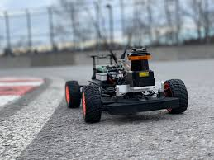
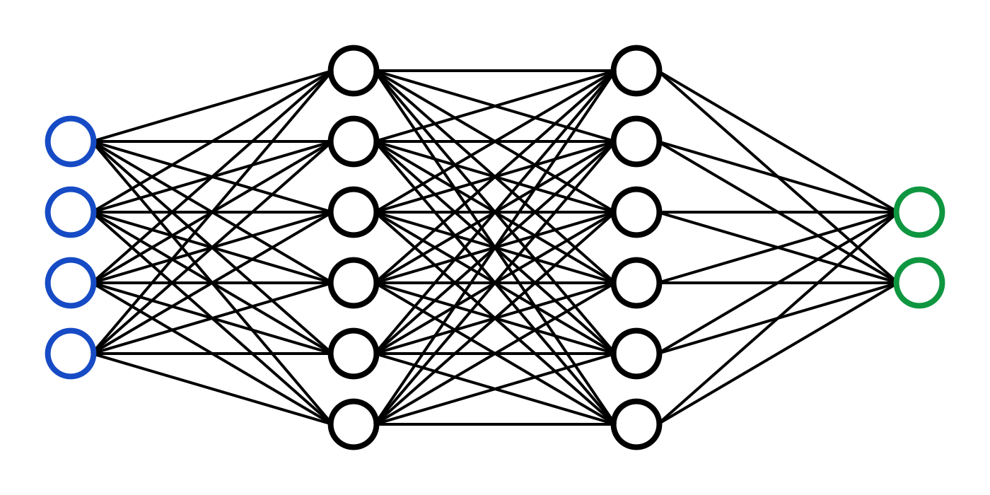
Reinforcement Learning (RL)
Given a task, generate a policy that accomplishes it.
Environment
State
Action
Reward
Policy
Notes:
Many of us would know of RL as the third wheel of ML.
It has lots of applications, including to design control policies for AI Systems like robots and autonomous vehicles.
RL is a policy synthesis algorithm in which the environment is assumed to be unknown.
As a result, the policy is generated through a policy iteration loop. During this loop, the policy samples the environment. Based on this, the policy receives feedback in the form of a reward – which is used to update the policy.
In other words, the specification of the policy is given in the form of rewards.

Slide 3
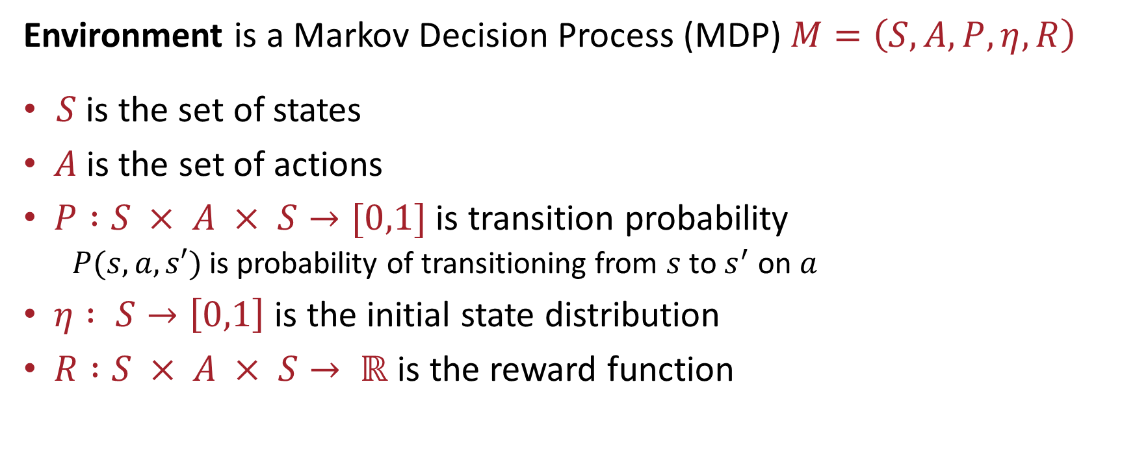
Markov Decision Process (MDP)
Environment is a Markov Decision Process (MDP) $M=\left(S,A,P, η, R\right)$
$S$ is the set of states
$A$is the set of actions
$P :S × A × S→[0,1]$ is transition probability
$P(s,a,s′)$ is probability of transitioning from $s$ to $s^{′}$ on $a$
$η : S→\left[0,1\right]$ is the initial state distribution
$R :S × A × S→ ℝ$ is the reward function
Notes:
Write score is probability of satifying spec

Slide 4
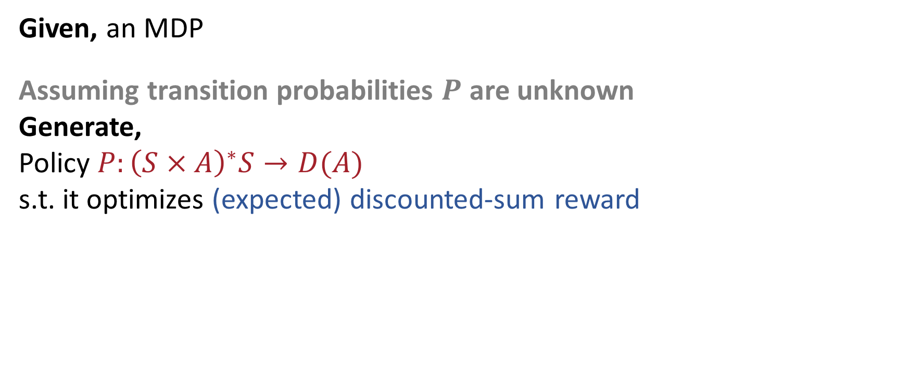
RL Problem
Given, an MDP
Assuming transition probabilities $P$ are unknown
Generate,
Policy $P:{\left(S×A\right)}^{∗}S→D(A)$
s.t. it optimizes (expected) discounted-sum reward
Notes:
Then, the Rl from temporal logics is defined as follows: given mdp and spec, generate a policy that optimizes satisfiaction fo spec. Observe, policy maps history of executions to a distribution on which action to take next.
As illustration, if spec is eventually s1 then policies that generates dotted-orange execution are optimal.

Slide 5
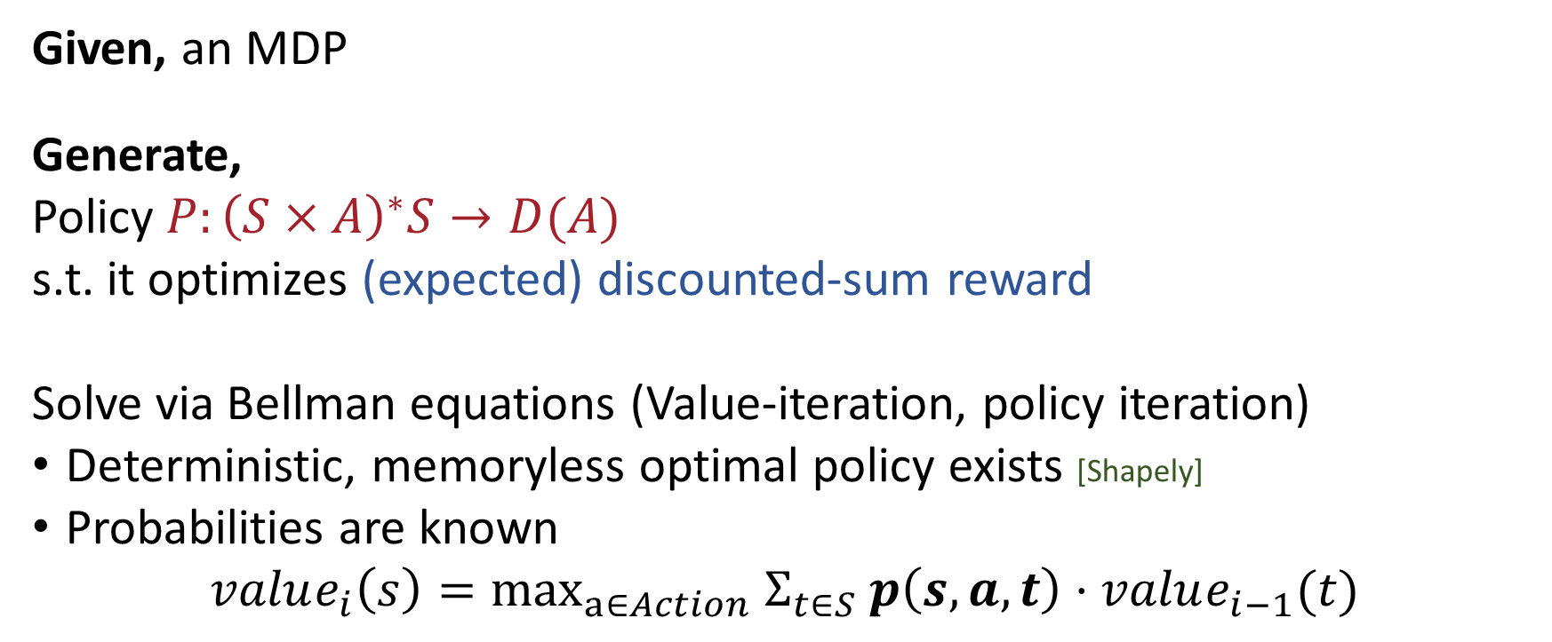
If transition probabilities were known ….
Given, an MDP
Generate,
Policy $P:{\left(S×A\right)}^{∗}S→D(A)$
s.t. it optimizes (expected) discounted-sum reward
Solve via Bellman equations (Value-iteration, policy iteration)
Deterministic, memoryless optimal policy exists [Shapely]
Probabilities are known
$$value_{i}\left(s\right)={\max_{a∈Action} Σ}_{t∈S} p\left(s, a, t\right)⋅value_{i−1}(t)$$
}
Optimization Problem
Notes:
Then, the Rl from temporal logics is defined as follows: given mdp and spec, generate a policy that optimizes satisfiaction fo spec. Observe, policy maps history of executions to a distribution on which action to take next.
As illustration, if spec is eventually s1 then policies that generates dotted-orange execution are optimal.

Slide 6
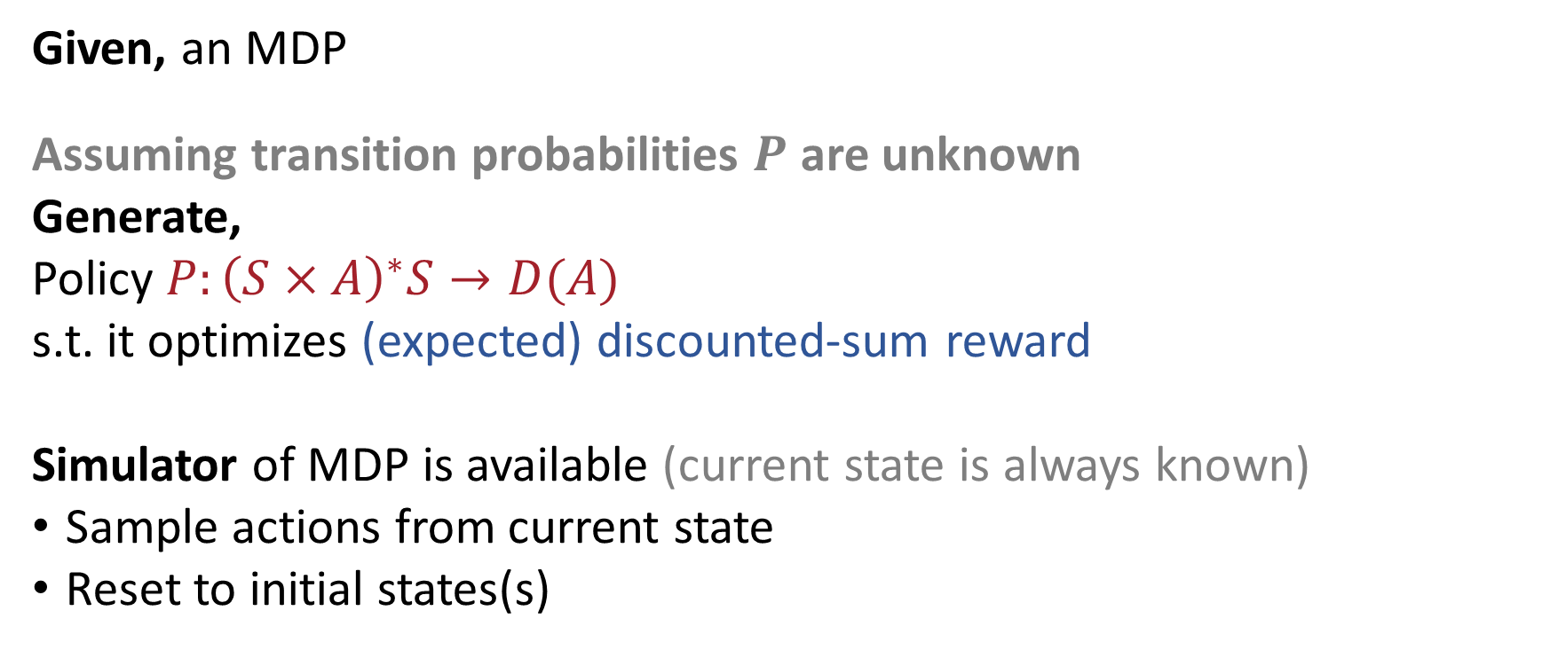
RL Problem
Given, an MDP
Assuming transition probabilities $P$ are unknown
Generate,
Policy $P:{\left(S×A\right)}^{∗}S→D(A)$
s.t. it optimizes (expected) discounted-sum reward
Simulator of MDP is available (current state is always known)
Sample actions from current state
Reset to initial states(s)
Notes:
Then, the Rl from temporal logics is defined as follows: given mdp and spec, generate a policy that optimizes satisfiaction fo spec. Observe, policy maps history of executions to a distribution on which action to take next.
As illustration, if spec is eventually s1 then policies that generates dotted-orange execution are optimal.

Slide 7

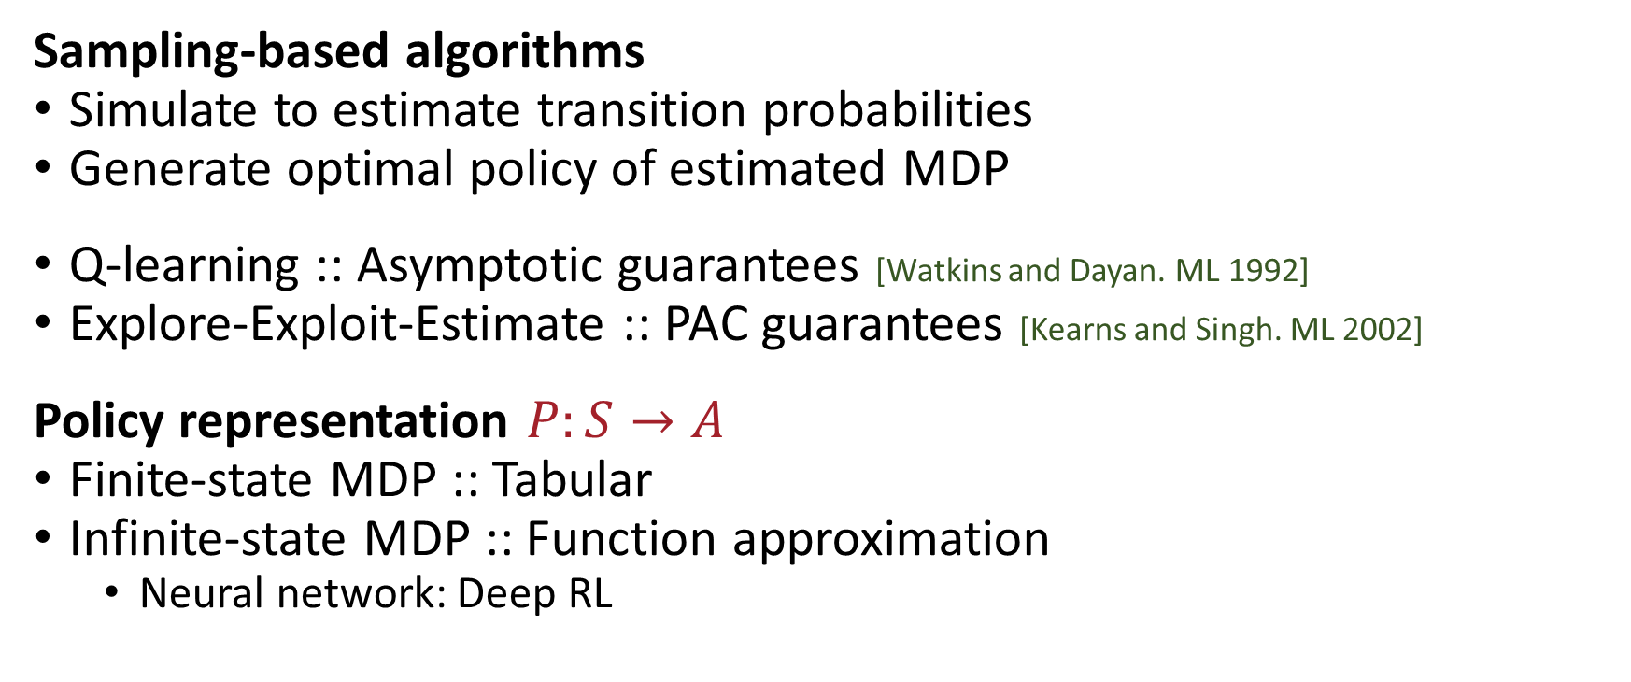
RL Algorithms and Toolkits
Sampling-based algorithms
Simulate to estimate transition probabilities
Generate optimal policy of estimated MDP
Q-learning :: Asymptotic guarantees [Watkins and Dayan. ML 1992]
Explore-Exploit-Estimate :: PAC guarantees [Kearns and Singh. ML 2002]
Policy representation $P:S→A$
Finite-state MDP :: Tabular
Infinite-state MDP :: Function approximation
Neural network: Deep RL
Notes:
Then, the Rl from temporal logics is defined as follows: given mdp and spec, generate a policy that optimizes satisfiaction fo spec. Observe, policy maps history of executions to a distribution on which action to take next.
As illustration, if spec is eventually s1 then policies that generates dotted-orange execution are optimal.

Slide 8
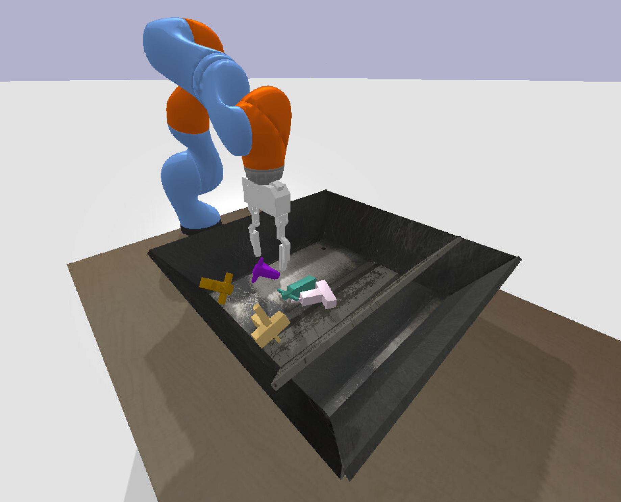
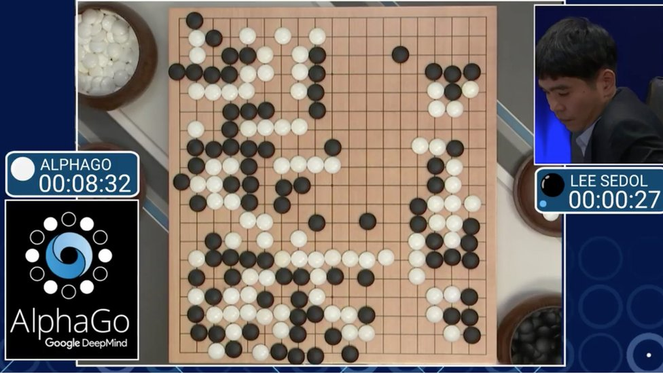
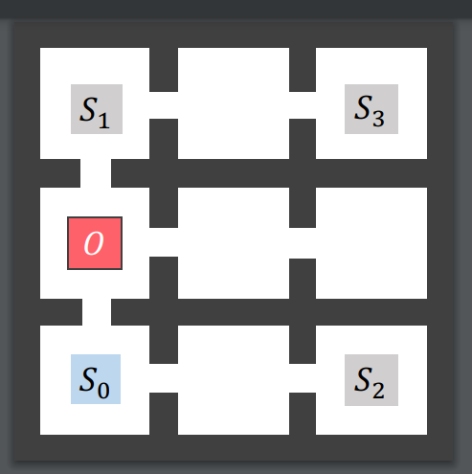

Challenge : RL for long-horizon tasks
Manipulation and planning
Games and Multi-agent systems
SoTA
requires an
astronomical number of samples,
if solvable

Slide 9


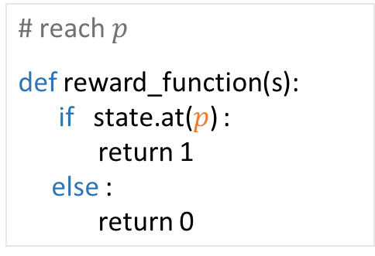

A. Expressiveness
Cumbersome to express long-horizon tasks as rewards
Temporal logics vs. rewards [Li, Vasile, Belta IROS 17] [Camacho et. al. IJCAI 19] [Bozkurt et. al. 2019] [Hahn et. al. TACAS 19, ATVA 20] [Balakrishnan and Deshmukh. IROS 19] [Kalagarla, Jain, and Nuzzo. CDC 2021] [Jothimurugan, Bansal, Bastani, Alur. NeurIPS 2021]
# reach $p$
def reward_function(s):
if state.at($p$) :
return 1
else :
return 0
$$q$$
# reach $p$ then reach $q$
### reach $p$
### reach $q$
Initial
$$p$$
Desired policy
Learnt policy

Slide 10
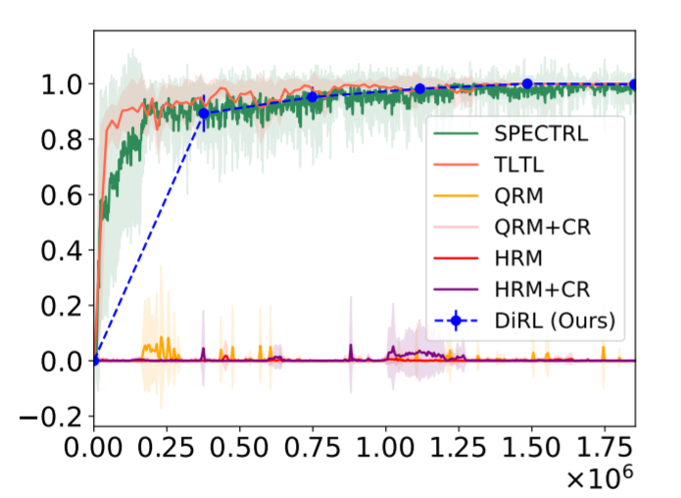
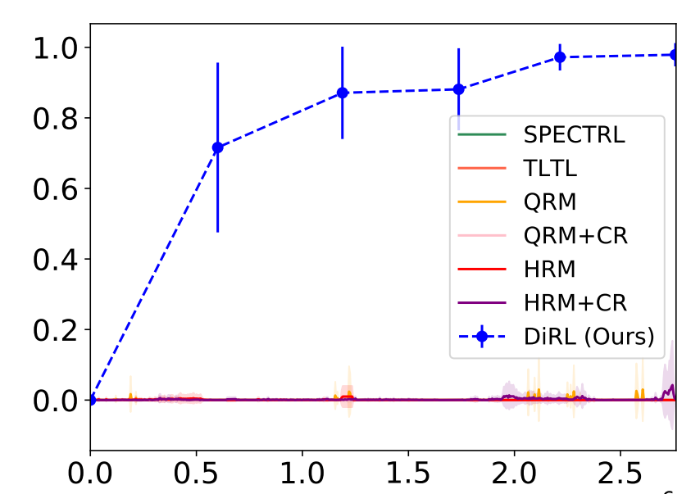

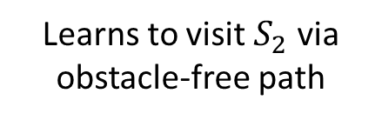

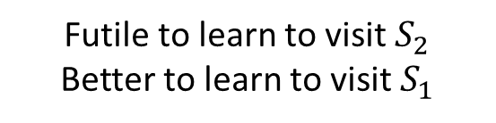
B. Scalability
I. Sparsity of rewards
II. RL is greedy
RL + Planning + Compositional RL [Jothimurugan, Bansal, Bastani, Alur. NeurIPS 2021]
Visit $S_{1}$ or $S_{2}$ then visit $S_{3}$while avoiding $O$
Visit $S_{1}$ or $S_{2}$ while avoiding $O$
Probability
Probability
Number of samples
Number of samples
Learns to visit $S_{2}$ via obstacle-free path
Futile to learn to visit $S_{2}$
Better to learn to visit $S_{1}$
Notes:
A challenge facing existing algoirthms for learning from logics is that RL is inherently myopic. Which means ---- good at --- poor at ---
For example, take here the same 9-rooms environment.
Suppoes we consider the short horizon task – which says to visit either s1 or s2 all the while avoiding the red obstacle region 0.
Here we plot the performance of several sotas. The x-asix denotes … y-axix denote probability of speciifcaiton satisfaction after x-samples. We see that after few samples most algorithms learn policy with probability close to 1.
Next, let us make the specification one step longer. So, after reaching either s1 or s2 the task is to reach s3. Now suddenly the performance of all algorithms has dropped.
Reason is in the first case, between learning to reach s1 and s2, all algorithms successfully learnt the obstacle free path to s2.
In the second case, this is futile since there is no direct path from s2 to s3. In other words, learning a locally optimal short-horizon subtasks costs learning of the original specification.
What these algorithms are missing is a high-level reasoning which informs it that even though some subtasks may be harder to learn, they are the better one to learn in the long horizon.

Slide 11



C. No Guarantees
Theorem [Alur, Bansal, Bastani, Jothimurugan. (To appear) Henzinger-60. CoRR 2021]
There can not exist a PAC algorithm for RL from temporal specifications
Spec: Always (Not Unsafe)
How to obtain guarantees, especially in NN-enabled policies?
Explanation to learnt policies
Interpretable summaries of policies
Unsafe
$$b, γ$$
$$b, 1−γ$$
Init
Safe
$$a, 1$$

