Slide 1
Classification Central A Classification Playground for Aspiring Data Scientists By Data Scientists

Slide 2
How many of you wish you had a site to learn about classification on an interactive basis?

Slide 3
How many of you wish you had a good explanation for each piece of code that’s happening in a model on an interactive basis?

Slide 4
Project Goal
Provide Aspiring Data Scientists with
1. A clear understanding of each step within the classification modeling process
2. A tutorial of how to classify their own dataset

Slide 5
Classification Techniques Explained
Logistic Regression
KNN
Random Forest
Naïve Bayes

Slide 6
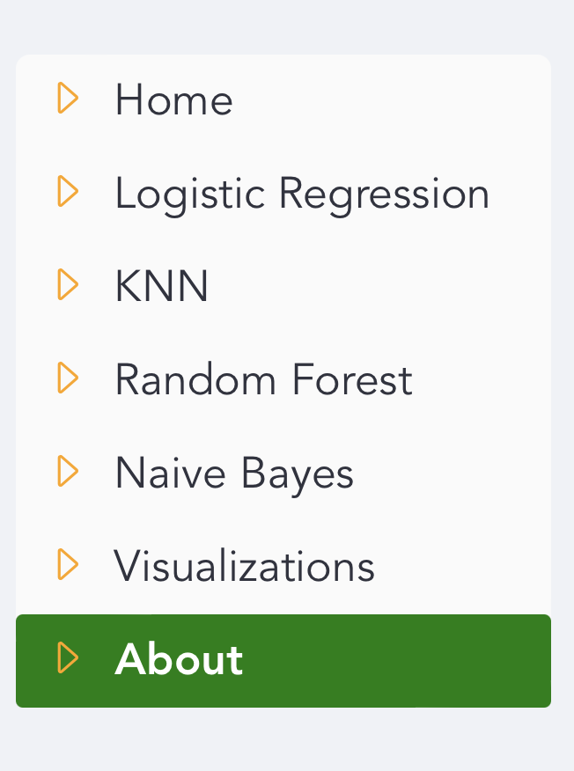

Slide 7
Check for and Remove Null Values
Summarize Your Data
Replace the Classifier with 0 and 1
Implement Test and Training Sets
Determine the Accuracy Score
Output a Confusion Matrix

Slide 8
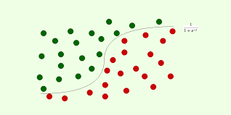
Logistic Regression Summary

Slide 9
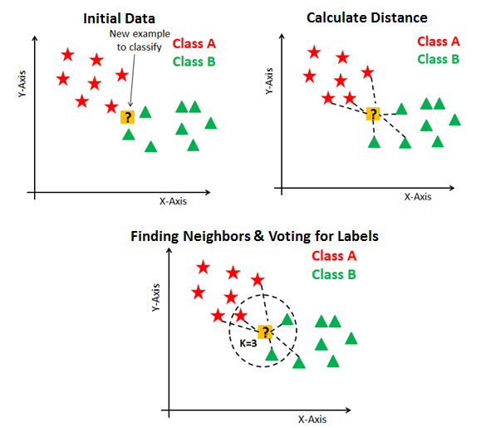
KNN Summary

Slide 10
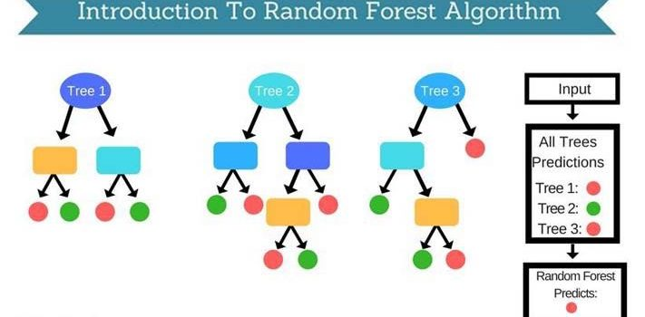
Random Forest Summary

Slide 11
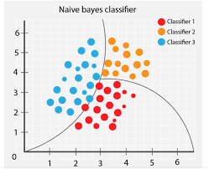
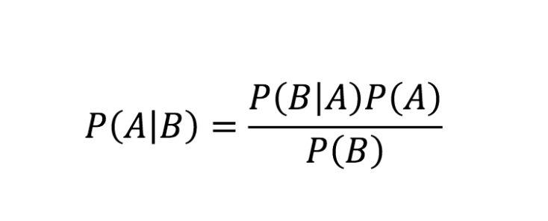
Naïve Bayes Summary

Slide 12
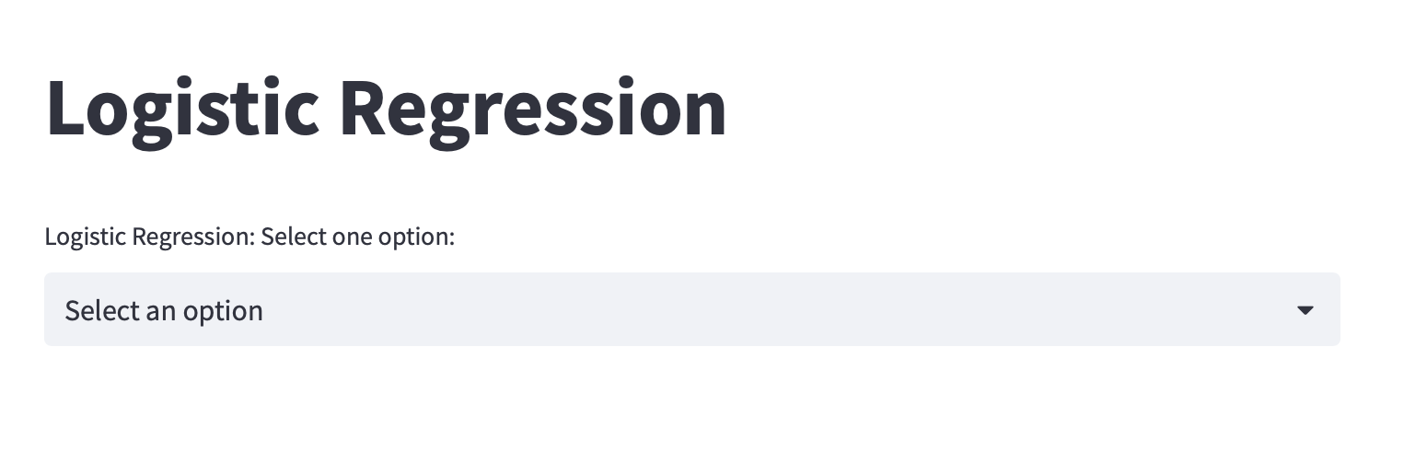

Slide 13
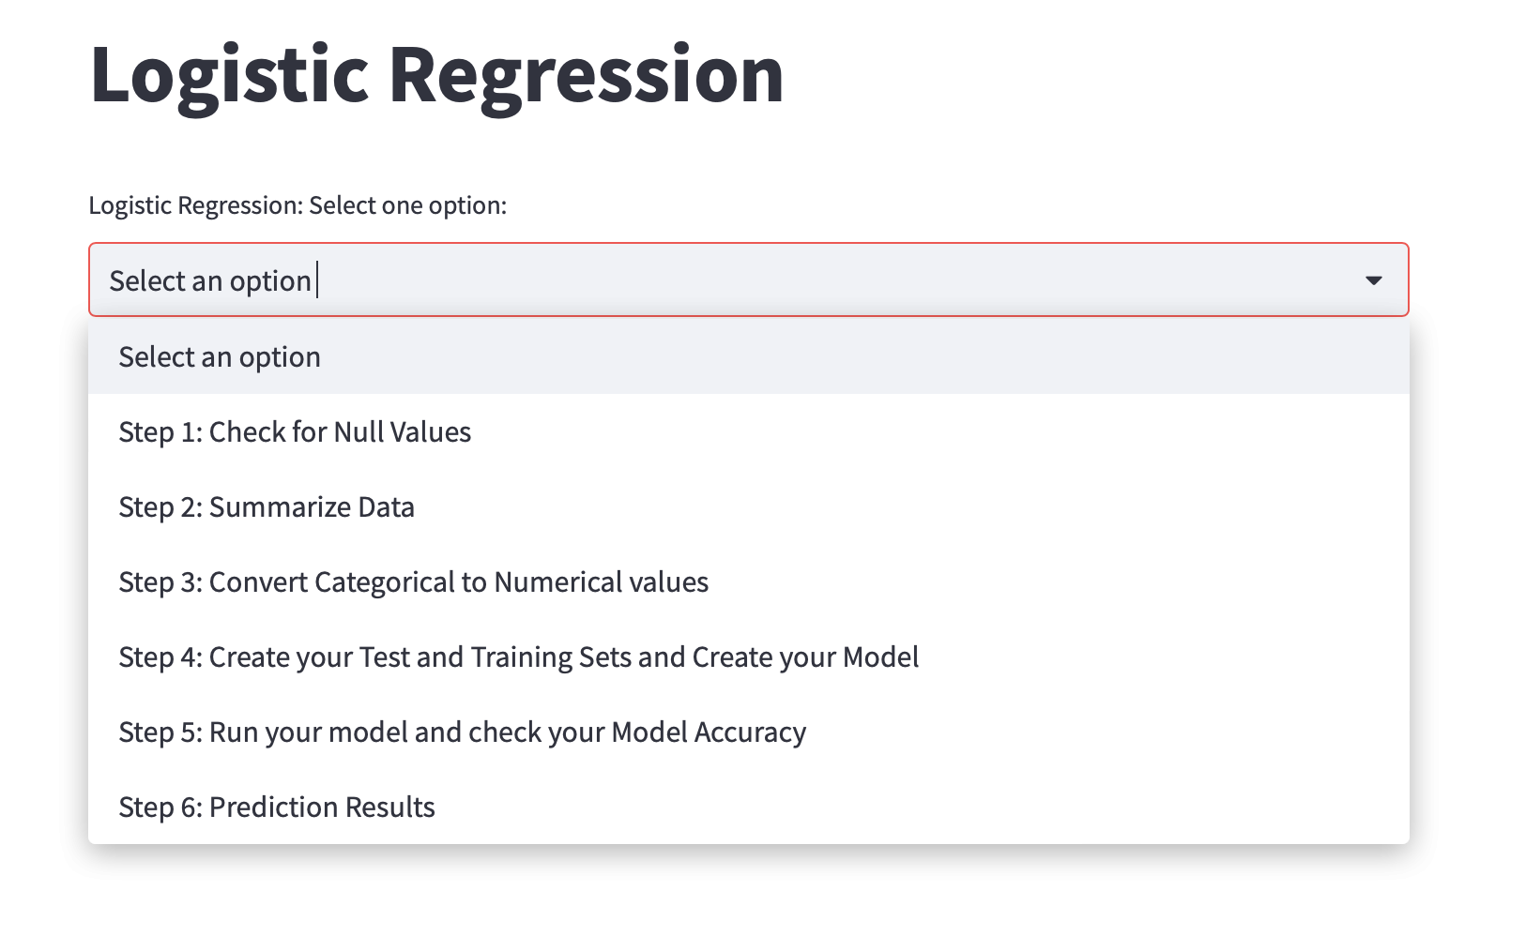

Slide 14
Tutorial Steps

Slide 15
What is the most important step in any modeling?

Slide 16

Understanding your dataset!!!

Slide 17

How do you understand your data?
By performing Exploratory Data Analysis
Histogram
Box Plot
Outlier Analysis
Central Tendency
Dispersion

Slide 18
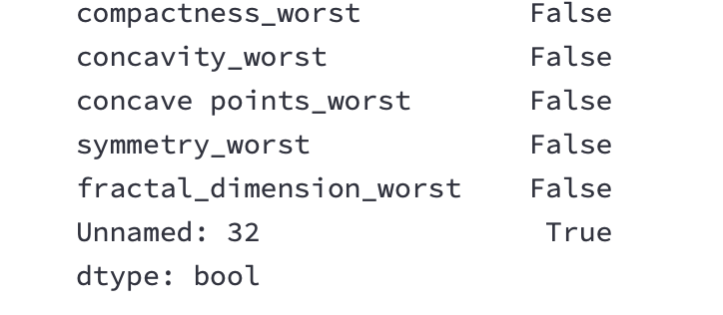
Determine Column Name Containing the Nulls, then Delete

Slide 19
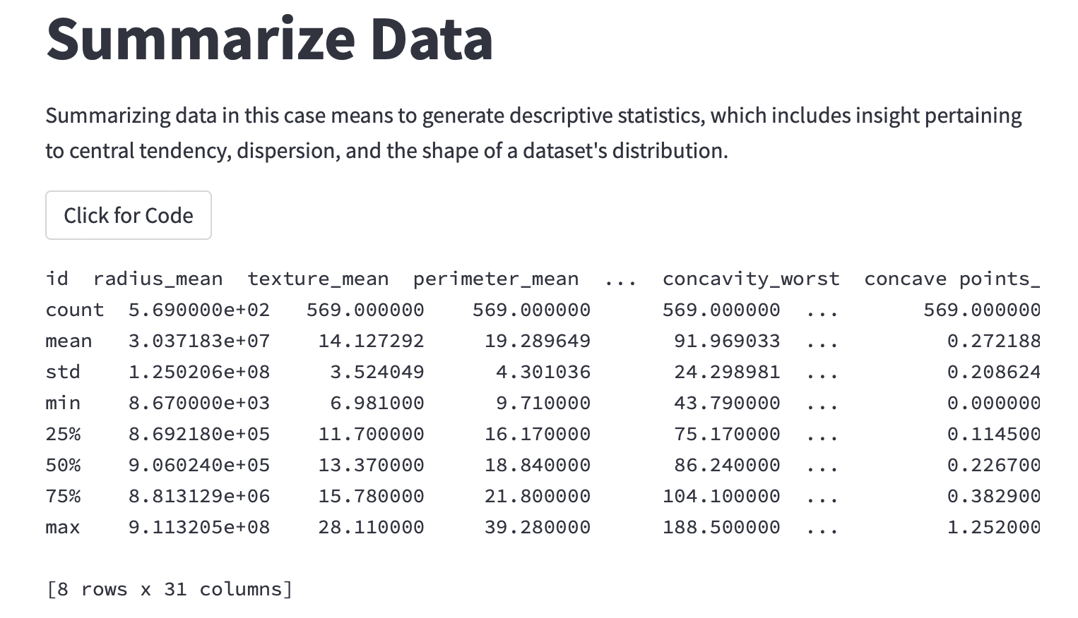

Slide 20
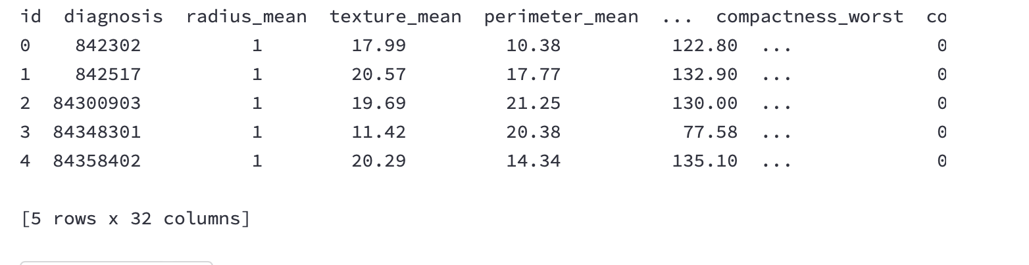
Let’s Replace Categorical Values to Quantitative

Slide 21
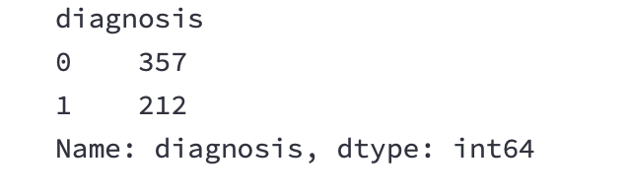
Replace Cont’d

Slide 22
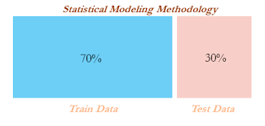
Test and Training Data
Part 2: Select a dependent variable
Part 3: Splits the dataset into test and training
Part 4: Create a model
Part 5: Train the data
Part 6: Test the model
Part 1: Select independent variables

Slide 23
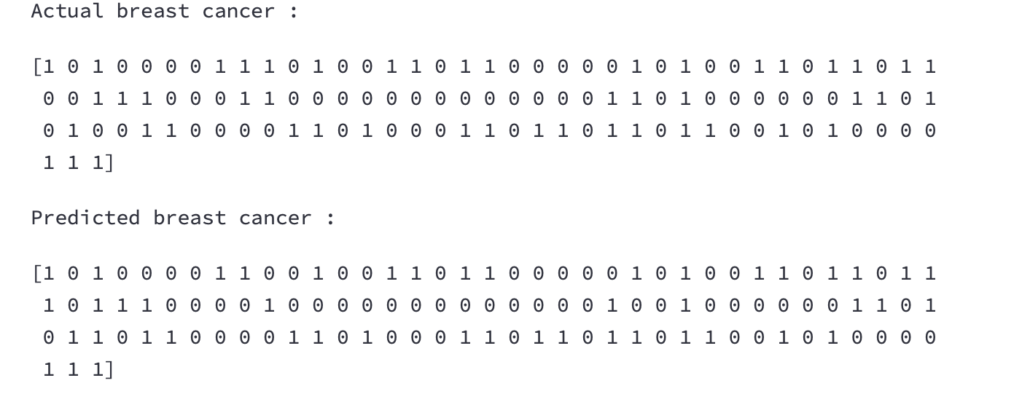
Accuracy: Can you spot the difference?

Slide 24
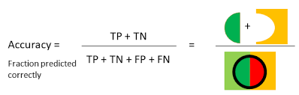
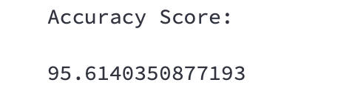
How accurate is the model?

Slide 25
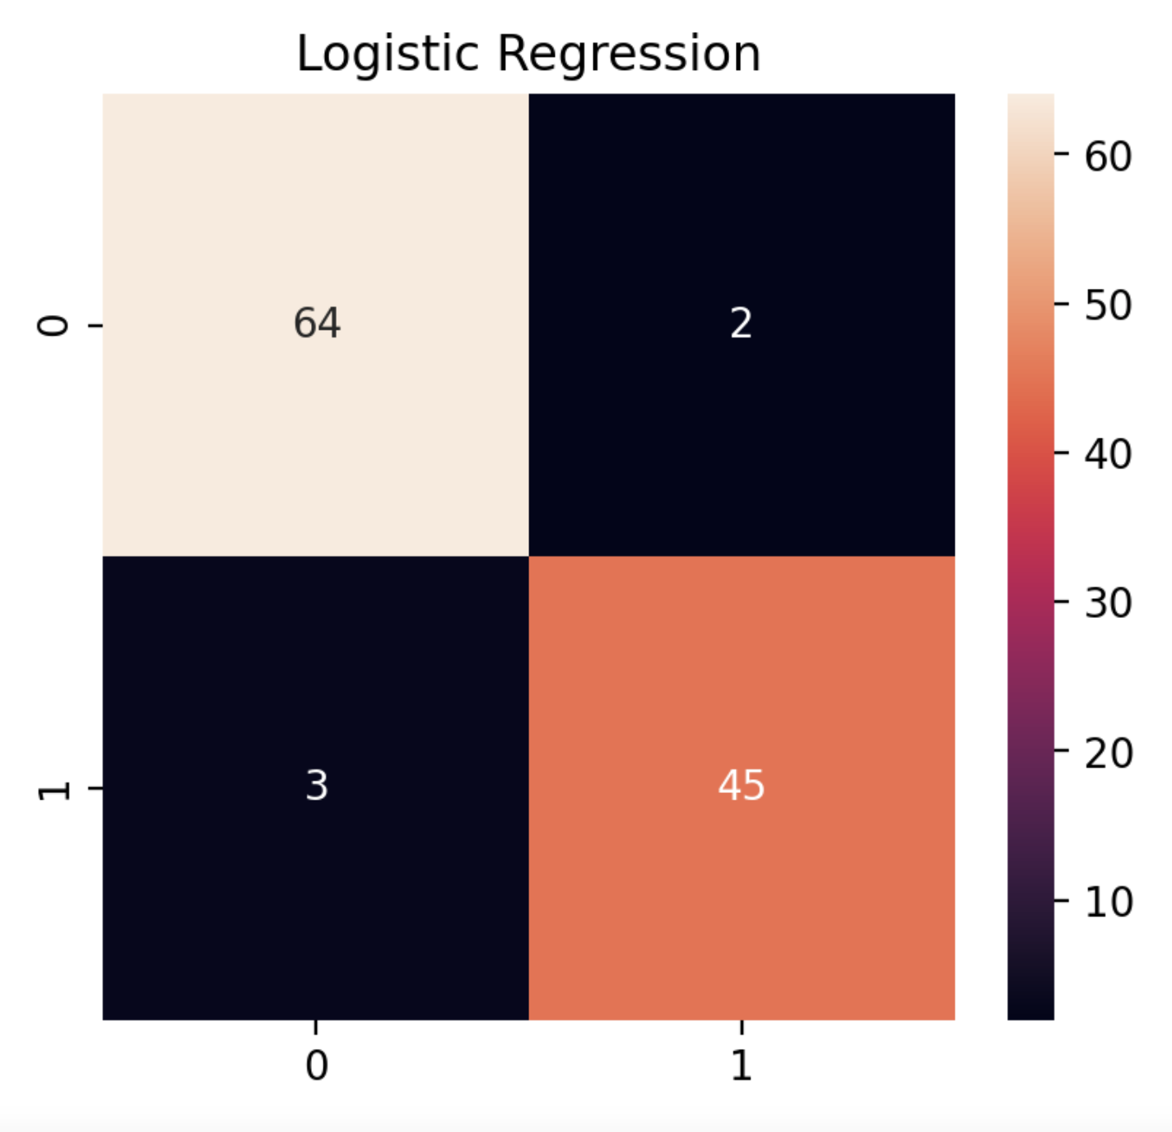
Output Confusion Matrix

Slide 26
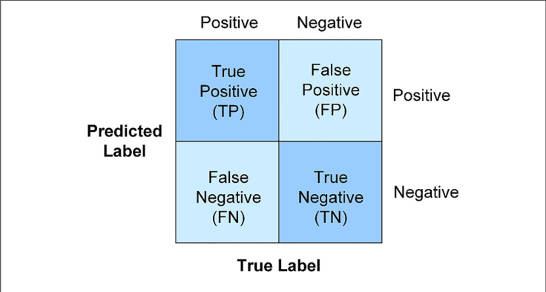

Slide 27
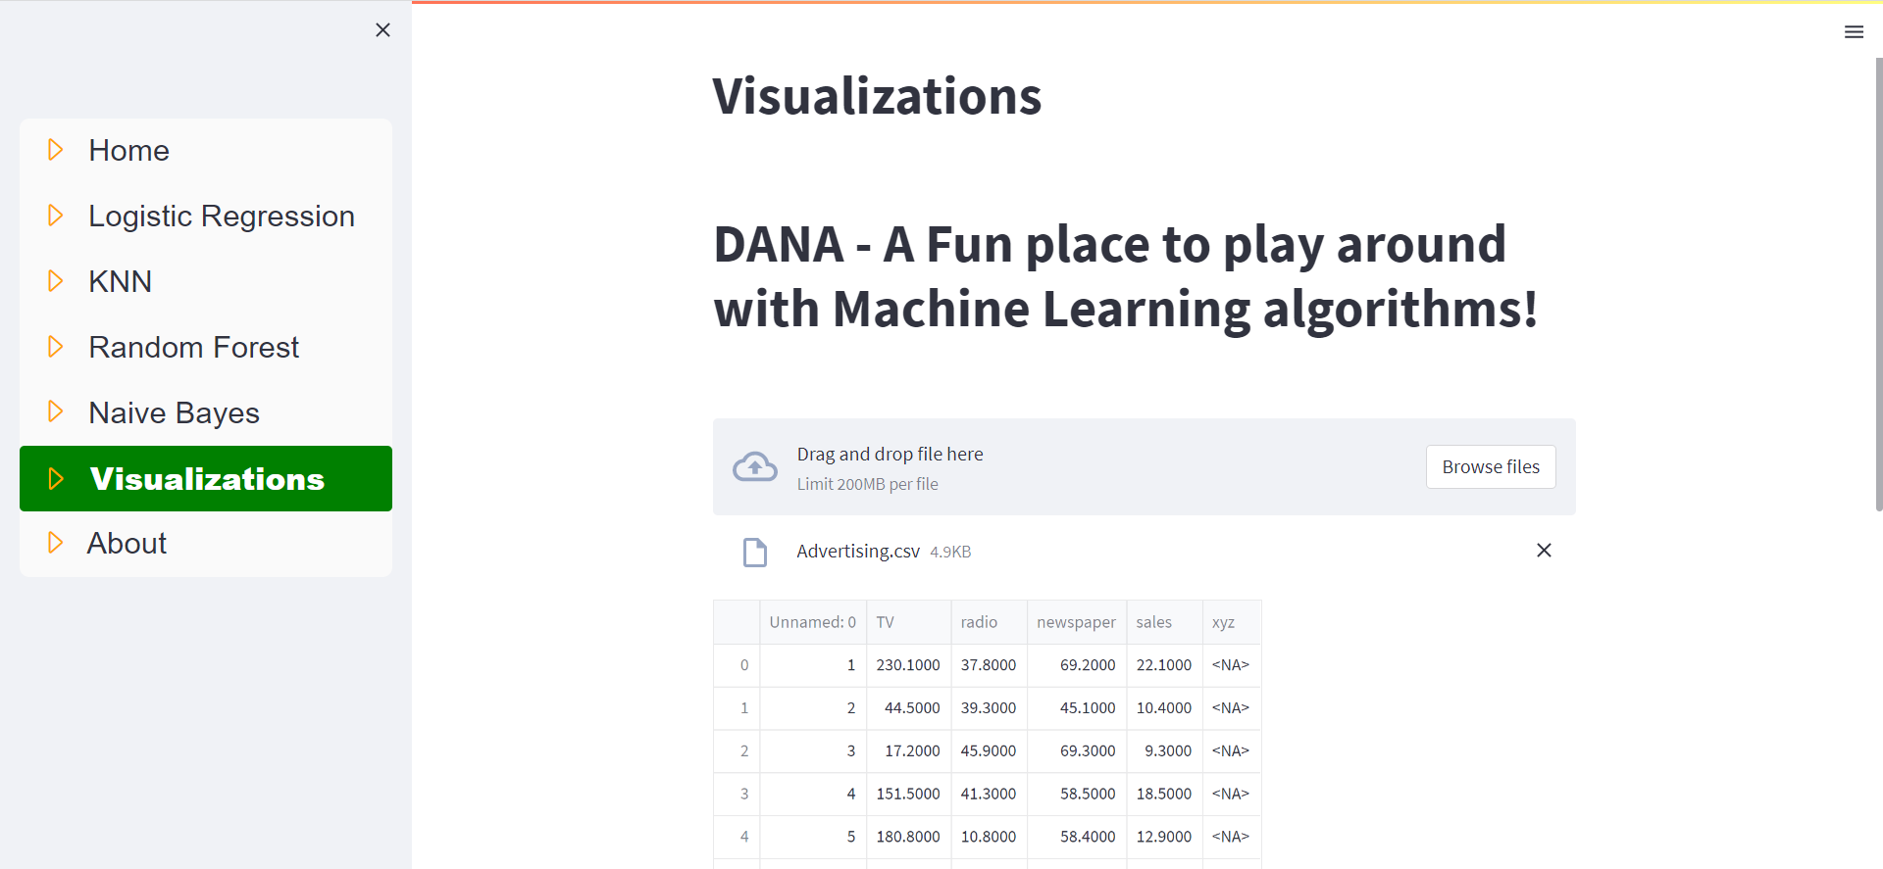

Slide 28
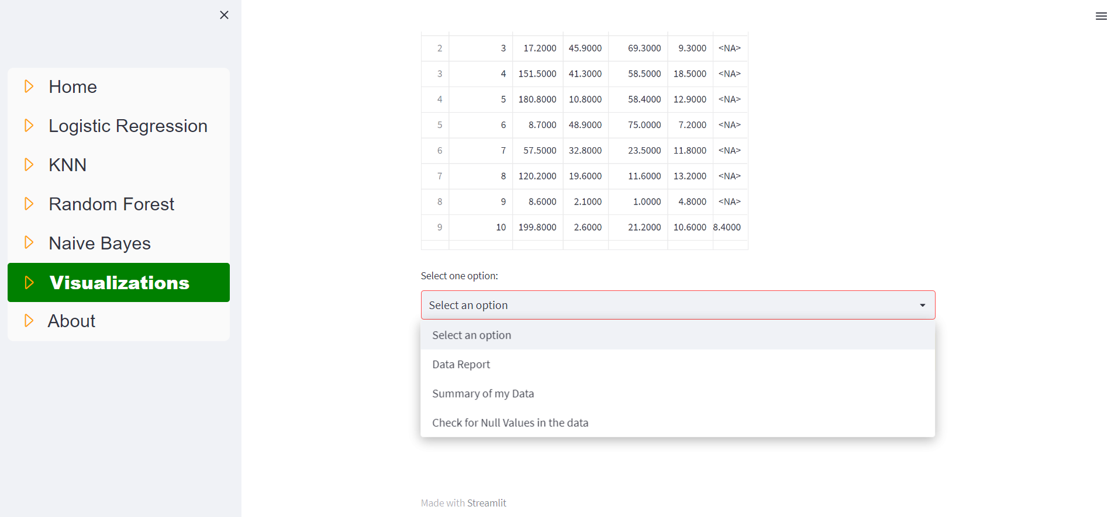

Slide 29
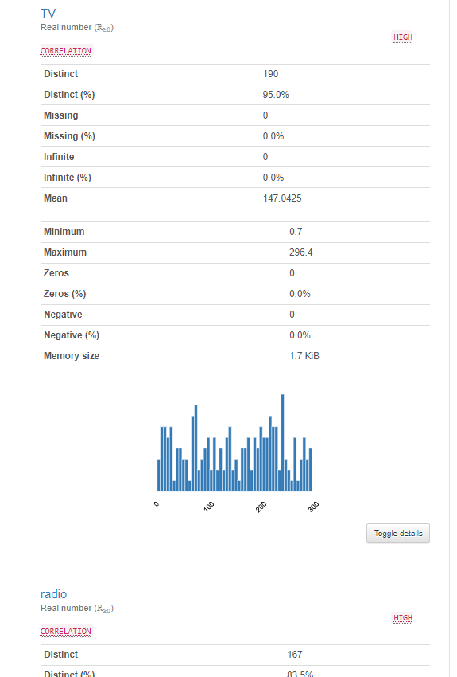
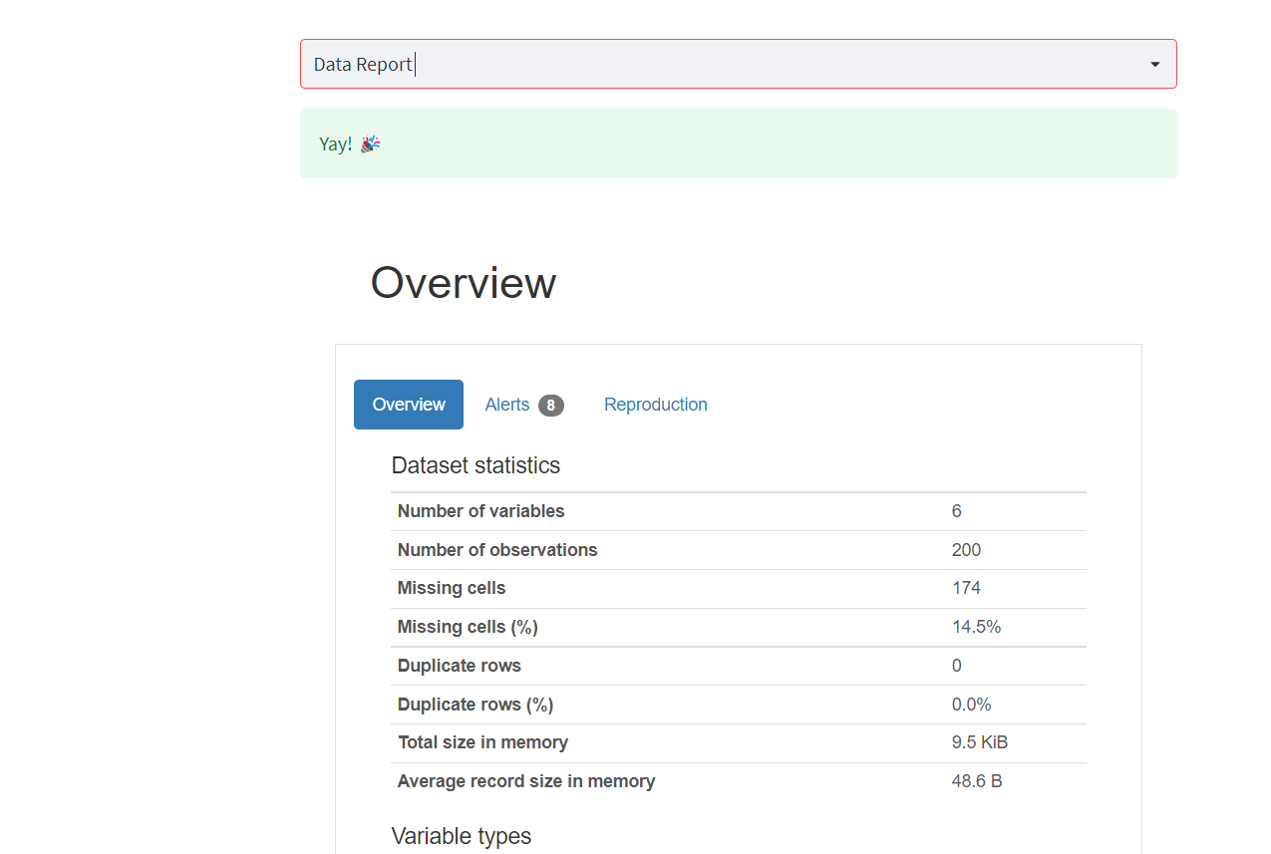
Data Report

Slide 30
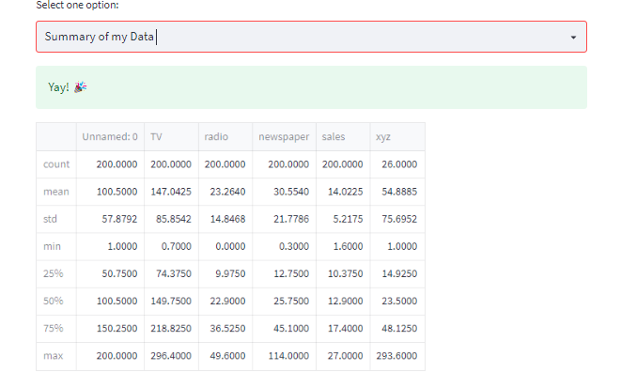

Slide 31
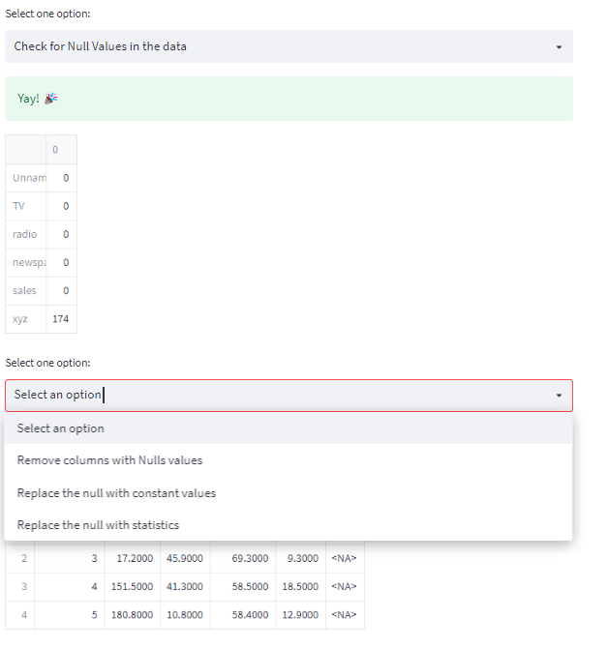
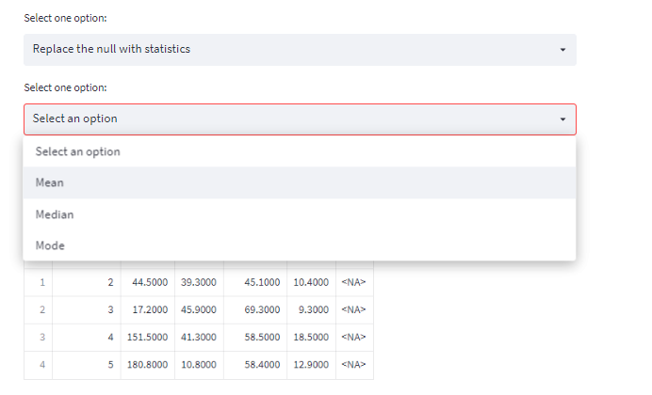
Null Values

Slide 32
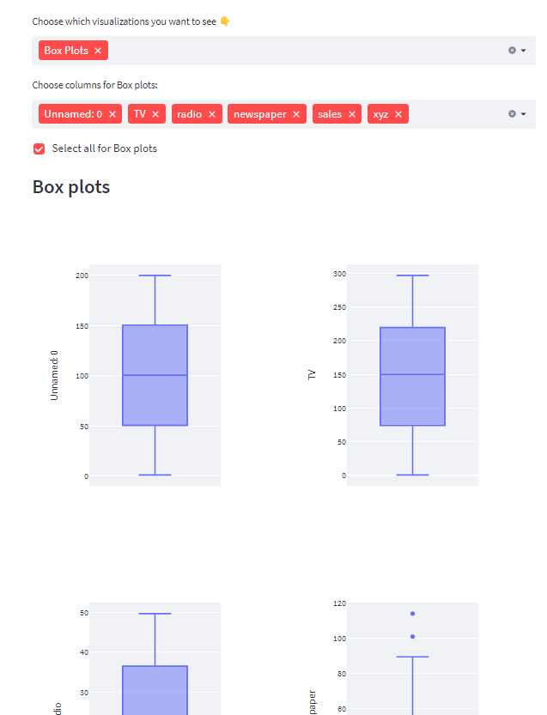
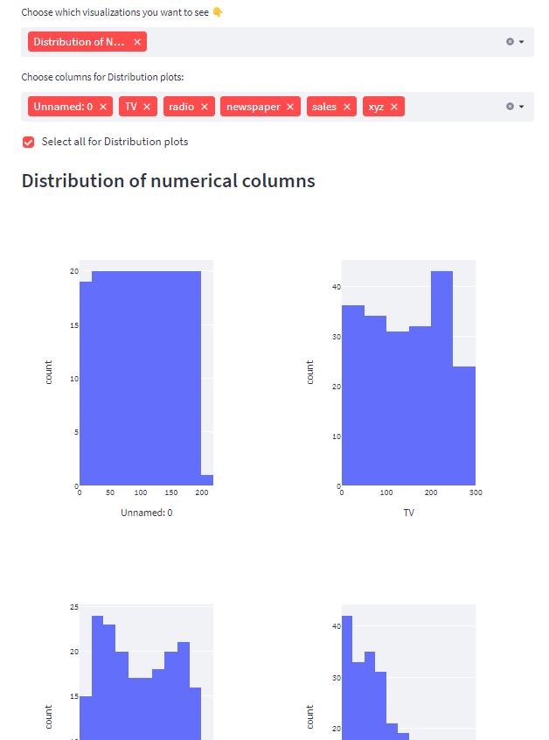
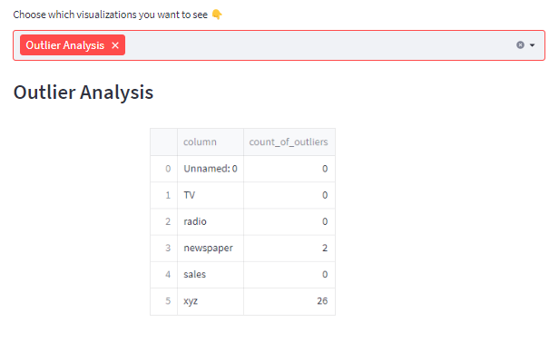
Visualizations

Slide 33

Classification Central Video Walk-Through:
https://www.youtube.com/watch?v=QCucIBfCy84

