Slide 1


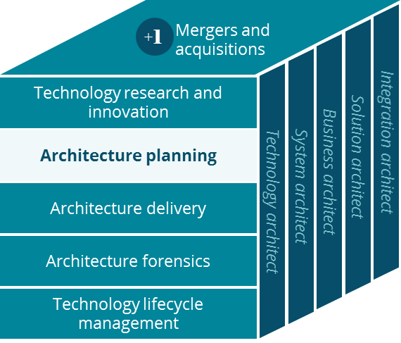
Sales POV
Architecture Planning
Nov, 2018

Slide 2


Executive Summary
Enhance the Producer experience by transforming the way Aetna approaches Sales
The Opportunities read more like Recommendations
Opportunity
Conclusions
Recommendations
Create an engaging and delightful experience for Producers.
Assist Producers in cross-selling and upselling to Prospects
Consolidate SFDC sales orgs and reduce overall operational expenditure
Produce valuable reports and analytics by consuming Sales Data into UDF
Legacy SOE for producers that does not deliver an engaging valuable experience to our producer community.
Multiple SFDC Sales orgs without any real integration produces inconclusive, at best, inaccurate, at worst, sales reports.
Invest in Ecosystem capabilities for Producer and Prospect constituents.
Consolidate and create a true Enterprise Sales SFDC org.
Integrate sales data with UDF to create dependable reports and gather data for valuable and actionable insights.

Slide 3

Business Opportunity
Aetna is facing a pivotal decision as to how they can remain a leader in the future health care market
Opportunity Statement
Overview
Engagement:
Invest and create in a digital platform that addresses Producer community.
Business Operations:
Consolidate multiple Book Of Records so that the Enterprise has clear visibility to Sales prospects and projections.
Insights:
Build a robust insights engine to identify and address pain points for producer community
With the lack of support to the producer community, and the existence of multiple Sales Book of records across the enterprise Aetna has an opportunity to streamline the producer experience and transform the sales organization to become an industry leader.

Slide 4
Why is it Important to Aetna?
Aligning to this Architecture North Star will allow Aetna to excel in a variety of business areas and transform the sales organization.
What Aetna could gain…
Potential Benefit
Description
Positive Outcomes
Deliver an industry leading provider experience.
Deliver an end to end delightful producer experience by enabling features such as global identity, communications management, insights to producers and avail Aetna resources such as Shared Service cloud to premier producers.
Grow Producer retention and recruitment.
Increased productivity gains of existing producers.
Improve operations by having accurate projections over sales pipelines and sales leads.
Consolidate multiple BOR’s that exist today and integrate with the ecosystem platform (for both members and producers), this will provide up to date, context rich information for all of the sales organization.
Actionable, accurate projections and predictions.

Slide 5

Where are we today?
A disconnected experience for our producer community and an inaccurate picture with regards to sales.
Engagement
Business Operations
Insights
Legacy Producer SOE
Inconsistent, inaccurate siloes of sales data
No deep insights
Our Current State
Digital Experience
Producer World and Sales Web are legacy Aetna Assets that needs a complete redesign. The engagement numbers from the producer community is very low as of today.
Inconsistent Reporting
Multiple Book of Records exist with duplicate data leading to inaccurate and inconsistent sales reporting.
Personalized
No personalized insights gathered with respect to producers or members
No tools currently available for producers for cross selling and upselling opportunities.
Cross Coordination
No real integration between sales, service and marketing that will help both our producer and prospect community.
Operational Expenditure
We have X number of Salesforce orgs, with their own licensing model and no integrations. Manual expensive work happens all the time to reconcile data across these books of Records.
= positive capability
= negative capability

Slide 6
In Flight Investments
Currently, there are no investments driving Aetna forward
Engagement
ILLUSTRATIVE
Current Initiatives
Consolidated Producer/Inside Sales SOE
Next Best Product to sell
Consolidated Sales org
Producer
Prospect
Ecosystem Platform
The current investment landscape is not aligned to support [north star topic]
To succeed, a change in investment strategy is needed
Account for Life
Global ID
Next Gen Authentication
Preferences
360 Profile
Omni-channel interaction
Business Operations
Benefit Admin Model
Service
Clinical
Service platform
Insights
Reporting & Business Performance
Actionable Insights
Enterprise Sales reports]
Producer performance
Unified Data Fabric
NBA for products to sell
NBA for producers to.

Slide 7
What does Success look like?
In an ideal future state, Aetna would transform the sales experience driven by engagement, operations, and deep insights
Engagement
Business Operations
Insights
To…
To…
To…
Delightful, Omni channel, Digital Experience
Centralized BOR ensuring data lineage and quality
From…
From…
From…
Legacy Producer SOE
No deep insights
Personalized insights to both producers and prospects
Where we want to go
Inconsistent, inaccurate siloes of sales data
Digital Experience
An Omni channel enabled, mobile friendly, SOE letting producers and inside sales people to interact with Aetna in their chosen mode.
Centralized BOR
Consolidate multiple SFDC sales orgs across the enterprise and create one BOR for Sales prospects
NBA
Provide next best product to sell based on prospect 360 to Producers.
Provide next best action for brokers with respect to regulations.
Personalized journeys
A curated personalized journeys for producers and prospects that engages them and removes any friction during their interaction with Aetna.
Reduce Opex
By consolidating book of records and streamlining the need for creation of microsites overall operational expenditure will be reduced.
Reporting
Extract data from Sales BOR to UDF and utilize Aetna BI capabilities to build enterprise wide sales reports.

Slide 8
Necessary Actions (1 of 2)
Based on the results of this analysis we are recommending the following capabilities.
Ecosystem Area
Related Capabilities
Necessary Actions
Seamless transition from Prospect to Member through use of Global Identity
Centralized Identity strategy for Producer SOEs
Preferences and communication management for producers and prospects
360 profile for Prospects and Producer constituents.
NBA for prospects and producer constituents.
Ecosystem Platform
Global ID
Preferences
Omni Channel Interaction
NBA
Sunset Sales Web and Producer World
One consolidated SOE for Producer community to do with business with all lines of business
A separate console in the Enterprise shared service platform to service producers.
Expose Aetna APIs to the producer community to get actionable data.
Engagement
SOE for producers.
Service console
API Gateway
ILLUSTRATIVE
= Guidance on previously determined investment decision
= Recommendation for brand new initiative / investment

Slide 9
Necessary Actions (2 of 2)
Based on the results of this analysis we are recommending the following capabilities
Ecosystem Area
Related Capabilities
Necessary Actions
Business Operations
Consolidate the multiple SFDC Sales orgs into one to get the complete picture
Connect the Enterprise Sales org to Aetna Ecosystem components
Sales BOR
Insights
Sales data needs to go into the UDF and Aetna BI tools an be used to build sales reports
Build Producer and Prospect 360 capabilities
Build NBA geared towards cross selling/up selling to Prospects. Build NBA geared towards producers.
Integrate Sales Data to UDF
NBA
360
ILLUSTRATIVE
= Guidance on previously determined investment decision
= Recommendation for brand new initiative / investment

Slide 10
Recommendations
Aetna should focus on developing core eco system capabilities for prospects and brokers and a new SOE before dwelling into APIs and insights.
Recommendations
High-Priority
Mid-Priority
Low-Priority
Enable Ecosystem capabilities for producer and prospect constituents
Consolidate SFDC Sales Orgs and create an enterprise Sales org
Invest and build a new SOE that meets both Producer and Inside Sales requirements.
Expose APIs to Producer constituents
Start building out Producer and Prospect 360 views
Integrate sales data into UDF and utilize Aetna BI tools for reporting purposes.
NBA for Prospects that can be exposed to Producers
NBA for Producers

Slide 11

Next Steps
To move Aetna forward towards our future, the o-CTO must achieve buy-in from the business on capabilities requiring additional investment
Owner
Near-Term Action
(<6 months)
Long-Term Action
(>6 months)
[Office of
The CTO]
Finalize recommendations and get business buy in towards technology vision.
New SOE and consolidate SFDC sales orgs
[Owner]
Start building eco system capabilities for brokers and prospects.
Build out Producer 360, Prospect 360 and NBA geared towards them.

Slide 12
Appendix

Slide 13
Sales Web
Overview
Official Description:
SalesWeb is the central repository and primary resource for all sales and marketing applications, information and tools. SalesWeb supports all market segments, field sales representatives, regions and internal support areas. Content is received from a wide variety of business areas including Market Segments, Regions, Product and Programs, Compensation Services and many more.
Notes:
After reviewing this site, and the companion Highspot web site, they both appear to be mainly portals with links to the various sales related content. SalesWeb does interface with some services to retrieve and update Producer information. There may be overlap between the two sites.
Related Links:
Sales Web website, Tabor: 891, NEAR Application Diagram, Sales Highspot

Slide 14
Iterating and reimagining the broker experience can ignite growth
Severe Pain Point
Medium Pain Point
Low Pain Point
Brokers have multiple ways to find information
Concern brokers are sent too many communications; hard to keep track & always have the most recent information
Producer World is difficult to access and navigate; lack of a comprehensive singular view for the broker
Negative feedback to sales reps that brokers are sometimes not receiving the information they need from Aetna
Enabling tool (internal)
Broker tool/touchpoint
Difficult to understand plan documentation and changes in plans year-over-year
Limited self-serve capabilities due to high touch process (quoting requires phone support) *exception is Small Group & SG/MM Springboard efforts, which are partially automated
Internal efforts to address pain points are done in silos, with limited overall governance
Producer World registration requires dedicated help desk to onboard firms
No single source of broker contact and registration data
Education on Aetna Products
Silverpop
Highspot
Licensing & Appointment
Broker alerts
Quoting & Selling
Emails
Producer
Directory
Sales Reps
SG AFA
Quick Quote
Sales reps
(CPQ)
SBC Tool
No systematic and personalized method of broker communication/ marketing
Lack of broker “prospecting”; minimal efforts to engage new brokers to Aetna
Aetna.com
Poor data quality in Producer World
Manual data tracking
Limited use of SFDC
Lack of robust reporting capabilities
Lacking the ability to use data & analytics to showcase the broker how to grow their book of business with Aetna
Producer Public
(Aetna.com)
SMART (SG)
Producer World
Springboard (SG + MM + JV)
Producer
World
Engagement
MM Standard Plan (?)
Enrollment & BoB
Crystal
reporting
Sales reps
Enrollment tools
Silverpop
Microsites
Sales reps
SFDC
Producer World
(multiple dashboards)
15+ broker tools
Brokers are inundated with information, processes, and tools with no easy way to access what they need when they need it, potentially putting Aetna in a position of not maximizing their fair share of a broker’s book of business.
Notes:
Fill the broker tools
No ‘selling’ tool exists for brokers. Silverpop – is this used during engagement? Is it used for marketing analytics? SFDC – what is the usage of SFDC (if any) during L&A?
Crowd the broker with the BLUE – create another track for the internal – add a # tools

Slide 15
Brokers are integral to Aetna’s Commercial revenue
Brokers
Direct
Percent of Sales Through Brokers
Plan Sponsors Channel of Business (By Segment)
Brokers bring in $5.2 billion of annual SG revenue
Small Group
Middle Market
Brokers bring in $16.5 billion of annual MM revenue
Brokers bring in $4.3 billion of annual NA revenue
National Accounts
Note: Data from Informatics, 2018. MM Revenue PMPM is based
on fully insured only.
Note: MM revenue #’s need adjustment; directional only

Slide 16
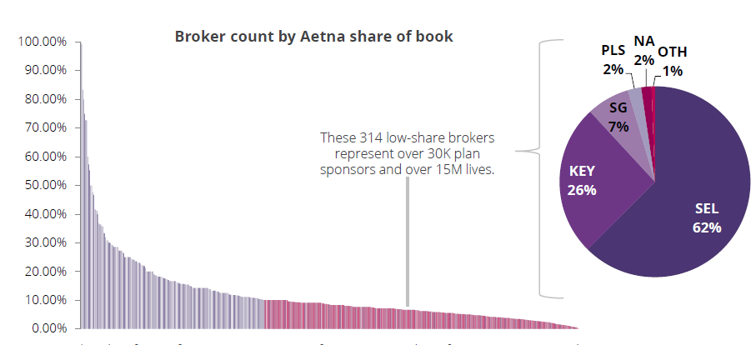
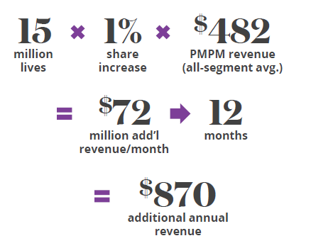
Aetna’s share-of-wallet is low for the majority of brokers
For 63% of brokers, Aetna represents <10% share in their book of business. If Aetna can gain 1 point of share in each of these brokers, Commercial will earn over $870 million in additional revenue.
Note: Broker data from Informatics, 2018. Analysis is limited to brokers whose book of business comprises at least 10
sponsors (any carrier) and at least 1 Aetna plan sponsor

Slide 17
The future broker experience will be enabled by key tools that serve both brokers and sales reps
Enabling tool (internal)
Broker tool/touchpoint
Receive relevant product and plan information – streamline uncoordinated broker communications and support with differentiated content management experience
Register with Aetna and obtain license to sell – convert traffic from broker campaigns to become licensed & appointed or connect with an Aetna sales rep
Obtain quotes and insights on product-market fit from account managers or obtain quotes online for SG & MM (standard plans) - simplify fragmented processes for selling and improve user experience
Education on Aetna Products
Marketo + Highspot
Licensing & Appointment
Quoting & Selling
Producer Directory
TBD
Highspot + opportunity to curate one product look-up, availability, quoting tool or (access through broker portal)*
Aetna.com
View book of business reports on a single dashboard and receive relevant recommendations – unlock more sales opportunities through better data and insights
Explore Why Aetna (campaigns drive brokers to personalized Aetna.com) – single destination, enhanced experience
Enrollment & BoB
Engagement
AEM
TBD
Adobe Analytics
Aetna.com
TBD (Broker Portal?)
Broker
Brokers will receive communications from Highspot and have access to a singular broker portal that offers a unified digital experience* for all functions, such as product information, quoting, enrolment, and predictive content.
*SG and MM brokers will be primary users of the broker portal, while
NA brokers will be serviced through sales reps

Slide 18
Value of enhancing Aetna.com is driven by an increase in qualified broker leads and number of licensed and appointed brokers
Broker Education and Conversions
Greater number of marketing-qualified broker leads
Diversification and increase in the number of L&A brokers due to better awareness and understanding of Aetna’s full product portfolio and value proposition
Improved Aetna branding with brokers because of a targeted and unified marketing campaign experience
Improved broker experience due to tailored marketing content
Cost Savings
Coordinated and consistent process for Commercial marketers to leverage Aetna.com as a strategic destination to support their broker focused campaigns
Cost savings from reduction in microsites, which are currently used to support broker campaigns
Revenue Gained from Increase in L&A Brokers
Additional revenue from increase in broker firms
2%
X
X%
$60M
=
x
x
increase in broker leads
additional broker leads per year
current
conversion rate
avg. annual revenue/broker
$8.7
$X
=
additional annual
revenue
Additional revenue from increase in independent brokers
10%
X
X%
$18M
=
x
x
increase in broker leads
additional broker leads per year
current
conversion rate
avg. annual revenue/broker
$8.7
$X
=
additional annual
revenue
WIP Analysis
Notes:
Quantify satisfaction?
Primary value drivers are these – we’ll see right away

Slide 19

Table of Contents
Aetna Vision
Pain Points
Potential Future
Capability Assessment
Assessment Findings
Recommendations
Next Steps

