Slide 1
C360
Yogesh Shinde
Jeff O’Dell

Slide 2
Strategic Data Access Integrate with multiple generations during EDP transition
Evolving
Microservices and APIs
Semantic layer
Stable
UDP
EDW
Retail
EDH
Transitioning
Hadoop
in datacenter
Oracle/TD/DB2
in datacenter
Snowflake
in Azure
HCB in
MarkLogic
ODS
CDR
EDP
Strategic
MongoDB
in GCP
Spanner
in GCP
BiqQuery
in GCP

Slide 3
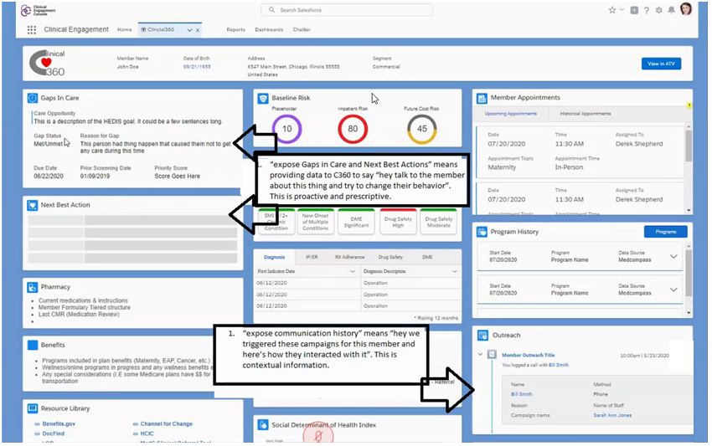
HCB Integration to C360
SoR
API
DPIM
User Interface
API
EDH
DPIM
SoR
TSM
ODBC
ODS
TSM
Data
Lake
Connectors
DPIM – Domain specific interface model
TSM – Topic specific model
ODBC – Industry standard data access
API – Application programming interface
SoR – System of record
ODS – Operational data store

