Slide 1

Clinical IoT PoV – 2021 (Point of View) This Point of View provides directional guidance for addressing Remote Patient Monitoring and the use of IoT across the enterprise.
Dave Fitzgerald, Dan McCutcheon, Manu Marulachary
February 2021

Slide 2


Executive Summary
Remote Health Monitoring - IoT (Internet of Things) – Direction and Integration with the Clinical Platform. Enable access to member’s real-time health monitoring data to provide coaching, to improve management of members care and transform raw data into actionable information through analytics
Overview
Conclusions
Recommendations
CVS has an interest to collect clinical data associated with our patients/members for reference and clinical stratification purposes.
IoT Platforms and Partners can provide a common infrastructure, framework and polices to ingest and use IoT device data for reference and insights
CVS Health is missing an opportunity to properly leverage ever increasing IoT devices in a secure, coordinated and consistent manner
CVS/Aetna/AHM/Digital have established integrations with wearables such as Fitbit and Apple Watch devices via data integrators
We have also experimented directly integrating health data from Apple watch
We have several direct IoT integrations and a strategic partnership with Validic (for device integration); however Validic should not be our only solution
There is little enterprise wide coordination of IoT partners, data integration and IoT data stewardship which leads to siloed solutions, poorly coordinated data and possible friction with Patients/Members.
A common IoT platform with consistent polices and associated ecosystem can help drive faster implementations, partnerships and utilization of IoT enabled devices should provide better customer engagement experiences, and positive health outcomes for our patients/members.
With the advent of COVID more people need remote care, CVS should more aggressively drive towards an IoT platform strategy as part of the Clinical Platform to position CVS Health as a leader in healthcare and clinical based IoT integrations
CVS should continue to establish Remote Monitoring manufacturers relationships and leverage industry standards for data integrations with them.
CVS should leverage the Clinical Connected Platform initiatives as a means to collaborate on innovative initiatives and establish Enterprise level components to support IoT (Remote Monitoring) in order to deliver more precise clinical care and insights at the right time while reducing implementation costs and redundancies

Slide 3

Internet of Things (IoT) – Vision/Strategy Serving our members/patients – each stakeholder has the ability to influence their health outcomes and assist each other through those activities
Value Proposition
Bi-directional sharing of clinical data has the ability to foster a collaborative approach to patient care with each stakeholder gaining value through the process
Internal to CVS Health the power will be in selective storing /use/sharing of the data through Analytics, Rules, and AI
Member/Patient
Meeting/Exceeding the Health Journey and Experience (Remote Monitoring, Wearables, Other Channels)
Data Aggregators & IoT Partners
Provider
Connection to allow for bi-directional sharing of clinical data/information
Clinical
Provide meaningful/actionable member/patient EMR/EHR clinical data – make it easy to share
Clear/Concise/Meaningful information from payors to assist Providers in treating their patients
Leveraging key clinical data/information to bring efficiency and automation to our Enterprise Clinical Organization
HH, Minute Clinic, Clinical Ops etc
CVS Health
Connected Platform
Store/Orchestrate/Curate & Automate the use of clinical data for the Enterprise “Intelligence Layer”
Data Storage, Rules, Analytics and Artificial Intelligence
* Susan Brayton

Slide 4
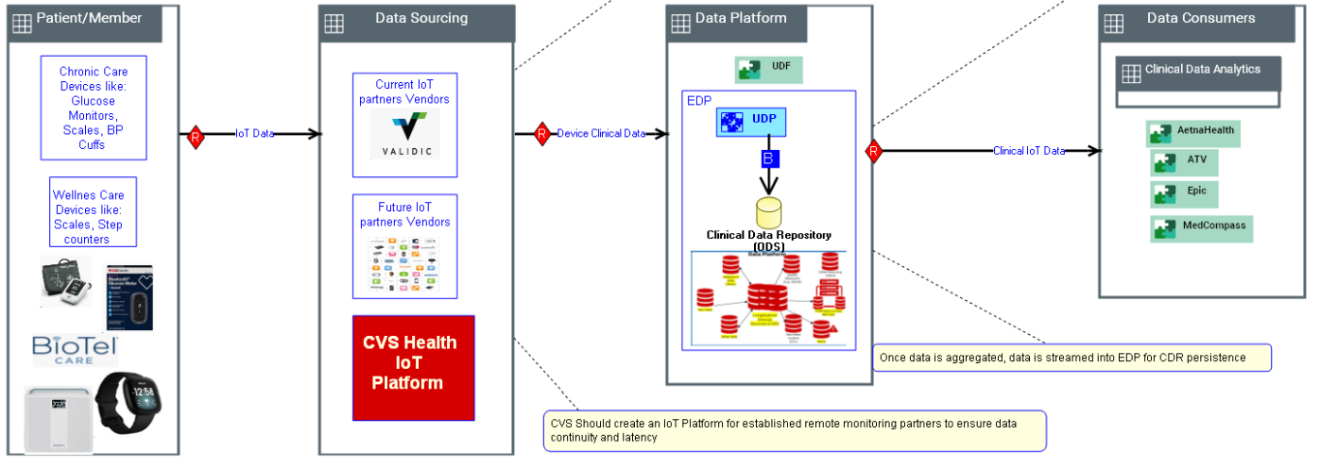
Clinical IoT – Remote Patient Monitoring
“Be Local: Engage people with the care the need where they need it”. AND Improve Health: Help people achieve better health at a lower cost.” Remote monitoring current thinking will be in the Patient/Member home to not only monitor the persons health condition but to assist the person in their health journey. If CVS can keep people engaged there will be reduced hospital visits and lower costs.
Remote Monitoring / IoT
Chronic Condition Management:
Partner with not only Aetna but other Payers, Plan Sponsors to support Chronic Condition management offerings that improve with Remote devices
E-commerce and Reconciliation for Retail sales of payer agnostic DME for payer reimbursement - CVS use of IoT systems monitoring and logging
Consumerism and Education :
Offer health monitoring services for those health conscious customers that just want to track their own health being blood pressure, weight, blood sugar, etc today there are many companies doing similar data collection for customers like FitBit (collecting weight, O2, sleep steps etc) (which was purchased by Google), Apple (Attain and a partnership with Aetna collecting similar data to FitBit) and Many others
Create Actionable Insights:
When appropriate tie the vast amount of clinical data being collected by CVS into data science for health condition awareness/opportunities/alerts.
Notes:
What will be the high-level focus and the Architecture to support that.

Slide 5

CVS Health Internet of Things ecosystem
Customer/Member/Patient centric
HealthHUBs
Pharmacy Benefit Management
Care Management
Pharmacy Retail
CVS Health is in a unique and challenging position.
Adding IoT capabilities will serve the customer holistically leveraging innovative product and service offerings from its HealthHUBs, care management, pharmacy, and PBM businesses.
Customer
* IoT Tech PoV – Manu Marulachary
Notes:
An IoT ecosystem could connect these systems….it needs built

Slide 6
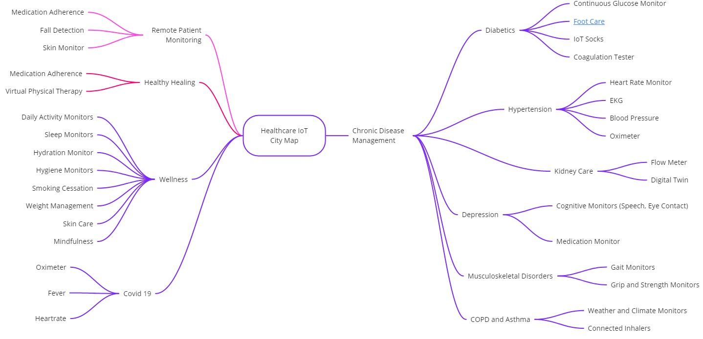
CVS Health IoT City Map
Opportunities for IoT devices in Healthcare
* IoT Tech PoV – Manu Marulachary

Slide 7
Remote Patient Monitoring : Clinical Platform Initiatives by Capability
 | Feature |  | Feature Description | Expected Delivery Date | Impacted LoBs | Delivery Initiative
Remote Patient Monitoring | AB | Enterprise IoT | Create a larger CVS IoT strategy to partner and integrate RPM data and make that data available for clinical and data analysis purposes ingest biometric data, and create actionable insights from the data. Includes wearables. | 2022 | All | TBD
 | AC | AEC (Acute Event Care): Healing Better | E-commerce and Reconciliation for Retail sales of payor agnostic DME for payor reimbursement - CVS use of IoT systems monitoring. | 2022 | Payor Agnostic | TBD
 | AD | Envisioned | Consumer transformation connected device. | 2022 | Digital | TBD
 | AE | Health Cloud Validic Integration | IoT Integration. | 2022 | Digital | TBD

Slide 8
What Might an IoT Platform Look Like?
An IoT Platform should provide a common framework and policies to integrate IoT devices
The platform provides infrastructure, framework, polices, and capabilities to:
Security, governance and monitoring
manage devices
Deliberately collect data with user consent
ingest and process IoT data
Define data models to support raw IoT data, device data
Create IoT data analytics and business apps that combine disparate data
IoT Platform Reference Architecture
Security
Governance
Device Management
SDK, API
User Consent and Authorizations
Streaming and Event Processing
Data Model and Management
Analytics, AI, ML, Insights
Business Applications
* IoT Tech PoV – Manu Marulachary

Slide 9
Partner vs Build IoT Platforms
Decision guide
Partner
Build Your Own
Time to market
Best of the breed products and services
Plug and Play capability
Less complexity/accountability in managing
Choice for members for using their choice of products
Possibility of multiple apps for members to manage
Possibility of data proliferation
Complexity of Integration
Less data proliferation
Single, integrated app, easy of use for Members
Increased privacy, preferences and protection to members
Ability to provide edge computing capabilities
Complicated time to market
Limited choice to members
TAI recommends a hybrid IoT ecosystem to derive the strength from both patterns
* IoT Tech PoV – Manu Marulachary

Slide 10


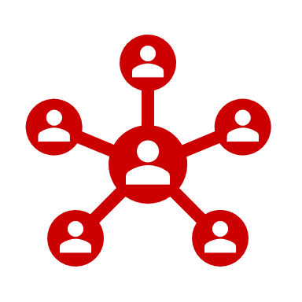
Hybrid IoT Platform Capability
Thoughts on a Hybrid mix
Pharmacy Platforms
HBA Platform
EMR Platforms
Biometric wearables
Capability | Current State | Hybrid | Build
Device Management | Vendor | Vendor | CVS
Device OS, SDK, APIs | Vendor | Vendor | CVS
Device Dev, Sec, Ops | Vendor | Vendor / CVS | CVS
Streaming and Event Processing | Vendor | Vendor / CVS | CVS
Device Data Management | Vendor | Vendor / CVS | CVS
Analytics, AI, ML and Insights | Vendor | CVS | CVS
User Consent and Authorization | Vendor | CVS | CVS
Command and Control | Vendor | CVS | CVS
Operational Analytics | Vendor | CVS | CVS
Operations
Smart Environment Sensors
End User Applications
Connectivity
Networks & Hubs
IoT
Platforms
Data Aggregation
Applications
Insight Platforms
Smart Appliances
Business Applications
IoT Platform Capabilities
DevSecOps
Command & Control
Device Management
OS, SDK, API
User Consent and Authorizations
Streaming and Event Processing
Data Model and Management
Analytics, AI, ML, Insights
Operational Analytics
* IoT Tech PoV – Manu Marulachary

Slide 11
IoT – Clinical Future State

Slide 12
Appendix

Slide 13



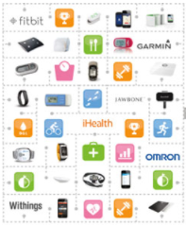
IoT – Integration with Clinical Systems Primary Capabilities:
1
2
3
4
1. Data Sourcing:
For ngTDC Cellular Glucometer, business does not need/want the data to flow into ATV or EPIC. Nurse will access the BioTel Care portal to review member blood glucose readings in order to provide coaching to improve management of diabetes
IoT vendors to identify the members with the data they collect and publish to CVS/Aetna via secure and standard interfaces near real-time
IoT vendors to support FHIR standards for biometric data and other supported resources
IoT vendors must be able to meet the CVS security and legal requirements
2. Data Aggregation:
Data from IoT vendors will be ingested into Elasticsearch and UDP data stores via standard set of API, File and Kafka based interfaces
Data aggregation/ingestion capabilities must ensure that aggregated data is available to users/applications that need the data in a timely fashion
Once data is aggregated, data is streamed into EDP for analytics
3. Data Analytics:
Data Lineage (base layer through canonical/conformed layers through presentment layers) , Audit Balancing Controls (ABC), Metadata, Data Security & Data Governance
Generate opportunities, campaigns etc. based on the aggregated IoT data combined with other member topics
4. Data Consumption:
For ngTDC Glucometer, ATV/EPIC users will SSO over to BioTel Care Portal to review member blood glucose readings
In the end state architecture, clinical systems to consume the data directly from internal aggregation and analytic layers
5. Connected Platform:
Ecosystem platform will enable Global Id interoperability across the systems as well as preferences management.
Data and Analytics platform will provide insights to the data scientists and the care management teams.
Services platform will enable member services
Data Sourcing
Data Aggregation
Data Analytics
Data Consumption
External IoT Vendors
Aetna (On Prem)
EDP - Snowflake on GCP
ATV
VALIDIC
UDF
Adhoc Data Sources
MedCompass
UDP
Others
Staging
EPIC
Conformed
Snow Pipes
Industry and Reference Data
CEC
API (FHIR)
Pub/Sub
File
EDI
API
Kafka
Snowflake Kafka/Streaming Connector
BioTel Care
Future IoT Vendors
API (Elasticsearch)
Storage
API
Users
SSO over to Vendor Portal (ngTDC 2021)
Data and Analytics platform
Services platform
Ecosystem platform

Slide 14
Next Steps Thoughts
Agree to a targeted roadmap creation and investment in skills, structure, and technologies
Owner
Near-Term Action
(<6 months)
Long-Term Action
(>6 months)
Business
Identify opportunities, products and services to utilize IoT
Partner with IoT product startups to integrate their IoTs with CVS Health product offering
Establish HIPAA compliant Business Associates Agreement with selected IoT Platform partners and data aggregators
Establish IoT enabled product roadmaps & offerings
Pilot and test for acceptance among key constituents
Establish Ethics Framework for IoT capabilities
Enterprise IT Delivery
Plan for integration of ecosystem capabilities with the IoTs data to support unified view of constituents
Expand foundational capabilities to a broader set of interaction channels, including IoT devices
Plan/design for delivery of streaming data and event-based processing for real-time insights from the IoTs and edge-devices
Establish IoT Council and CoE to promote IoT strategy across the enterprise
Plan for integration with the Enterprise Engagement and Service platforms
Incorporate Digital Analytics into all interaction channels
Build out streaming and event-based capabilities
Technology Architecture & Innovation
Look for solution opportunists for IoTs and Digital Twins
Expand understanding and potential benefits of IoTs to applicable business areas through cross-functional workshop / roadmap planning sessions
Establish design patterns for streaming and event-based processing to support real-time data ingestion from IoTs and edge devices
Plan for a multivendor IoT Strategy and governance
Collaborate with IT delivery to incorporate IoTs in a broader set of channels
Support data streaming and event processing strategy as technology matures
* IoT Tech PoV – Manu Marulachary

Slide 15
Into Action.
Turning Vision…

