Slide 1

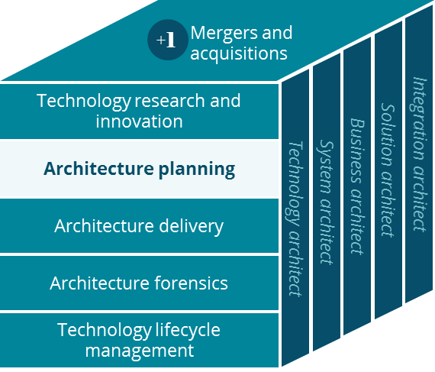
Aetna Student Health Business Canvas
Architecture Planning
Daniel McCutcheon
4/2019

Slide 2
Business Canvas
Aetna Student Health
Key Partnerships
Key Activities
Value Proposition
Customer Relationships
Customer Segment
Brokers
PBM
Prospect Customers
Manage Account
Enhanced Institutional Services
Brokers
Members (students)
Students
Providers
Member Admin
Manage Network
Lower Member Cost
Institutions of Higher Education
Auditing
Non-Member
(Students)
Deliver Service
Pay Providers
Co branding
Hospitals
Vendors
Clinical Management
Quality of Service
States
Channels
Key Resources
Integrated Digital Experience
Consumer Portal
Mail
Institutions of Higher Education
Local Presence
CVS / Aetna Brand
Consumer Portal
Data & Insights
Local Presence
Phone, Fax, Emails
Face to face
IT Platform
Preventative Health Care
Video (TeleDoc)
Minute Clinic
Cost Structure
Revenue Streams
Marketing & Sales
Operational Costs
Product Development
General & Administrative Costs
Institutional Billing
Member Semester Billing
Checks, CC, Digital checks
Notes:
Unique networks formed with providers close to schools, larger network/provider management – Grace?
Vendors – Eligibility processors
States – State reporting and regulatory
Products – med, dent, vision, travel
Prevent Health – Smoking Sensations, Pregnancy prevention, etc.

