Slide 1

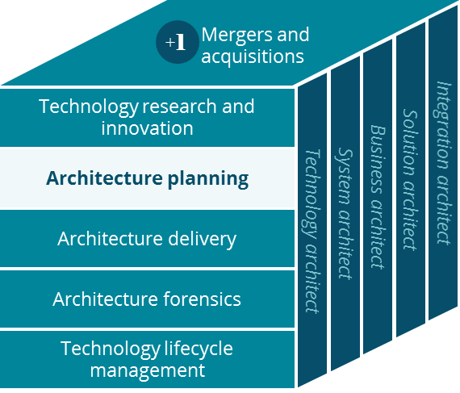
Aetna Voluntary Business Canvas
Architecture Planning

Slide 2
Business Canvas
Aetna Voluntary
Key Partnerships
Key Activities
Value Proposition
Customer Relationships
Customer Segment
Brokers
PBM
Member/provider claim payments
Sales/marketing
Improves medical sales and retention
Members
Plan Sponsors
National Accounts
Providers
Eligibility/billing
Customer service/act. mgmt.
Improved health for Members
Providers
Brokers
Plan Sponsors
Middle Market
Hospitals
Reducing Medical Costs
Vendors
Key Resources
Channels
Voluntary
States
CVS/Aetna brand
Member portal
Online claim submissions
Member Portal
Phone
Dept of Insurance
Email
Fax
Exchanges
IT Platform
Vendors
Direct deposit for members
Members
In person
Cost Structure
Revenue Streams
Marketing/Sales
Product Development
System admin and upgrades
Member Premium
Portability Premium
Operational Costs
General/Admin Costs
Commissions

