Slide 1

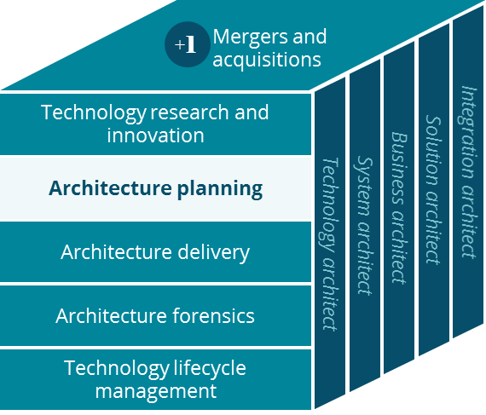
Behavior Health Canvas
Architecture Planning
David Fitzgerald
March 2019

Slide 2
Business Canvas
Business Canvas – Behavior Health including EAP
Key Partnerships
Key Activities
Value Proposition
Customer Relationships
Customer Segment
UM Outsource Partners
Local Community
Perform Prior Authorization
Case Planning with Providers
Holistic care for Members
Plan Sponsors
Members Families
Providers
CM Outsource Partners
Providers
Case Planning for Members
Claim Adjudication
Improved health for Members
Aetna
Key Resources
Fewer Hospitalizations
Channels
Provider Portals
States
Aetna BH Employees
Digital Platform
Reducing Medical Costs
Substance Abuse
Sales Brokers
Phone
Provider Network
Technology
Platform
Influencing Members Behaviors to Improve Health
Digital
Cost Structure
Revenue Streams
Business Operations
Employing Clinicians
Leasing Software/hardware
Program Purchase (buy-ups)

