Slide 1

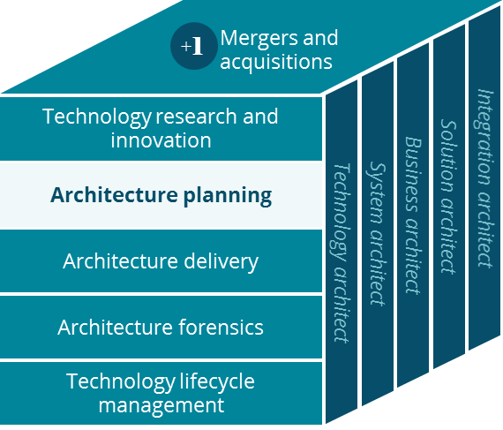
Clinical Programs Canvas
Architecture Planning
David Fitzgerald
March 2019

Slide 2
Business Canvas
Business Canvas – Clinical Programs
Key Partnerships
Key Activities
Value Proposition
Customer Relationships
Customer Segment
UM Outsource Partners
Local Community
Perform Prior Authorization
Care Planning for Members
Holistic care for Members
Members
Plan Sponsors
Providers
Case Planning for Members
Case Planning with Providers
Improved health for Members
Providers
CM Outsource Partners
Aetna
CMS
Influencing Members Behaviors to Improve Health
Provider Portals
Key Resources
Channels
Members
States
Aetna Clinicians
Member Stratification
Fewer Hospitalizations
Face-to-face
Phone
PBM
Reducing Medical Costs
Member Digital
Fax
Digital Platform
Clinical Insights
Reduced Claims
Provider Portals
Cost Structure
Revenue Streams
Employing Clinicians
Leasing Software/hardware
Medical Insurance Plans
Program Purchase (buy-ups)

