Slide 1

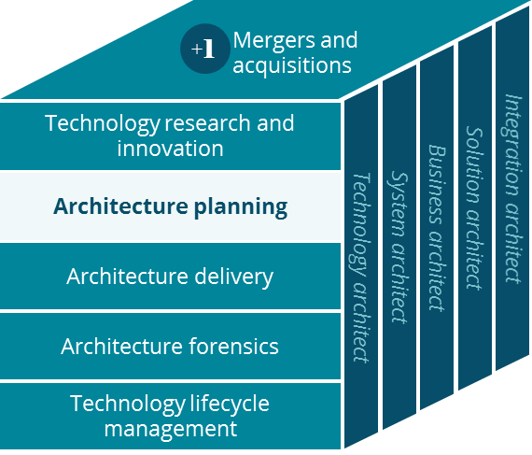
International Business Canvas
Architecture Planning
Daniel McCutcheon
April 2019

Slide 2
Business Canvas
Business Canvas – International
Key Partnerships
Key Activities
Value Proposition
Customer Relationships
Customer Segment
TPA Partners
Provider Networks
Claim Adjudication
Provider Management
Travel for Treatment
Members
Plan Sponsors
Plan Sponsors
PBM
Providers
Plan Sponsor Management
Providers
Governmental Authorities
A
Underwriting
Virtual Health Consultation
Members
Key Resources
Medical Claim Management
Channels
Aetna CSR’s
Virtual Health Platform
Member Portals
Phone
Health Management
Services
International Service Platform
Provider Portals
Fax
Administrative Platforms
email
IVR
A
Cost Structure
Revenue Streams
Claim Operations
Provider Management
Product Management
Medical Claim Management
Health Management
Services
A = Americas Business Only

