Slide 1

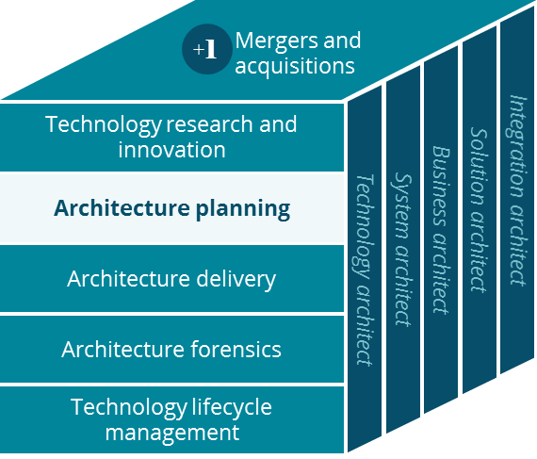
Medicaid Business Canvas
Architecture Planning

Slide 2
Business Canvas
Aetna Medicaid
Key Partnerships
Key Activities
Value Proposition
Customer Relationships
Customer Segment
Local Community
PBM
Pay Claim
Manage members
Special care for members
Aged, Blind, Disabled
Children
State
Long term care
Needy Families
Providers
Manage Care for members
Manage Providers & Networks
Engage members in local community
CMS
Substance abuse
Mental Illness
Key Resources
Improve health for members
DSNP
Pregnant moms
Clearing House
Hospitals
Local Presence
Aetna Brand
Channels
Service Platform
Digital Platform
Data & Insights
Mobile Apps
Systems of Engagement
Cost Structure
Revenue Streams
Members not caring about their well-being
Partnering with local communities
Administer member and claims
PMPM from state
Members don’t have to pay for their treatment
Business Costs (e.g. Claims, Enrollments etc.)
IT Systems
Approximately 90 cents to 1 dollar is towards claims payment. The remaining 10% is for operational costs plus any profits
Notes:
Should state be customer Relationships?
Who purchases and who serves

