Slide 1
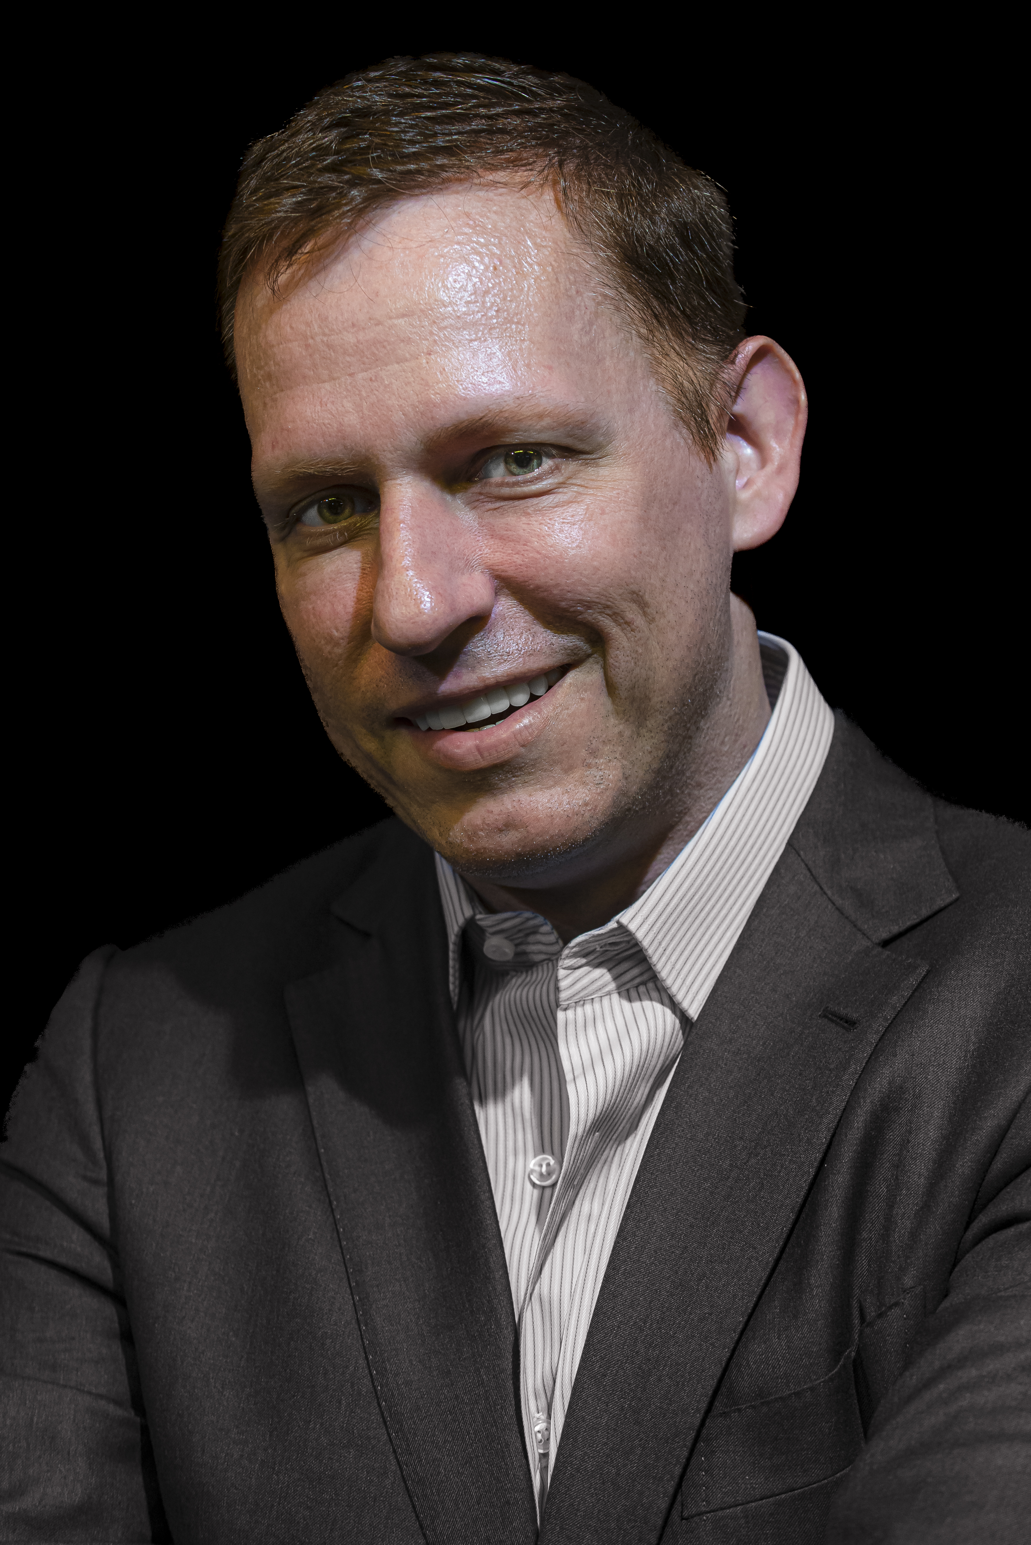
PETER THIEL
Not a cartoon
villain.
Secrets, fear, and the architecture of power
A personal inquiry — fact, interpretation, and lore kept separate
01
Notes:
TALK TRACK
Open personally: I did not meet Peter Thiel through politics or Palantir. I met him as a puzzle—an investor who seemed to see around corners. This talk asks what makes that puzzle coherent, then tests the flattering and frightening versions against the record.
[Sources]
- https://commons.wikimedia.org/wiki/File:Peter_Thiel_-_Photo-_Dan_Taylor_-_dantaylor.me-1.jpg — cover image credit and license
[/Sources]

Slide 2
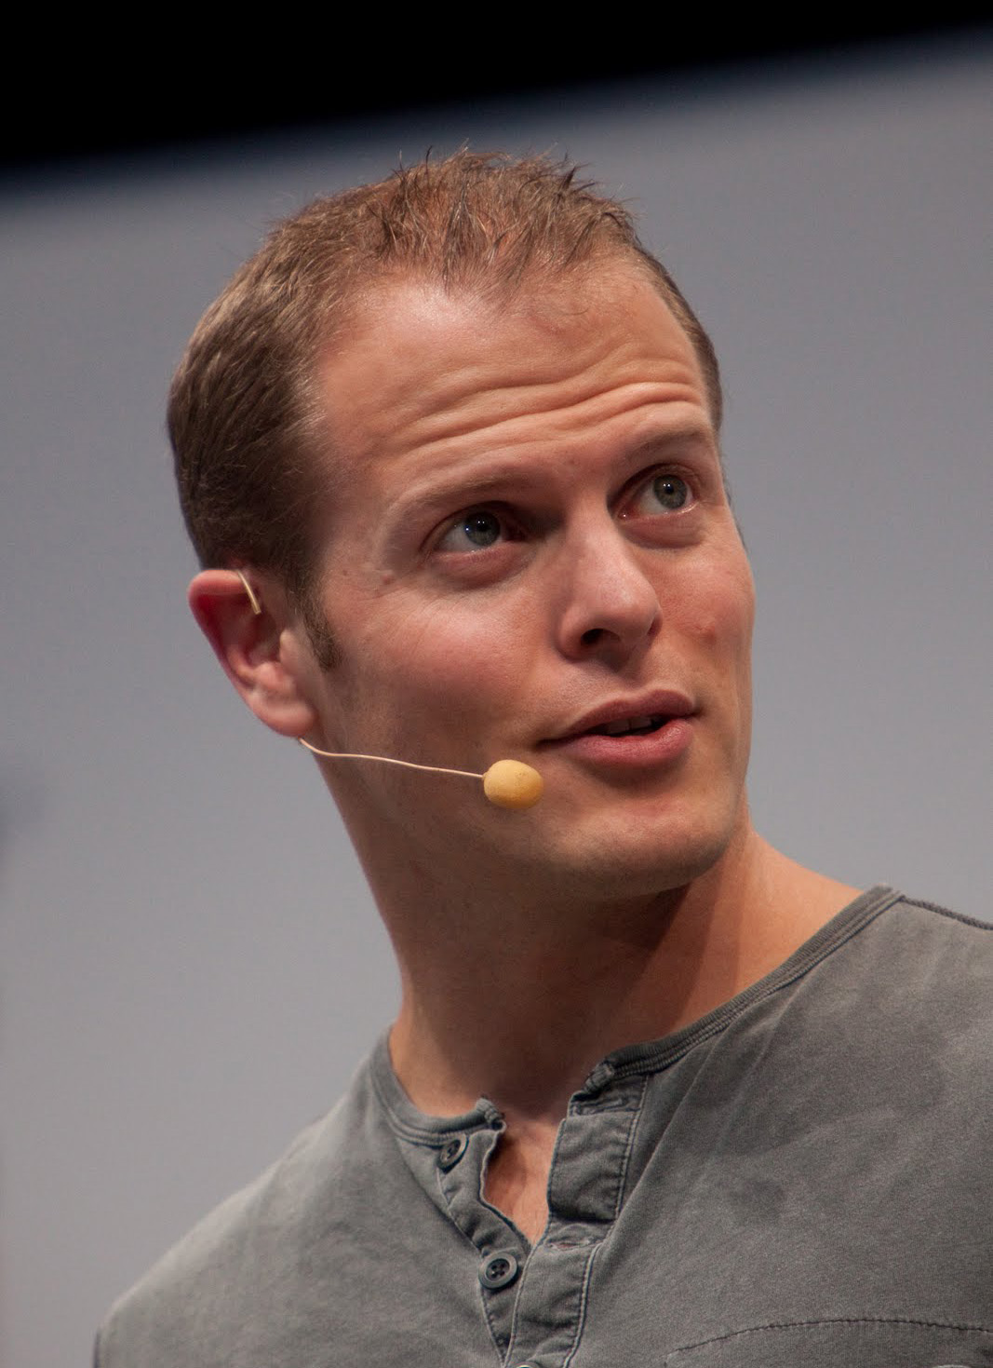
ORIGIN STORY
I met Thiel through Tim Ferriss—and memory blurred the cast.
SEP 9, 2014
COPY UPLOADED · JUL 7, 2026
Ferriss publishes his Peter Thiel interview
The startup question lands: how does one person keep spotting important companies early?
DEC 6, 2016
Tools of Titans is published
CORRECTION
“Oracle of Silicon Valley” referred to Reid Hoffman—not Thiel.
PETER THIEL — SECRETS, FEAR & POWER
02
Notes:
TALK TRACK
Tell the origin honestly. Tim Ferriss published episode #28 with Thiel on September 9, 2014; the supplied YouTube URL is a July 7, 2026 repost. The exact recording day is not public. Ferriss says the episode was asynchronous because he was on medical leave, with Blake Masters reading the questions. Tools of Titans arrived in December 2016. The phrase I remembered—‘Oracle of Silicon Valley’—was attached to Reid Hoffman in Ferriss’s material. My memory stitched two PayPal-era figures together. But the question it created was real and very Thiel-like: what does someone see before everyone else sees it?
[Sources]
- https://tim.blog/2014/09/peter-thiel/ — Ferriss interview date and episode
- https://www.youtube.com/watch?v=kSHehMhSUq4 — July 7, 2026 repost of Tim Ferriss Show episode #28
- https://www.penguin.co.uk/books/435625/tools-of-titans-by-timothy-ferriss/9781785041273 — Tools of Titans publication date
- https://tim.blog/wp-content/uploads/2021/08/Tools-of-Titans-and-Tribe-of-Mentors-Introductions-and-Profiles.pdf — ‘Oracle of Silicon Valley’ attribution to Reid Hoffman
- https://commons.wikimedia.org/wiki/File:Timothy_Ferriss.jpg — image credit and license
[/Sources]

Slide 3
THE REAL QUESTION
What is his method for seeing around corners?
01
02
03
Secrets
Founder conviction
Power
Look for truths that are important, defensible—and still unpopular.
Back people whose vision survives the pressure to conform, sell, or retreat.
Build networks and institutions that can turn unusual ideas into durable leverage.
The same method can discover breakthroughs—or rationalize dangerous systems.
PETER THIEL — SECRETS, FEAR & POWER
03
Notes:
TALK TRACK
This is the organizing frame for the deck. Thiel searches for secrets, treats unusually stubborn founder conviction as information, and builds networks that make a contrarian idea consequential. None of those qualities is inherently good or evil. The moral question appears when the method meets institutions with asymmetric power.
[Sources]
- https://www.penguinrandomhouse.com/books/234730/zero-to-one-by-peter-thiel-with-blake-masters/9780804139304/ — Zero to One overview and publication context
- https://blakemasters.tumblr.com/peter-thiels-cs183-startup — Stanford CS183 notes that became Zero to One
[/Sources]

Slide 4
THE ARC
One career, three expanding arenas of influence.
1998
2000
2003
2004
2014
2016
2022→26
Confinity
PayPal CEO
Palantir
Facebook
Zero to One
Trump
Vance era
COMPANIES
CAPITAL
POLITICS
Build new systems
Choose the builders
Choose the state
PETER THIEL — SECRETS, FEAR & POWER
04
Notes:
TALK TRACK
The story expands in scale. Thiel begins by building a company, then becomes a capital allocator who chooses builders, then becomes a political patron who helps choose the people shaping the state. The throughline is not merely wealth. It is leverage over which future becomes real.
[Sources]
- https://www.sec.gov/Archives/edgar/data/1103415/000091205702009834/a2073071z10-k405.htm — PayPal corporate history
- https://investors.palantir.com/files/2025%20FY%20PLTR%2010-K.pdf — Palantir founding and leadership
- https://money.cnn.com/2012/08/20/technology/facebook-peter-thiel/index.html — Facebook investment
- https://www.press.org/sites/default/files/20161031_thiel.pdf — Thiel’s 2016 Trump support and political argument
- https://apnews.com/article/c3a6c7d2daba501caf8152558ac2d743 — Thiel, Vance, and current political context
[/Sources]

Slide 5
PAYPAL, BEFORE PAYPAL
Two rival companies collided around one urgent idea: money on the internet.
CONFINITY
X.COM
Peter Thiel
Max Levchin
Elon Musk
MERGE
A broader online financial-services vision—and a fierce competitor.
Its email-payment product already carried the name PayPal.
MARCH 2000
The merger did not erase the rivalry. It moved it inside the company.
PETER THIEL — SECRETS, FEAR & POWER
05
Notes:
TALK TRACK
Correct the familiar shorthand. Thiel and Musk did not simply sit down and invent PayPal together. Thiel led Confinity; Musk led X.com. The companies were competitors, then merged in March 2000. Confinity already had the PayPal product. Their later conflict makes more sense when we remember that the merger joined rival visions and rival power centers.
[Sources]
- https://www.sec.gov/Archives/edgar/data/1103415/000091205702009834/a2073071z10-k405.htm — SEC-filed PayPal corporate history and March 2000 merger
- https://www.paypalobjects.com/webstatic/en_US/mktg/pages/stories/pdf/paypal_infogrpahic_-_key_milestones.pdf — PayPal milestones
[/Sources]

Slide 6
THE ORIGINAL SCALE
PayPal’s real ambition was a new currency.
“We, too, tried to create
a new currency.”
2014 RETROSPECTIVE
PayPal became powerful by linking money and email.
PAYMENT SYSTEM
→
NEW CURRENCY
But Thiel said it never fully achieved the currency goal.
The payment product was the wedge. Monetary sovereignty was the destination.
WATCH THE REPOST · 7:16
TIM FERRISS SHOW #28 · PUBLISHED SEP 9, 2014
PETER THIEL — SECRETS, FEAR & POWER
06
Notes:
TALK TRACK
This changes the scale of the PayPal story. In Tim Ferriss Show episode #28, Thiel says PayPal was not merely intended to make online checkout easier. The team was trying to create a new currency, using a new payment system as the starting point. He also admits that PayPal became powerful as a payment system but never fully achieved the currency goal. The supplied YouTube video is a July 7, 2026 repost; the original episode was published September 9, 2014. The relevant answer begins around 7:16 and runs through about 8:05.
[Sources]
- https://tim.blog/2014/09/09/peter-thiel/ — original Tim Ferriss Show episode #28, published September 9, 2014
- https://tim.blog/wp-content/uploads/2018/07/28-peter-thiel.pdf — official transcript, Bitcoin/PayPal currency passage
- https://youtu.be/kSHehMhSUq4?t=436 — supplied repost, currency discussion beginning around 7:16
[/Sources]

Slide 7
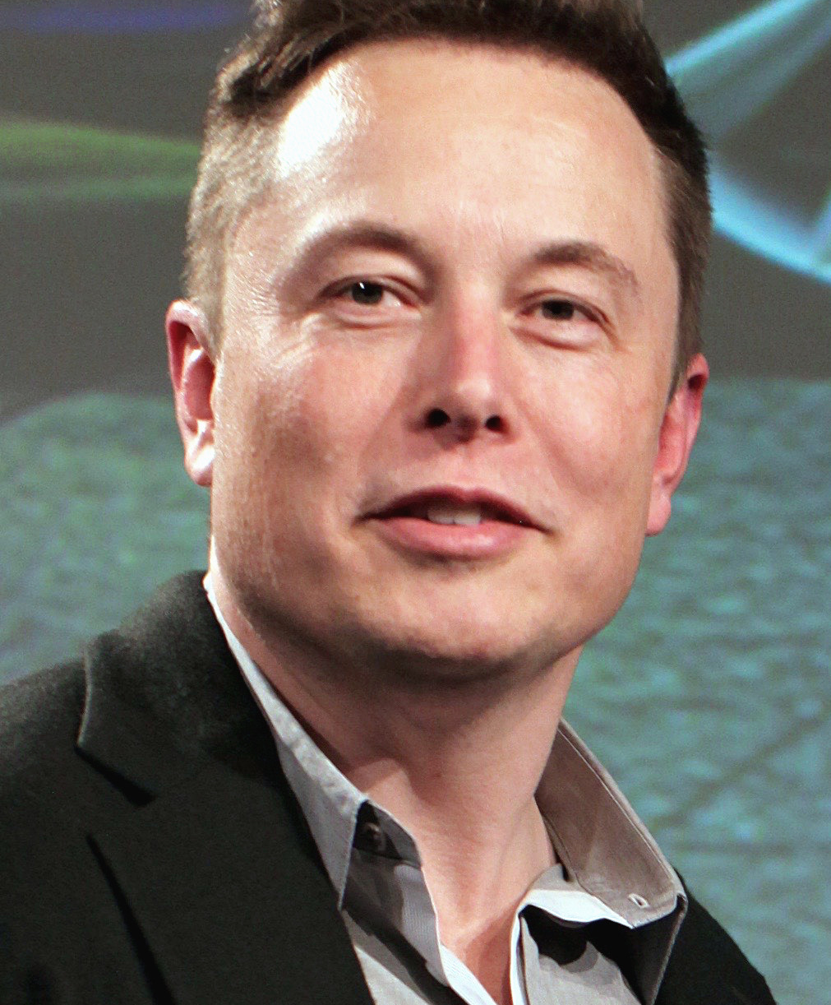
THE SCAR TISSUE
The board removed Musk while he was away on his honeymoon.
THE RECORD
Senior employees and the board replaced Musk with Thiel as CEO in September 2000.
THE DRAMATIZATION
“Thiel stabbed Musk in the back” compresses a board revolt into a two-man betrayal story.
Later respect is real. The ‘PTSD from vacations’ story is lore, not documented fact.
PETER THIEL — SECRETS, FEAR & POWER
07
Notes:
TALK TRACK
Keep the drama, but get the mechanism right. A group of senior employees and directors moved against Musk while he was on honeymoon in Australia. Thiel returned as CEO. The event plainly mattered to Musk, and both men later expressed respect for one another. But the claim that it clinically caused an aversion to vacations is a colorful inference, not something the public record establishes.
[Sources]
- https://www.sec.gov/Archives/edgar/data/1103415/000091205702009834/a2073071z10-k405.htm — Thiel’s return as CEO in September 2000
- https://www.newyorker.com/news/letter-from-silicon-valley/what-is-it-about-peter-thiel — account of PayPal conflict and Thiel’s role
- https://www.washingtonpost.com/history/2023/07/25/elon-musk-paypal-twitter-x-rebrand/ — Musk’s honeymoon and board ouster
- https://commons.wikimedia.org/wiki/File:Elon_Musk_2015.jpg — image credit and license
[/Sources]

Slide 8
THE NETWORK EFFECT
PayPal’s most durable product may have been its alumni network.
LINKEDIN
YOUTUBE
Reid Hoffman
Chen · Hurley · Karim
PAYPAL
YELP
AFFIRM
Jeremy Stoppelman
Max Levchin
FOUNDERS FUND
TESLA / SPACEX
Thiel · Luke Nosek
Elon Musk
A dense trust network turned one exit into decades of companies, capital, and shared access.
PETER THIEL — SECRETS, FEAR & POWER
08
Notes:
TALK TRACK
The ‘PayPal Mafia’ is not a story about Thiel personally commanding every later company. It is a story about a dense network of experienced operators, friendships, grudges, shared capital, and mutual credibility. Thiel’s advantage is partly an information advantage: he is connected to people who see unusual companies before most investors do.
[Sources]
- https://www.newyorker.com/news/letter-from-silicon-valley/what-is-it-about-peter-thiel — PayPal alumni network and Thiel profile
- https://www.sec.gov/Archives/edgar/data/1103415/000091205702009834/a2073071z10-k405.htm — PayPal leadership context
[/Sources]

Slide 9
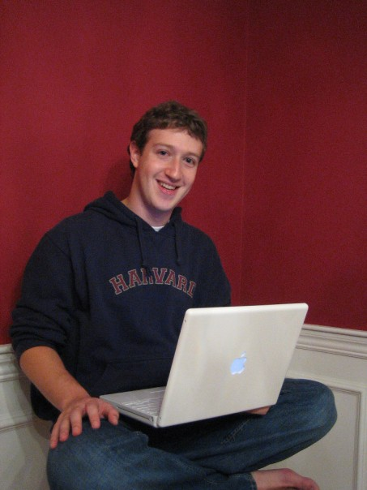
THE FOUNDER SIGNAL
Facebook taught Thiel to read refusal as information.
$500K
Thiel’s 2004 investment—Facebook’s first major outside check.
$1B
Yahoo’s 2006 offer. Zuckerberg told the board the meeting was effectively a formality: he would not sell.
THE SIGNAL: ambition survived a life-changing exit.
PETER THIEL — SECRETS, FEAR & POWER
09
Notes:
TALK TRACK
Thiel invested $500,000 in Facebook in 2004 and joined the board. Two years later Yahoo offered roughly $1 billion. Thiel later recalled that he and Jim Breyer were inclined to consider selling, while Zuckerberg treated the meeting as a formality. The key insight is not that Thiel predicted every detail of social media. It is that Zuckerberg’s refusal revealed the scale of the founder’s internal model.
[Sources]
- https://money.cnn.com/2012/08/20/technology/facebook-peter-thiel/index.html — $500,000 investment and board role
- https://www.inc.com/allison-fass/peter-thiel-mark-zuckerberg-luck-day-facebook-turned-down-billion-dollars.html — Thiel’s account of Zuckerberg rejecting Yahoo’s offer
- https://commons.wikimedia.org/wiki/File:MarkZuckerberg.jpg — image credit and license
[/Sources]

Slide 10
THE OPERATING MANUAL
Zero to One turned the private method into a public vocabulary.
2012 CLASS → 2014 BOOK
ZERO
TO
ONE
“What important truth do very few people agree with you on?”
Secrets
Monopoly
Definite optimism
Great businesses begin with a truth others have not recognized.
Build differentiated value before competing in a crowded market.
Make a plan for a better future instead of waiting for one.
PETER THIEL
with BLAKE MASTERS
PETER THIEL — SECRETS, FEAR & POWER
10
Notes:
TALK TRACK
Blake Masters’s notes from Thiel’s 2012 Stanford course became Zero to One in 2014. The book matters because it gives names to the method: secrets, monopoly, and definite optimism. The famous interview question is often misquoted. The book’s wording is: ‘What important truth do very few people agree with you on?’
[Sources]
- https://blakemasters.tumblr.com/about — Masters’s notes and origin of the book
- https://blakemasters.tumblr.com/peter-thiels-cs183-startup — CS183 course notes
- https://www.penguinrandomhouse.com/books/234730/zero-to-one-by-peter-thiel-with-blake-masters/9780804139304/ — publication date and book description
[/Sources]

Slide 11
PALANTIR’S CORE IDEA
An ontology turns scattered records into a shared operational reality.
RAW SYSTEMS
ONTOLOGY
DECISIONS
Customer_ID
PERSON
Investigate
Facility #
→
PLACE
→
Allocate
Case subject
EVENT
Alert
Sensor tag
ASSET
Act
Palantir models objects, relationships, and actions while preserving permissions and lineage.
PETER THIEL — SECRETS, FEAR & POWER
11
Notes:
TALK TRACK
Explain ontology without mysticism. Different systems may refer to the same real-world person, place, asset, or event using incompatible fields. Palantir’s ontology maps those records into shared objects, relationships, and actions. That gives users a common operational picture while the platform tracks provenance, permissions, and changes. The novelty is not simply search. It is a governed semantic layer between data and decisions.
[Sources]
- https://www.palantir.com/docs/foundry/getting-started/introductory-concepts — official ontology concepts: objects, links, actions, and organizational representation
- https://www.palantir.com/docs/foundry/security/overview — security, access control, and audit model
[/Sources]

Slide 12
THE PALANTIR PARADOX
The promise and the danger are the same capability.
CAPACITY
ASYMMETRY
Make institutions
see and coordinate
Make institutions
see too much
Granular access controls
Surveillance at operational scale
Audit logs and data lineage
Errors amplified across systems
Faster cross-system decisions
Power concentrated behind secrecy
Governance—not capability alone—decides which side wins.
PETER THIEL — SECRETS, FEAR & POWER
12
Notes:
TALK TRACK
Present the steelman and the risk together. Palantir documents granular permissions, audit logs, lineage, and a privacy-and-civil-liberties function. Critics argue that the same integration makes surveillance and enforcement more scalable, especially when oversight is weak. The system’s moral character cannot be read from the software alone. It emerges from contracts, users, rules, and accountability.
[Sources]
- https://www.palantir.com/pcl/technologies/ — Palantir privacy and civil-liberties controls
- https://www.palantir.com/docs/foundry/security/overview — Palantir security, audit, and access controls
- https://www.aclu.org/news/privacy-technology/palantir-deportation-roundup — civil-liberties critique of Palantir’s government work
[/Sources]

Slide 13
FACT-CHECKING THE LEGEND
“Palantir found bin Laden” is a strong story with weak public proof.
PUBLICLY VERIFIED
PLAUSIBLE
NOT PROVEN
Palantir served U.S. intelligence and counterterrorism missions.
Tools like it can fuse the fragmented data used in manhunts.
No authoritative public account credits Palantir with locating him.
Keep the legend as lore—never as evidence.
PETER THIEL — SECRETS, FEAR & POWER
13
Notes:
TALK TRACK
This is a useful demonstration of epistemic hygiene. Palantir was founded for intelligence and counterterrorism work, so the rumor feels plausible. Public accounts of the bin Laden operation emphasize the fusion of intelligence and operations, but they do not authoritatively identify Palantir as the tool that located him. The supplied Free Press interview repeats the claim as settled biography in Bari Weiss’s introduction around 4:43. That is a useful example of a compelling rumor hardening into conventional wisdom. Say ‘rumored’ or ‘lore,’ not ‘Palantir found bin Laden.’
[Sources]
- https://investors.palantir.com/files/2025%20FY%20PLTR%2010-K.pdf — Palantir founding purpose and government work
- https://www.af.mil/News/Article-Display/Article/113320/gates-perfect-fusion-made-bin-laden-raid-succeed/ — official public account of intelligence-operation fusion; does not identify Palantir
- https://youtu.be/wwJV_NuN43Y?t=283 — Free Press introduction repeating the Palantir/bin Laden claim around 4:43
[/Sources]

Slide 14
THE CENTRAL CONTRADICTION
Thiel warned that AI centralizes power—while Palantir increases state capacity.
CRYPTO
AI
DECENTRALIZES
CENTRALIZES
Peer-to-peer systems can weaken the gatekeeper’s control.
Data-rich institutions can see, predict, and coordinate at massive scale.
“libertarian”
“communist”
The irony is real. The explanation is not necessarily hypocrisy: it may be a bet on who controls the center.
PETER THIEL — SECRETS, FEAR & POWER
14
Notes:
TALK TRACK
Thiel has repeatedly contrasted decentralized crypto with centralizing AI. In 2018 he compressed the argument into the provocative line that crypto is libertarian and AI is communist. In 2021 he said AI is what a surveillance society needs. Palantir therefore creates a genuine tension: he fears centralized surveillance while chairing a company that can make centralized institutions dramatically more capable. That is the deck’s central contradiction.
[Sources]
- https://www.hoover.org/node/91149 — 2018 Stanford/Hoover debate context
- https://www.axios.com/2018/02/13/peter-thiel-ai-is-communist-1518541570 — ‘crypto is libertarian and AI is communist’ quotation
- https://nixonseminar.com/2021/04/the-nixon-seminar-april-6-2021-transcript/ — ‘AI is what you need for a surveillance society’
- https://investors.palantir.com/files/2025%20FY%20PLTR%2010-K.pdf — Thiel remains chairman; Karp is CEO
[/Sources]

Slide 15
FRONTIER EXPERIMENTS
He funds strange exits from constraints—even when the evidence is thin.
01
02
03
Seasteading
Longevity
Young-blood lore
Real funding. Limited execution. Thiel backed floating-governance experiments, then conceded the engineering was not yet feasible.
A durable interest in defeating aging and extending healthy life—part technology thesis, part fear of mortality.
Documented curiosity about parabiosis. No credible public evidence that Thiel personally received young-blood transfusions.
Silicon Valley satire fused these interests into the ‘blood boy’ gag—attached to Gavin Belson, not Peter Gregory.
PETER THIEL — SECRETS, FEAR & POWER
15
Notes:
TALK TRACK
This is the experimental Thiel: fund an escape route from geography, aging, or political constraint. Seasteading received real support but did not become the new-world platform imagined. Young-blood stories demonstrate how curiosity becomes lore. Thiel expressed interest in parabiosis research; that is different from proof he personally used transfusions. And the Silicon Valley ‘blood boy’ scene belongs to Gavin Belson, not Peter Gregory—the character partly inspired by Thiel.
[Sources]
- https://finance.yahoo.com/news/peter-thiel-no-longer-thinks-005900481.html — Thiel on seasteading feasibility and past funding
- https://time.com/4579899/young-blood-transfusion-aging/ — documented interest in parabiosis and lack of confirmed personal transfusion
- https://www.newyorker.com/culture/culture-desk/how-silicon-valley-nails-silicon-valley — Peter Gregory as a partial Thiel inspiration
- https://techcrunch.com/2014/05/06/silicon-valley-show-disrupt/ — Mike Judge on the show’s composites and inspirations
[/Sources]

Slide 16
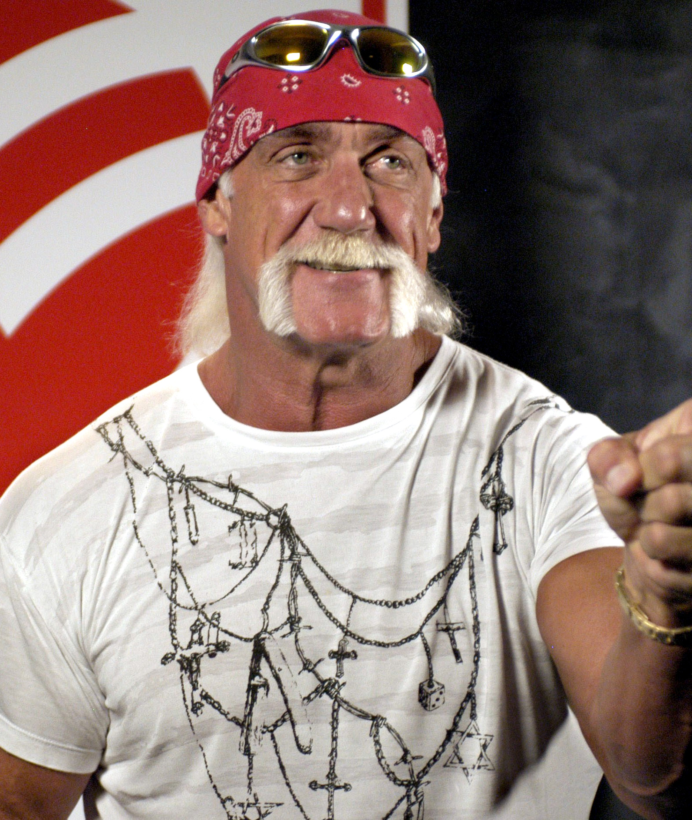
WHEN PRIVACY BECAME PERSONAL
Gawker turned a principle into a vendetta—and a test of private power.
2007
Valleywag, a Gawker site, publicly outs Thiel.
2012–16
Thiel secretly funds Hulk Hogan’s sex-tape privacy case.
$140M
Jury verdict; Gawker later files for bankruptcy and settles.
The unresolved question
Was this accountability for an abusive publisher—or a billionaire demonstrating that litigation can destroy a newsroom?
PETER THIEL — SECRETS, FEAR & POWER
16
Notes:
TALK TRACK
Gawker’s Valleywag site publicly outed Thiel in 2007. Years later, Thiel secretly funded Hulk Hogan’s privacy suit over a published sex tape. A jury awarded Hogan $140 million; Gawker filed for bankruptcy and eventually settled. Thiel framed the fight as privacy, not libel. The case can be understood both as accountability for a publisher that crossed ethical lines and as a demonstration of how private wealth can impose existential legal costs on a media institution.
[Sources]
- https://time.com/4348840/peter-thiel-gawker-lawsuit-hulk-hogan/ — Thiel funding, outing context, and verdict
- https://apnews.com/article/9e0034fdbbaf8d0a60ee19acab49ec80 — retrospective on Hogan, Gawker bankruptcy, and settlement
- https://www.press.org/sites/default/files/20161031_thiel.pdf — Thiel’s defense of the case as a privacy issue
- https://commons.wikimedia.org/wiki/File:Hulk_Hogan.jpg — image credit and public-domain status
[/Sources]

Slide 17
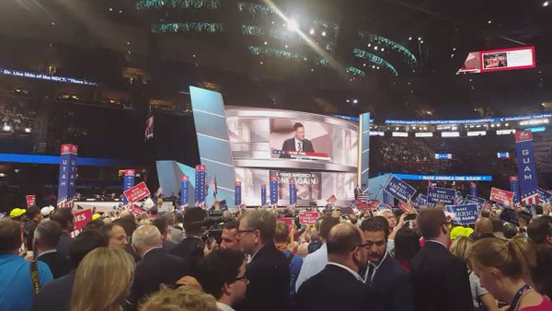
FROM TECHNOLOGY TO POLITICS
Political patronage became the next form of venture capital.
2016
Trump
Public endorsement, convention speech, and major financial support.
2018
Los Angeles
Moves operations, calling Silicon Valley a one-party state.
2022
Vance + Masters
2016 RNC
Roughly $15M for pro-Vance PAC; Masters runs for U.S. Senate—not governor.
An openly gay Silicon Valley billionaire makes the case for Donald Trump.
2025
Vice President Vance
A former Mithril Capital principal enters the White House.
PETER THIEL — SECRETS, FEAR & POWER
17
Notes:
TALK TRACK
Thiel’s politics should be understood as a new investment arena. He backed Trump publicly in 2016, spoke at the Republican National Convention, and donated heavily. He later supported J.D. Vance and Blake Masters. Vance had worked at Thiel-linked Mithril Capital; Thiel contributed roughly $15 million to a pro-Vance super PAC. In the supplied Free Press interview, the Vance section begins around 1:22:06. Thiel says around 1:22:37 that he first met Vance at Yale Law School in 2011 and that Vance later worked for one of his venture funds. Masters was the 2022 Republican nominee for U.S. Senate in Arizona—not governor—and lost. Vance became vice president in 2025.
[Sources]
- https://www.press.org/sites/default/files/20161031_thiel.pdf — Thiel’s 2016 endorsement and political argument
- https://www.latimes.com/business/la-fi-peter-thiel-20180215-story.html — move to Los Angeles and ‘one-party state’ framing
- https://techcrunch.com/author/j-d-vance/ — Vance biography and Mithril Capital role
- https://www.fec.gov/data/committee/C00783142/?cycle=2022 — Protect Ohio Values PAC records
- https://elections.maricopa.gov/asset/jcr%3Ab2fea8aa-6f09-4fb1-906c-78773eaa9999/11-08-2022-1%20Final%20Official%20Summary%20Report.pdf — 2022 Arizona U.S. Senate result
- https://apnews.com/article/c3a6c7d2daba501caf8152558ac2d743 — Vance/Thiel relationship and vice-presidential context
- https://youtu.be/wwJV_NuN43Y?t=4926 — Free Press Vance discussion beginning around 1:22:06
- https://commons.wikimedia.org/wiki/File:Peter_Thiel_2016_RNC_(2).jpg — image credit and public-domain source
[/Sources]

Slide 18
A NECESSARY CORRECTION
Thiel did not invent “Make America Great Again.” He interpreted it.
THE CLAIM
THE STRONGER VERSION
“Thiel probably helped
create the slogan.”
Thiel gave the slogan
an intellectual frame.
He argued Trump was naming decline that elites refused to acknowledge.
No supporting public evidence.
TRUMP TRADEMARK FILING · NOV 19, 2012
Thiel’s public Trump alliance came years later, in 2016.
PETER THIEL — SECRETS, FEAR & POWER
18
Notes:
TALK TRACK
Do not claim Thiel invented MAGA. Trump filed a trademark application for the slogan in November 2012, years before Thiel’s public 2016 endorsement; Ronald Reagan had used similar language decades earlier. What Thiel did provide was an intellectual interpretation. In his 2016 speech he argued that Trump was naming stagnation and elite denial, and said the agenda was also about making America a ‘normal country.’
[Sources]
- https://tmog.uspto.gov/eOG/case/178051/info.pdf — official trademark record for MAKE AMERICA GREAT AGAIN, filed November 19, 2012
- https://www.washingtonpost.com/politics/how-donald-trump-came-up-with-make-america-great-again/2017/01/17/fb6acf5e-dbf7-11e6-ad42-f3375f271c9c_story.html — slogan history and Trump’s account
- https://www.press.org/sites/default/files/20161031_thiel.pdf — Thiel’s 2016 interpretation of Trump’s appeal and ‘normal country’ language
[/Sources]

Slide 19
WHAT THE 2024 CLIP CLARIFIES
For Thiel, MAGA was a stagnation thesis—not optimism.
“Make America Great Again was the most pessimistic slogan…”
NOV 14
2024 · THE FREE PRESS
Published after Trump’s 2024 victory
33:02
34:07
34:38
VINDICATION
STAGNATION
THE SLOGAN
The counter-elite caught up.
Progress and the intergenerational compact are breaking.
MAGA begins by admitting America is no longer great.
WATCH · 33:02–35:40
PETER THIEL — SECRETS, FEAR & POWER
19
Notes:
TALK TRACK
The supplied timestamp lands at the beginning of a revealing sequence. At about 33:02, Bari Weiss asks whether Thiel feels vindicated after being early to Trump. Around 34:07, Thiel explains the deeper 2016 thesis: American society is stagnant, progress is slowing, and the intergenerational compact is breaking. Around 34:38, he calls Make America Great Again the most pessimistic slogan used by a major candidate in roughly a century, because it begins by admitting the country is no longer great. By 35:09, he says the first step is to level-set and admit where the country is. Later, around 37:13, he describes the Silicon Valley political shift as a preference cascade, with Elon Musk giving others cover around 37:46. This is the clearest evidence for the stronger claim on the previous slide: Thiel did not author MAGA, but he supplied an unusually coherent theory of what it meant.
[Sources]
- https://www.thefp.com/p/peter-thiel-honestly-trump-jd-vance — original Free Press publication, November 14, 2024, and edited transcript
- https://youtu.be/wwJV_NuN43Y?t=1982 — supplied video beginning at 33:02; stagnation and MAGA discussion runs to about 35:40
[/Sources]

Slide 20
THE EXIT-OPTION PROBLEM
Equity aligns upside. A second passport hedges downside.
STARTUP LOGIC
SOVEREIGN LOGIC
Shared equity
Private optionality
Everyone wins if the company grows.
U.S. + New Zealand citizenship
Everyone loses if it fails.
A legal right to relocate
The incentive is mutual commitment.
Personal downside is partly hedged
THE ACCOUNTABILITY QUESTION
Can someone shape a country while retaining an easier exit from its failures than most citizens?
That does not prove disloyalty: his companies, capital, and political project remain deeply tied to the United States.
PETER THIEL — SECRETS, FEAR & POWER
20
Notes:
TALK TRACK
Use the startup analogy carefully. Equity aligns everyone around shared upside and downside. Thiel’s New Zealand citizenship, added to his American citizenship, creates a sovereign hedge: a legal right to live somewhere else if the United States becomes unstable or unattractive. That does not establish that he wants America to fail or is indifferent to its success—his wealth, companies, relationships, and political project remain heavily American. The sharper critique is asymmetric downside: he can help shape U.S. institutions while retaining more exit capacity than the citizens who must absorb the consequences. This is an incentive and accountability argument, not proof of motive or disloyalty.
[Sources]
- https://ao.parliament.nz/2017/peter-thiel — New Zealand Audit Office: citizenship approved in June 2011 under the special-cases provision of section 9(1)(c)
- https://www.theguardian.com/technology/2017/feb/01/documents-reveal-how-peter-thiel-was-granted-new-zealand-citizenship — released citizenship documents, American citizenship context, and public controversy
- The incentive analysis and startup-equity analogy are the presenter’s interpretation; no claim about Thiel’s private motive is asserted.
[/Sources]

Slide 21
THE OPERATING SYSTEM
Secrets are not just a theme. They are Thiel’s information architecture.
01
02
03
04
PRIVATE SELF
PRIVATE TRUTHS
PRIVATE NETWORKS
PUBLIC CONSEQUENCES
A gay identity kept private until a publication made it public.
The investor’s search for insights that consensus has missed.
PayPal alumni, founders, political candidates, and invitation-only salons.
Companies and political bets that reshape institutions at scale.
Dialog, co-founded with Auren Hoffman, makes the pattern literal: an invitation-only forum built around off-record exchange.
PETER THIEL — SECRETS, FEAR & POWER
21
Notes:
TALK TRACK
Secrets connect the biography, the investment method, and the networks. Thiel’s sexuality was private until Valleywag publicized it. Zero to One tells founders to search for hidden truths. PayPal created a trust network with privileged access. Dialog, co-founded by Thiel and Auren Hoffman, is an invitation-only forum organized around candid, off-record discussion. Private exchange can create epistemic advantage; it also creates opacity when the participants hold public power. The Free Press interview adds a revealing complication around 1:48:19: Thiel argues that a technologically advanced society may require experts, intelligence agencies, and secrets. He does not oppose secrecy in principle; he is concerned with which institutions possess it and how they use it.
[Sources]
- https://time.com/4348840/peter-thiel-gawker-lawsuit-hulk-hogan/ — outing and privacy context
- https://www.penguinrandomhouse.com/books/234730/zero-to-one-by-peter-thiel-with-blake-masters/9780804139304/ — secrets in Zero to One
- https://www.axios.com/2025/08/07/dialog-secret-network-thiel-hoffman — Dialog’s origins and invitation-only structure
- https://www.wired.com/story/leak-exposes-members-of-peter-thiels-secretive-dialog-society/ — reporting on Dialog membership and opacity
- https://youtu.be/wwJV_NuN43Y?t=6499 — Thiel on advanced technological society, experts, intelligence agencies, and secrets around 1:48:19
[/Sources]

Slide 22
INTERPRETIVE LENS—NOT DIAGNOSIS
The Enneagram 6 reading: fear becomes vigilance, alliances, and control.
⚠
This is a narrative hypothesis. Thiel has not publicly verified this type, and the Enneagram is not a clinical instrument.
1
→
2
→
3
→
4
SCAN
TEST
ALLY
CONTROL
What threat is everyone else ignoring?
Who is loyal? Which founder holds under pressure?
Build a trusted network outside the consensus.
Create systems powerful enough to contain the threat.
The shadow pattern: build the very system that embodies the feared outcome.
PETER THIEL — SECRETS, FEAR & POWER
22
Notes:
TALK TRACK
Present this as the speaker’s interpretive lens, not a diagnosis. The Type 6 pattern helps organize visible behaviors: threat scanning, testing loyalty, building alliances, and using powerful systems to manage uncertainty. The counterphobic version can move toward danger and control rather than away from it. The provocative application is that an intense fear of surveillance may motivate systems that expand surveillance capacity. This lens may explain a pattern; it does not excuse consequences or prove motive.
[Sources]
- Interpretation based on the presenter’s Enneagram framework; no public self-typing by Peter Thiel is claimed.
- https://www.hoover.org/node/91149 — Thiel’s public argument about centralization and AI
- https://nixonseminar.com/2021/04/the-nixon-seminar-april-6-2021-transcript/ — surveillance-society concern
[/Sources]

Slide 23
A REBRAND FOR PETER THIEL
Don’t create the thing
you fear most.
01
02
03
State the positive end goal plainly.
Make governance as visible as capability.
Invite scrutiny before power forces it.
Not evil is not the same as harmless. Judge intention, method, and institutional impact separately.
Can a person obsessed with freedom build powerful systems without building surveillance?
23
Notes:
TALK TRACK
Land on a distinction, not an acquittal. ‘Not a cartoon villain’ does not mean harmless, benevolent, or unaccountable. Evaluate intention, method, and institutional impact separately. The rebrand is not cosmetic. It is governance: state the positive goal, make safeguards legible, and invite scrutiny before concentrated power forces it. The final question remains open: can someone obsessed with freedom build powerful systems without building surveillance?
[Sources]
- Synthesis and recommendations are the presenter’s analysis, built from the factual record cited throughout the deck.
[/Sources]

