Slide 1
GRD global Capital Advisors
Quantitative Strategy Development
Equity Strategy Research & Development
Machine Learning Algorithm
Option Adjusted Spreads To Predict Equity Market States
FinTech BootCamp Project 3
Antonio Girardi, MFin, CFA

Slide 2
Project hypothesis

Slide 3
Project hypothesis
Lagged Option Adjusted Spreads (OASs) values for different bond ratings can be used to predict future equity market states
Where the equity market experiences a positive return: Up Market State
Where the equity market experiences a negative or zero return: Down Market State
Machine Learning can be used to predict future equity market states
Empirical studies exist for understanding whether credit default swap spreads (CDS Spreads) explain equity performance
A paper published by the Bank for International Settlements (BIS) concluded:
A structural model with stochastic volatility and jumps implies particular relationships between observed equity returns and credit spreads.
Their empirical results suggest that volatility risk alone predicts 50% of CDS spread variation, while jump risk alone forecasts 19%.
https://www.bis.org/publ/work181.pdf

Slide 4
Project hypothesis
Why use OAS rather than CDS data?
OAS captures sufficient risk premia to be used for predictive purposes
Credit Risk Premiums via use of different rating indices
Interest Rate Risk Premiums (Duration Risk) via nature of fixed income instruments
Liquidity Risk Premium (Off-the -run vs. On-the-run, Flight to quality) via investor preference during market distressed periods
Changes in option premiums during varying market environments
Data Availability For CDS Levels
Leading Industry vendors include The Intercontinental Exchange (ICE) & IHS MarkIT
From industry experience, annual data licensing fees can range between $200K- $1MM
https://www.theice.com/market-data/indices/fixed-income-indices
https://ihsmarkit.com/products/cds-indices.html
Empirical Studies Already Exist
The BIS study referenced on the prior slide
Theoretical credit risk model, such as the Merton Model (1974), predict a non-linear negative link between the default likelihood and asset value of a firm.
The Merton model is an analysis model used to assess the credit risk of a company's debt.
Analysts and investors utilize the Merton model to understand how capable a company is at meeting financial obligations, servicing its debt, and weighing the general possibility that it will go into credit default.

Slide 5
Project hypothesis
The option-adjusted spread (OAS) is the measurement of the spread of a fixed-income security rate and the risk-free rate of return, which is then adjusted to take into account an embedded option.
Typically, an analyst uses Treasury yields for the risk-free rate.
The spread is added to the fixed-income security price to make the risk-free bond price the same as the bond.
The option-adjusted spread (OAS) measures the difference in yield between a bond with an embedded option, such as an MBS or callables, with the yield on Treasuries.
Using historical data and volatility modeling, OAS considers how a bond's embedded option can change the future cash flows and thus the overall value of the bond.
The option-adjusted spread helps investors compare a fixed-income security’s cash flows to reference rates while also valuing embedded options against general market volatility.
The OAS method is more accurate than simply comparing a bond’s yield to maturity to a benchmark.

Slide 6
Project hypothesis summary
The daily rate of changes for OAS (Risk Measure) are expected to predict the future state of the equity market.
The use of lagged values for the OAS and the Random Forest Classifier Model can be used to make these predictions.
Random Forest Classifier Model parameters can be optimized to produce a superior annual rate of return as compared to naively setting parameters or using a buy-and-hold strategy for the equity security.

Slide 7
Feature data source
Federal Reserve Economic Data (FRED), is an online database consisting of hundreds of thousands of economic data time series from scores of national, international, public, and private sources.
FRED, was created and maintained by the Research Department at the Federal Reserve Bank of St. Louis
FRED offers both web based and API access to their database
Their API was used to import data for project purposes
https://fredhelp.stlouisfed.org/fred/about/about-fred/what-is-fred/

Slide 8
Feature data source
FEATURE 1:
ICE BofA US High Yield Index Option-Adjusted Spread
FRED mnemonic: BAMLH0A0HYM2
FEATURE 2:
ICE BofA US Corporate Index Option-Adjusted Spread
FRED mnemonic: BAMLC0A0CM
FEATURE 3:
ICE BofA BBB US Corporate Index Option-Adjusted Spread
FRED mnemonic: BAMLC0A4CBBB
FEATURE 4:
ICE BofA BB US High Yield Index Option-Adjusted Spread
FRED mnemonic: BAMLH0A1HYBB
FEATURE 5:
ICE BofA CCC & Lower US High Yield Index Option-Adjusted Spread
FRED mnemonic: BAMLH0A3HYC

Slide 9
target data source
The SPDR® S&P 500® ETF Trust (SPY) seeks to provide investment results that, before expenses, correspond generally to the price and yield performance of the S&P 500® Index (the “Index”)
The S&P 500 Index is a diversified large cap U.S. index that holds companies across all eleven GICS sectors
Launched in January 1993, SPY was the very first exchange traded fund listed in the United States
The ‘yfinance’ library was used to source the target’s data
Ever since Yahoo! finance decommissioned their historical data API, many programs that relied on it to stop working.
yfinance aims to solve this problem by offering a reliable, threaded, and Pythonic way to download historical market data from Yahoo! finance.
Was selected for the project solution as no data restrictions exist for the length of the data time series (i.e. Alpaca trial version restricts historical time series to 1,000 days)
https://www.ssga.com/library-content/products/factsheets/etfs/us/factsheet-us-en-spy.pdf
https://pypi.org/project/yfinance/

Slide 10
Feature set analysis
Understanding Our Feature Set
Daily Levels vs. Percentage Change
Correlation, Distribution, & Lag Analysis

Slide 11
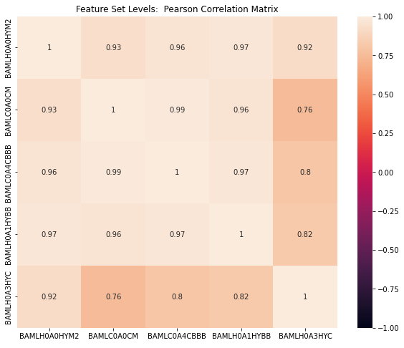
Pearson correlation OAS Daily Levels
High degree of positive correlation between all the feature set variable

Slide 12
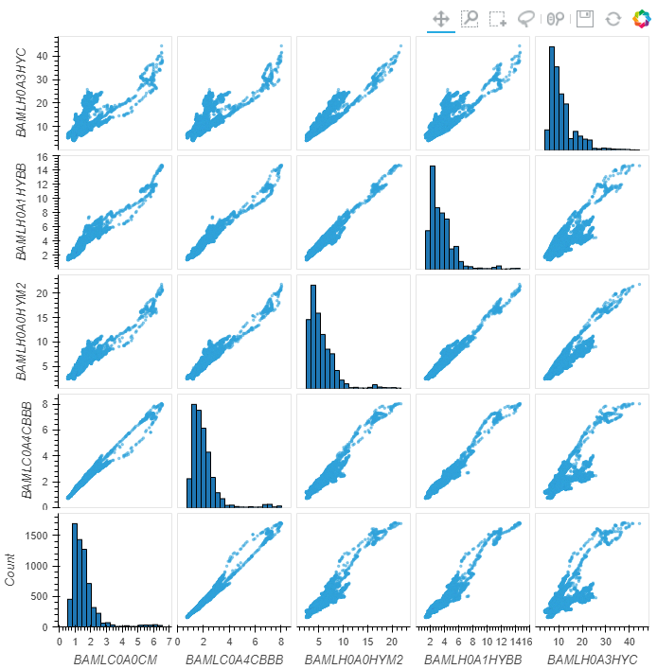
Scatter matrix OAS daily Levels
Using the hvplot.scatter_matrix() plotting function helps confirm that some linear relationship may exist between the feature set variables

Slide 13
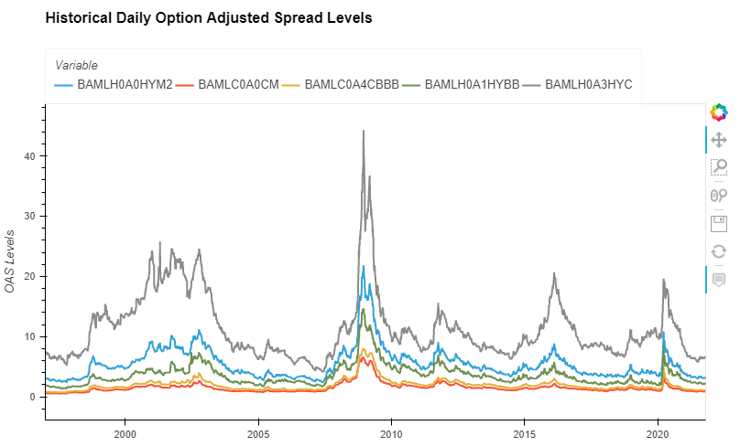
OAS daily Levels Time series
A simple line plot for OAS Levels also reveals some time dependent relationship between feature set levels

Slide 14
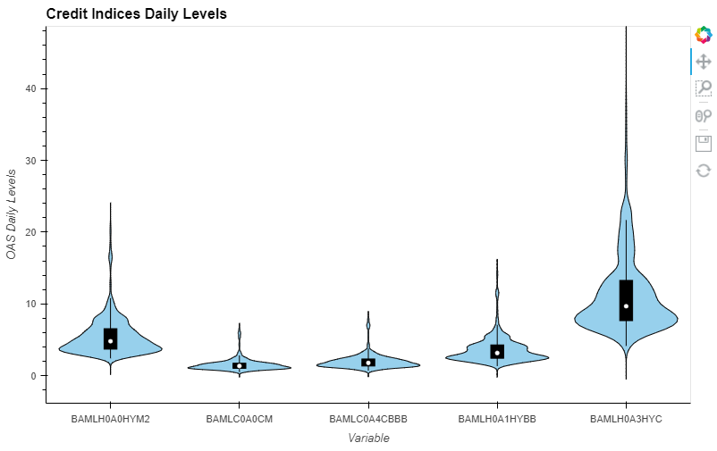
Box blots OAS daily Levels
Using hvplot.violin() allows for a visual description of the distribution (mean, max, min, standard deviations, quartile ranking)

Slide 15
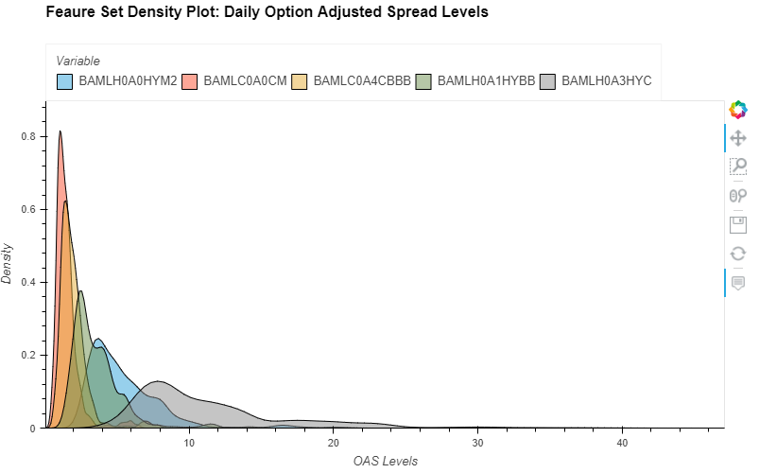
Density plot OAS daily Levels
Using hvplot.kde () also allows for a visual description of the distribution

Slide 16
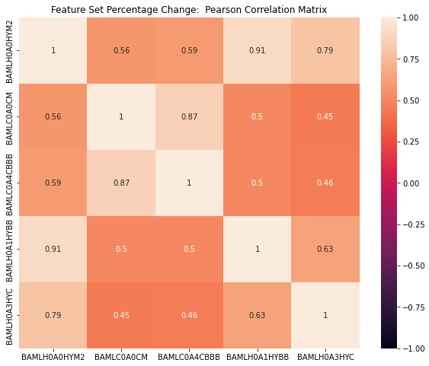
Pearson correlation OAS daily Percentage Change
Transforming the data set by using daily percentage changes helps reduce the correlation between feature set variables

Slide 17
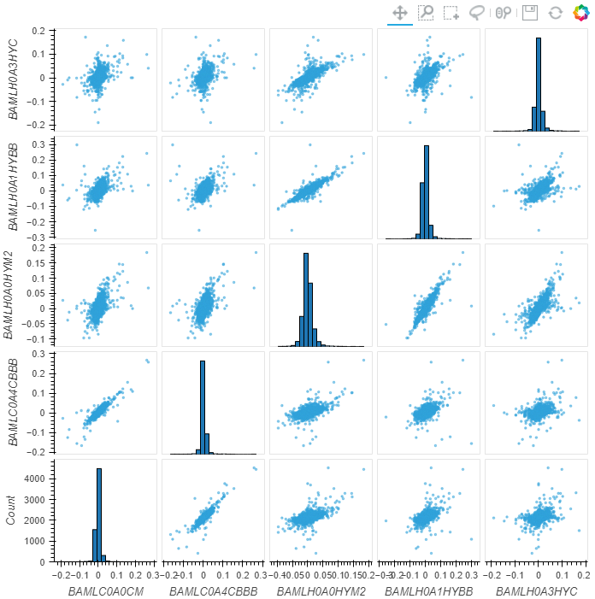
Pearson correlation OAS daily Percentage Change
hvplot.scatter_matrix() helps to visually confirm that transforming the relationship between feature set variables

Slide 18
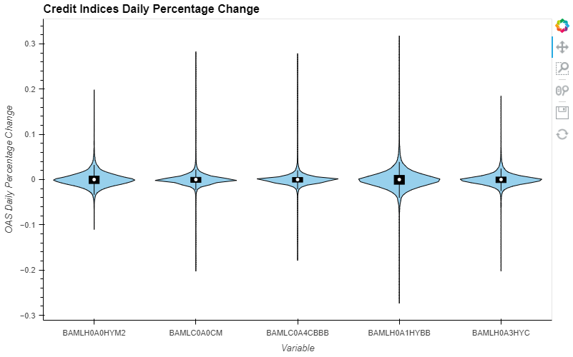
Box blots OAS daily percentage change
Using hvplot.violin() allows for a visual description of the distribution (mean, max, min, standard deviations, quartile ranking)

Slide 19
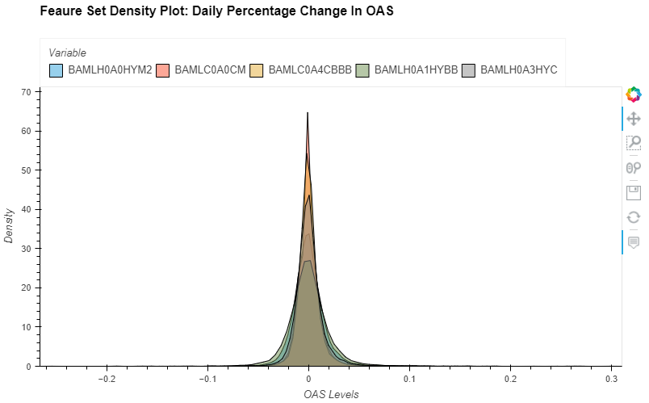
Density plot OAS daily percentage change
Using hvplot.kde () also allows for a visual description of the distribution

Slide 20
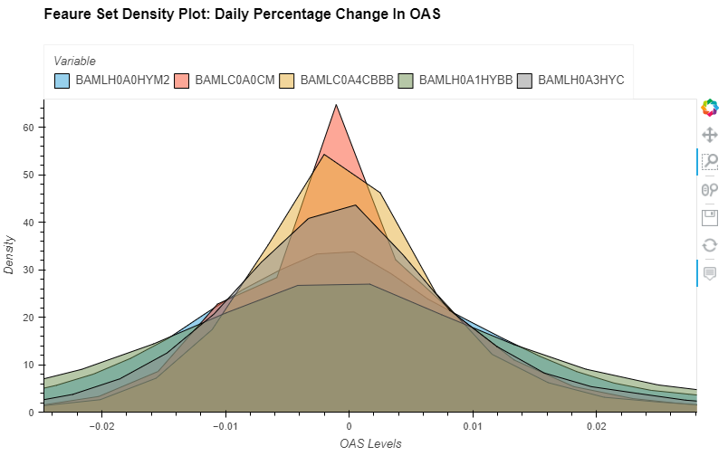
Density plot OAS daily percentage change
Using the ‘box zoom’ widget allows us to inspect plot areas of interest: CENTRE DENSITY OF DISTRIBUTION

Slide 21
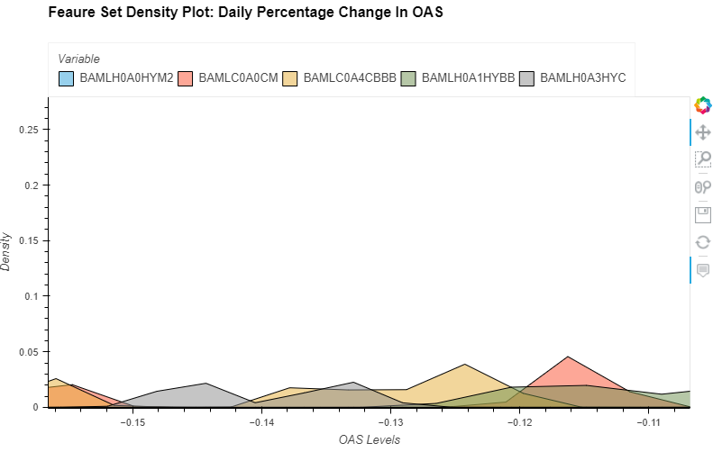
Density plot OAS daily percentage change
Using the ‘box zoom’ widget allows us to inspect plot areas of interest: LEFT TAIL OF DISTRIBTION

Slide 22
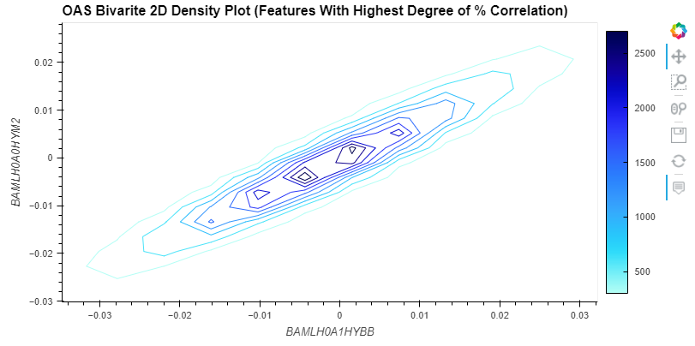
BIVARIATE 2D DENSITY PLOT OAS daily percentage change
hvplot.bivariate() is a statistical method for creating a 2D density plot. Bivariate plots can be a useful alternative to scatter plots if your data are too dense to plot each point individually.

Slide 23
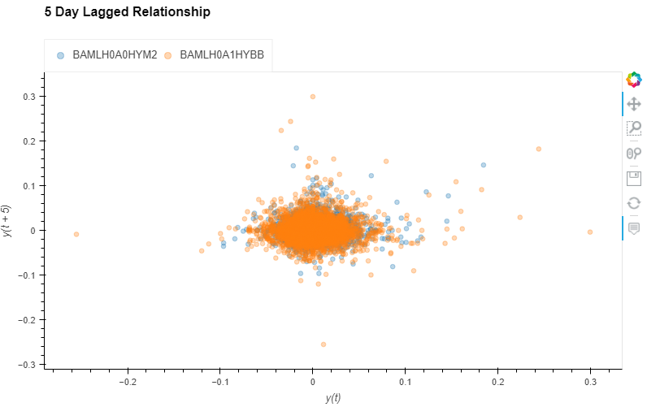
Lagged relationships OAS daily percentage change
Lag plots are used to check if a data set or time series is random and random data should NOT exhibit any structure in the lag plot.

Slide 24
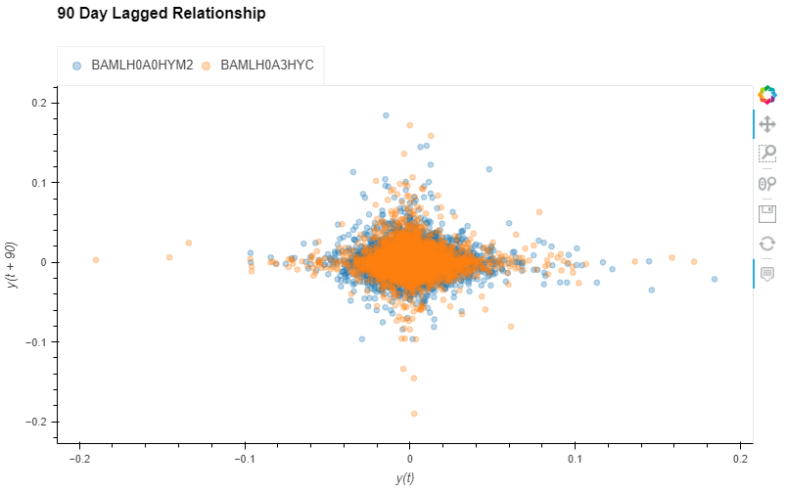
Lagged relationships OAS daily percentage change
hvplot.lag_plot() function was used to understand if potential lag relationships exist

Slide 25
Random Forest Classifier Model review

Slide 26
Random forest classifier models
They are supervised learning models
Like its name implies, it consists of a large number of individual decision trees that operate as an ensemble.
Each individual tree in the random forest provides a class prediction and the class with the most votes becomes our model’s prediction.
The fundamental concept behind random forest is a simple but powerful one — the wisdom of crowds.
In data science speak, the reason that the random forest model works so well is:
A large number of relatively uncorrelated models (trees) operating as a committee will outperform any of the individual constituent models.
The low correlation between models is the key.
https://towardsdatascience.com/understanding-random-forest-58381e0602d2

Slide 27
Bagging (Bootstrap aggregation)
Decisions trees are very sensitive to the data they are trained on
small changes to the training set can result in significantly different tree structures.
Random forest takes advantage of this by allowing each individual tree to randomly sample from the dataset with replacement, resulting in different trees.
This process is known as bagging.
We end up with trees that are not only trained on different sets of data (thanks to bagging) but also use different features to make decisions

Slide 28
Finance analogy
Just like how investments with low correlations come together to form a portfolio that is greater than the sum of its parts, uncorrelated models can produce ensemble predictions that are more accurate than any of the individual predictions.
The holy grail is to build a bunch of uncorrelated models, each with a positive expected return, and then put them together in a portfolio to earn alpha
Random Forest is the data science equivalent of that.
The reason for this wonderful effect is that the trees protect each other from their individual errors (as long as they don’t constantly all err in the same direction).
While some trees may be wrong, many other trees will be right, so as a group the trees are able to move in the correct direction.

Slide 29
Random forest classifier models
So the prerequisites for random forest to perform well are:
There needs to be some actual signal in our features so that models built using those features do better than random guessing.
The predictions (and therefore the errors) made by the individual trees need to have low correlations with each other.

Slide 30
Random forest classifier models
Random forest algorithm can be used for both classifications and regression task.
It provides higher accuracy through cross validation.
If there are more trees, it won’t allow over-fitting trees in the model.
It has the power to handle a large data set with higher dimensionality
https://www.newgenapps.com/blogs/random-forest-analysis-in-ml-and-when-to-use-it-2/

Slide 31
Optimized parameters
N_estimators
n_estimators represents the number of trees in the forest.
Usually the higher the number of trees the better to learn the data.
However, adding a lot of trees can slow down the training process considerably
max_depth
max_depth represents the depth of each tree in the forest.
The deeper the tree, the more splits it has and it captures more information about the data.
min_samples_split
min_samples_split = min number of data points placed in a node before the node is split
This can vary between considering at least one sample at each node to considering all of the samples at each node.
When we increase this parameter, each tree in the forest becomes more constrained as it has to consider more samples at each node.
max_features
max_features represents the number of features to consider when looking for the best split.

Slide 32
RandomizedSearchCV Cross validation
The technique of cross validation (CV) is best explained by example using the most common method, K-Fold CV.
When we approach a machine learning problem, we make sure to split our data into a training and a testing set.
In K-Fold CV, we further split our training set into K number of subsets, called folds.
We then iteratively fit the model K times, each time training the data on K-1 of the folds and evaluating on the Kth fold (called the validation data).
As an example, consider fitting a model with K = 5.
The first iteration we train on the first four folds and evaluate on the fifth.
The second time we train on the first, second, third, and fifth fold and evaluate on the fourth.
We repeat this procedure 3 more times, each time evaluating on a different fold.
At the very end of training, we average the performance on each of the folds to come up with final validation metrics for the model.
https://towardsdatascience.com/hyperparameter-tuning-the-random-forest-in-python-using-scikit-learn-28d2aa77dd74

Slide 33
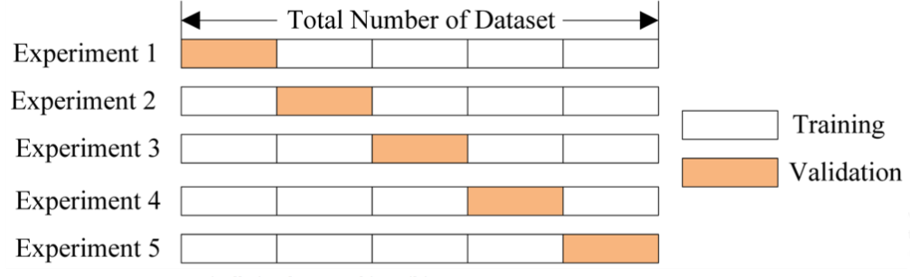
Cross validation example
https://towardsdatascience.com/hyperparameter-tuning-the-random-forest-in-python-using-scikit-learn-28d2aa77dd74

Slide 34
Research & testing approach

Slide 35
Defining time periods
Training Period Start Date = October 25, 2011
Sufficient feature set data exists that allows for using lagged values that align with this training start date
Training Period End Date = December 14, 2018
Held constant for all in-sample testing
Testing Period Start Date = December 15, 2018
Held constant for all in-sample testing
Testing Period End Dates was varied to allow for average model parameters to be calculated when using RandomizedSearchCV to determine model parameters
Range between October 1, 2021 to October 15, 2021
Lagged time frames range from 1 Day to 90 Days
Forward Test Start Date = Monday, October 18, 2021

Slide 36
Creating baseline comparisons
A “Naïve Approach” to setting the Random Forest Classifier parameters
n_estimators = 500
max_depth = 5,000
max_features = 'auto‘
Of note the use of ‘auto‘ does introduce some issues in replicating results
Future enhancements will better control for this parameter
An “Optimal Approach” to setting the Random Forest Classifier parameters
This fits within the world of Model Optimization
RandomizedSearchCV from sklearn.model_selection library along with the associated best_params_ method were used to obtain the following model parameters for each of the lagged periods
'max_depth': list(range(9, 6001))
'max_features': list(range(1,6)),
'n_estimators': list(range(1,1001)),
'min_samples_split': list(range(1,51))
scoring='accuracy‘ and cv_value = 5 were used for the RandomSearchCV
The mean value for the resulting best_params_ across all lags were then calculated based on results for October 1, 2021 to October 15, 2021, inclusively

Slide 37
Creating baseline comparisons
These optimized parameters were then used to once again train and test the model for the periods between October 1, 2021 to October 15, 2021, inclusively
The objective was to determine which lag produces the highest expected annual return
Mean Model Parameter Values used for this analysis and across all lags
n_estimators = 477
min_samples_split = 31
max_features = 3
max_depth = 2,988
The lagged period that produced the highest expected annual return for the above period was deemed the ideal lag for forward testing
A 30 Day lag produced the highest expected annual return for the in-sample period
The ‘Naïve Model’ followed a similar approach when determining which lag should be used for forward testing purposes
n_estimators = 500, max_depth = 5,000, max_features = 'auto‘
A 27 Day lag produced the highest expected annual return for the in-sample period

Slide 38
In-Sample Approach Summary
In-Sample Testing
Testing End Date | Lags
Friday, October 1, 2021 | 90
Monday, October 4, 2021 | 90
Tuesday, October 5, 2021 | 90
Wednesday, October 6, 2021 | 90
Thursday, October 7, 2021 | 90
Friday, October 8, 2021 | 90
Monday, October 11, 2021 | 90
Tuesday, October 12, 2021 | 90
Wednesday, October 13, 2021 | 90
Thursday, October 14, 2021 | 90
Friday, October 15, 2021 | 90
Total Model Versions | 990
990 Naïve Lagged Model Versions Based On In-Sample Data
Use the same Naïve Model Parameters for all lags
The lagged version that produced the highest annual return expectation over this period was selected for forward testing
990 Optimal Lagged Model Versions Based on In-Sample Data
Iterative approach
Use RandomizedSearchCV & the best_params_ method to determine Random Forest Classifier parameter settings for each lag on each day in period
Calculate the mean parameter value, across all lags, for each of the following parameters
max_depth, max_features, n_estimators, and min_samples_split
Train and Test each lag on each in-sample testing date using the mean parameter values
Calculate each lags mean annual return during the in-sample testing period
Select the lag that produced the highest expected annual return during the in-sample testing period

Slide 39
Creating baseline comparisons
Although the current objective is Annual Return, additional performance and risk statistics were also calculated for future use and for different objectives (i.e. Highest Shape Ratio)
pyfolio is a Python library for performance and risk analysis of financial portfolios
The ‘empyrical’ library allows for accessing the risk and performance measures, which allows for flexibility in structuring code, as compared to their ‘tear sheet’
empyrical.annual_return(algo_performance_series),
empyrical.annual_volatility(algo_performance_series),
empyrical.sharpe_ratio(algo_performance_series),
empyrical.calmar_ratio(algo_performance_series),
empyrical.max_drawdown(algo_performance_series),
empyrical.sortino_ratio(algo_performance_series),
empyrical.alpha(algo_performance_series,Equity_performance_series),
empyrical.beta(algo_performance_series,Equity_performance_series)

Slide 40
In-Sample Approach Summary
Optimal Model Example: Mean Annual Return Highest for Feature Lag 30 During In-Sample Testing Period
PeriodEndDate | Lag | n_estimators | max_depth | max_features | Annual Return | Annual Volatility | Sharpe Ratio | Calmar Ratio | Max Drawdown | Sortino Ratio | Alpha | Beta
1-Oct-21 | 30 | 477 | 2988 | 3 | 29.723% | 19.018% | 1.464 | 1.805 | -16.468% | 2.235 | 0.126 | 0.702
4-Oct-21 | 30 | 477 | 2988 | 3 | 29.675% | 19.005% | 1.463 | 1.802 | -16.468% | 2.233 | 0.129 | 0.701
5-Oct-21 | 30 | 477 | 2988 | 3 | 29.627% | 18.992% | 1.462 | 1.799 | -16.468% | 2.232 | 0.126 | 0.700
6-Oct-21 | 30 | 477 | 2988 | 3 | 29.580% | 18.978% | 1.461 | 1.796 | -16.468% | 2.230 | 0.125 | 0.700
7-Oct-21 | 30 | 477 | 2988 | 3 | 29.532% | 18.965% | 1.459 | 1.793 | -16.468% | 2.229 | 0.123 | 0.700
8-Oct-21 | 30 | 477 | 2988 | 3 | 29.401% | 18.952% | 1.455 | 1.785 | -16.468% | 2.222 | 0.122 | 0.700
11-Oct-21 | 30 | 477 | 2988 | 3 | 29.021% | 18.945% | 1.440 | 1.762 | -16.468% | 2.198 | 0.121 | 0.700
12-Oct-21 | 30 | 477 | 2988 | 3 | 28.862% | 18.933% | 1.434 | 1.753 | -16.468% | 2.189 | 0.121 | 0.700
13-Oct-21 | 30 | 477 | 2988 | 3 | 28.980% | 18.921% | 1.440 | 1.760 | -16.468% | 2.198 | 0.121 | 0.700
14-Oct-21 | 30 | 477 | 2988 | 3 | 28.934% | 18.907% | 1.439 | 1.757 | -16.468% | 2.197 | 0.116 | 0.699
15-Oct-21 | 30 | 477 | 2988 | 3 | 29.234% | 18.898% | 1.452 | 1.775 | -16.468% | 2.217 | 0.117 | 0.699
Mean Values |  |  |  |  | 29.324% | 18.956% | 1.452 | 1.781 | -16.468% | 2.216 | 0.122 | 0.700

Slide 41
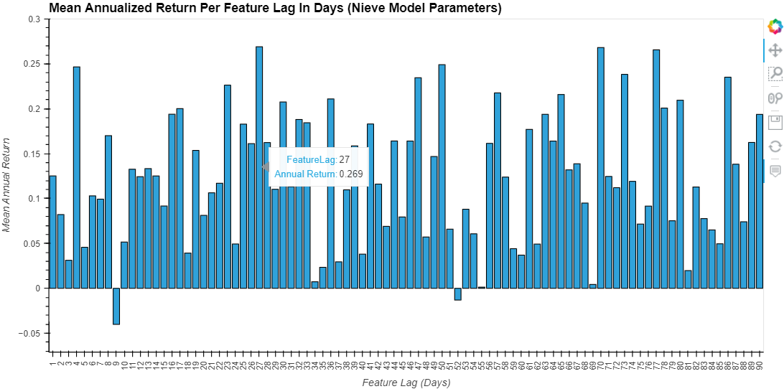
Creating baseline comparisons

Slide 42
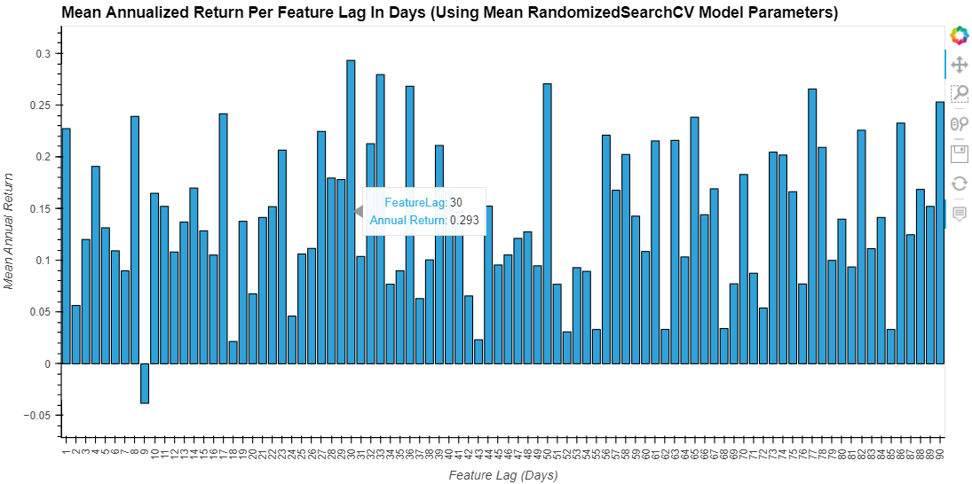
Creating baseline comparisons

Slide 43
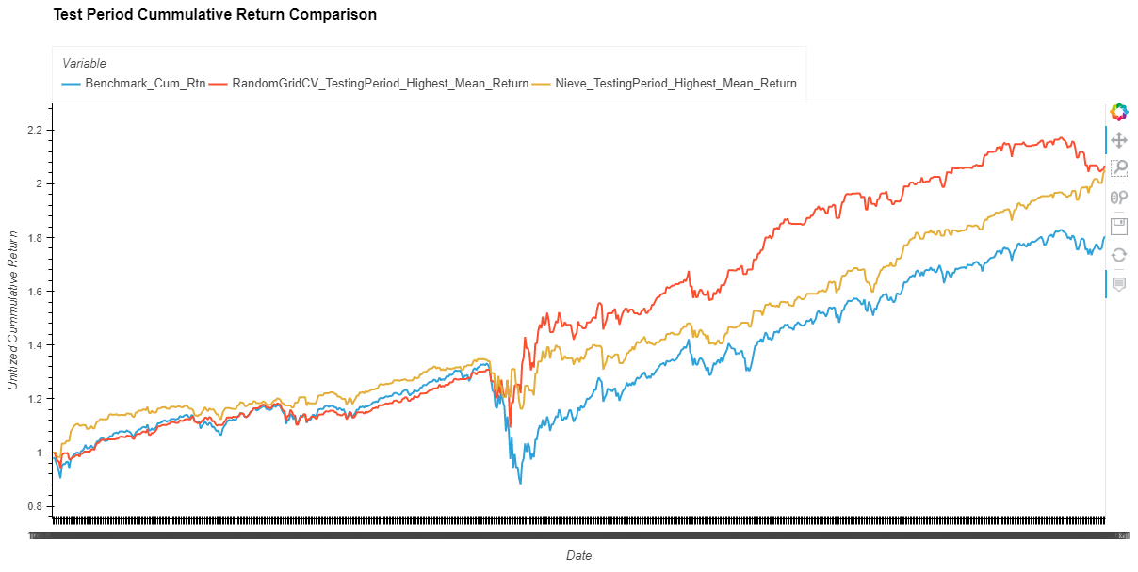
In-sample return path
Aids in understanding the return path taken to earn the cumulative return
Optimal Model Cumulative Return = 106.81%
Naïve Model Cumulative Return = 105.25%
Equity Buy-and-Hold Cumulative Return = 80.46%

Slide 44
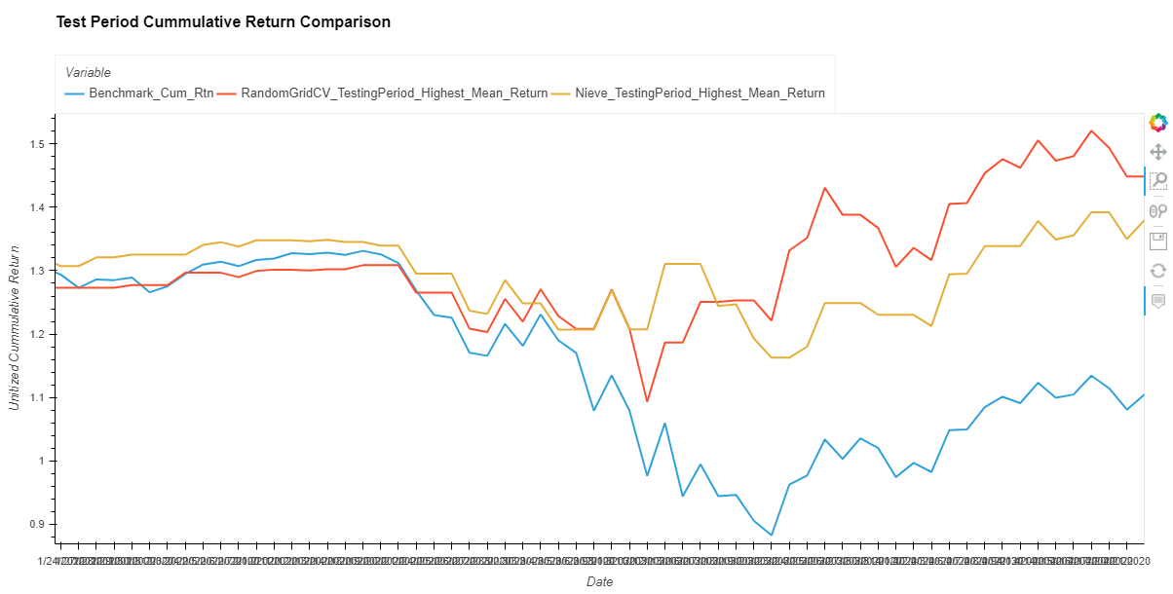
In-sample downside comparison

Slide 45
Optimal model feature importance
Gini Importance or Mean Decrease in Impurity (MDI) is the default RFC criterion setting
criterion{“gini”, “entropy”}, default=”gini”
The function to measure the quality of a split.
Supported criteria are “gini” for the Gini impurity and “entropy” for the information gain.
It calculates each feature importance as the sum over the number of splits (across all tress) that include the feature, proportionally to the number of samples it splits.
In scikit-learn, it is sometimes called “gini importance” or “mean decrease impurity”
Defined as the total decrease in node impurity weighted by the probability of reaching that node averaged over all trees of the ensemble.
At each split in each tree, the improvement in the split-criterion is the importance measure attributed to the splitting variable, and is accumulated over all the trees in the forest separately for each variable.
Feature importance are provided by the fitted attribute feature_importances_ and they are computed as the mean and standard deviation of accumulation of the impurity decrease within each tree.
https://scikit-learn.org/stable/modules/generated/sklearn.ensemble.RandomForestClassifier.html
https://medium.com/the-artificial-impostor/feature-importance-measures-for-tree-models-part-i-47f187c1a2c3

Slide 46
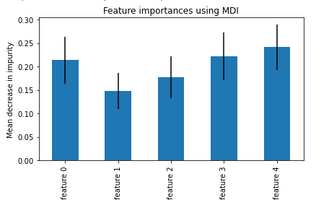
Optimal model feature importance
The blue bars are the feature importance of the forest, along with their inter-trees variability represented by the error bars.
The gold highlighted features that follow appear to have a greater level of importance, justifying a another model approach the less important features are dropped
Feature 0 Index: ICE BofA US High Yield Index Option-Adjusted Spread (BAMLH0A0HYM2)
Expected as HY captures a greater amount of credit risk
Feature 1 Index: ICE BofA US Corporate Index Option-Adjusted Spread (BAMLC0A0CM)
Expected as this is a broader index with higher rated names
Feature 2 Index: ICE BofA BBB US Corporate Index Option-Adjusted Spread (BAMLC0A4CBBB)
Unexpected as BBB was expected to capture a sufficient amount of credit risk
Feature 3 Index: ICE BofA BB US High Yield Index Option-Adjusted Spread (BAMLH0A1HYBB)
Expected as BB is still below investment grade and expected to capture a sufficient level of credit risk
Feature 4 Index: ICE BofA CCC & Lower US High Yield Index Option-Adjusted Spread (BAMLH0A3HYC)
Expected as BB is still below investment grade and expected to capture a sufficient level of credit risk

Slide 47
Potential over-fitting
The “.score” method can be used to obtain the training and testing period score
The score represents the mean accuracy during the respective training and testing periods
Optimal RFC Model accuracy during training period: 0.8709
Optimal RFC Model accuracy during testing : 0.5686
Given the material decline in accuracy score during the testing period, evidence exists that over-fitting may introduce issues with the model during the Forward Test Period (out-of-sample testing)

Slide 48
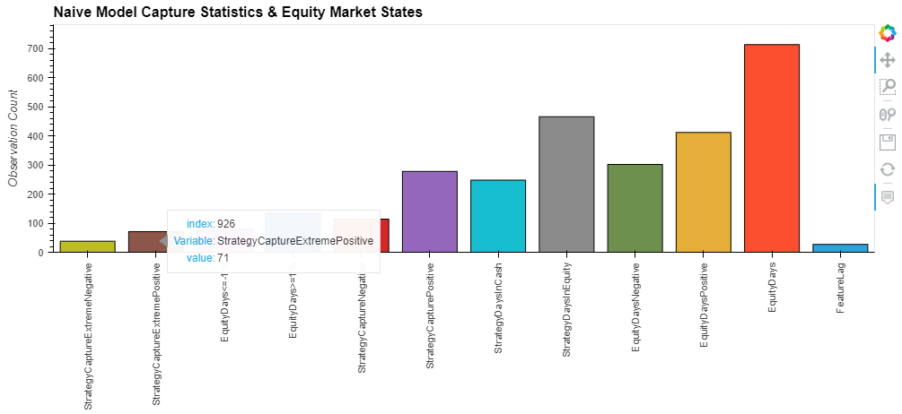
Development phase
The above represents Naïve Model capture and Equity Market state statistics (in-sample)
Purpose of this analysis is to understand whether the strategy contains any biases in different market states
The analysis compliments the return path analysis
For example, the Naïve Strategy was invested in the equity market on 71 days where the market experienced a return greater than or equal to 1%

Slide 49
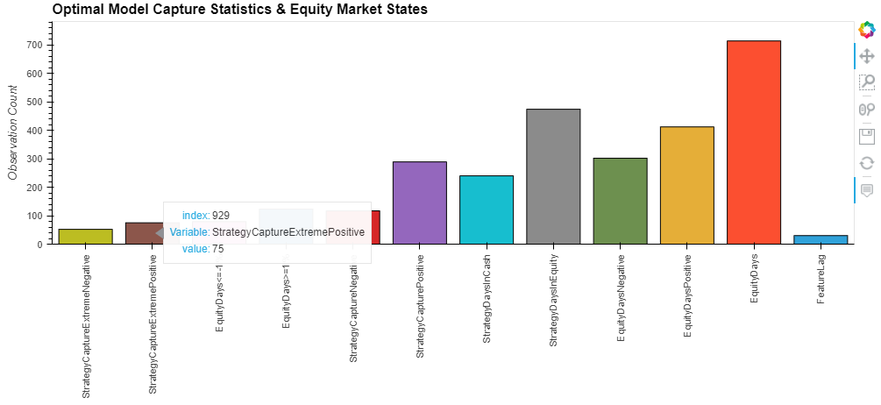
Development phase
The above represents Optimal Model capture and Equity Market state statistics (in-sample)
For example, the Optimal Strategy was invested in the equity market on 75 days where the market experienced a return greater than or equal to 1%
These statistics are calculated for all Naïve & Optimal Models, including the different lagged versions

Slide 50
Forward test results

Slide 51
Save finalized model
Every version of the lagged models were saved using the joblib library
from joblib import dump, load
Naïve Model with a 27 Day lag & Optimal Model with a 30 Day lag were selected for forward testing purposes
Each delivered the highest expected annual return during the test period
Recall that each model uses different model parameters (noted earlier)
The October 15, 2021 models were saved and forward testing started on Monday, October 18, 2021

Slide 52
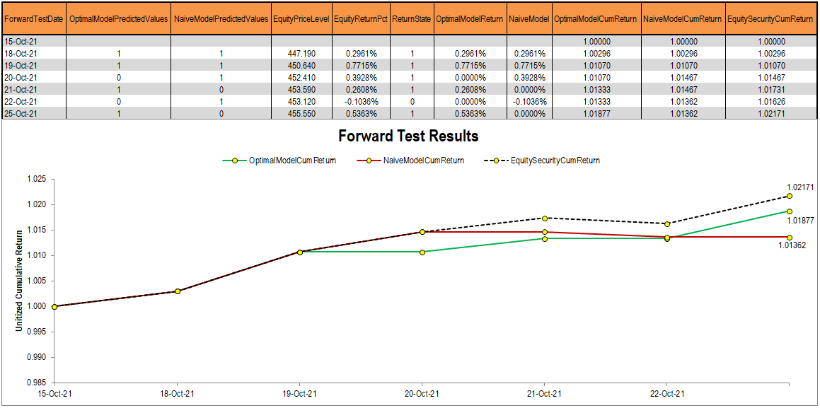
Naïve & Optimal Predictions
Let the forward test battle begin!
1 = Positive Market State & 0 = Flat or Negative Market State
Long Equity or Long Cash Strategy

Slide 53
Post mortem & future enhancements

Slide 54
Post mortem & future enhancements
Develop a more robust averaging period to determine optimal RFC parameters
Calculate mean RFC parameters across different dimension
Each lags’ own test history averages rather than average across all lags
Better control for Naïve RFC parameter settings
Explicitly state all the Naïve parameter settings to ensure reproducibility of results
It is believed that the max_features = 'auto‘ created these issues
Use findings from feature set analysis and feature importance to reduce the feature set
Feature 0 Index: ICE BofA US High Yield Index Option-Adjusted Spread (BAMLH0A0HYM2)
Feature 3 Index: ICE BofA BB US High Yield Index Option-Adjusted Spread (BAMLH0A1HYBB)
Feature 4 Index: ICE BofA CCC & Lower US High Yield Index Option-Adjusted Spread (BAMLH0A3HYC)

Slide 55
Thank you for your attention!

Slide 56
Appendix B
Alpha (α)
A term used in investing to describe an investment strategy's ability to beat the market
Alpha is thus also often referred to as “excess return” or “abnormal rate of return,” which refers to the idea that markets are efficient, and so there is no way to systematically earn returns that exceed the broad market as a whole.
Alpha is often used in conjunction with beta
Beta (β)
A measure of the volatility – or systematic risk – of a security or portfolio compared to the market as a whole.
For beta to be meaningful, the stock should be related to the benchmark that is used in the calculation.
Gaining market exposure via the State Street Global Advisor SPDR S&P 500 ETF Trust (SPY)
Standard Deviation
A measure of how much an investment's returns can vary from its average return.
It is a measure of volatility and, in turn, total risk.
Finding out the standard deviation as a measure of risk can show investors the historical volatility of investments.
The higher the standard deviation, the more volatile or risky an investment may be.
Sharpe Ratio
The Sharpe ratio was developed by Nobel laureate William F. Sharpe and is used to help investors understand the return of an investment compared to its risk.
The ratio is the average return earned in excess of the risk-free rate per unit of volatility or total risk.

Slide 57
Appendix B
Drawdown (DD) & Maximum Drawdown (MDD)
A maximum drawdown (MDD) is the maximum observed loss from a peak to a trough of a portfolio, before a new peak is attained.
Maximum drawdown is an indicator of downside risk over a specified time period.
It can be used both as a stand-alone measure or as an input into other metrics such as "Return over Maximum Drawdown" and the Calmar Ratio.
Maximum Drawdown is expressed in percentage terms.
Calmar Ratio
The Calmar ratio is a gauge of the performance of investment funds such as hedge funds and commodity trading advisors (CTAs).
It is a function of the fund's average compounded annual rate of return versus its maximum drawdown.
The higher the Calmar ratio, the better it performed on a risk-adjusted basis during the given time frame
Sortino Ratio
The Sortino ratio is a variation of the Sharpe ratio that differentiates harmful volatility from total overall volatility by using the asset's standard deviation of negative portfolio returns—downside deviation—instead of the total standard deviation of portfolio returns.
The Sortino ratio takes an asset or portfolio's return and subtracts the risk-free rate, and then divides that amount by the asset's downside deviation.

