Slide 1

Team #9 Team Name: Les Musiciens Game Name: Da Capo al Fine (To Repeat from the Beginning to the End) Leader: William Harper Artist: Duo (Doris) Xu Programmers: Kevin Hartline, Inna Limjoco

Slide 2
Remix:
Story-driven RPG/ Platformer
Goals:
Rules:
Feedback:
Solve the mystery
Solve the puzzles to pick up items needed to advance
After completion, rewarded with a music sheet (contains flashback)

Slide 3
Core Aspects:
Extras:
Explore the isometric overworld
Solving puzzles to advance
Completing platforming segments
Cutscenes, music, stuff like that

Slide 4
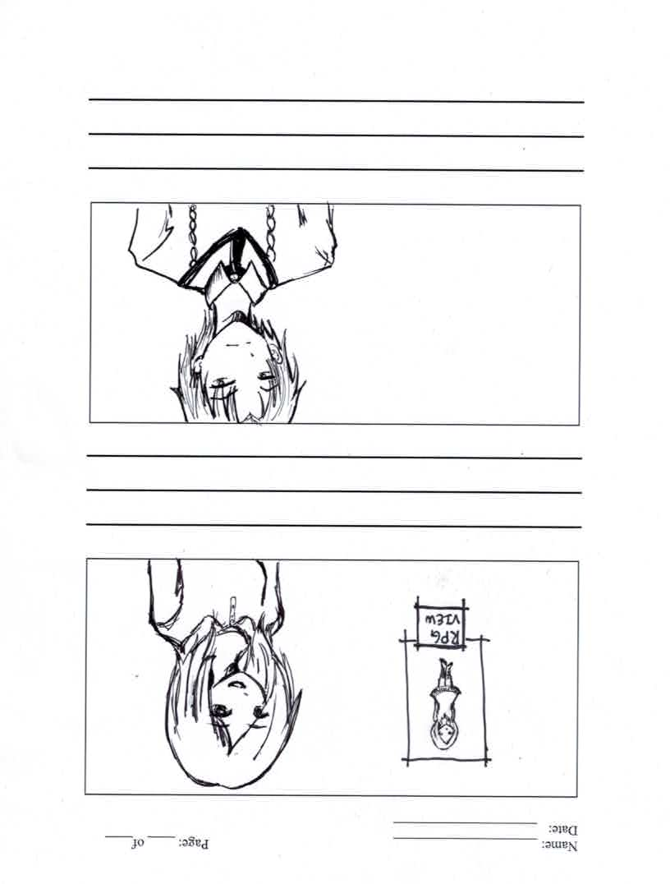
Girl
(Player)

Slide 5
Guy
(NPC)

Slide 6
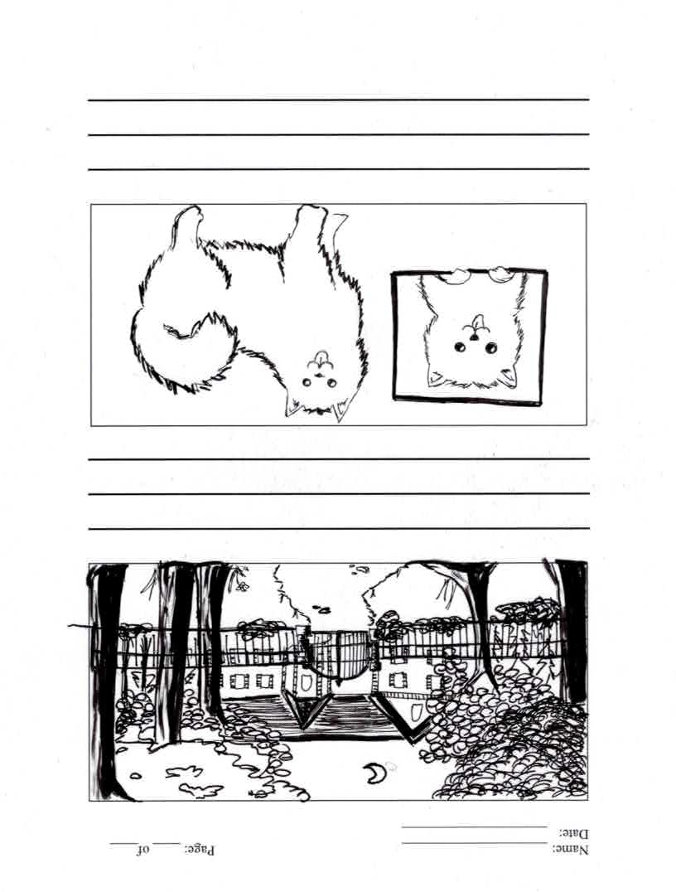
Approach to the Manor
(Opening Cutscene Frame)

Slide 7
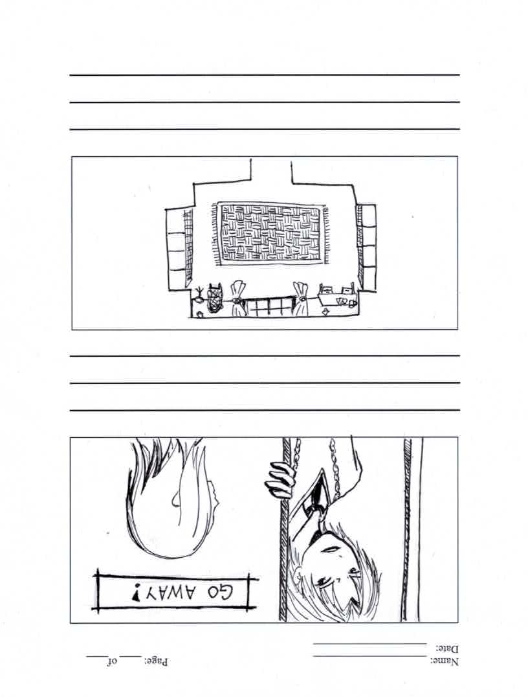
Conversation at the Door
(Opening Cutscene Frame)

Slide 8
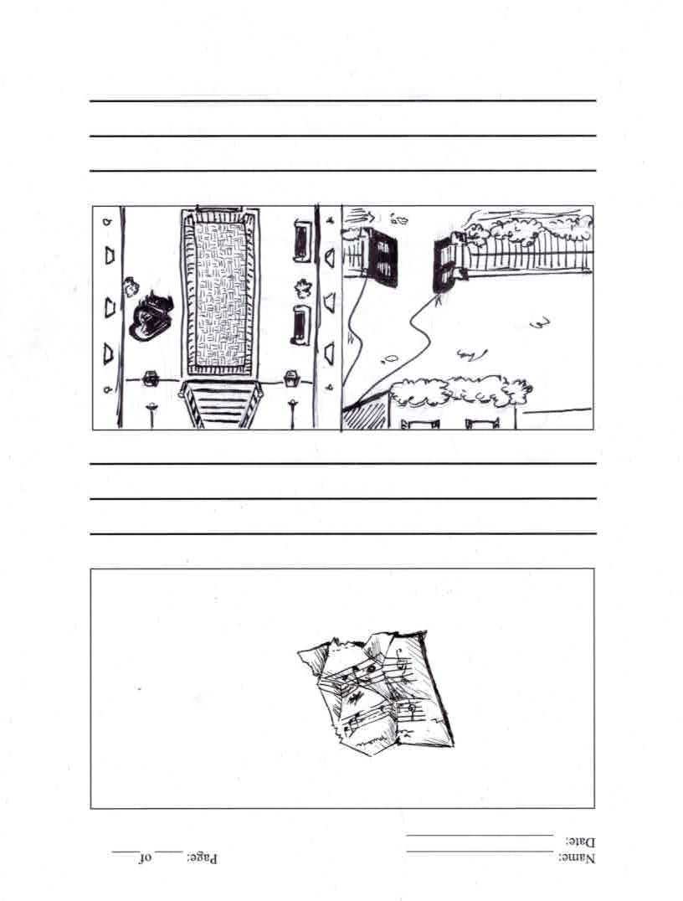
Music Sheet
(Pickup)

Slide 9
Manor
(Isometric Overworld)

Slide 10
Study room/library
(1st Platforming Level)

Slide 11
Cheerful Dog
(NPC)

