Slide 1
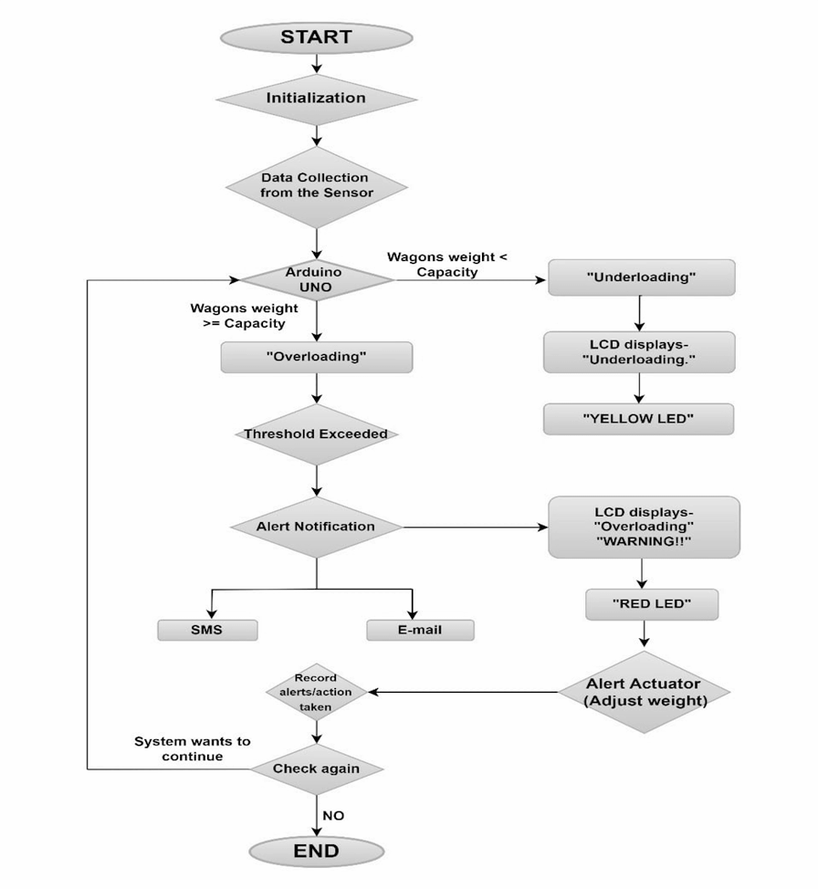

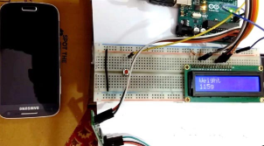
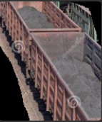
IOT based Automated Handling
FLOW CHART
MODUS OPERANDI
Weight sensor, also called load cell senses the weight placed in the wagon and supplies an electrical analog voltage to HX711 Load Amplifier Module. It is a 24 bit ADC, which amplifies and digitally converts the output. This amplified value is fed to Arduino. The microcontroller stores the ideal capacity of the wagon which is compared with the detected weight. Hence, it determines if the wagon is underused or overloaded and accordingly writes the same on the LCD as well as activating the right LED (red, yellow, or green). The LCD will output the status of the wagon (“underloaded”, “overloaded”, or “normal”) and the detected weight. In addition to this, an application is also developed that will inform the user of the status of each wagon via SMS or email.
Origin of Research Problem
Coal India Limited supplies coal to consumers through railway sidings. Wagons at such sidings often results in overloading or underloading. During 2021-22, the expense for under-loading was nearly Rs.593 Cr. whereas the contract for wagon loading itself was only Rs.276 Cr.
Technology stack
APPLICATIONS
Software:
Front-end ~ XML
Back-end ~ Java and Python
Firmware: Arduino IDE version 2.2.1
Hardware: Arduino UNO Board, Embedded Python, Weight sensor, Amplifier, LCD, 3 Leds and Bluetooth
Improves the transparency in railway department and lowers the maintenance on railway tracks.
Can be used in handling goods in various transportation means like cargo aircrafts, freighters, trailers etc.
Can be used in check posts (toll plaza) as well as managing weight control in Elevators, Escalators etc.
OVERLOADING
EXPERIMENTAL SETUP
UNDERLOADING
Conclusion
Automated Handling allows wagon worker to work efficiently without any error.
It also prevents high expense that are in crores , saves government’s capital which can be utilised somewhere else without getting waste in Railway Sidings.

