Slide 1
Event Manager
Prototyping Project
Luca Bosin

Slide 2
Contents
Project Description
Entity-Relationship-Model
Endpoints

Slide 3
Project Description
Goal
Create a web platform where event managers can create new events and guests can sign up to participate.
Subgoals
Keep accessibility in mind
Keep search engines in mind
Adhere to REST semantics

Slide 4
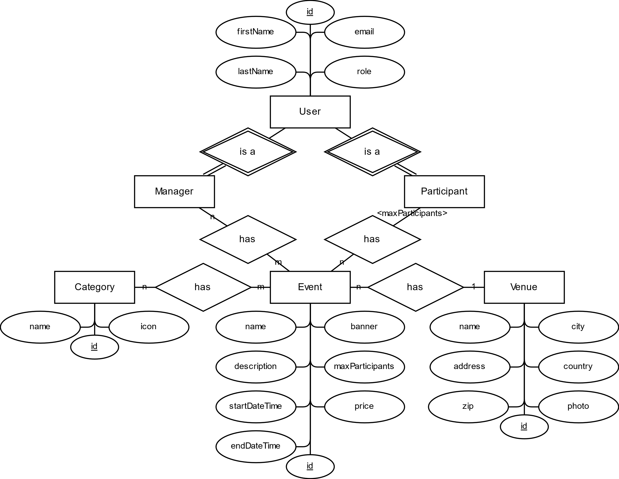
Entity-Relationship Model

Slide 5
Endpoints
 | Events | Venues | Users | Categories
Frontend-Endpoints | 5 | 4 | 2 | 0
Form-Action-Endpoints* | 2 | 2 | 2 | 0
API-Endpoints GET POST PUT DELETE | 5 2 1 1 1 | 5 2 1 1 1 | 3 2 1 0 0 | 1 1 0 0 0
* POST- Endpoint

Slide 6
Events
Endpoints
Frontend-Endpoints
/events List upcoming and past events
/events/new Create an event
/events/{id} View details of an event
Creates an n:n- Relationship
/events/{id}/edit Modify an event
/events/{id}/signup Sign up for an event
/ List logged in users’ events and all upcoming events
/venues/{id} List all events at a venue

Slide 7
Events
Endpoints
API-Endpoints Get, create, modify or delete events
GET
/events Get all events
POST
/events Create an event
GET
/events/{id} Get an event by its ID
PUT
/events/{id} Modify an event by its ID
DELETE
/events/{id} Delete an event by its ID

Slide 8
Venues
Endpoints
Frontend-Endpoints
/venues List all venues (incl. total number of upcoming events)
/venues/new Create a venue
/venues/{id} View details of a venue (incl. list of all upcoming events)
/venues/{id}/edit Modify a venue

Slide 9
Events
Endpoints
API-Endpoints Get, create, modify or delete venues
GET
/venues Get all venues
POST
/venues Create a venue
GET
/venues/{id} Get a venue by its ID
PUT
/venues/{id} Modify a venue by its ID
DELETE
/venues/{id} Delete a venue by its ID

Slide 10
Users
Endpoints
Frontend-Endpoints
/login List all users and log in to a user account
/register Create a user account
/[any] List all users in the navbar’s user account dropdown
/events/{id} List all users participating at an event
/events/{id}/signup Sign a user up as a participant of an event

Slide 11
Users
Endpoints
API-Endpoints Get or create users
GET
/users Get all users
POST
/users Create a user
GET
/users/{id} Get a user by its ID

Slide 12
Categories
Endpoints
Frontend-Endpoints
none This entity type does not have its own pages
/events Filter events by categories
/events/{id}/edit Specify the categories of an event

Slide 13
Categories
Endpoints
API-Endpoints Get categories
GET
/categories Get all categories

Slide 14
Implementation
Let’s jump right into the demo!
> and then //the code!

