Slide 1

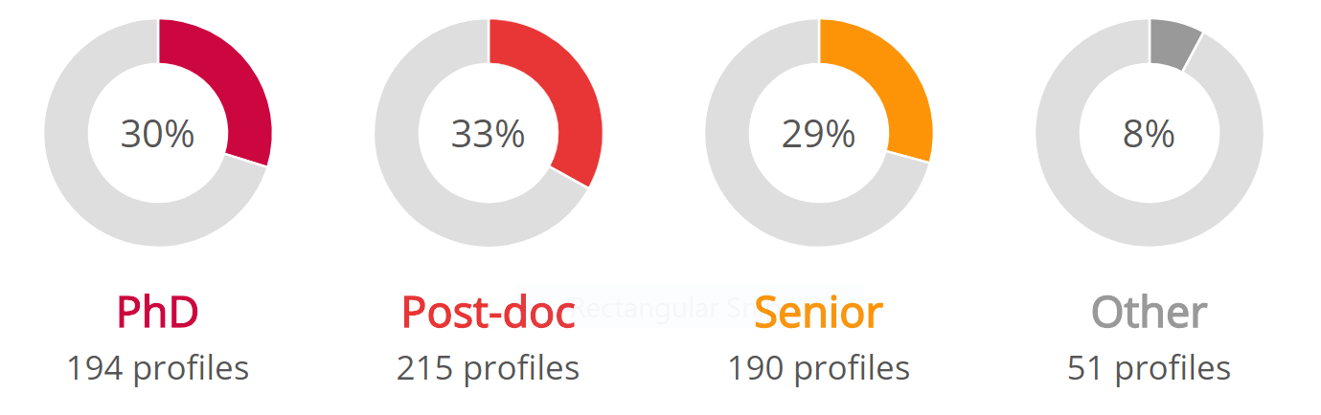
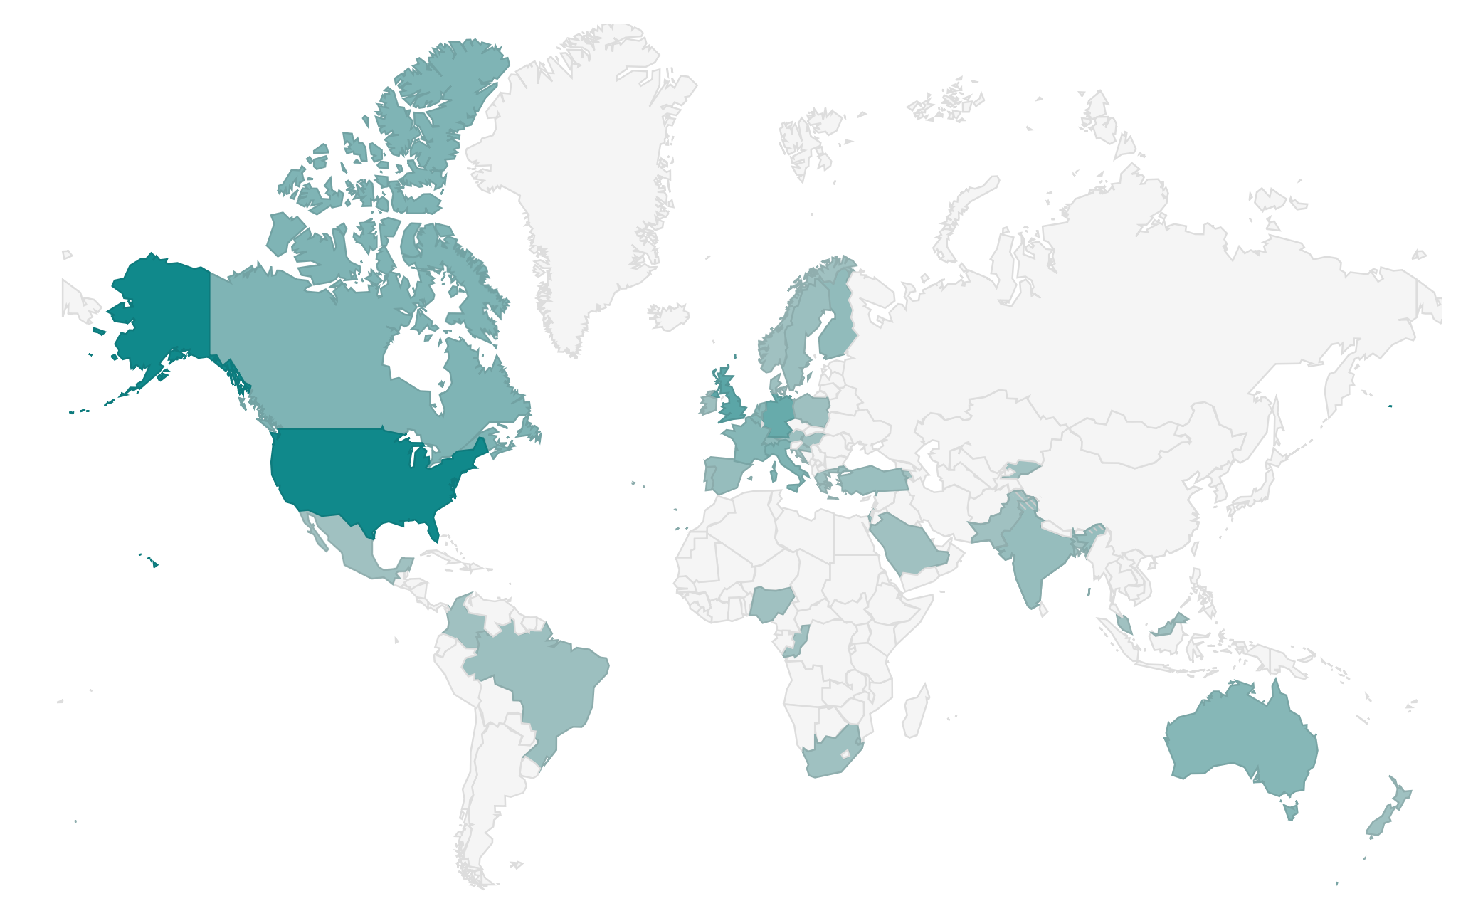


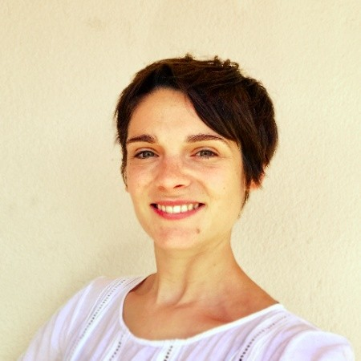



- www.winrepo.org - over 700 profiles - easy search - recommendations
Repository for women in neuroscience
Support us:
sign up
spread the word
submit recommendations

