Slide 1
Jump Into JavaScript
Learn the FUNdamentals

Slide 2

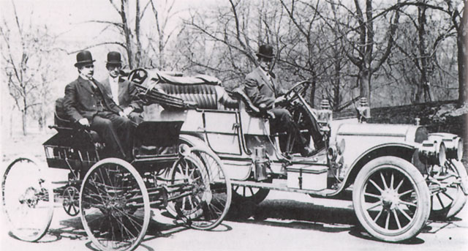
So lets start at the beginning…
Notes:
A little history and basic mechanics for what browsers do: (anyone can learn to drive a car … designing or building takes a little more know how)
Netscape vs. Microsoft IE
JavaScript wars
Standardization through ECMAScript (European Computer Manufacturers Assoc.)
Latest is ECMAScript 6 and browsers are all trying to implement these latest features
https://caniuse.com
Babel transpiler

Slide 3
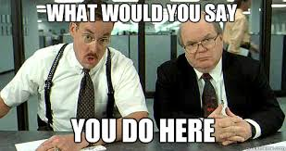
So what does your browser do?

Slide 4
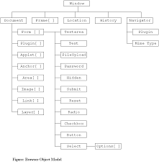
Creates a Window Object
Goes out and follows the address / URI / URL you entered
Takes the resources that come back and parses / deciphers them
Creates an object in memory that represents those resources
Applies all of the styles and special instructions it was given

Slide 5
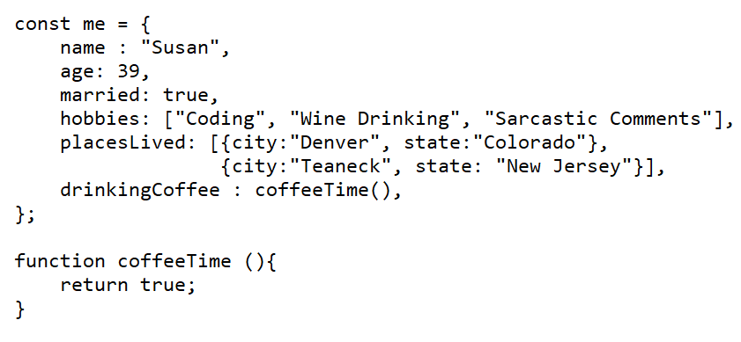
What is an object?
A series of key : value pairs wrapped in brackets
Can hold values (properties)
Can hold functions (methods)
Can hold primitive data types
Can hold other objects
Notes:
Primitives … String, Symbol, Number, Boolean, Undefined, NULL
Objects … Arrays, functions, object literals

Slide 6
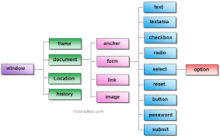
Window Object has: - properties - methods Some of those properties are nested objects … like document
Notes:
window.location.href
window.location.href = ‘https://www.womenintechallies.com/’
window.history.back()
-Events
-Document
-Console
- All of your HTML elements are objects in the node list of your document object
JavaScript is a language to interact with our window object

Slide 7
Declaring Variables & Variable Scope
Variables are saved values (Primitive) or references to saved values (Object)
If you create a variable in your code outside of any function it is placed on the “window” object and has “global scope”
If you create a variable in your code within a function it has “functional scope” and is hoisted to the beginning of the function (so you can use it before it is declared)
If you create a variable with “let” or “const” within a function it will have “block scope” and be defined within the code block it is created and from where they are created onwards.

