Slide 1
GIT & GITHUB
--Sowjanya Mudunuri

Slide 2
What and why?
GIT is a Version Control System
Created by Linus Torvalds to maintain the Linux Kernel
Handles small to large projects
Its open source
Powerful branching and merging capabilities
Other alternatives : CVS, Perforce, SCM.

Slide 3
States of Files in GIT
Committed: Safely stored in your local database
Modified: file is changed but not committed
Staged: modified file that is marked to go into next commit
Untracked: Files not in the staging area and new
Notes:
Remember that each file in your working directory can be in one of two states: tracked or untracked. Tracked files are files that were in the last snapshot; they can be unmodified, modified, or staged. Untracked files are everything else — any files in your working directory that were not in your last snapshot and are not in your staging area. When you first clone a repository, all of your files will be tracked and unmodified because you just checked them out and haven’t edited anything.

Slide 4
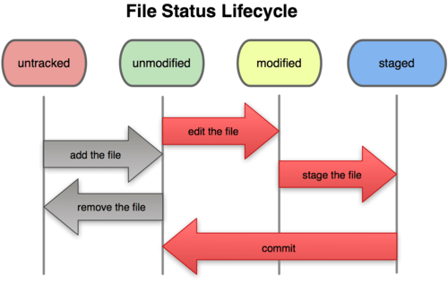
GIT Workflow

Slide 5
GIT Workflow
Modify/create files in your working directory
Stage the file in the staging area
Commit the files in the staging area so they are permanently stored
Notes:
As you edit files, Git sees them as modified, because you’ve changed them since your last commit. You stage these modified files and then commit all your staged changes, and the cycle repeats. This lifecycle is illustrated in Figure 2-1.

Slide 6
After Install and Setup
Initialize a repository in an existing Directory
$ git init
Clone an existing repository.
$ git clone <path_to_the_existing_repo>
Cloning gets a copy of an existing repository
Check the state of your files( staged/unstaged/untracked )
$ git status

Slide 7
Git commands
Adding new/modified files to staging area
$ git add <file_name>
$ git add –p
$ git add .
$ git add –A
What you have changed but not yet staged
$ git diff
What you have changed that is staged
$ git diff --cached

Slide 8
Git commands
Committing the changes in staging area
$ git commit
$ git commit –m “message”
Amend a previous commit
$ git commit –amend
Removing a file from git
$ git rm <file_name>
Renaming/moving a file
$ git mv file_from file_to
Notes:
Committing means taking snapshots of the changes and putting it as a record.

Slide 9
Git commands
Viewing the commit history
$ git log
Unstaging a staged file
$ git reset HEAD <file_name>

Slide 10
Exercise Time !

Slide 11
References
http://git-scm.com/

