Slide 1
PYTHON LAB
Matplotlib
Women Who Code – DC Chapter

Slide 2
We are Women Who Code!
Women Who Code (WWC) is global non-profit dedicated to inspiring women to excel in technology careers. We work to support this generation in being and becoming leaders and role models in the tech industry.
We are the DC Chapter!
Volunteer / Donate
Visit our Meetup site
Python Beginners: 1st Wednesday of the Month; Python Hack Night: 3rd Wednesday of the month
NOTE: All Python Lab meetups are developed for beginners

Slide 3
We are Women Who Code!
Women Code of Conduct Women Who Code (WWCode) is dedicated to providing an empowering experience for everyone who participates in or supports our community, regardless of gender, gender identity and expression, sexual orientation, ability, physical appearance, body size, race, ethnicity, age, religion, socioeconomic status, caste, or creed.
Our events are intended to inspire women to excel in technology careers, and anyone who is there for this purpose is welcome. Because we value the safety and security of our members and strive to have an inclusive community, we do not tolerate harassment of members or event participants in any form. Our Code of Conduct (http://bit.ly/wwcode-code-of-conduct) applies to all events run by Women Who Code, Inc. If you would like to report an incident or contact our leadership team, please submit an incident report form (http://bit.ly/wwcode-incident-form).

Slide 4
What is Python?
Powerful scripting language that offers simplicity and flexibility
Easy to learn syntax
Used in simple and complex programming
Has a large family of libraries to support a variety of science, math, and engineering applications
The Python community provides a variety of tools for common applications.
Scripts well in various codes: Java, Fortran, C#, SQL, Perl,HTML,Lisp, PHP
Integrates well in various Applications – ESRI ArcGIS, desktop based apps, YouTube, DropBox, NASA scientific work, game development, GUI, Excel, R Studio,
Interfaces well with all commercial major databases
“Glue it all together with Python”
Notes:
Scripts well in various programs/projects – ESRI ArcGIS, web development, Linux OS, desktop based apps, YouTube, DropBox, NASA scientific work, Game development, GUI development

Slide 5
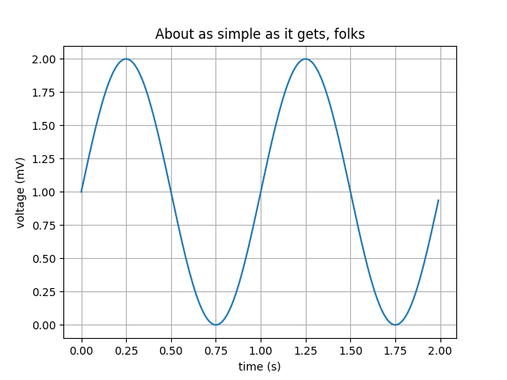
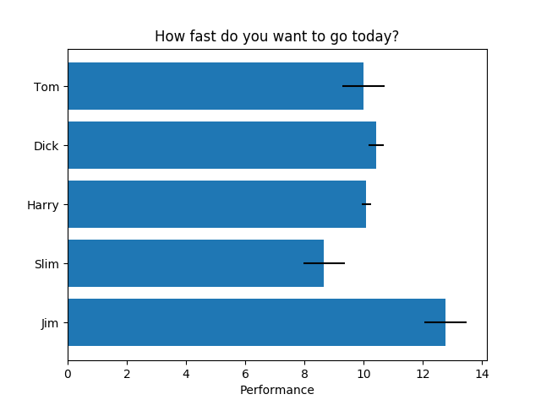
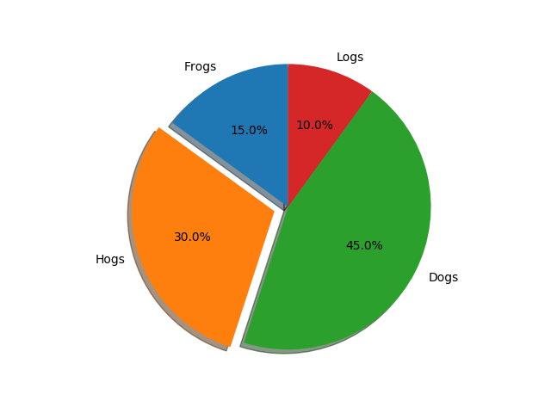
Matplotlib
What is it?
Python 2D plotting library which produces publication quality figures
Users can create plots such as scatter plots, line graphs, and bar graphs.
Resources: https://matplotlib.org/index.html
Resour

Slide 6
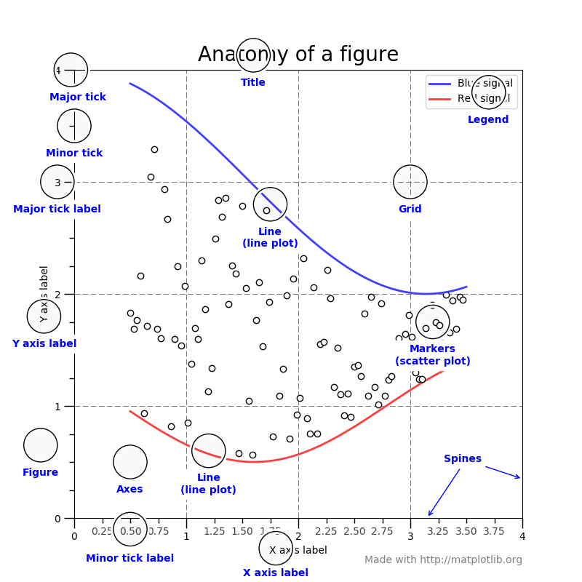
Matplotlib

