Slide 1

Mock Behavioral Interview
Notes:
Good Evening everyone. Thank you for joining us on a Thursday evening for the launch Mock Behavioural Interview program which is an initiative by Women Who Code London to help and support our members at acing behavioural interviews. We have an action packed agenda for you.
Before I start today’s session full disclaimer that I am here in my personal capacity and I am not representing my current or previous employers.
Agenda:
First 30mins going through :
What behavioural interviews are?
Why are they important?
Introduction to the STAR technique of answering behavioural questions
Sample Answers
Then we will have a breakout sessions for 20mins :
Where Irina is going to help us in set up breakout rooms which will be lead by our 5 volunteers – Adrianna, Antra, Ayla, Maria and Stephanie
During this time you will have the opportunity to practice answering behavioural questions with a small group of people. It would be helpful if you have a pen and paper by your side during the breakout session.
And the last 10 mins will be for Q and A.

Slide 2

Your Purpose
What would make this program worthwhile for you?
What information do you need?
What do you want to learn?
What do you want to practice?
What resources are available?
How much time can you allocate?
Notes:
I would like to start this session by requesting participants to take a minute and really think what is your purpose today.
And once you have the purpose defined, you will find the program much more engaging and probably feel less distracted on a Thursday evening ready to kick-start the weekend.
Another way of asking the question is : (refer to slide)

Slide 3
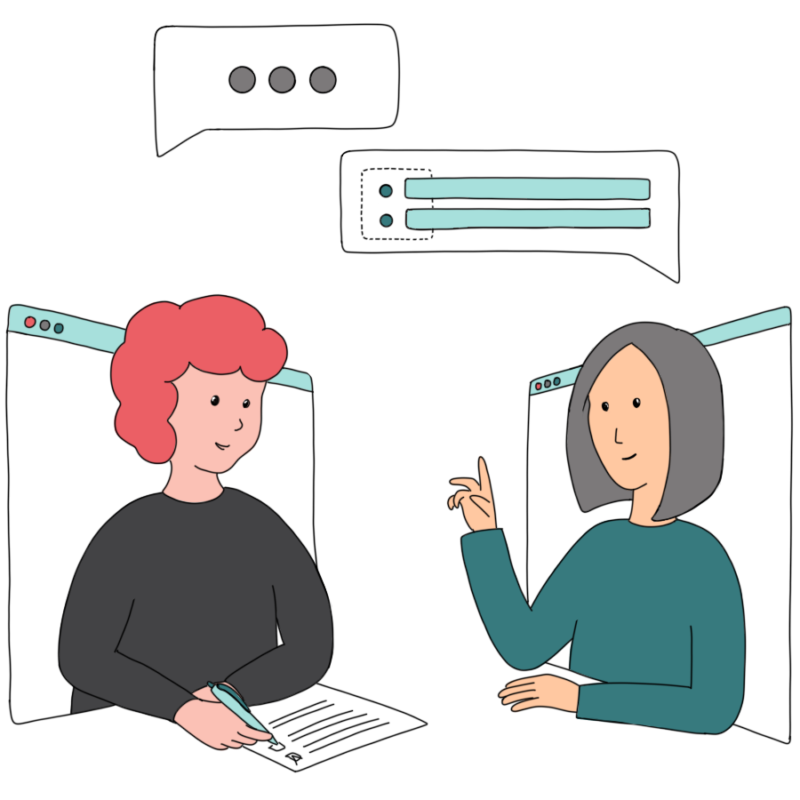

WWCode London Organizes 2 Projects
Mock Interviews
Resume Clinic
Notes:
WWC organizes 2 projects – Mock Interviews and Resume Clinic
Today – we are going to be focus on the behavioural interview questions specifically.
We will be conducting mock technical interviews at a later stage but today’s focus is on behavioural interviews.

Slide 4
Behavioral Interview Questions
What?
Questions about how you behaved in the past?
They begin with phrases such as : “Tell me about a time when…” and “Give me an example when…”
Why?
Proven way to reveal a person’s potential, specifically their ability to adapt, grow, collaborate, prioritize, lead, and strengthen company culture
Notes:
What?
- Strong, Persuasive, Behavioural interviewing skills. These skills are totally transferable across various industries and roles.
Why is this section so important because people usually prepare well for technical interviews and the truth is the behavioural interview part often gets overlooked. And it’s a huge lost opportunity. You are leaving too much upto chance if you are not preparing for this part.
A lot of the times you will be asked questions like - Tell me a time when you had a conflict with your co-worker and how did you resolve it? Now its very difficult to come up with a story on the spot. And stories are something that people will remember. You see there is no magic here – with the right tools, framework and mindset you can absolutely knock your behavioural interviews out of the park.
Why?
From an interviewers perspective, these questions allow them ascertain if you have the behaviours and the experience they are looking for. And these qualities can be difficult to determine from your resume. They cover areas like leadership, handling conflict, failure, team working, problem-solving, working under pressure and overcoming setbacks.
Now from your perspective as the person being interviewed , they allow you to let your past work performance show what you could do for this employer. They also give you the opportunity to differentiate your self from other candidates applying for the same role. Add some examples :

Slide 5
Sample Questions
Tell me about a time when you demonstrated leadership?
Tell me about a time when you had a problem and you had to go through several hoops to discover the root cause.
Tell me about a time when you had a disagreement with your manager.
Tell me about a time you went above and beyond what was expected to wow a customer?
Resources:
WWCode – London Github Repository

Slide 6



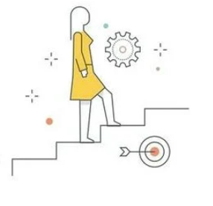

STAR Method
(Prepare)
Listen to the question and think of an event.
Result
Close with the result of your efforts.
Situation
Describe the event or situation you were in.
Task
Explain the task you had to complete.
Action
Describe the specific actions you took to complete the task.
Notes:
The STAR method is an interview technique that gives you a straightforward format you can use to tell a story by laying out the Situation, Task, Action, and Result.
Situation: Set the scene and give the necessary details of your example. Describe the context within which you performed a job or faced a challenge at work. For example, perhaps you were working on a group project, or you had a conflict with a coworker. This situation can be drawn from a work experience, a volunteer position, or any other relevant event. Be as specific as possible. Avoid using cliché beginnings such “This one time” and “Once upon a time”
Task: Next, describe your responsibility in that situation. Perhaps you had to help your group complete a project within a tight deadline, resolve a conflict with a coworker, or hit a sales target. Share details of the exact challenges and constraints that you had to face without exaggerating them.
Action: This step is probably the most important part of the story. You then describe how you completed the task or endeavored to meet the challenge. Focus on what you did, rather than what your team, boss, or coworker did. (Tip: Instead of saying, "We did xyx," say "I did xyz.")
Result: Finally, explain the outcomes or results generated by the action taken. It may be helpful to emphasize what you accomplished, or what you learned. If possible, quantify the results and show the effects of your actions. Examples saving your team five hours of work in a week, reducing 30% of manual effort required to complete a task. Can also be a negative result , especially if a failure, stress the lesson learned not the inability.
By using these four components to shape your anecdote, it’s much easier to share a focused answer, providing the interviewer with “a digestible but compelling narrative of what a candidate did,”

Slide 7
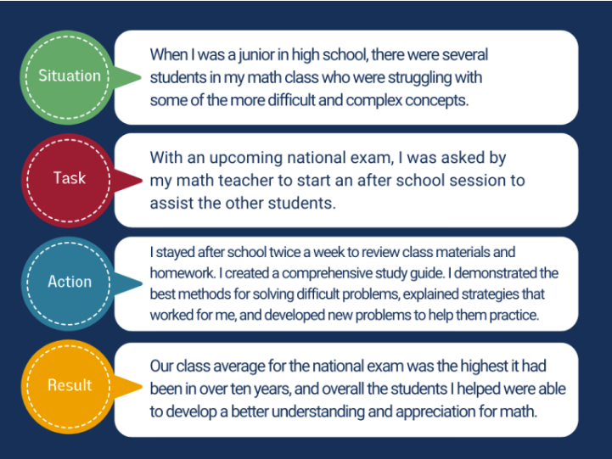
Sample Response
Tell me about a time when you demonstrated leadership?
Instead of responding simply with “I tutored kids in math” provide context for your interviewer and demonstrate your skills through an engaging example.
Notes:
Avoid using internal company specific technical jargon. Speak with clarity , try to use simple generic terms. If the interviewer knows about the subject they will ask for more information and then you can go deep into it.
You want to have a little bit of a story arc, you want to paint a picture and you want to make sure that you’re really sharing what you in particular did to contribute to the project , or the situation, right? Instead of falling back on the generic we, which I think some people and I think this might come from people who are a little bit on the modest side. Instead of saying “ I did this” or “I came up with this solution” , Its “Well we-we-we”
And sometimes it can get difficult , when you’re telling a story of a multi-month, or even year project, So you got to think about – Ok What are the highlights here? What are the key things I want to talk about? Ofcourse being prepared to give more information if there are follow up questions if they wany detail on certain things. So having a couple of bullet points
and then all of that leading up to the R the happy ending , every good story has a happy ending having some sort of +ve outcome. And this could be a concrete result, and often that’s very effective –being able to say we saved the company, X amount of dollars, or we increased revenue by X%. But sometimes it can anecdotal, like I got great feedback, everyone was really happy with the project, finishing under budget , before timelines, etc. Having a +ve outcome that you can speak to that gives it a nice story arc – a little bit of a hero’s journey from the beginning to the +ve outcome.
For any answer 1-2 mins is a sweet spot (U don’t want to spend 10mins ) as after 2 mins, you are going to start losing people even if you’re content is good. I think it’s just attention span , monologue vs dialogue, and hoping by the way you tell your story that you’ve given them some interesting things that they might want to dig more deeply into. I think its one of the things that people struggle with to keep it concise and engaging and still make sure that they’re giving information to show why this was a big success.
- Remember that many behavioral questions try to get at how you responded to negative situations; you'll need to have examples of negative experiences ready, but try to choose negative experiences that you made the best of or -- better yet, those that had positive outcomes.

Slide 8
Mock Interviews: Steps
Join the WWCode London #mock_interviews slack channel
Join slack channel
Join slack channel
Request Interview
Send a message in the slack channel providing required details
Accept Interview Request
Wait for the request to be confirmed by a interviewer
Accept request to conduct a mock interview
Prepare for the Interview
Attend Interview
Feedback
Monitor slack channel for incoming requests
Schedule Interview
Check preferred time with interviewer and schedule a 30mins meeting
Wait for meeting invite and accept invitation
Resources for candidates
Resources for interviewers
Attend the interview
Attend the interview
Complete Mock Behavioural interview feedback form
Complete Candidate Evaluation Feedback Form
Candidate
Interviewer

Slide 9
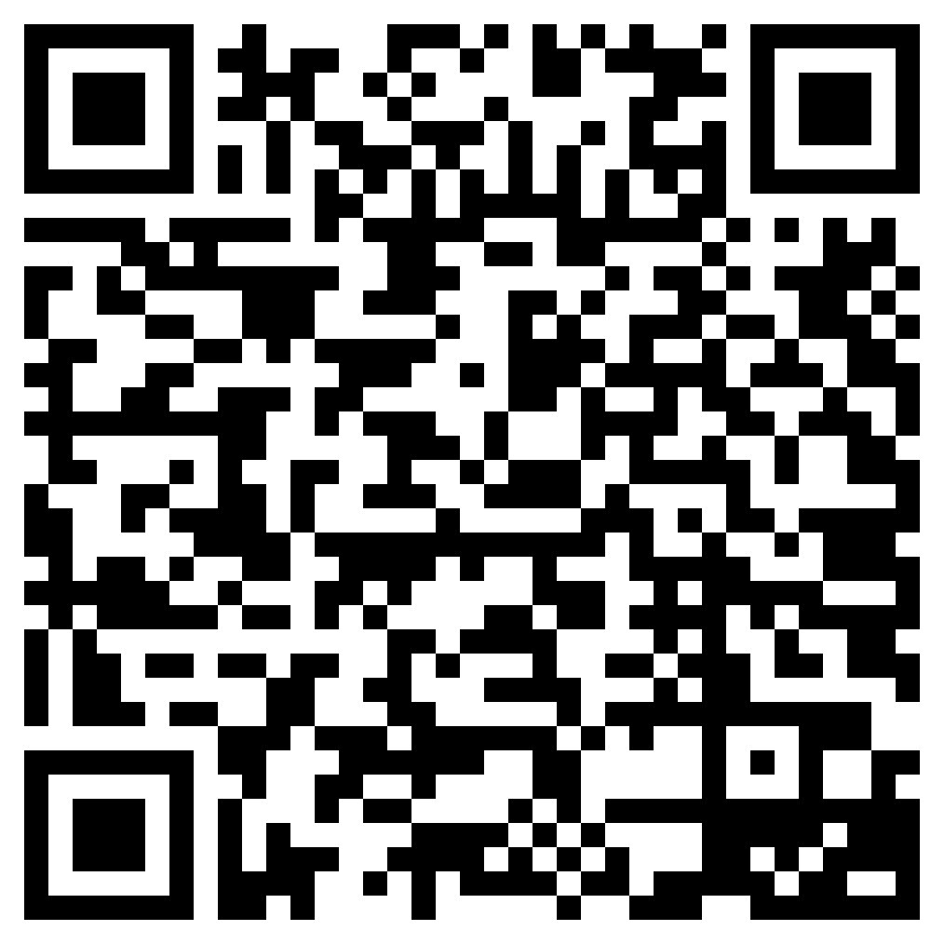

Resume Clinic
1
Post your resume in the Slack channel
Please, find channel #resume_clinic

Slide 10

Resume Clinic
2
All submissions will be reviewed by the experts.
Please, find channel #resume_clinic

Slide 11
Resources
LinkedIn : 30 Behavioral Interview Questions to Identify High Potential Candidates
MIT STAR Method for Behavioral Interviews
WWC-London Github Repo
Mock Interview Feedback Form
Candidate Evaluation Form

Slide 12
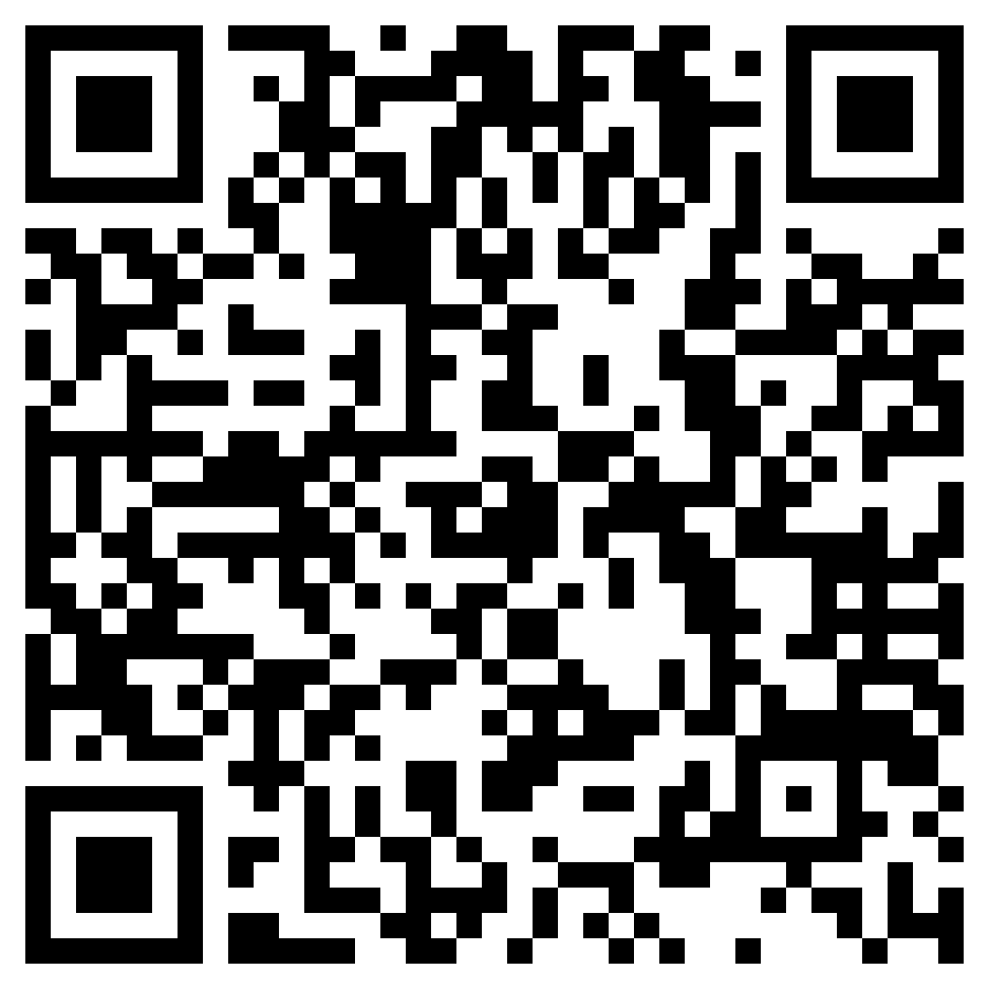
Resume Clinic
Please, find channel #resume_clinic
Mock Interviews
Notes:
I am going to close out.
Whatever kind of beginner you are, we hope this has given you a good starting point as you start to learn and improve your behavioural skills, where to ask questions and get help from the community.
Whatever you do embrace failures, and don't stop trying. Engage with others. Use your resources.
Like the famous quote from Benjamin Franklin - Tell me and I forget , Teach me and I may remember , Involve me and I learn.

