Slide 1
WomenWhoCode Meetup

Slide 2
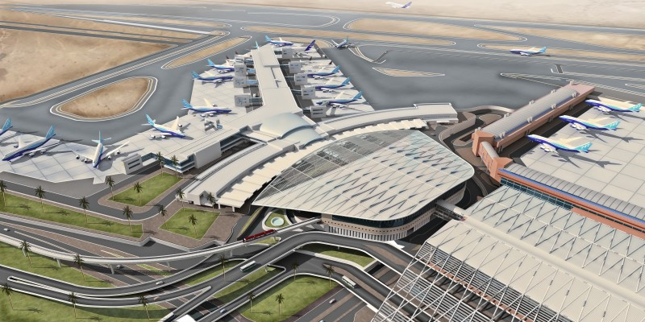
What a Computer is?

Slide 3
Operating System
Why there aren‘t any Made in China Microsoft Windows or MS Office or Mac?
What an OS is?
What are .exe files?

Slide 4
Programming Languages
Low Level Language
High Level Language

Slide 5
Low Level Language
CPU
Source
Code
Assembler
Machine
Language

Slide 6
High Level Language
Compiled
Intrepreted

Slide 7
C
Source
Code
Compiler
0111
Input
0111
Valar
Morghulis

Slide 8
Python
Source
Code
Intrepretor
Valar
Morghulis
Inputs

Slide 9
Python Interpretor
Python is a langage, Cpython is implementation of python in C.
Cpython Interpretor
Source
File.py
Output
Compiler
ByteCode
Dynamic Type Checking
Autoatic garbage collection

Slide 10
Difference between bytecode, machine code and assembly code.
Compiled Code Eg: Indian movie seen by subtitles in Russia
Interpreted Code Eg: Hindi being translated at runtime to Russian representative during meeting.

Slide 11
Just In Time Compiler
Source
Code
X =1
Y=2
f=x+y
p=f+a
q=f+b
print(f)
ptint(f)
ByteCode
JIT
Compiler
Interpretor
Uses machine code of f instead of interreting it from bytecode
Machine
code of f
Memory

