Slide 2
4 detected image corners
+
known tag size
+
camera calibration
↓
3D pose

Slide 3
Camera Calibration
Camera calibration teaches the program how your specific webcam turns real 3D rays into distorted 2D pixels.
Print calibration board
↓
Show board to webcam at many positions/angles
↓
Detect known board geometry
↓
Compare known geometry vs observed image points
↓
Estimate camera parameters
↓
Save calibration file
↓
Use those parameters later for AprilTag/ArUco 3D pose
Notes:
We calibrate each webcam once at the intended operating resolution. That calibration estimates the lens and camera projection characteristics. During tracking, we combine that calibration with the known physical marker size and detected marker corners to estimate 3D head pose.

Slide 4
Camera Calibration
Detection of ChArUco Boards
https://docs.opencv.org/3.4.20/df/d4a/tutorial_charuco_detection.html
A ChArUco board combines:
ChArUco board
↓
camera calibration
↓
camera_matrix + dist_coeffs
↓
├── ArUco 3D pose
└── AprilTag 3D pose
chessboard corners
+
ArUco marker IDs
ChArUco board
→ calibrates the CAMERA
AprilTag / ArUco head marker
→ tracks the PARTICIPANT
planned calibration utility uses a collection of roughly 15–25 useful views, rather than 15 nearly identical snapshots.

Slide 5
Camera Calibration
For ArUco:
For AprilTag:
ArUco detector
↓
4 ArUco corners
↓
shared pose estimator
↓
use camera_matrix + dist_coeffs
↓
x/y/z + yaw/pitch/roll
AprilTag detector
↓
4 AprilTag corners
↓
shared pose estimator
↓
use camera_matrix + dist_coeffs
↓
x/y/z + yaw/pitch/roll
Then pose can contain:
pose_estimator = PlanarMarkerPoseEstimator(
camera_matrix=calibration.camera_matrix,
dist_coeffs=calibration.dist_coeffs,
marker_size_mm=50.0,
)
pose = pose_estimator.estimate(corners)
x_mm
y_mm
z_mm
yaw_deg
pitch_deg
roll_deg

Slide 6
After Calibration
Suppose you later detect a 50 mm AprilTag.
the four corners are physically:
(-25, +25, 0)
(+25, +25, 0)
(+25, -25, 0)
(-25, -25, 0)
webcam sees them at positions like:
(535, 260)
(683, 271)
(671, 410)
(523, 397)
solvePnP()
translation:
X = 30 mm
Y = -12 mm
Z = 725 mm
rotation:
yaw = 38°
pitch = 7°
roll = -3°
OpenCV has three pieces of information:
known physical tag geometry
+
measured image corner positions
+
calibrated camera model

Slide 7
extrinsic calibration
“Where is this camera located and oriented relative to the room or speaker array?”
Speaker-array coordinate system
↑
|
| Camera
| /
| /
Participant
Set 0° Reference

Slide 8
Recalibration? Or every session?
No recalibration
same webcam
same resolution
same focus/zoom setting
same lens
Calibration
Changed webcam
change lens
change hardware zoom/focus in a way that changes camera intrinsics
change to a substantially different camera resolution/cropping mode
physically modify the optics

Slide 9
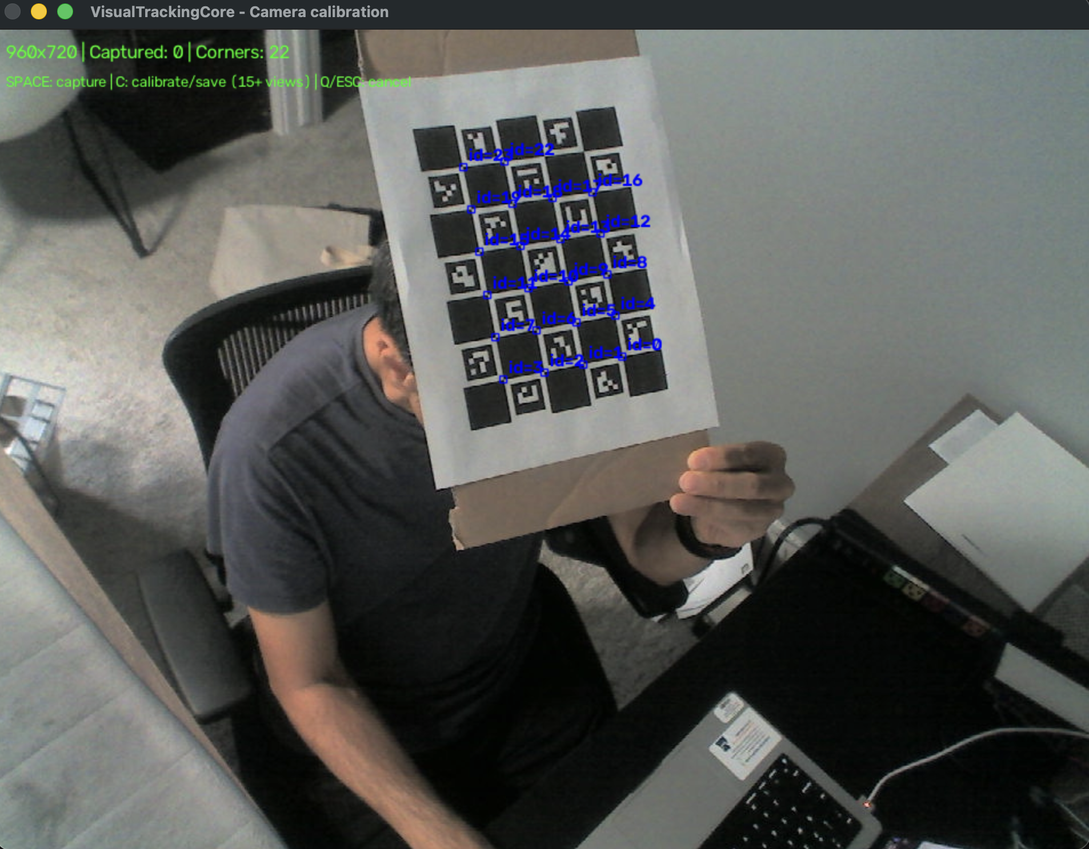
Calibration Steps
Step1) activate the virtual environment and generate the board:
python tools/calibrate_camera.py --generate-board calibration/charuco_board.png
Step2) close/stop camera tracking in the main VisualTrackingCore app so the webcam is free. Start calibration capture:
python tools/calibrate_camera.py --camera 0 --width 1280 --height 720 --output calibration/webcam_calibration.npz
Step3) collect views. This part matters more than simply reaching 15 images.
Space capture this view
C calculate calibration and save
Q/Esc cancel

Slide 10
Calibration Steps (Continued)
Start with the board centered and approximately facing the camera, then move it around. Capture something like:
1–3 center, different distances
4–6 left side
7–9 right side
10–12 upper part of image
13–15 lower part of image
16–18 tilted left/right
19–21 tilted forward/backward
22–25 combinations of edge position + tilt
The .npz stores the important camera information
camera_matrix
dist_coeffs
image_width
image_height
reprojection_error
timestamp
board_definition
have at least 15 good views—preferably 20–25—press:
C
output
Resolution: 1280 x 720
Valid frames: 22
Reprojection RMS: 0.42 px
Saved: .../calibration/webcam_calibration.npz

Slide 11
Main.py
Workflow
1. Start VisualTrackingCore
2. Select AprilTag or ArUco
3. Select 3D Pose
4. Enter the real tag size
5. Load webcam_calibration.npz
6. Start tracking
7. Verify XYZ + yaw/pitch/roll
8. Set 0° Reference
9. Verify response_azimuth_deg
10. Optionally verify LSL

Slide 12
Main.py
[Setup]
Tracking Method: AprilTag
Tracking Mode: 3D Pose
Tag Family: tagStandard41h12
Tag ID: 0
Tag Size: 50.0 mm
Calibration:
calibration/webcam_calibration.npz
Calibration status: Valid
tag size must match the physical printed marker size

Slide 13
Main.py
Move left/right
→ mostly X changes
Move closer/farther from camera
→ mostly Z changes
Rotate head/marker left-right
→ mostly Yaw changes
Tilt forward/back
→ mostly Pitch changes
Tilt sideways
→ mostly Roll changes

Slide 14
Main.py
Face the marker toward your defined center-speaker direction and press:
Set 0° Reference
should show something like:
Reference: 3D yaw 14.6° = speaker-array 0°
Response azimuth: 0.0°
Need to verify
tracking stays valid
yaw changes in the expected direction
zero reference works
response azimuth is stable
pitch/roll don’t badly corrupt yaw

Slide 15
Response azimuth
response_azimuth = current_orientation - reference_orientation
then the result is wrapped into: -180° to +180°
azimuth = wrap_degrees(
self.sign * (float(value) - self.reference_deg)
)
Set 0° Reference, and later subtracts that value from the live orientation. It also checks that tracking is valid and that the source/tag ID still matches the one used for calibration.
AprilTag / ArUco 2D mode
→ marker rotation
AprilTag / ArUco 3D mode
→ 3D yaw
MediaPipe
→ yaw

Slide 16
Mediapipe
key issue. Need to review
nose
chin
left eye
right eye
left mouth
right mouth
focal_length = float(width)
camera_matrix = [
[focal_length, 0, width / 2],
[0, focal_length, height / 2],
[0, 0, 1]
]
distortion = zeros
MODEL_POINTS = [
nose,
chin,
left eye,
right eye,
left mouth,
right mouth
]
No calibration and assuming…
focal length ≈ image width
optical center = exact image center
lens distortion = zero
generic face
Notes:
“MediaPipe is currently a markerless proof-of-concept. It estimates head yaw from facial landmarks using an approximate camera model. Zero reference removes the forward-facing offset, but its angular accuracy has not yet been calibrated the same way as the AprilTag/ArUco 3D mode.”

Slide 17
pointTracker
Main Project Repository: github.com/opentrack/opentrack
PointTracker Source Code Subdirectory: opentrack/tracker-pt
Pose Calculation (PnP Solver): tracker-pt/ftnoir_tracker_pt.cpp (takes the detected 2D points and calculates the 6-DoF pose against your specified model dimensions)

Slide 18
LED Response
Input Adapter → LEDResponseController → Output Adapter
Raw Wii orientation
↓
Set Zero Reference
↓
Relative angle
↓
Response azimuth
↓
LED index
Raw orientation at center = 87°
User presses Set Zero
87° → response 0°
117° → response +30°
57° → response -30°
the Wii Remote works once connected, but Windows Bluetooth pairing/reconnection is still inconsistent, so connection handling is one of the things that needs improvement

Slide 19
Workflow
LEDResponseCore V1.2.0
↓
Show physical LED/Arduino setup
↓
Keyboard control
↓
Show modular architecture
↓
Wii Remote connection
↓
Wheel mode
↓
Set Zero Reference
↓
Rotate left / center / right
↓
Show corresponding LEDs / azimuth
↓
Briefly show experimental free-pointing mode
↓
Discuss limitations
↓
Ask for requirements / next-phase direction
Notes:
“How can we measure where the participant's head/response is pointing?”

Slide 20
Main.py

Slide 21
Main.py

Slide 22
Ideas
Should the participant response be wheel-based, free pointing, or should we continue supporting both?
Is the LED strip primarily participant feedback, experimenter feedback, or part of the actual response mechanism?
What angular range do we really need: ±90°, ±120°, ±180°, etc.?
How many speaker positions / LED positions should the final system represent?
Should responses be continuous azimuth values or snapped to speaker locations?
Should LEDResponseCore communicate directly with the experiment software, probably through LSL, rather than operate as a standalone tool?
Do we want Wii Remote to remain the target controller given the Bluetooth friction, or is it mainly useful for proving the interaction concept?

