Slide 1
CNN Accelerator Configuration
AIHA-Intern-2023-NPU
Dongbeom Son / Wonbin Seo / Sumin Lee
bumin35@hanyang.ac.kr / kkyou123@hanyang.ac.kr / slbiog3025@hanyang.ac.kr
2023 aiha-intern

Slide 2
Table of Contents
Configuration specific
  INPUT-OUTPUT
    IFM/WGT/OFM
    Parser
  PE-FSM
  Stall Signal
  3 X 8 PE array– Timestamp
VGG-16 structure
Address Control
  Input Feature Map
  Weight
  Output Feature Map

Slide 3
INPUT-OUTPUT
IFM
  Two 3x8 pe arrays share same input
  8 * 10(number of rows in an input tile) = 80bit per cycle = 3000MB/s
WGT
  Each pe array has different WGT
  8 * 2 * 3(kernel size) = 48bit per cycle = 1800 MB/s
OFM
  Each pe arrays produces output of different output channel.
  8 output from each pe array total (tile_length) output (tile_length = 16)
  32 * 8 * 2 = 512bit per cycle for tile_length cycles when it’s validate
  For validate output, ci * (tile_length + kernel_size – 1) cycles required
  Peak output throughput = 64byte / cycles = 19200 MB/s
  Average output throughput = 64byte / (18 * ci + 16) cycles
  ci is minimum for 1st layer (ci = 64), Maximum output throughput = 16.43 MB/s

Slide 4
INPUT-OUTPUT
Parser
  IFM/WGT data width in input buffer is 512bit.
  IFM/WGT data width to conv_acc module is 80/48bit
  512 bit cannot be divided evenly with 80/48bit
  IFM parser stores 5 512bit data to produce 32 80bit input ifm data
  WGT parser stores 3 512bit data to produce 32 48bit input ifm data
  Parser sent input request to input buffer to fill the parser buffer again before using all of data
512bit
Total 32
80bit ifm

Slide 5
PE-FSM
IDLE
  Before the start signal & after the end of convolution
S1
  State for filling ofm and wgt buffer
  When buffers are full(3 values for each buffer) move to S2
S2
  State that convolution occurs
  After convolution for one input tile is done, move to S1 and fill the buffer for new input tile
Count
  Cnt1 counts column of input tile, 0~3 range is for S1, 4~18 range is for S2
  Cnt2 counts number of input tiles calculated. 8 input tiles produce 1 output tile
  Cnt3 counts number of ofm tile produced. Cnt2 increased by 1 means are 2 ofm tile for different channels are produced.

Slide 6
PE-FSM
Ifm_read / wgt_read
  Ifm_read signal is high for every cycle of convolutional operation
  Wgt_read rises when convolution for one input tile is done and falls after 3 wgt columns are stored in wgt buffer. Basically 1 in S1, 0 in S2
P_valid signal
  Signal indicating that output of pe is valid and need to be accumulated. Rises when first 3 inputs are multiplied and accumulated.
Last_channel signal
  Indicating current ifm tile is in last input channel and need to take outputs from ping-pong buffer after operation for this tile is done.

Slide 7
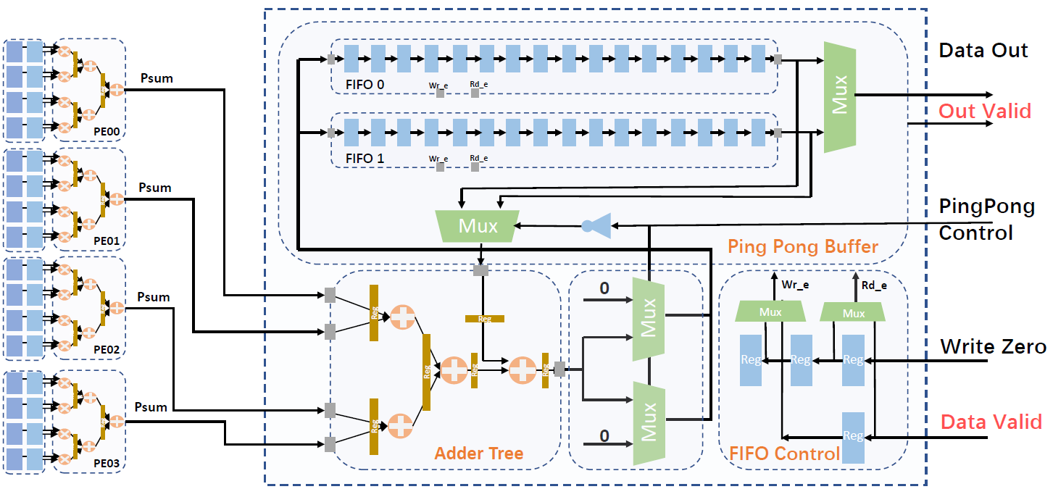
Stall Signal
Need to create stall signal that stops operation when the Input/Output buffer is not ready

Slide 8
3 X 8 PE array– Timestamp
Cycle 1 (input channel: 0)
PE-array : 1
0 | 1 | 2 | 3 | 4 | 5 | 6 | 7 | 8 | 9 | 10 | 11 | 12 | 13 | 14 | 15 | 16 | 17
18 | 19 | 20 | 21 | 22 | 23 | 24 | 25 | 26 | 27 | 28 | 29 | 30 | 31 | 32 | 33 | 34 | 35
36 | 37 | 38 | 39 | 40 | 41 | 42 | 43 | 44 | 45 | 46 | 47 | 48 | 49 | 50 | 51 | 52 | 53
54 | 55 | 56 | 57 | 58 | 59 | 60 | 61 | 62 | 63 | 64 | 65 | 66 | 67 | 68 | 69 | 70 | 71
72 | 73 | 74 | 75 | 76 | 77 | 78 | 79 | 80 | 81 | 82 | 83 | 84 | 85 | 86 | 87 | 88 | 89
90 | 91 | 92 | 93 | 94 | 95 | 96 | 97 | 98 | 99 | 100 | 101 | 102 | 103 | 104 | 105 | 106 | 107
108 | 109 | 110 | 111 | 112 | 113 | 114 | 115 | 116 | 117 | 118 | 119 | 120 | 121 | 122 | 123 | 124 | 125
126 | 127 | 128 | 129 | 130 | 131 | 132 | 133 | 134 | 135 | 136 | 137 | 138 | 139 | 140 | 141 | 142 | 143
144 | 145 | 146 | 147 | 148 | 149 | 150 | 151 | 152 | 153 | 154 | 155 | 156 | 157 | 158 | 159 | 160 | 161
162 | 163 | 164 | 165 | 166 | 167 | 168 | 169 | 170 | 171 | 172 | 173 | 174 | 175 | 176 | 177 | 178 | 179
0 | 1 | 2
3 | 4 | 5
6 | 7 | 8
wgt #1
a | b | c
d | e | f
g | h | i
wgt #2
Input
PE00
PE01
PE02
PE03
PE04
PE05
PE06
PE07
 |  | 0
 |  | 18
 |  | 36
 |  | 54
 |  | 72
 |  | 90
 |  | 108
 |  | 126
 |  | 0
 |  | 0
 |  | 0
 |  | 0
 |  | 0
 |  | 0
 |  | 0
 |  | 0
PE10
PE11
PE12
PE13
PE14
PE15
PE16
PE17
 |  | 18
 |  | 36
 |  | 54
 |  | 72
 |  | 90
 |  | 108
 |  | 126
 |  | 144
 |  | 3
 |  | 3
 |  | 3
 |  | 3
 |  | 3
 |  | 3
 |  | 3
 |  | 3
PE20
PE21
PE22
PE23
PE24
PE25
PE26
PE27
 |  | 36
 |  | 54
 |  | 72
 |  | 90
 |  | 108
 |  | 126
 |  | 144
 |  | 162
 |  | 6
 |  | 6
 |  | 6
 |  | 6
 |  | 6
 |  | 6
 |  | 6
 |  | 6

Slide 9
3 X 8 PE array– Timestamp
Cycle 1 (input channel: 0)
PE-array : 2
0 | 1 | 2 | 3 | 4 | 5 | 6 | 7 | 8 | 9 | 10 | 11 | 12 | 13 | 14 | 15 | 16 | 17
18 | 19 | 20 | 21 | 22 | 23 | 24 | 25 | 26 | 27 | 28 | 29 | 30 | 31 | 32 | 33 | 34 | 35
36 | 37 | 38 | 39 | 40 | 41 | 42 | 43 | 44 | 45 | 46 | 47 | 48 | 49 | 50 | 51 | 52 | 53
54 | 55 | 56 | 57 | 58 | 59 | 60 | 61 | 62 | 63 | 64 | 65 | 66 | 67 | 68 | 69 | 70 | 71
72 | 73 | 74 | 75 | 76 | 77 | 78 | 79 | 80 | 81 | 82 | 83 | 84 | 85 | 86 | 87 | 88 | 89
90 | 91 | 92 | 93 | 94 | 95 | 96 | 97 | 98 | 99 | 100 | 101 | 102 | 103 | 104 | 105 | 106 | 107
108 | 109 | 110 | 111 | 112 | 113 | 114 | 115 | 116 | 117 | 118 | 119 | 120 | 121 | 122 | 123 | 124 | 125
126 | 127 | 128 | 129 | 130 | 131 | 132 | 133 | 134 | 135 | 136 | 137 | 138 | 139 | 140 | 141 | 142 | 143
144 | 145 | 146 | 147 | 148 | 149 | 150 | 151 | 152 | 153 | 154 | 155 | 156 | 157 | 158 | 159 | 160 | 161
162 | 163 | 164 | 165 | 166 | 167 | 168 | 169 | 170 | 171 | 172 | 173 | 174 | 175 | 176 | 177 | 178 | 179
0 | 1 | 2
3 | 4 | 5
6 | 7 | 8
wgt #1
a | b | c
d | e | f
g | h | i
wgt #2
Input
PE00
PE01
PE02
PE03
PE04
PE05
PE06
PE07
 |  | 0
 |  | 18
 |  | 36
 |  | 54
 |  | 72
 |  | 90
 |  | 108
 |  | 126
 |  | 0
 |  | 0
 |  | 0
 |  | 0
 |  | 0
 |  | 0
 |  | 0
 |  | 0
PE10
PE11
PE12
PE13
PE14
PE15
PE16
PE17
 |  | 18
 |  | 36
 |  | 54
 |  | 72
 |  | 90
 |  | 108
 |  | 126
 |  | 144
 |  | 3
 |  | 3
 |  | 3
 |  | 3
 |  | 3
 |  | 3
 |  | 3
 |  | 3
PE20
PE21
PE22
PE23
PE24
PE25
PE26
PE27
 |  | 36
 |  | 54
 |  | 72
 |  | 90
 |  | 108
 |  | 126
 |  | 144
 |  | 162
 |  | 6
 |  | 6
 |  | 6
 |  | 6
 |  | 6
 |  | 6
 |  | 6
 |  | 6

Slide 10
3 X 8 PE array– Timestamp
Cycle 3 (input channel: 0)
PE-array : 1
0 | 1 | 2 | 3 | 4 | 5 | 6 | 7 | 8 | 9 | 10 | 11 | 12 | 13 | 14 | 15 | 16 | 17
18 | 19 | 20 | 21 | 22 | 23 | 24 | 25 | 26 | 27 | 28 | 29 | 30 | 31 | 32 | 33 | 34 | 35
36 | 37 | 38 | 39 | 40 | 41 | 42 | 43 | 44 | 45 | 46 | 47 | 48 | 49 | 50 | 51 | 52 | 53
54 | 55 | 56 | 57 | 58 | 59 | 60 | 61 | 62 | 63 | 64 | 65 | 66 | 67 | 68 | 69 | 70 | 71
72 | 73 | 74 | 75 | 76 | 77 | 78 | 79 | 80 | 81 | 82 | 83 | 84 | 85 | 86 | 87 | 88 | 89
90 | 91 | 92 | 93 | 94 | 95 | 96 | 97 | 98 | 99 | 100 | 101 | 102 | 103 | 104 | 105 | 106 | 107
108 | 109 | 110 | 111 | 112 | 113 | 114 | 115 | 116 | 117 | 118 | 119 | 120 | 121 | 122 | 123 | 124 | 125
126 | 127 | 128 | 129 | 130 | 131 | 132 | 133 | 134 | 135 | 136 | 137 | 138 | 139 | 140 | 141 | 142 | 143
144 | 145 | 146 | 147 | 148 | 149 | 150 | 151 | 152 | 153 | 154 | 155 | 156 | 157 | 158 | 159 | 160 | 161
162 | 163 | 164 | 165 | 166 | 167 | 168 | 169 | 170 | 171 | 172 | 173 | 174 | 175 | 176 | 177 | 178 | 179
0 | 1 | 2
3 | 4 | 5
6 | 7 | 8
wgt #1
a | b | c
d | e | f
g | h | i
wgt #2
Input
PE00
PE01
PE02
PE03
PE04
PE05
PE06
PE07
0 | 1 | 2
18 | 19 | 20
36 | 37 | 38
54 | 55 | 56
72 | 73 | 74
90 | 91 | 92
108 | 109 | 110
126 | 127 | 128
0 | 1 | 2
0 | 1 | 2
0 | 1 | 2
0 | 1 | 2
0 | 1 | 2
0 | 1 | 2
0 | 1 | 2
0 | 1 | 2
PE10
PE11
PE12
PE13
PE14
PE15
PE16
PE17
18 | 19 | 20
36 | 37 | 38
54 | 55 | 56
72 | 73 | 74
90 | 91 | 92
108 | 109 | 110
126 | 127 | 128
144 | 145 | 146
3 | 4 | 5
3 | 4 | 5
3 | 4 | 5
3 | 4 | 5
3 | 4 | 5
3 | 4 | 5
3 | 4 | 5
3 | 4 | 5
PE20
PE21
PE22
PE23
PE24
PE25
PE26
PE27
36 | 37 | 38
54 | 55 | 56
72 | 73 | 74
90 | 91 | 92
108 | 109 | 110
126 | 127 | 128
144 | 145 | 146
162 | 163 | 164
6 | 7 | 8
6 | 7 | 8
6 | 7 | 8
6 | 7 | 8
6 | 7 | 8
6 | 7 | 8
6 | 7 | 8
6 | 7 | 8
0,0
0,1
0,2
0,3
0,4
0,5
0,6
0,7

Slide 11
3 X 8 PE array– Timestamp
Cycle 18 (input channel: 0)
PE-array : 1
0 | 1 | 2 | 3 | 4 | 5 | 6 | 7 | 8 | 9 | 10 | 11 | 12 | 13 | 14 | 15 | 16 | 17
18 | 19 | 20 | 21 | 22 | 23 | 24 | 25 | 26 | 27 | 28 | 29 | 30 | 31 | 32 | 33 | 34 | 35
36 | 37 | 38 | 39 | 40 | 41 | 42 | 43 | 44 | 45 | 46 | 47 | 48 | 49 | 50 | 51 | 52 | 53
54 | 55 | 56 | 57 | 58 | 59 | 60 | 61 | 62 | 63 | 64 | 65 | 66 | 67 | 68 | 69 | 70 | 71
72 | 73 | 74 | 75 | 76 | 77 | 78 | 79 | 80 | 81 | 82 | 83 | 84 | 85 | 86 | 87 | 88 | 89
90 | 91 | 92 | 93 | 94 | 95 | 96 | 97 | 98 | 99 | 100 | 101 | 102 | 103 | 104 | 105 | 106 | 107
108 | 109 | 110 | 111 | 112 | 113 | 114 | 115 | 116 | 117 | 118 | 119 | 120 | 121 | 122 | 123 | 124 | 125
126 | 127 | 128 | 129 | 130 | 131 | 132 | 133 | 134 | 135 | 136 | 137 | 138 | 139 | 140 | 141 | 142 | 143
144 | 145 | 146 | 147 | 148 | 149 | 150 | 151 | 152 | 153 | 154 | 155 | 156 | 157 | 158 | 159 | 160 | 161
162 | 163 | 164 | 165 | 166 | 167 | 168 | 169 | 170 | 171 | 172 | 173 | 174 | 175 | 176 | 177 | 178 | 179
0 | 1 | 2
3 | 4 | 5
6 | 7 | 8
wgt #1
a | b | c
d | e | f
g | h | i
wgt #2
Input
PE00
PE01
PE02
PE03
PE04
PE05
PE06
PE07
15 | 16 | 17
33 | 34 | 35
51 | 52 | 53
69 | 70 | 71
87 | 88 | 89
105 | 106 | 107
123 | 124 | 125
141 | 142 | 143
0 | 1 | 2
0 | 1 | 2
0 | 1 | 2
0 | 1 | 2
0 | 1 | 2
0 | 1 | 2
0 | 1 | 2
0 | 1 | 2
PE10
PE11
PE12
PE13
PE14
PE15
PE16
PE17
33 | 34 | 35
51 | 52 | 53
69 | 70 | 71
87 | 88 | 89
105 | 106 | 107
123 | 124 | 125
141 | 142 | 143
159 | 160 | 161
3 | 4 | 5
3 | 4 | 5
3 | 4 | 5
3 | 4 | 5
3 | 4 | 5
3 | 4 | 5
3 | 4 | 5
3 | 4 | 5
PE20
PE21
PE22
PE23
PE24
PE25
PE26
PE27
51 | 52 | 53
69 | 70 | 71
87 | 88 | 89
105 | 106 | 107
123 | 124 | 125
141 | 142 | 143
159 | 160 | 161
177 | 178 | 179
6 | 7 | 8
6 | 7 | 8
6 | 7 | 8
6 | 7 | 8
6 | 7 | 8
6 | 7 | 8
6 | 7 | 8
6 | 7 | 8
15,0
15,1
15,2
15,3
15,4
15,5
15,6
15,7

Slide 12
3 X 8 PE array– Timestamp
Cycle 19 (input channel: 1)
PE-array : 1
0 | 1 | 2 | 3 | 4 | 5 | 6 | 7 | 8 | 9 | 10 | 11 | 12 | 13 | 14 | 15 | 16 | 17
18 | 19 | 20 | 21 | 22 | 23 | 24 | 25 | 26 | 27 | 28 | 29 | 30 | 31 | 32 | 33 | 34 | 35
36 | 37 | 38 | 39 | 40 | 41 | 42 | 43 | 44 | 45 | 46 | 47 | 48 | 49 | 50 | 51 | 52 | 53
54 | 55 | 56 | 57 | 58 | 59 | 60 | 61 | 62 | 63 | 64 | 65 | 66 | 67 | 68 | 69 | 70 | 71
72 | 73 | 74 | 75 | 76 | 77 | 78 | 79 | 80 | 81 | 82 | 83 | 84 | 85 | 86 | 87 | 88 | 89
90 | 91 | 92 | 93 | 94 | 95 | 96 | 97 | 98 | 99 | 100 | 101 | 102 | 103 | 104 | 105 | 106 | 107
108 | 109 | 110 | 111 | 112 | 113 | 114 | 115 | 116 | 117 | 118 | 119 | 120 | 121 | 122 | 123 | 124 | 125
126 | 127 | 128 | 129 | 130 | 131 | 132 | 133 | 134 | 135 | 136 | 137 | 138 | 139 | 140 | 141 | 142 | 143
144 | 145 | 146 | 147 | 148 | 149 | 150 | 151 | 152 | 153 | 154 | 155 | 156 | 157 | 158 | 159 | 160 | 161
162 | 163 | 164 | 165 | 166 | 167 | 168 | 169 | 170 | 171 | 172 | 173 | 174 | 175 | 176 | 177 | 178 | 179
0 | 1 | 2
3 | 4 | 5
6 | 7 | 8
wgt #1
a | b | c
d | e | f
g | h | i
Input
PE00
PE01
PE02
PE03
PE04
PE05
PE06
PE07
 |  | 0
 |  | 18
 |  | 36
 |  | 54
 |  | 72
 |  | 90
 |  | 108
 |  | 126
 |  | 0
 |  | 0
 |  | 0
 |  | 0
 |  | 0
 |  | 0
 |  | 0
 |  | 0
PE10
PE11
PE12
PE13
PE14
PE15
PE16
PE17
 |  | 18
 |  | 36
 |  | 54
 |  | 72
 |  | 90
 |  | 108
 |  | 126
 |  | 144
 |  | 3
 |  | 3
 |  | 3
 |  | 3
 |  | 3
 |  | 3
 |  | 3
 |  | 3
PE20
PE21
PE22
PE23
PE24
PE25
PE26
PE27
 |  | 36
 |  | 54
 |  | 72
 |  | 90
 |  | 108
 |  | 126
 |  | 144
 |  | 162
 |  | 6
 |  | 6
 |  | 6
 |  | 6
 |  | 6
 |  | 6
 |  | 6
 |  | 6

Slide 13
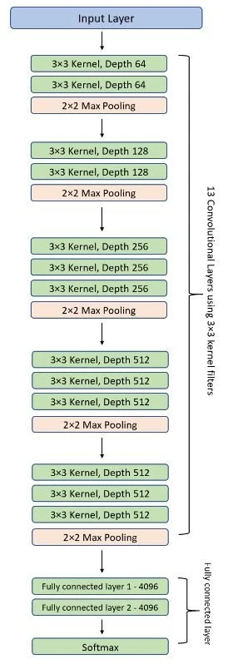
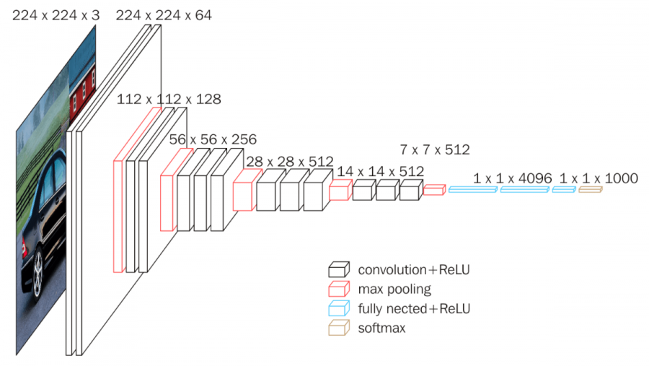
VGG-16 structure

Slide 14

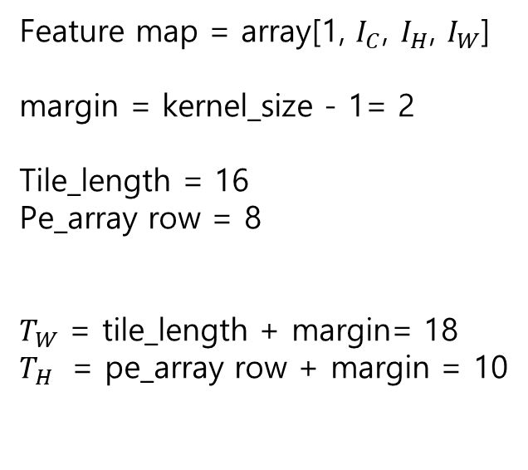








Address Control
In the previous setting, the order of the data was manipulated before the operation to deliver the sequential data
The following address control is required to deliver a tiled feature map without rearranging software feature map
Using A * B = C ⬄ $A^{T}$* $B^{T}$ = $C^{T}$, Calculated based on matrix product of transpose matrix
$$I_{W}$$
Feature map = array[1, $I_{C}$, $I_{H}$, $I_{W}$]
margin = kernel_size - 1= 2
Tile_length = 16
Pe_array row = 8
$T_{W}$ = tile_length + margin= 18
$T_{H}$ = pe_array row + margin = 10
$$I_{W}$$
$$T_{W}$$
tiling
$$T_{H}$$
$$I_{H}$$
$$I_{H}$$
$$I_{C}$$
$$I_{C}$$
Not rearranged Array

Slide 15


Address Control / Input Feature Map
The first layer should calculate 224x224x64 input (zero padding 256 x 256)
Operate a sequential read to deliver one Tiled channel
With 2 transfers (maximum: 4096 Byte) can deliver input feature map as much as
$T_{W}$ (Tile width) (4608 Byte)
Buffer needed that minimum 256 (zero padding) x 18 x 64 = 288kB
Read 4608Byte from offset address by channel
1st layer width = 224
1st layer input channel = 64
$T_{W}$= 18
Ti_address offset = $I_{W}$ * pe_row * tile index
= $I_{W}$ * 8 * tile index
address offset = Ti+ $I_{W}$ * $I_{H}$ * channel index
224 + 32 zeros
Ti1
18
64

Slide 16
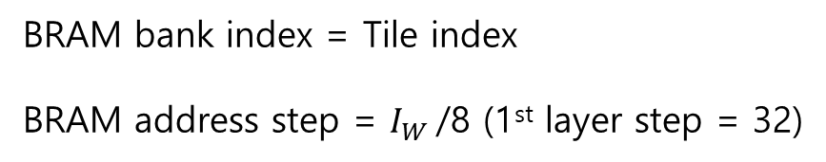
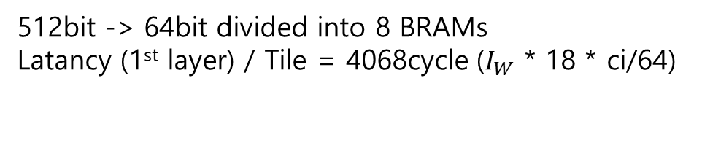
Address Control / Input Feature Map
The IFMs stored in the Buffer are in the same order as shown
2048 bit
512bit -> 64bit divided into 8 BRAMs
Latancy (1st layer) / Tile = 4068cycle ($I_{W}$ * 18 * ci/64)
1 | 2 | 3 | 4
5 | 6 | 7 | 8
9 | 10 | …
29 | 30 | 31 | 32
33 | 34 | 35 | 36
37 | 38 | 39 | 40
41 | 42 | …
61 | 62 | 63 | 64
18
64bit
1 | 2 | 3 | 4 | 5 | 6 | 7 | 8
9 | 10 | 11 | 12 | 13 | 14 | 15 | 16
…
25 | 26 | 27 | 28 | 29 | 30 | 31 | 32
33 | 34 | 35 | 36 | 37 | 38 | 39 | 40
BRAM bank index = Tile index
BRAM address step = $I_{W}$/8 (1st layer step = 32)
256 x 18
64bit
18bit
80bit

Slide 17




Address Control / Weight
Weight is used repeatedly according to output channel index until all ifm are computed
kk
Weight = array[$O_{C}$, $I_{C}$, kk, kk]
kk = kernel size = 3
Buffer size = kk*kk * $I_{C}$_max * 2 * 2 = 18432 Byte
Using the original FIFO + parser scheme
Address offset = kk * kk * $I_{C}$ * $O_{C}$
kk
$$I_{C}$$
kk
$$O_{C}$$
kk
$$I_{C}$$

Slide 18

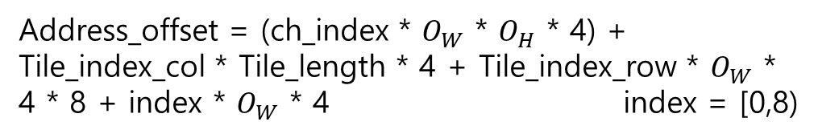
Address Control / Output Feature Map
4Kb x 2 register buffer is required to rearrange and send ofm to buffer for sequential write
64
When rearranged by software from one group,
overhead = 77%
1 | 2
3 | 4
cycle
16
Address_offset = (ch_index * $O_{W}$ * $O_{H}$ * 4) + Tile_index_col * Tile_length * 4 + Tile_index_row * $O_{W}$ * 4 * 8 + index * $O_{W}$ * 4 index = [0,8)
16*4 byte / transfer
Global memory
16
0bit
2 | 4 | 6 | 8 | 10 | … | … | 32
2
1 | 3 | 5 | 7 | 9 | … | … | 31
4byte
4
1
3
8x4byte
255
Register (4Kb) x2

