Slide 1
CNN Accelerator
AIHA-Intern-2023-NPU
Dongbeom Son / Wonbin Seo / Sumin Lee
bumin35@hanyang.ac.kr / kkyou123@hanyang.ac.kr / slbiog3025@hanyang.ac.kr
2023 aiha-intern

Slide 2
Table of Contents
CNN-Accelerator architecture overview
  Design requirements
  Design overview
Components
  Processing elements
  Write Back Buffer
Optimization
  Row stationary PE array
  Ping pong buffer
  Tiling the inputs and weights
Consideration for Alveo implementation
Possible methods for optimizing

Slide 3
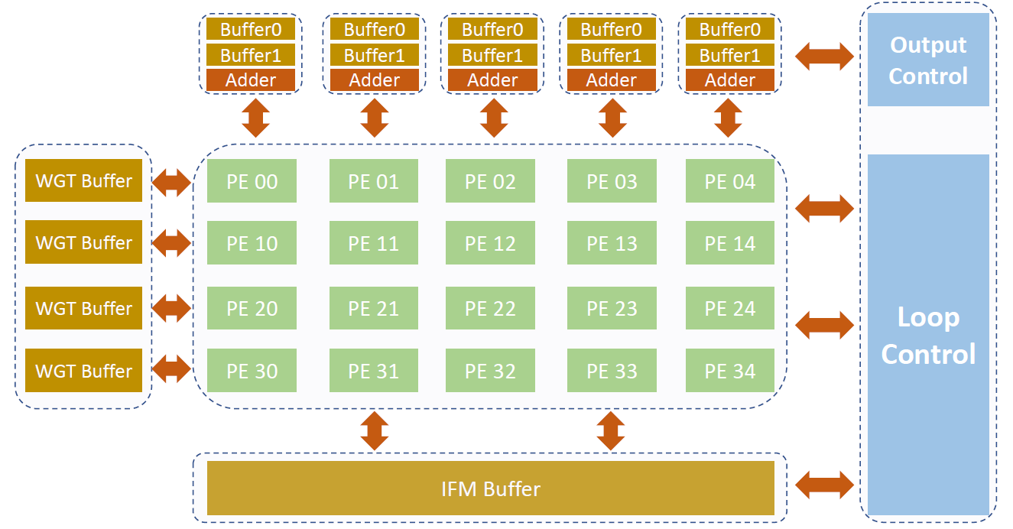
CNN-Accelerator architecture overview
Design requirements
  8bits input input feature map and weight
  25bits output data
  8x8bit input feature map and weight bandwidth
  2x25 bits output bandwidth
  64x64xI input feature map(8<I<32)
    8x64x64 IFM
  4x4xF filter size(8<F<32)

Slide 4
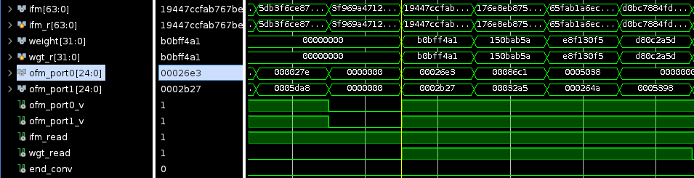
CNN-Accelerator architecture overview
Design overview
  4x5 processing elements array
  4 8bits weight buffer
  8 8bits input feature map buffer
  5 ping pong buffer storing partial sum
  All components are communicated through the handshake protocol
  All connections are hard wired

Slide 5
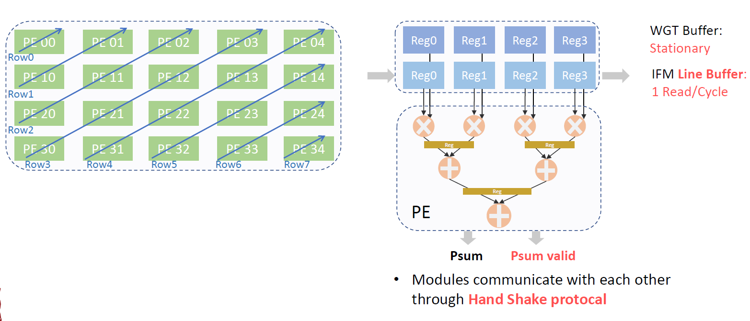
Components
Processing elements
  Each adder and multiplier outputs are pipelined
  8 ifm buffer connected diagonally
  Weight buffer is stationary

Slide 6
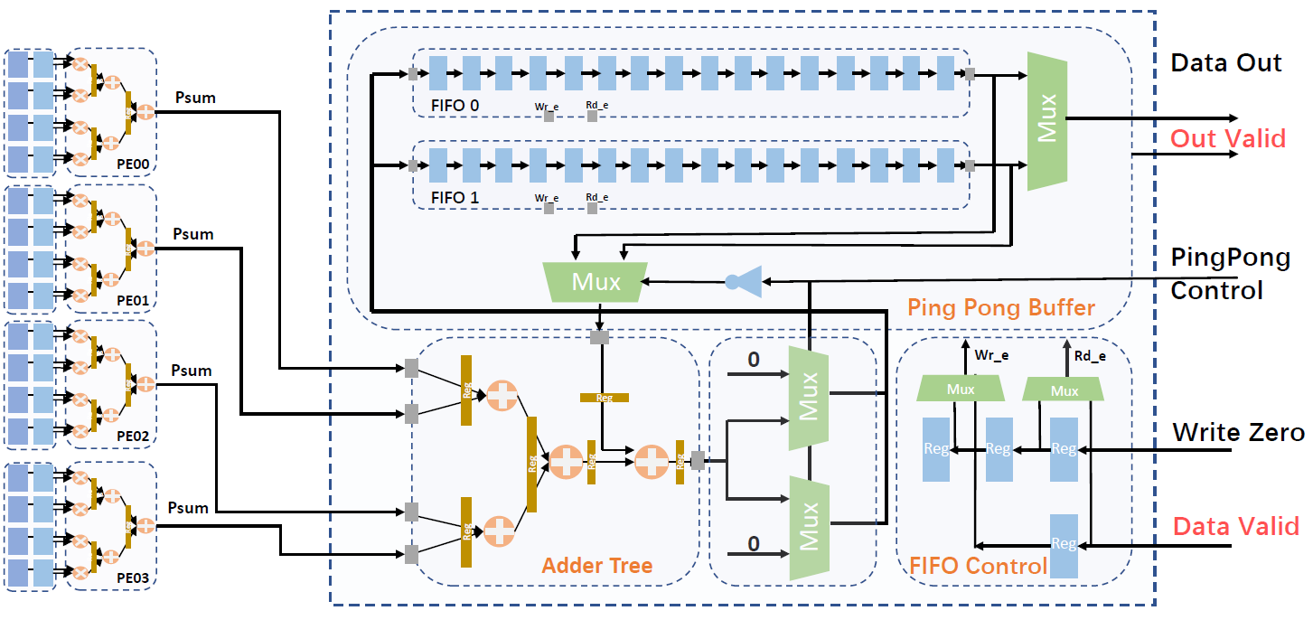
Components
Write Back Buffer
  Two synchronous FIFOs
  One adder tree
  One FIFO control signal
  Each pop of FIFO is added to addition result of current partial sum and pushed back to the same FIFO

Slide 7
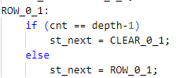
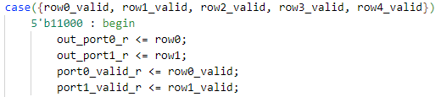
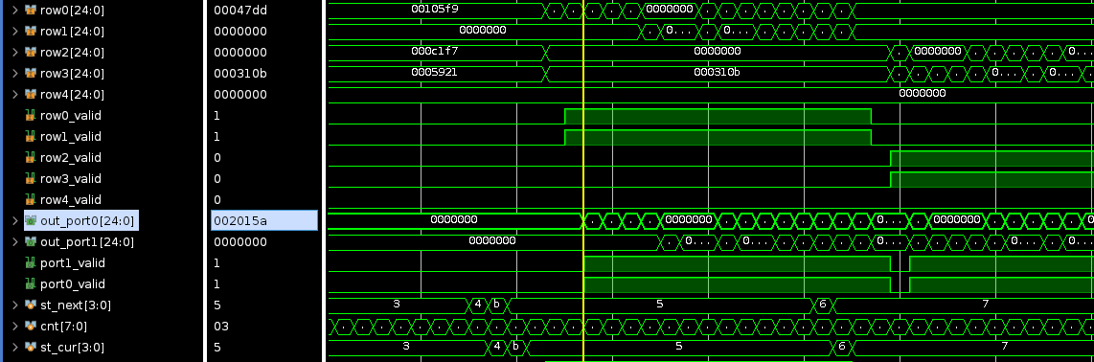
Components
Write Back Buffer
  Controlled by FSM
  With 5 row#_valid, determine output

Slide 8
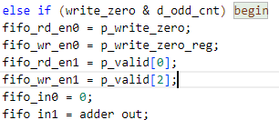
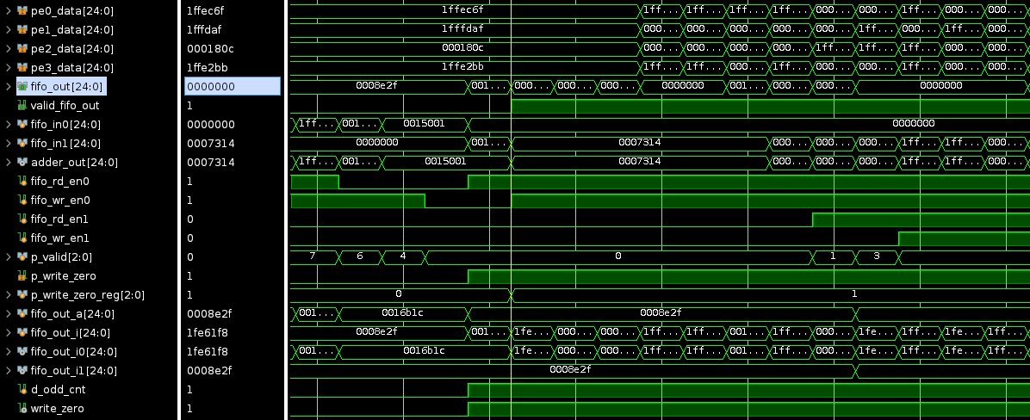
Components
Psum Buffer
  Using 2 signals to select when to write
    d_odd_cnt & write_zero
  Apply ReLU function to output data

Slide 9
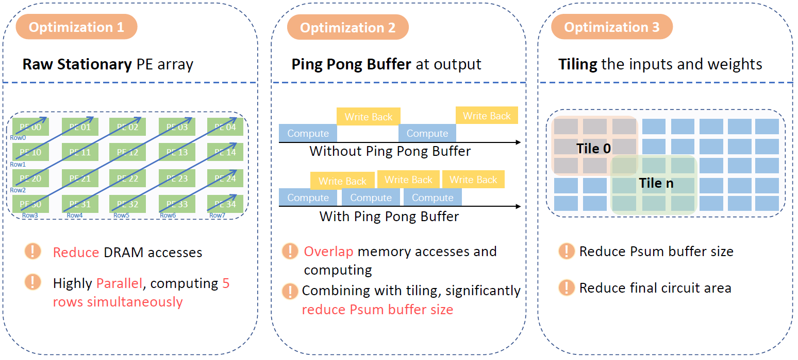
Optimization
Row stationary PE array
  Computing 5 rows simultaneously
  Reduce DRAM access
Ping pong buffer
  Overlap memory accesses and computing
  Using 2 FIFOs to write & compute data
Tiling the inputs and weights
  Overlap memory accesses and computing
  Tiling algorithm 추가

Slide 10
Consideration for Alveo implementation
AXI master port for DRAM access
  Separating IFM reading port and Weight reading port to utilize two DDR Banks simultaneously
AXI lite slave interface for host to kernel communication
  No kernel variables must be set
  Kernel running signals and base address for global memory buffer
No kernel-to-kernel communication
  All components combined in one top module
  AXI stream ports are not required
Host applications writing IFM and Weight to Global memory

Slide 11
Possible methods for optimizing
Separate IFM buffer, Weight buffer, output buffer into different DDR banks
Adding more computing units inside kernel to maximize DRAM access
Using multiple kernels in different SLRs
Additional MUX to clock gating

