Slide 1
DRAM Utilization
How to maximize memory bandwidth
AIHA-Intern-2023-NPU
Dongbeom Son / Wonbin Seo / Sumin Lee
bumin35@hanyang.ac.kr / kkyou123@hanyang.ac.kr / slbiog3025@hanyang.ac.kr
2023 aiha-intern

Slide 2
Table of Contents
Constraints
Use memory bandwidth at maximum
  Modify kernel for 512-bit interface
  Connect multiple bank for single kernel
  Connect multiple bank for multiple kernel one by one
Appendix
DDR4 Utilization
  Background
  Bandwidth optimization method
Using multiple banks
  Parallelizing with multiple banks
  Before using multiple memory
  Using 2 different memory resources
Using maximum data width
AXI Burst transfer

Slide 3
DDR4 utilization
Background
  Between kernel and global memory, data transferred with AXI4 Interface
  Global memory contains 4 DDR4 banks, each bank has one AXI slave Interface
  Only one kernel at a time can read and write data from the global memory.
  Reading and writing cannot occur simultaneously.
DDR4 specifications
  Maximum total bandwidth ~77GB/s (19GB/s for each bank)

Slide 4
DDR4 utilization
Bandwidth optimization method
  Parallelizing with multiple banks
  Using maximum data width for AXI4 interface which is 512bits
  Using AXI Burst transfers

Slide 5
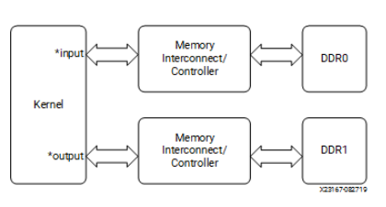
Using multiple banks
Parallelizing with multiple banks
  Each bank can handle only one transaction at a time.
  Ideal bandwidth of each bank is 19.2GB/s, utilizing all four bank simultaneously results in bandwidth of ~77GB/s

Slide 6
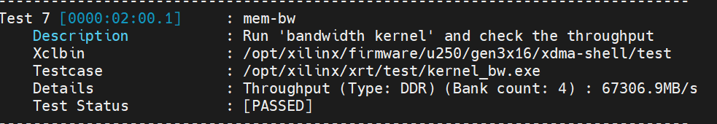
Using multiple banks
Before using multiple memory
  Using same memory resources (DDR[0])

Slide 7
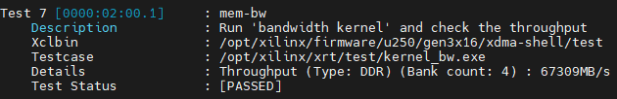
Using multiple banks
  Using 2 different memory resources (DDR[1], DDR[2])
  CU placement is notable feature

Slide 8
Using maximum data width
Using maximum data width for AXI4
  AXI4 interface supports 32, 64, 128, 256, 512bit data width
  Using 512bit width Ideally transfers 512bit per cycle which is 19.2GB/s
Application
  Set AXI4 interface bit width = 512
  Set appropriate data width as 4KB

Slide 9
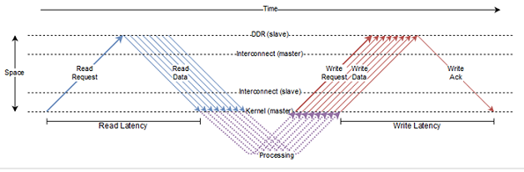
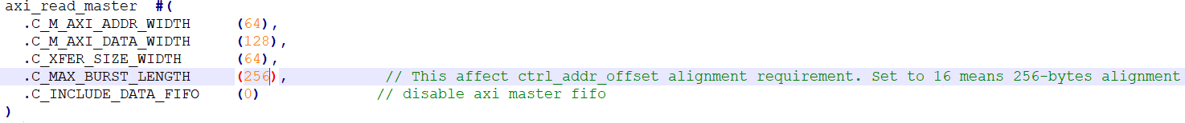
AXI Burst transfer
Using AXI Burst transfers
  AXI4 interface supports a maximum burst length of 256.
  It’s illegal in AXI to cross 4kB boundaries. For 512bit bandwidth, maximum burst length is 64 beats
  Buffer allocated in global memory has contiguous physical address so burst transfer can be very effective
  Large burst length minimizes Read/write latency
Application

Slide 10
Constraints
Constraint
  Using multiple bank
    Physical distance between kernel and bank becomes greater which causes setup time violation
    Using multiple computing unit to reduce physical distance between kernel and bank causes placement error
  Using AXI burst Transfer
    Buffer allocated in global memory should be large enough to save data contiguously

Slide 11
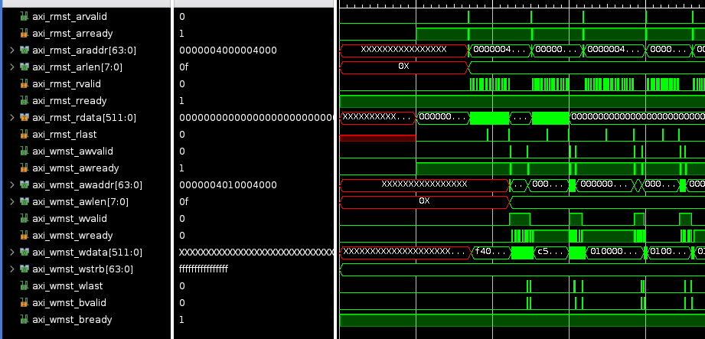
Use memory bandwidth at maximum
Modify kernel for 512-bit interface
  Expand Axi_data_width to 512 bits
  Wstrb also extends to 64bit
  Maximum Burst length is efficient to allow 4096 Byte to be transmitted in one transaction
  It will be efficient to set the maximum burst length to 64.
    512bit
16Byte | 16Byte | 16Byte | 16Byte

Slide 12
Use memory bandwidth at maximum
Modify kernel for 512-bit interface
    input
    512bit
16Byte | 16Byte | 16Byte | 16Byte
    +1 / 0
    +1 / 0
    +1 / 0
    +1 / 0
16Byte | 16Byte | 16Byte | 16Byte
    output

Slide 13
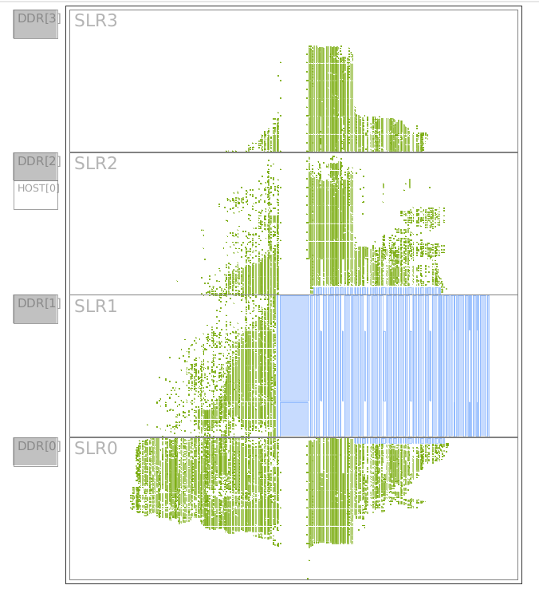
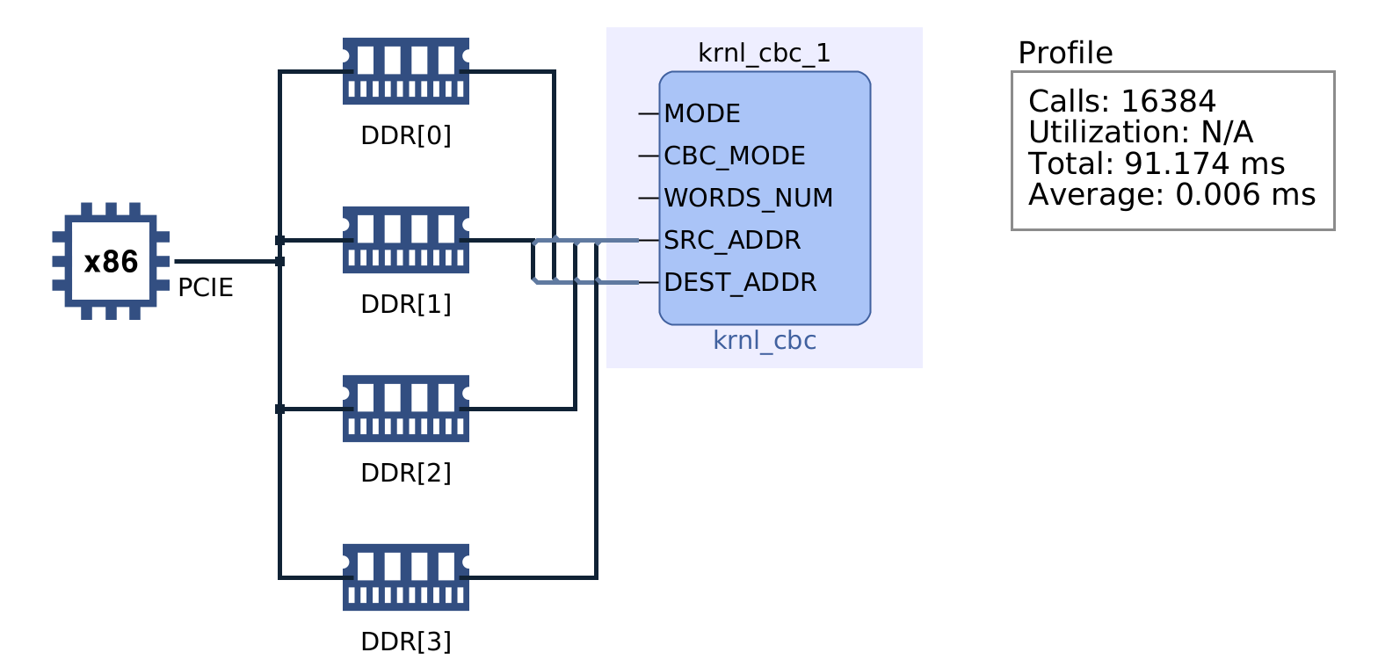
Use memory bandwidth at maximum
Connect multiple bank for single kernel

Slide 14
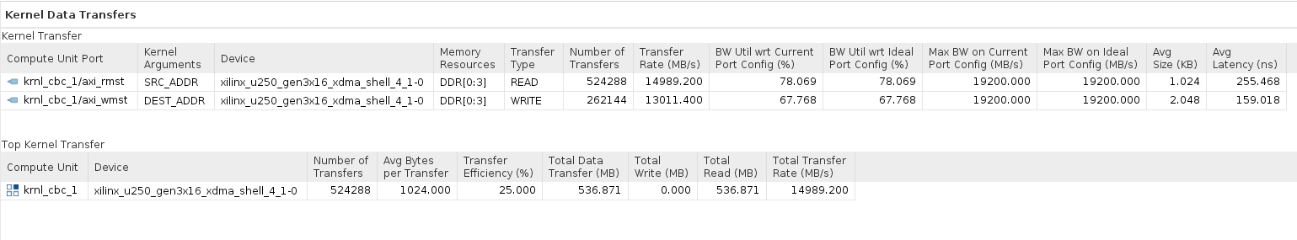
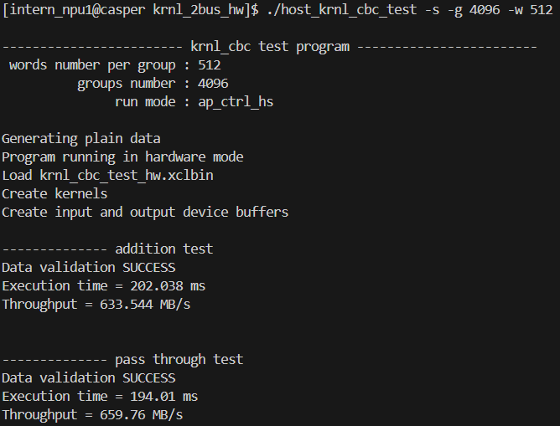
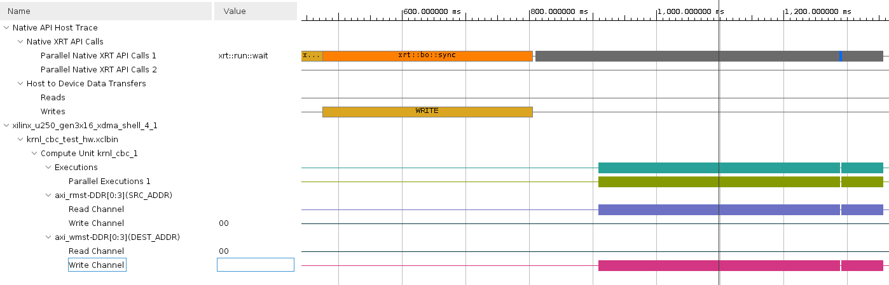
Use memory bandwidth at maximum
Connect multiple bank for single kernel
--profile.trace_memory $(TRACE_DDR)
BW가 향상된 것을 확인할 수 있다

Slide 15
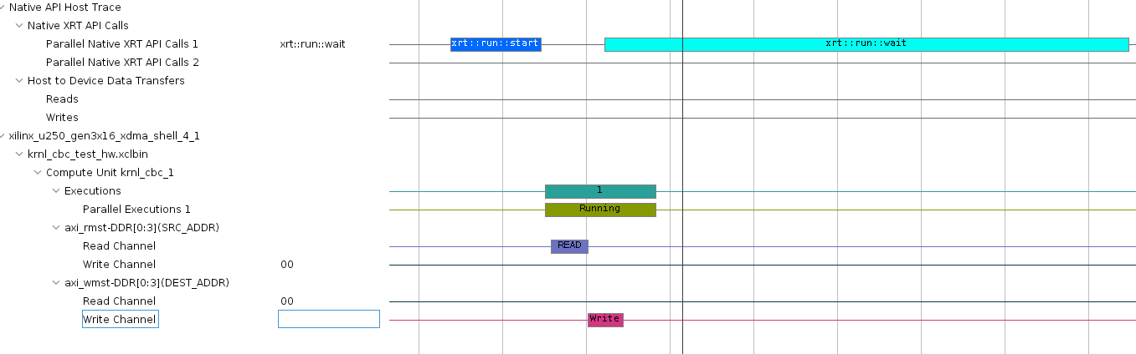
Use memory bandwidth at maximum
Connect multiple bank for single kernel
Significant
  Efficiency increases as the number of word increases
  The limitation of the word is 512 (HW freeze if increase it)
  Write # of transfer halved (Use --profile.trace_memory debug option and rebuild to confirm)
--profile.trace_memory $(TRACE_DDR)
BW가 향상된 것을 확인할 수 있다

Slide 16
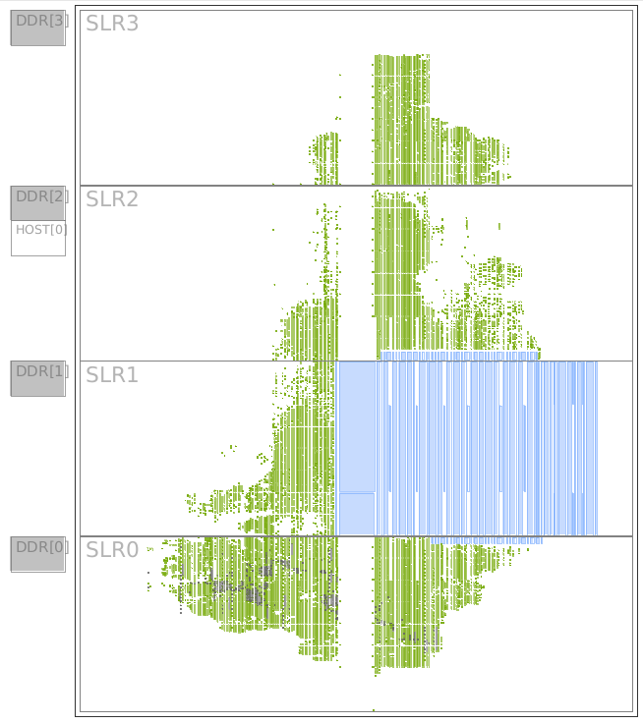
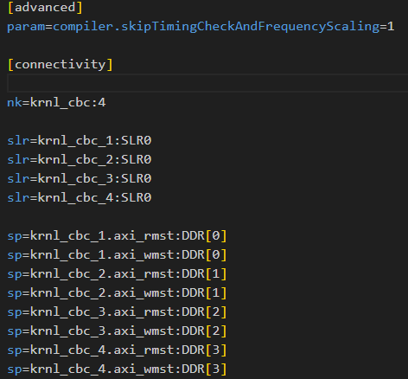
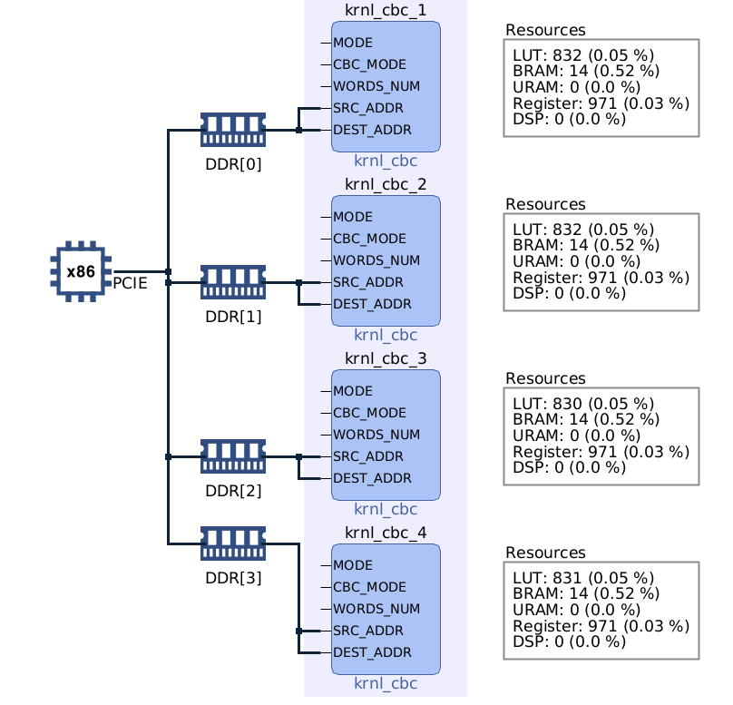
Use memory bandwidth at maximum
Connect multiple bank for multiple kernel one by one
--profile.trace_memory $(TRACE_DDR)
BW가 향상된 것을 확인할 수 있다

Slide 17
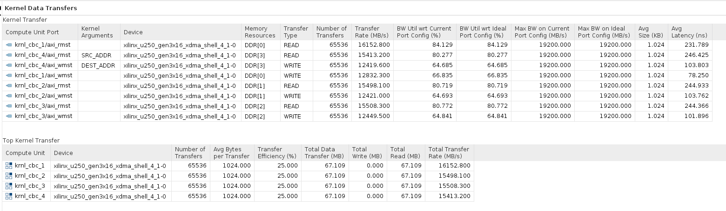
Use memory bandwidth at maximum
Connect multiple bank for multiple kernel one by one
  Minimum Read BW Util : 80%
  Maximum Read BW Util : 84 %
  Avg Read BW Util : 81
  Minimum Write BW Util : 66%
  Maximum Write BW Util : 64 %
  Avg Read BW Util : 65 %
--profile.trace_memory $(TRACE_DDR)
BW가 향상된 것을 확인할 수 있다

Slide 18
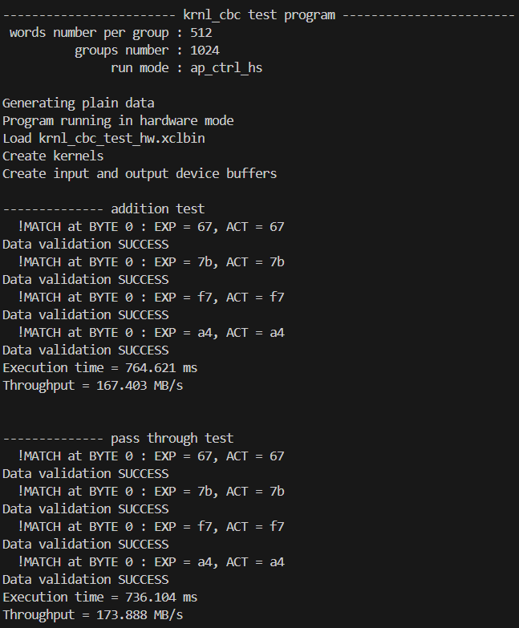
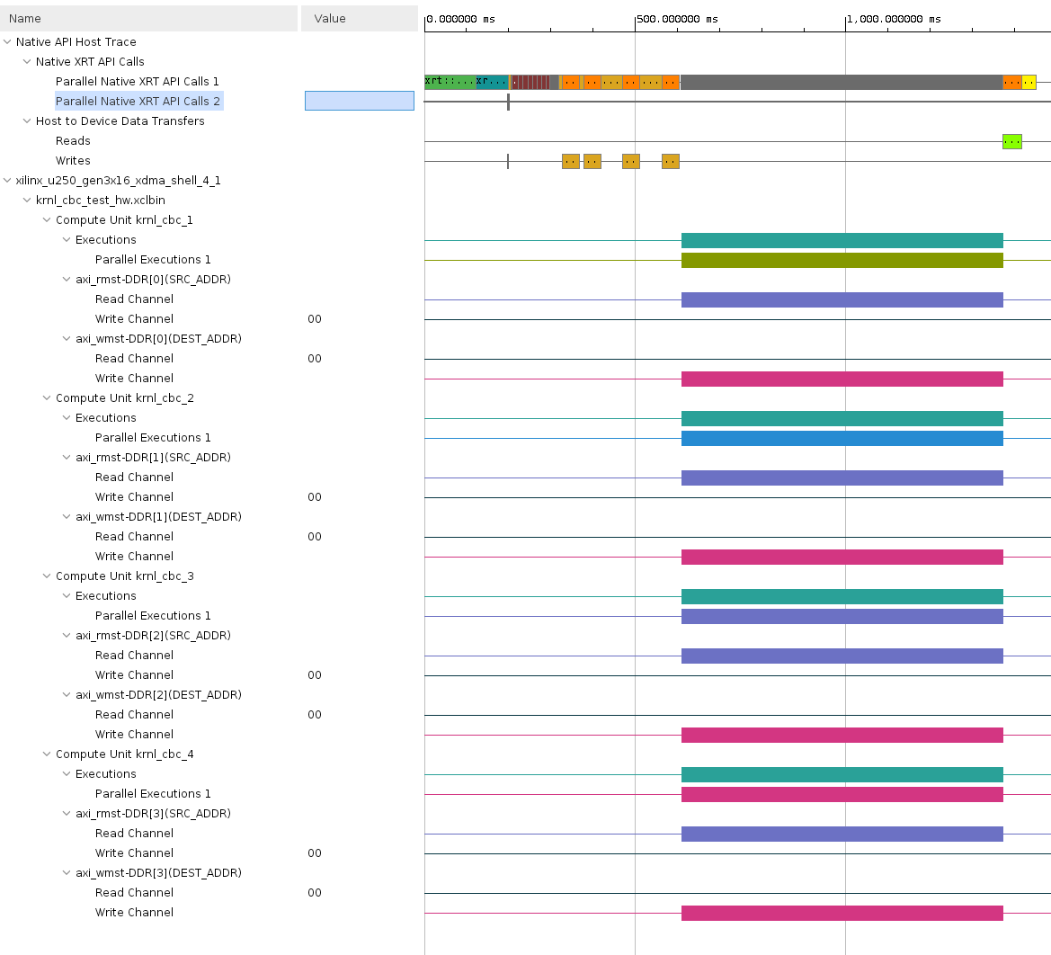
Use memory bandwidth at maximum
Connect multiple bank for multiple kernel one by one
--profile.trace_memory $(TRACE_DDR)
BW가 향상된 것을 확인할 수 있다

Slide 19
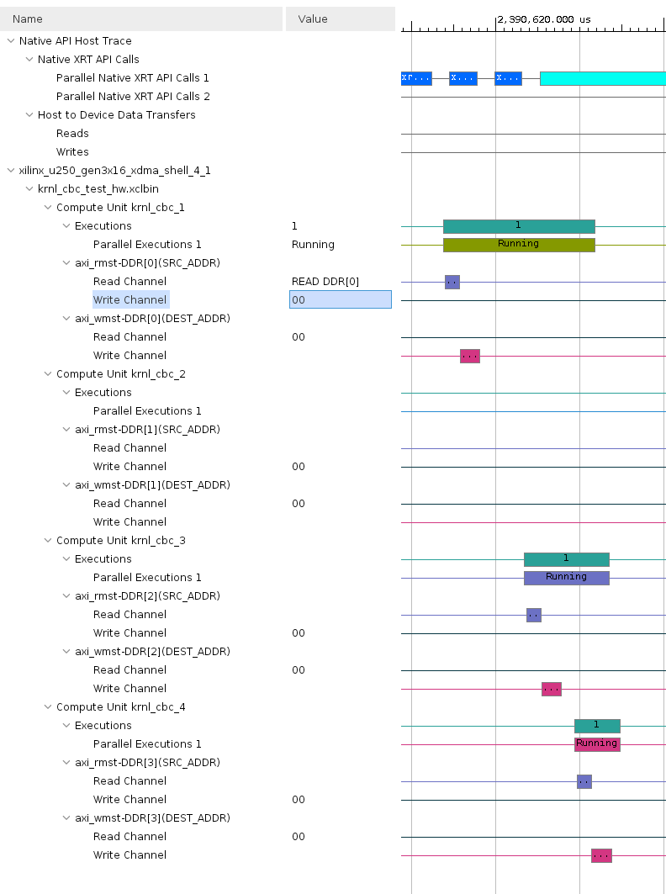
Use memory bandwidth at maximum
Connect multiple bank for multiple kernel one by one
Significant
  Parallel execution not implemented. Need to check if different memory bank access is possible simultaneously
  Not take advantage of Bandwidth using multiple axi ports.
  No write detected in Top kernel transfer
  Transfer efficiency is related with Maximum burst length (16 -> 64)
Need to check Read band 2 / Write bank 2 configuration
--profile.trace_memory $(TRACE_DDR)
BW가 향상된 것을 확인할 수 있다

Slide 20
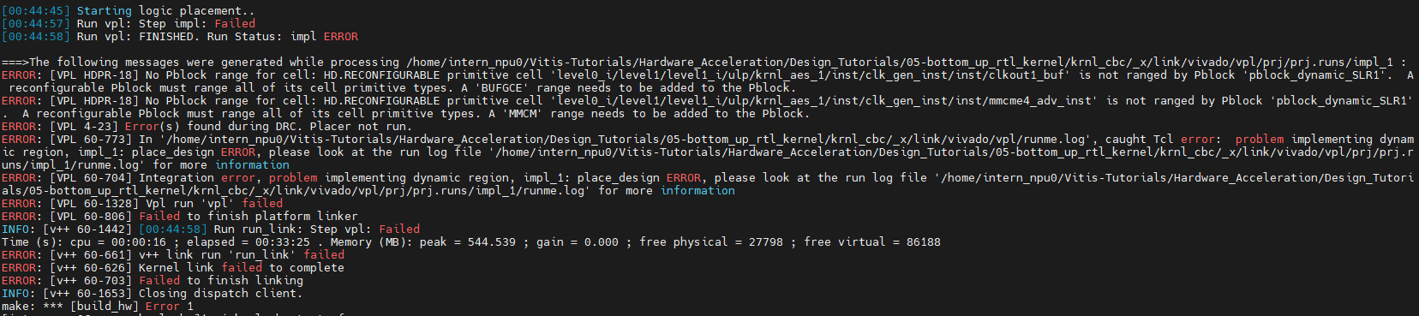
Appendix
PBLOCK ERROR
  Try to set CU in SLR2 region, PBLOCK error appeared
  Using clock region boundaries to define the size of the pblock
  Help limit skew, overall clock placement

