Slide 1
Machine Learning Decision Theory
Game Theory
Stable Marriage Problem

Slide 2
Game Theory: Pure Strategy Game
[Example] During the 8PM to 9PM, two TV broadcast service providers (e.g., MBC and KBS) compete for an audience of 100 viewers. The networks announce their schedule ahead of time and do not know of each other’s decision until the show time. Based on that a certain number of people will tune to MBC while the rest will watch KBS. The market research revealed the following expected number of viewers of MBC.
MBC (KBS)
Payoff Matrix

Slide 3
Game Theory: Pure Strategy Game
[Example] During the 8PM to 9PM, two TV broadcast service providers (e.g., MBC and KBS) compete for an audience of 100 viewers. The networks announce their schedule ahead of time and do not know of each other’s decision until the show time. Based on that a certain number of people will tune to MBC while the rest will watch KBS. The market research revealed the following expected number of viewers of MBC.
MBC (KBS)
Payoff Matrix

Slide 4
Game Theory: Mixed Strategy Game
[Example] Player 1 draws a card from a card deck (and hides it from the other player). Then he decides to either pass in which case he discards the card and pays $1 to Player 2, or he will bet in which case it is 2nd player’s turn. Player 2 can either fold in which case she pays $1 to Player 1, or she will call and the card is revealed. If the revealed card is HIGH (10, Jack, Queen, King, Ace), then Player 2 pays $2 to Player 1. Otherwise, the card is LOW (2 through 9) and Player 1 pays $2 to Player 2. Now, let’s analyze the possible strategies for Player 1. Given the card, the card can be either HIGH or LOW. Based on that the player can either pass or bet. So there are 4 possible strategies: pass on both HIGH and LOW (PP), pass on HIGH and bet on LOW (PB), bet on HIGH and pass on LOW (BP), and bet on both HIGH and LOW (BB). Player 2 can either Call or Fold.

Slide 5
Game Theory: Mixed Strategy Game
Player 1
Payoff Matrix

Slide 6
Game Theory: Mixed Strategy Game
Player 1
Payoff Matrix
Player 1 is always passing: getting -1 profit with the probability of 1 (HIGH and LOW) and no chance to Call or Fold in Player 2
Finally, (-1)*1=-1

Slide 7
Game Theory: Mixed Strategy Game
Player 1
Payoff Matrix
Player 1 is passing with HIGH: getting -1 profit with the probability of 5/13
Player 1 is betting with LOW and Player 2 is calling: getting -2 profit with the probability of 8/13
Finally, (-1)*(5/13)+(-2)*(8/13) = -21/13

Slide 8
Game Theory: Mixed Strategy Game
Player 1
Payoff Matrix
Player 1 is passing with HIGH: getting -1 profit with the probability of 5/13
Player 1 is betting with LOW and Player 2 is folding: getting 1 profit with the probability of 8/13
Finally, (-1)*(5/13)+(1)*(8/13) = 3/13

Slide 9
Game Theory: Mixed Strategy Game
Player 1
Payoff Matrix
Player 1 is betting with HIGH and Player 2 is calling: getting 2 profit with the probability of 5/13
Player 1 is folding with LOW: getting -1 profit with the probability of 8/13
Finally, (2)*(5/13)+(-1)*(8/13) = 2/13

Slide 10
Game Theory: Mixed Strategy Game
Player 1
Payoff Matrix
Player 1 is betting with HIGH and Player 2 is folding: getting 1 profit with the probability of 5/13
Player 1 is folding with LOW: getting -1 profit with the probability of 8/13
Finally, (1)*(5/13)+(-1)*(8/13) = -3/13

Slide 11
Game Theory: Mixed Strategy Game
Player 1
Payoff Matrix
Player 1 is always betting and Player 2 is calling: getting 2 profit with the probability of 5/13 (HIGH) and -2 profit with the probability of 8/13 (LOW)
Finally, (2)*(5/13)+(-2)*(8/13) = -6/13

Slide 12
Game Theory: Mixed Strategy Game
Player 1
Payoff Matrix
Player 1 is always betting and Player 2 is folding: getting 1 profit with the probability of 1 (HIGH and LOW)
Finally, 1*1=1

Slide 13
Game Theory: Mixed Strategy Game
Player 1
Payoff Matrix

Slide 14
Game Theory: Mixed Strategy Game
Player 1
Payoff Matrix (Reduced Form)

Slide 15
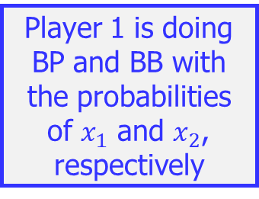
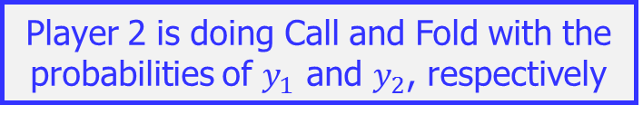
Game Theory: Mixed Strategy Game
Player 1
Payoff Matrix (Reduced Form)
Player 2 is doing Call and Fold with the probabilities of $y_{1}$ and $y_{2}$, respectively
Player 1 is doing BP and BB with the probabilities of $x_{1}$ and $x_{2}$, respectively

Slide 16
Game Theory: Mixed Strategy Game
Linear Programming Formulation
Maximizing the profit of Player 1
Expected Profit if Player 2 is doing Call
Expected Profit if Player 2 is doing Fold

Slide 17
Game Theory: Mixed Strategy Game
Linear Programming Formulation
Minimizing the loss of Player 2
Expected Loss if Player 1 is doing BP
Expected Loss if Player 1 is doing BB

Slide 18
Machine Learning Decision Theory
Game Theory
Stable Marriage Problem

Slide 19
Stable Marriage Example

Slide 20

Stable Marriage Problem: Setting and Definitions
General Setting
N men and N women; Each man (woman) has a preference list (ordering woman (man))
Definition
Matching: A pairing of each of the N men with a woman $(i, p(i))$ denotes man $i$ paired with woman $p(i)$.
Unstable Matching: There exist pairs $(i, p(i))$ and $(j, p(j))$; $i$ prefers $p(j)$ to $p(i)$; and $p(j)$ prefer $i$ to $j$.
Stable Matching: A matching that is not unstable.

Slide 21




Stable Marriage Problem: Example 1
Man | Preference List
Woman | Preference List
Kim
Jeon
Jin
Jeon
Kim
Lee
Lee
Jin
Jeon
Jin
Kim
Lee
Two
Possible
Matching
Stable
Kim
Jeon
Lee
Jin
Unstable
Lee
Jeon
Kim
Jin

Slide 22
Stable Marriage Problem: Gale-Shapley Algorithm (GSA)
All men are free
If some man are free
No
Terminate
Yes
The man proposes to woman who is the first woman who has not yet proposed to.
The man engaged to the woman
If the woman is free
Yes
No
The woman currently engaged to man2
No
The woman prefers man to man2
The woman engaged to the man1
Yes

Slide 23
Stable Marriage Problem: Example 2
GSA Procedure
(A 1)
(A 1)(B 2)
(A 1)(B 2)(C 3)
3 prefers D over C, i.e., (A 1)(B 2)(D 3)
C’s next preference is “2”. 2 prefers C over B, i.e., (A 1)(C 2)(D 3)
B’s next preference is “1”. The a does not want to switch.
B’s next preference is “4”; and the “4” is free., i.e., (A 1)(C 2)(D 3)(B 4)
A | 1 2 3 4
B | 2 1 4 3
C | 3 2 4 1
D | 3 4 2 1
1 | A C D B
2 | C D A B
3 | B A D C
4 | A B C D

Slide 24
Stable Marriage Problem: Internet Router Design with Virtual Queues
Head of Line Blocking

Slide 25
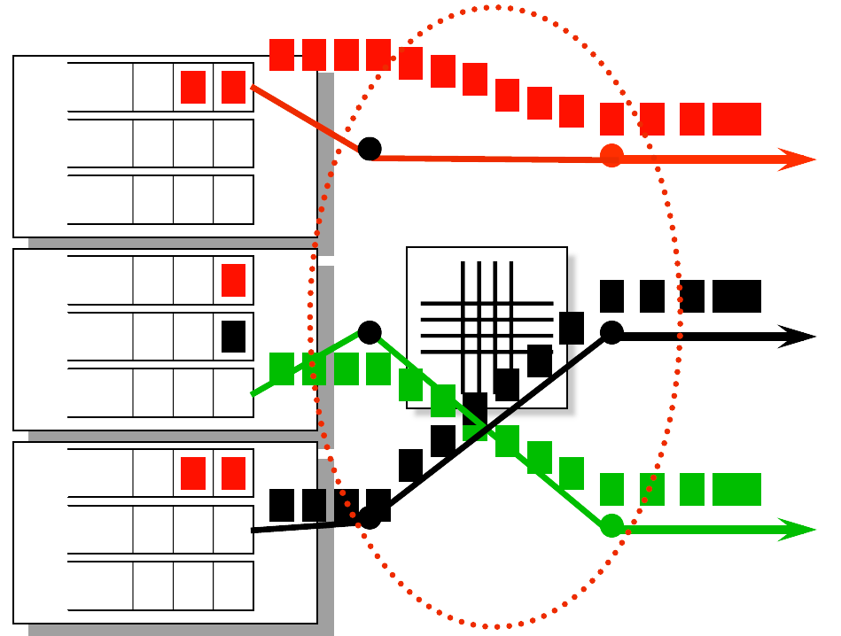
Stable Marriage Problem: Internet Router Design with Virtual Queues
Head of Line Blocking
Virtual Queues

Slide 26
Stable Marriage Problem: Internet Router Design with Virtual Queues
A
B
C
1
A | 1 3 2
B | 3 1 2
C | 3 1 2
A
B
C
2
1 | A B C
2 | B A C
3 | C B A
A
B
C
3
A
B
C

