Slide 1
GitHub Profile README
ReadMe로 Github profile 꾸미기
박원영 2020.10.27

Slide 2
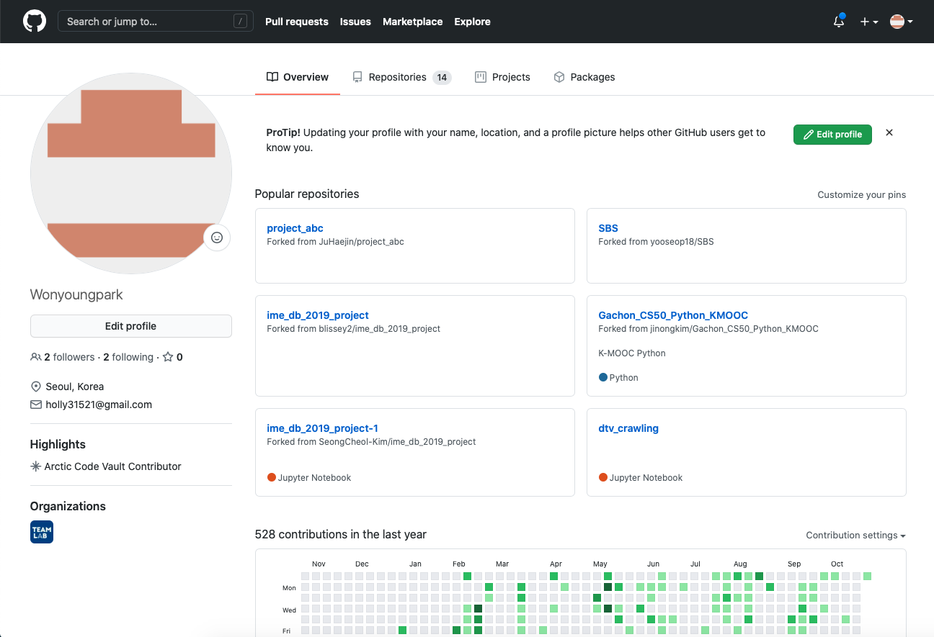
Git profile README로 꾸미기

Slide 3
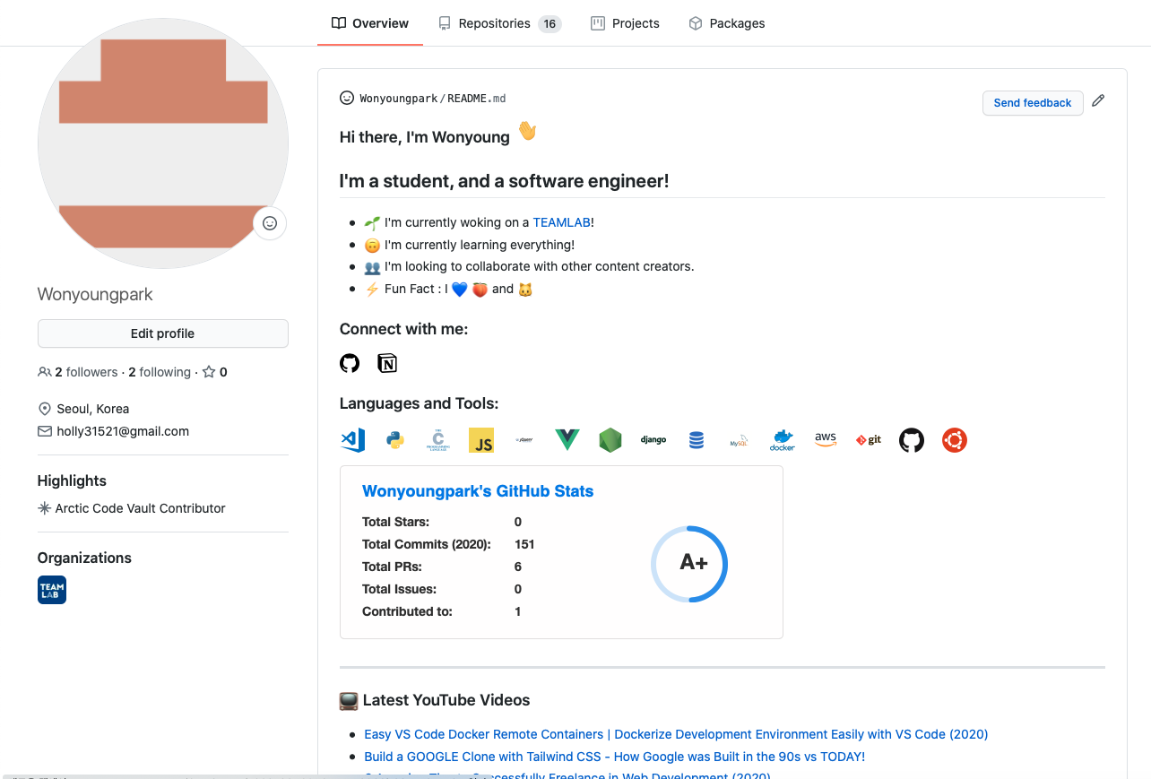
Git profile README로 꾸미기

Slide 4
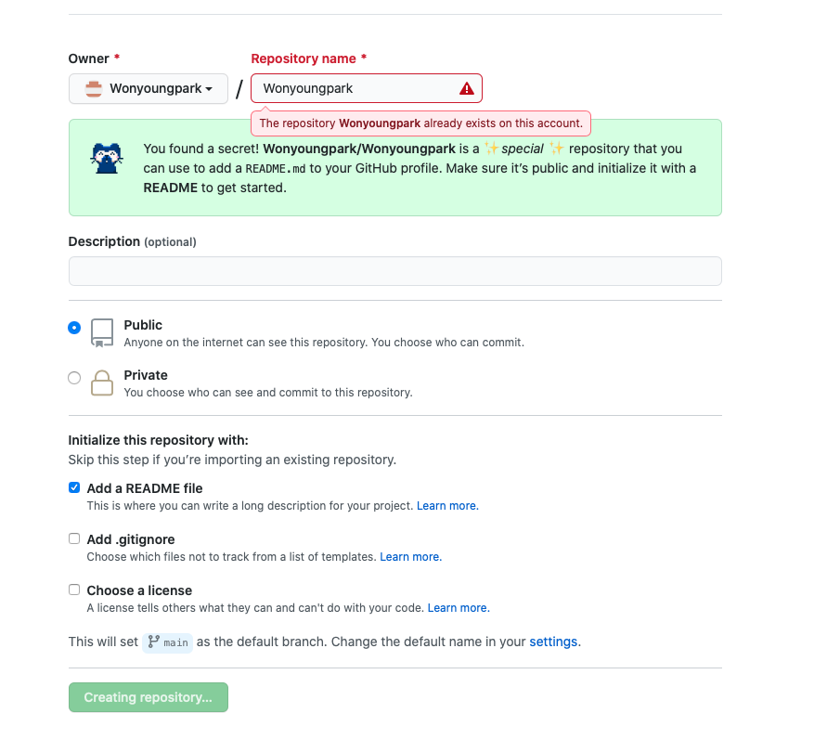
Git repository 생성

Slide 5
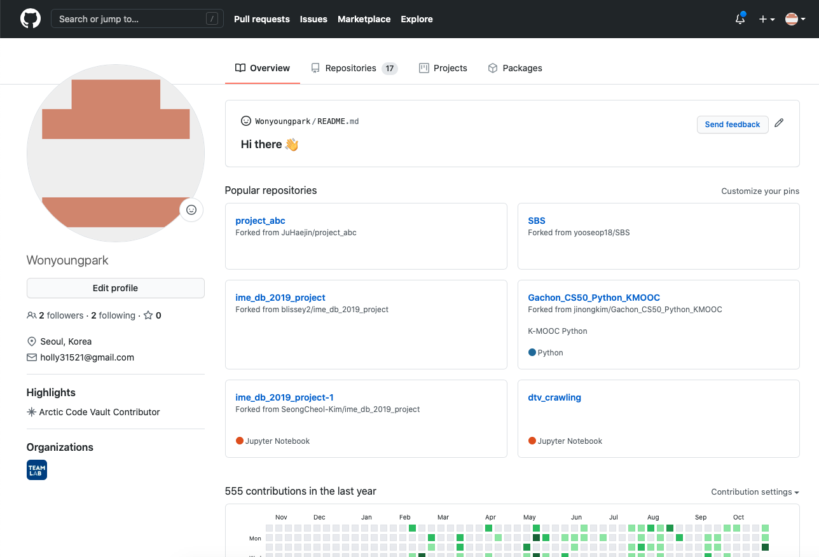

Slide 6
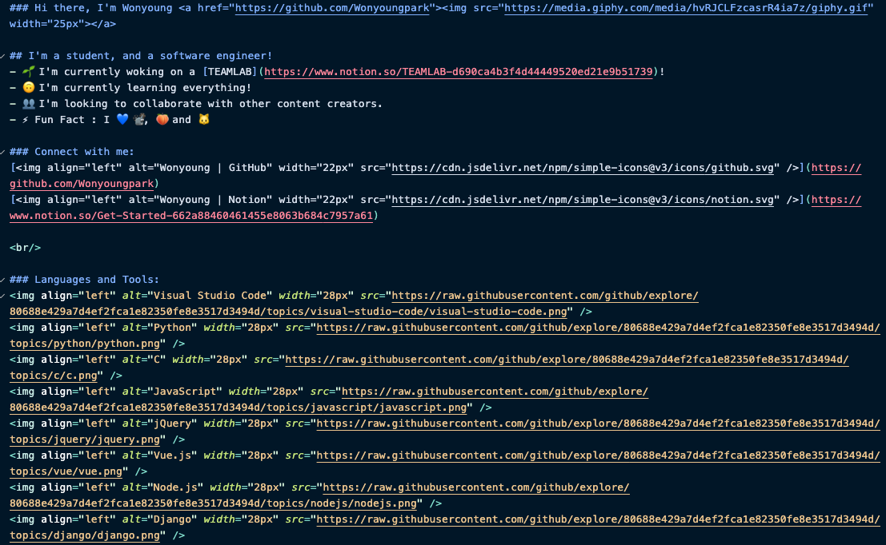
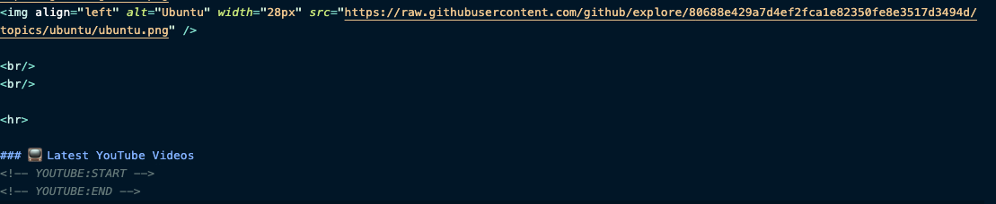
README.md
https://github.com/gautamkrishnar/gautamkrishnar

Slide 7
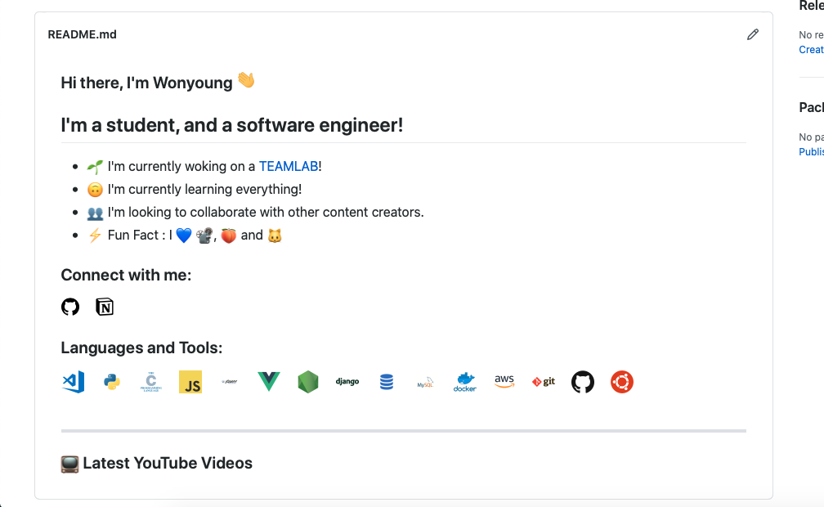

Slide 8
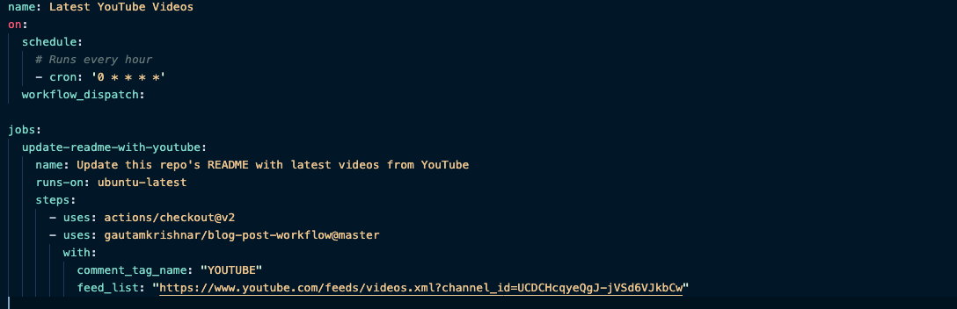
youtube-workflow.yml
https://github.com/gautamkrishnar/gautamkrishnar

Slide 9
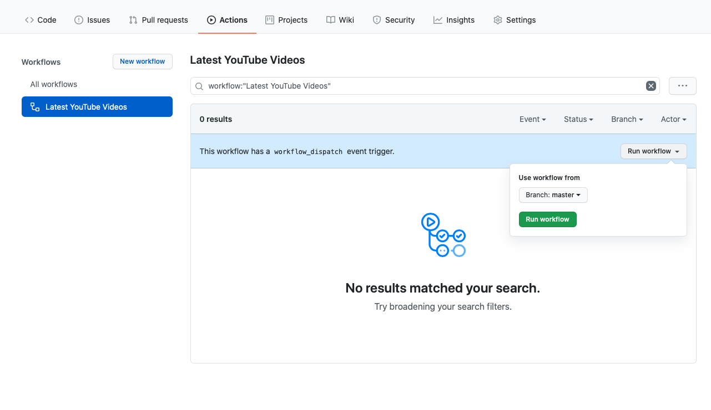
workflow 활성화

Slide 10
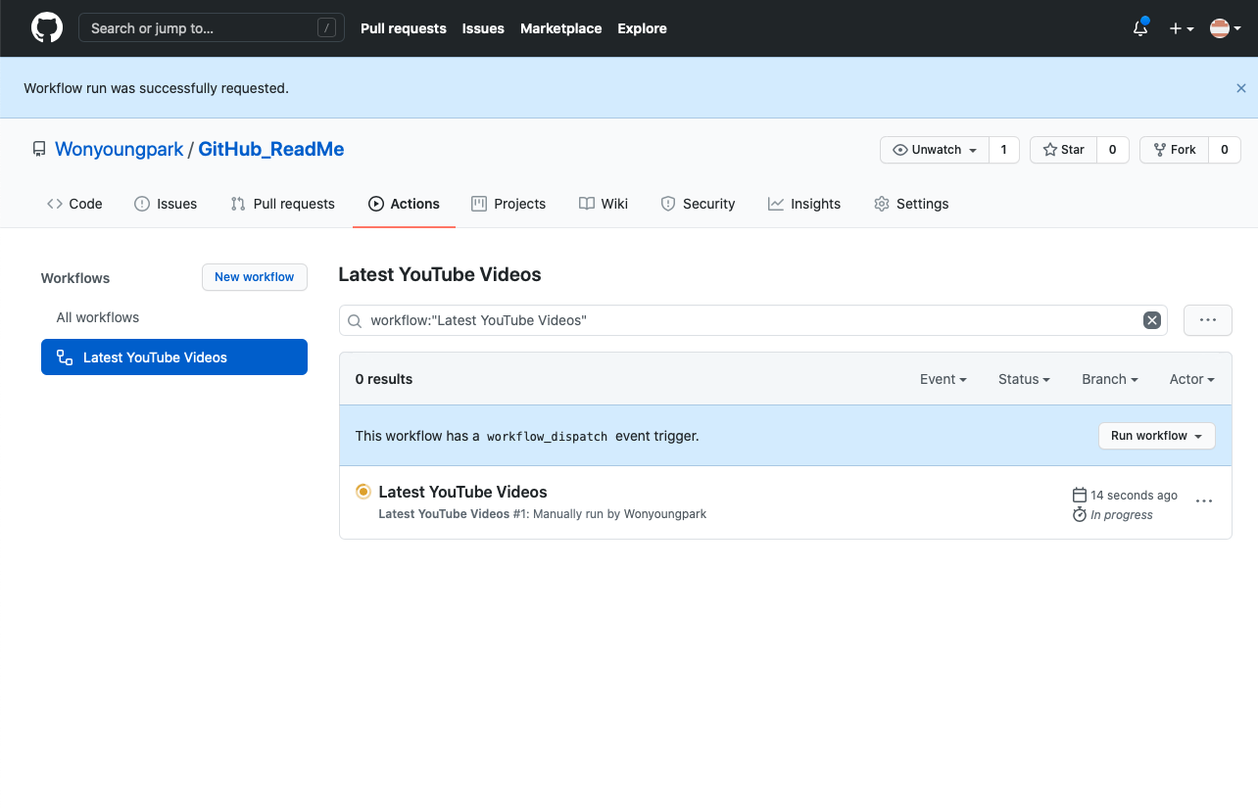

Slide 11
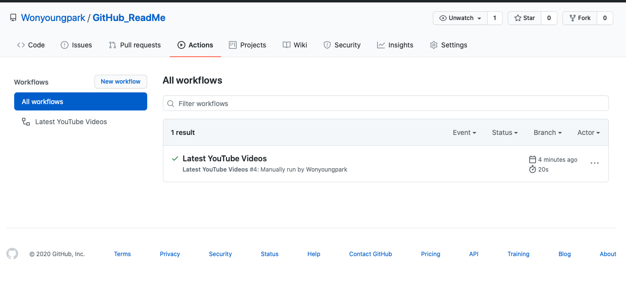

Slide 12
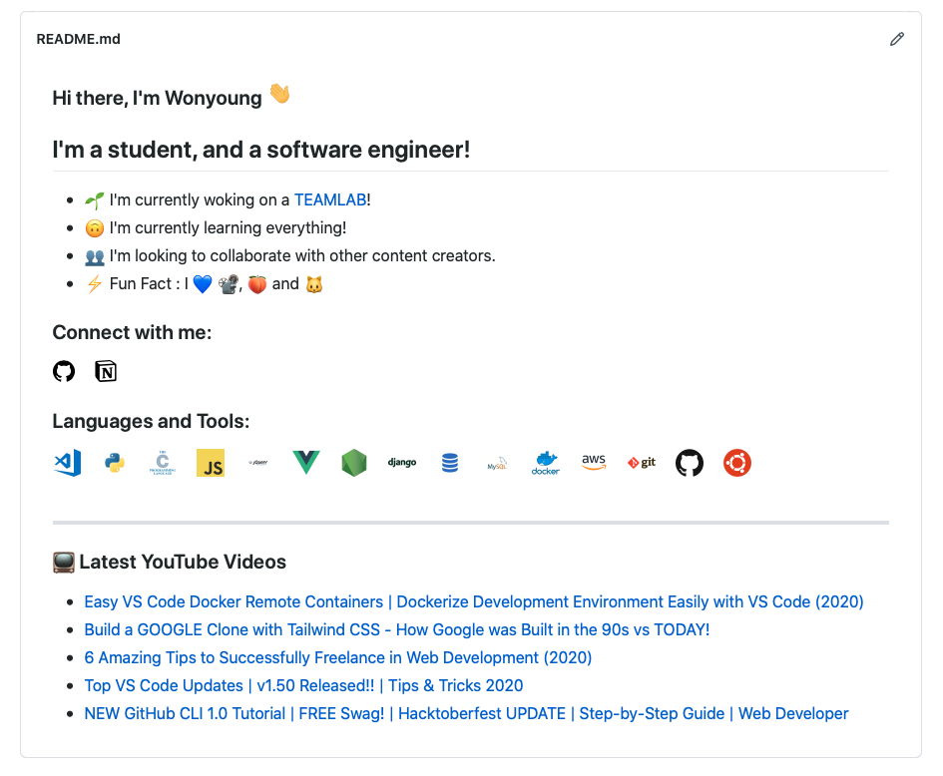


Slide 13
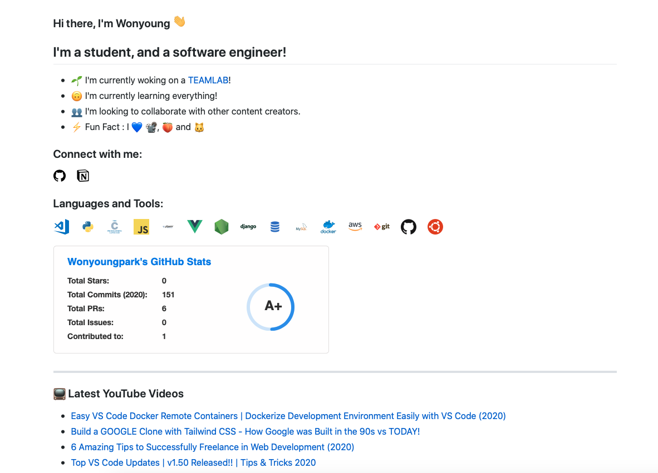
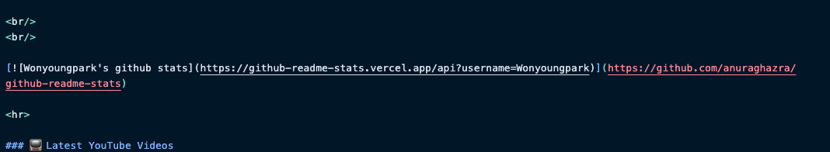
Git stats
https://github.com/anuraghazra/anuraghazra

Slide 14
감사합니다.

