Slide 1
Tanzania Mobile Money

Slide 2
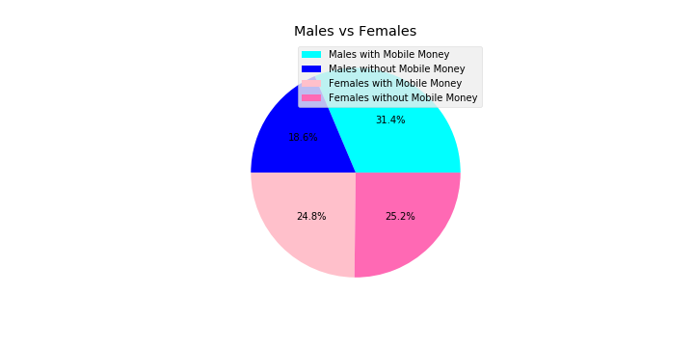
How Many People Have It?

Slide 3
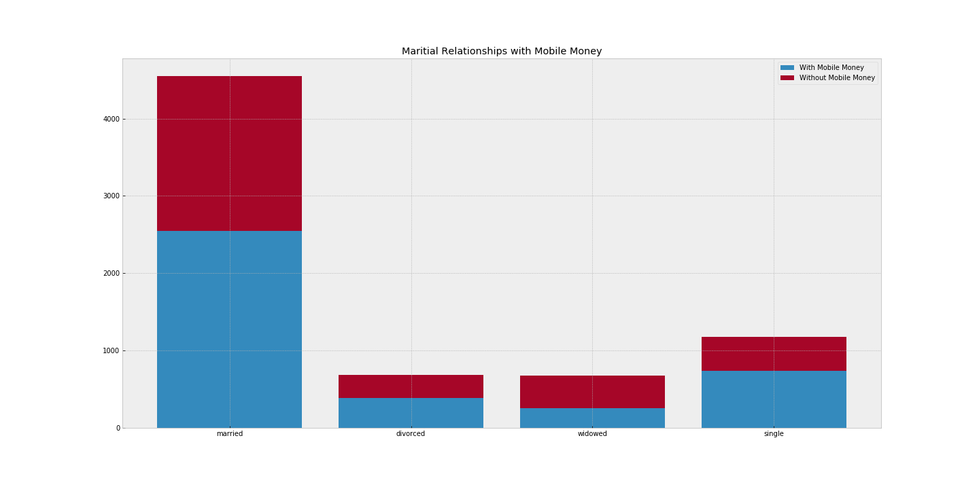
Relationships

Slide 4
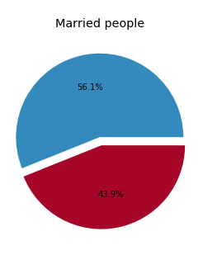
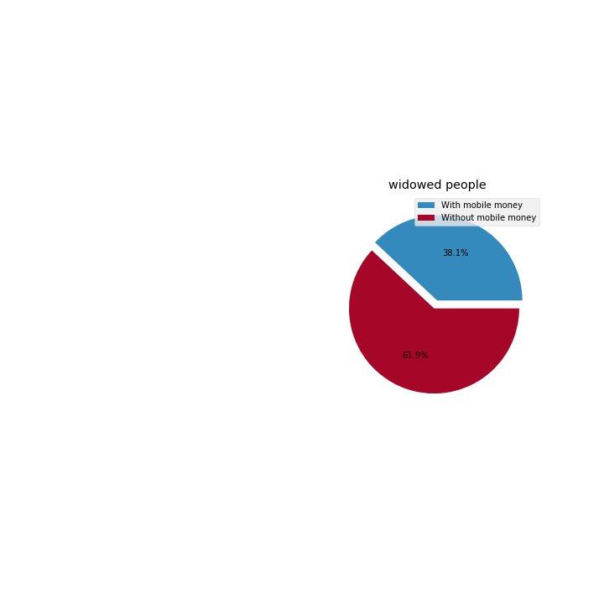
Married vs Widowed

Slide 5
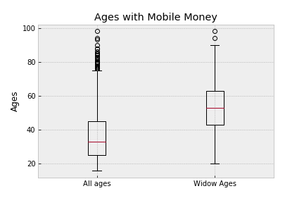
All ages compared to Widow ages

Slide 6
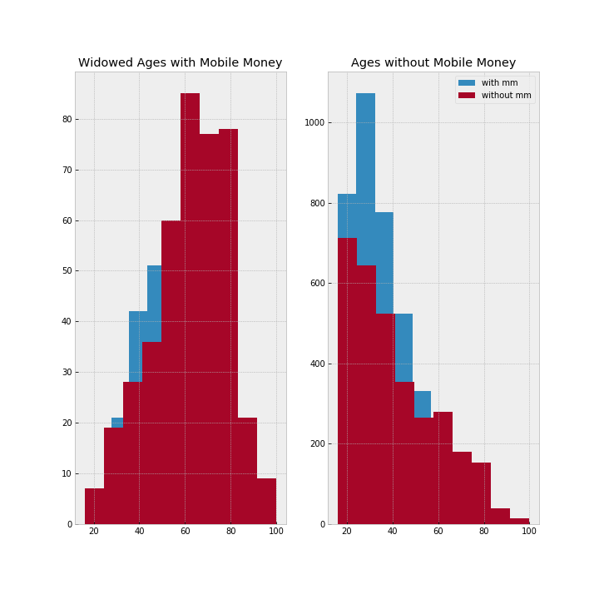
All ages compared to Widow ages

Slide 7
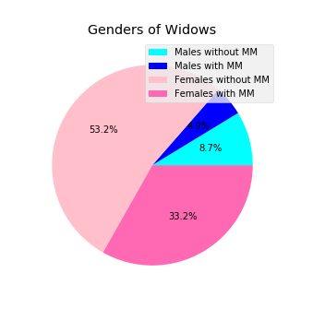
Gender of Widows

Slide 8
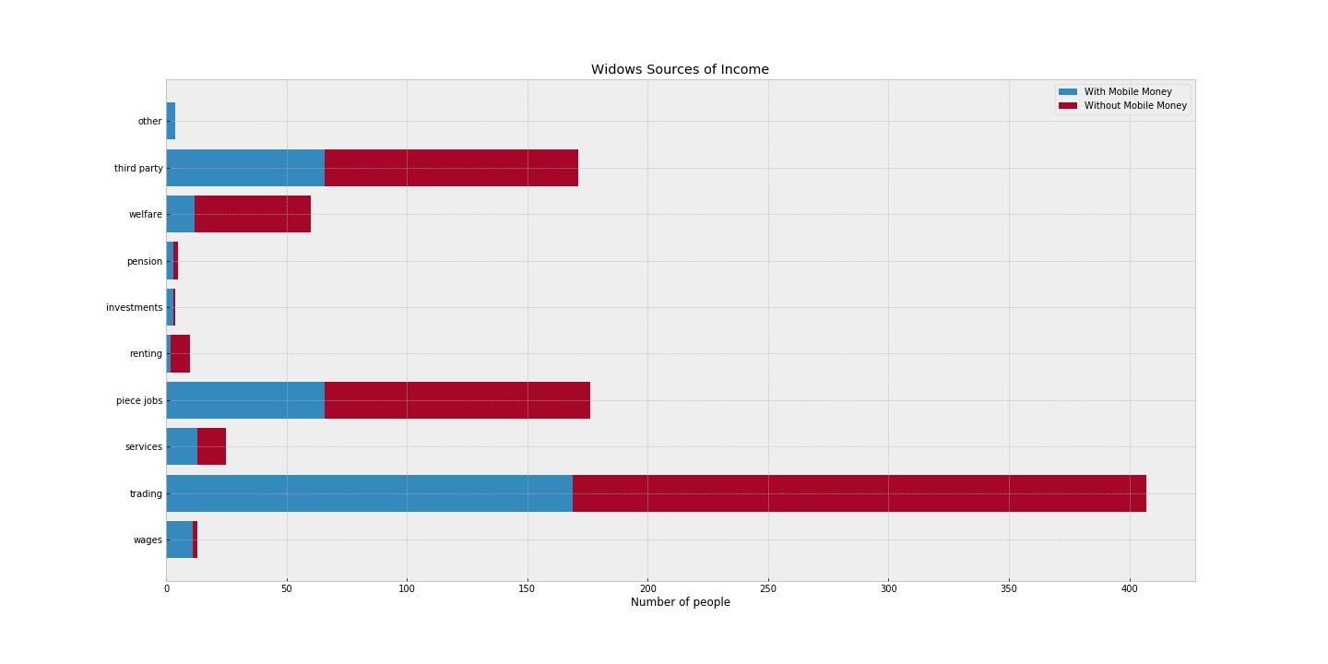
Why don’t the have Mobile Money

