Slide 1



Urban Infrastructure
Inspection System
Group 39
Jintong Zhang: 2360862
Qi Cao: 2360908

Slide 2

Content
01 Project Introduction
02 Sorting System
03 Graph System
04 Design of the Overall Application
05 Project Reflection

Slide 3
Project Introduction
Project Scenario
A city needs to conduct a large-scale infrastructure inspection task across its urban network. The task is to identify and prioritize important inspection locations from three candidate datasets, then calculate efficient routes for the given query cases using the weighted graph dataset.
Goal
Choose high-priority inspection targets and calculate shortest travel paths based on provided CSV files and query cases.
Objectives
Process three candidate datasets
Select top 10 highest-priority locations per dataset
Build weighted graph from paths.csv
Compute shortest paths for query cases

Slide 4
Task A – Algorithm Evaluation: Sorting

Slide 5
Task A Specification
Task A provided three datasets and required to implement three sorting algorithms and compare their performance. For each dataset, we have the following objectives:
Load Data
Program should correctly read 3 candidates dataset CSV files.
Sort Data
Perform experiments using Bubble Sort, Quick Sort, and Merge Sort.
Identify Top Priorities
Output top 10 highest-priority locations from each dataset.
Compare Performance
Measure and compare the running time of the three sorting
algorithms.

Slide 6
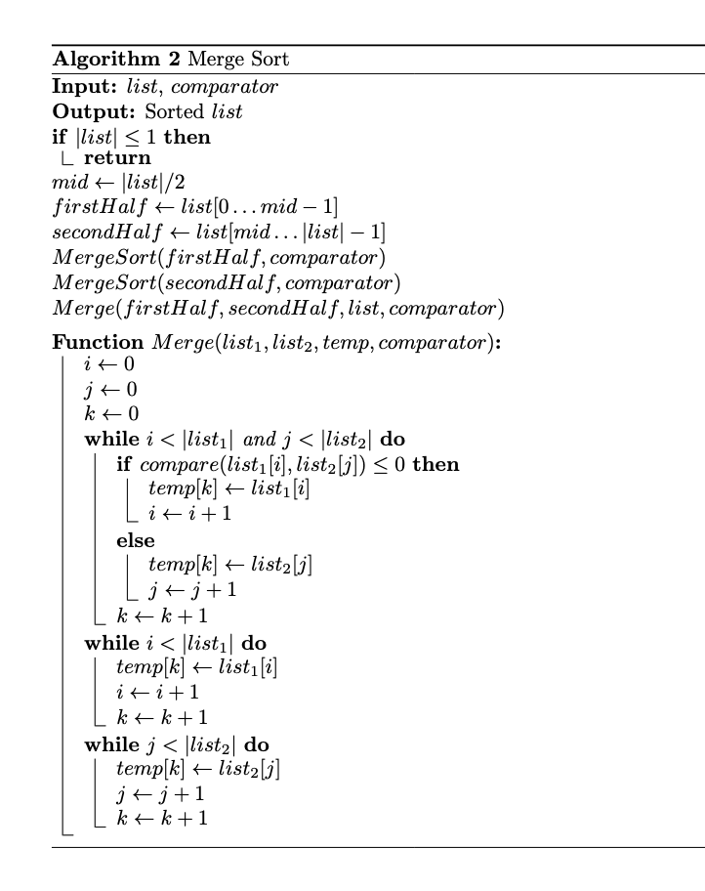
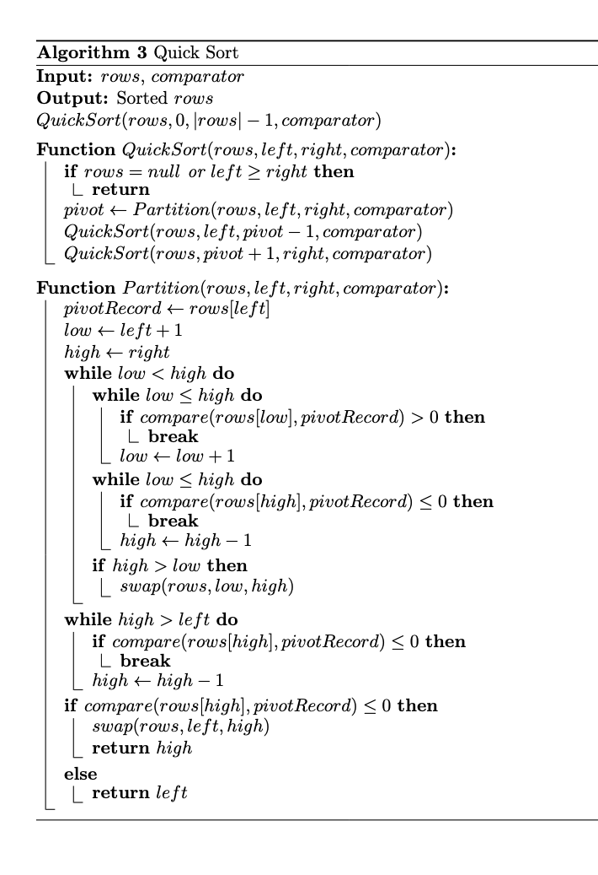
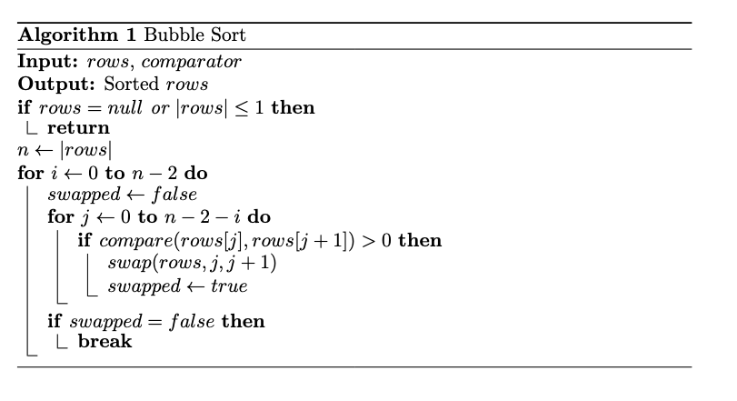
Task A - Algorithm Implementation

Slide 7




Task A - Sorting Rules and Running Details
Sorting Rules
Running Details
Primary Rule: Priority Score
Sort by priority_score in descending order.
Higher priority scores are processed first.
Warm-up Phase
50 iterations per dataset.
Ensures consistent JVM optimization/state.
Tie-breaking Rule: Location ID
If scores are equal, sort by location_id in ascending order.
Uses lexicographic comparison for identical scores.
Main Execution
1000 iterations per dataset.
Reliable performance measurement benchmark.

Slide 8
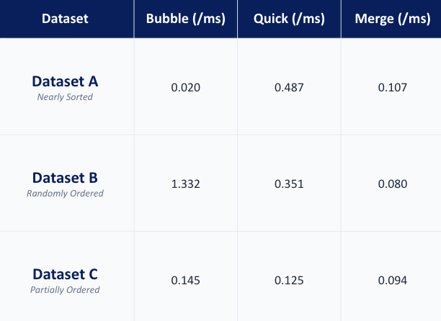
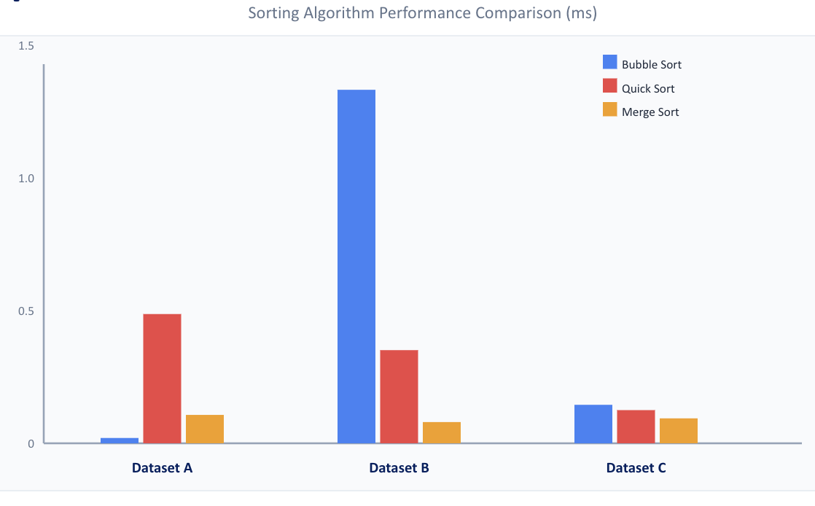
Task A - Experimental Results
Top 10 Locations
Dataset A: L0001, L0002, L0003, L0004, L0005, L0006, L0007, L0008, L0009, L0010
Dataset B: L0101, L0102, L0103, L0104, L0105, L0106, L0107, L0108, L0109, L0110
Dataset C: L0201, L0202, L0203, L0204, L0205, L0206, L0207, L0208, L0209, L0210
Top 10 Locations
DatasetA: L0001, L0002, L0003, L0004, L0005, L0006, L0007, L0008, L0009, L0010
DatasetB: L0101, L0102, L0103, L0104, L0105, L0106, L0107, L0108, L0109, L0110

Slide 9
Task A - Dataset Characteristics
Dataset A
Dataset B
Dataset C
Nearly Sorted
Priority scores are mostly in descending order.
Only a small number of records do not follow this ranking rule.
Randomly Ordered
Data is not arranged by priority score or tiebreaker.
Location ID tie-breaking is inconsistent for same priority scores.
Partially Ordered
General descending order with many duplicate priority values.
Tie-breaking via Location ID is not consistently sorted.

Slide 10
Task A - Analysis
Dataset A
Bubble Sort is the fastest.
Reasons: Data is nearly sorted, approaching the best-case scenario. The optimized version stops early when no swaps occur.
Merge and Quick Sort still process the whole dataset at O(nlogn).
Dataset B
Merge Sort is the fastest.
Reasons: Merge and Quick Sort average O(nlogn).
Quick Sort speed depends on pivot choice; our first-element pivot may affect runtime.
Random order forces Bubble Sort into O(n²) complexity.
Dataset C
Merge Sort is the fastest.
Reasons: While priority scores are descending, duplicates require secondary sorting. Merge Sort handles this stably at O(nlogn).
Quick Sort speed depends on pivot choice.
Bubble Sort performs better here than on Dataset B but still requires swaps.

Slide 11
Task A - Additional Experiment - Different Pivot Types
Average Time by Pivot Type (ms)
LEFT pivot
RIGHT pivot
MIDDLE pivot
MIDDLE_OF_THREE
0.6
RANDOM pivot
0.3
0
Dataset A
Dataset B
Dataset C

Slide 12
Task A - Tradeoff Analysis
Bubble Sort
Time Complexity
O(n²)
Space Complexity
O(1)
Highly efficient in memory usage, but performance is strictly dependent on the initial input order.
Quick Sort
Time Complexity
O(n log n)
Space Complexity
O(log n)
Offers a great balance between speed and recursive memory overhead.
Merge Sort
Time Complexity
O(n log n)
Space Complexity
O(n)
Guaranteed performance at the cost of additional memory space to store temporary subarrays.

Slide 13
Task B – Algorithm Evaluation: Graph

Slide 14
Task B - Specification
Identify several shortest paths using 30 selected inspection targets (10 from each dataset) on the weighted infrastructure graph.
Graph Data: paths.csv
Contains edge information for an undirected weighted graph.
from_location
to_location
weight
Pathfinding Scenarios
Case 1: From 1st selected location in Dataset A to itself.
Case 2: From 1st location in Dataset A to 10th location in Dataset A.
Case 3: From 1st location in Dataset A to 1st location in Dataset B, via 5th location in Dataset B.
Case 4: From 1st location in Dataset A to 1st location in Dataset C, passing through 5th location in Dataset B then 5th location in Dataset C.

Slide 15
Task B - Graph Construction
Implementation of the WeightedGraph class and its core adjacency data structure.
Adjacency List
Map<String, List<Edge>>
Key: Represents the locationId (unique identifier).
Value: Stores a list of Edge objects connected to that node.
public class WeightedGraph implements Graph {
private final Map<String, List<Edge>> adjacency = new HashMap<>();
public void addUndirectedEdge(String a, String b, int weight) {
adjacency.computeIfAbsent(a, k -> new ArrayList<>()).add(new Edge(b, weight));
adjacency.computeIfAbsent(b, k -> new ArrayList<>()).add(new Edge(a, weight));
}
@Override
public List<Edge> getNeighbors(String node) {
return adjacency.getOrDefault(node, Collections.emptyList());
}
@Override
public int edgeCount() {
int total = 0;
for (List<Edge> edges : adjacency.values()) { total += edges.size(); }
return total / 2;
}
}
Core Operations
Add Edge: Bi-directional addition for undirected graph structure.
Get Neighbors: Efficient O(1) lookup for adjacent nodes.
Get Edge Count: Iterates through values, dividing total by 2 to account for bi-directionality.

Slide 16
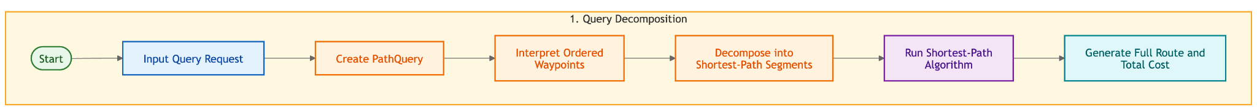
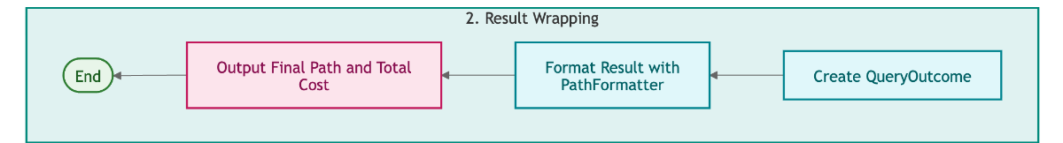
Task B - Query I/O Implementation

Slide 17
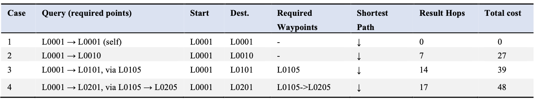
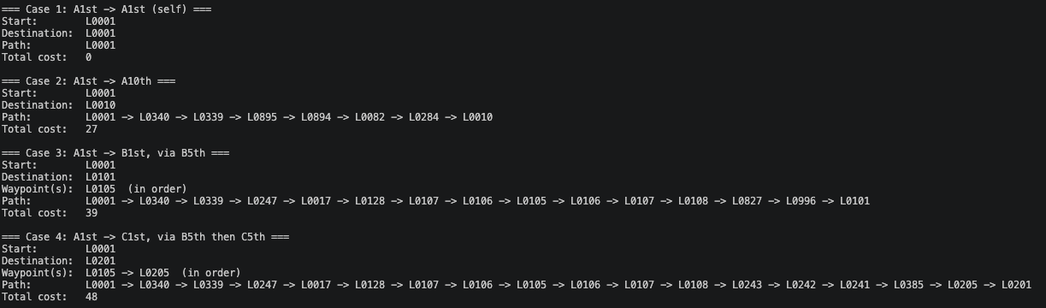
Task B - Experimental Results

Slide 18



Task B - Algorithm Choose
Prerequisites
Weighted Graph
Algorithm requires numerical weights on all edges.
No Negative Edges
Weights must be non-negative for correct convergence.
SSSP Problem
Solves Single Source Shortest Path efficiency.
Selected Algorithm
Dijkstra's
A greedy algorithm that finds the shortest paths between nodes in a graph.

Slide 19
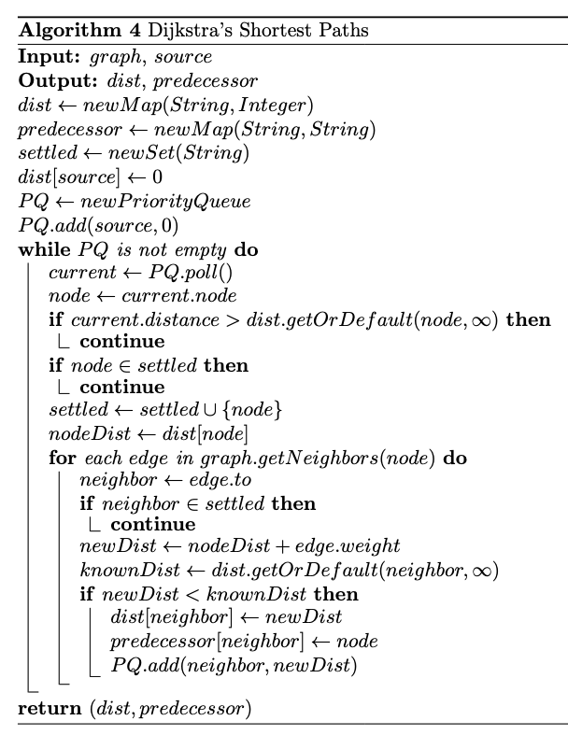
Task B - Dijkstra’s Algorithm
Implementation
PriorityQueue + Lazy-deletion
Time Complexity
O((V + E) log V)
Space Complexity
O(V + E)

Slide 20
Task B - Alternative Algorithms under Varying Graph Conditions
1. Unweighted Graph: BFS (Breadth-First Search)
The optimal choice for unweighted graphs, exploring level by level to guarantee the shortest path by edge count.
The FIFO queue used in BFS is sufficient to process nodes in increasing order of distance with time complexity of O(V+E).
2. Large-Scale Graph Processing: Bidirectional Dijkstra
Runs simultaneous searches from source and target to meet in the middle, reducing search space from a radius d to two circles of radius d/2.
Limitation: Doubles memory overhead and requires destination knowledge before the search begins.
3. Node Coordinates Available: A* Search Algorithm
Treats the graph as a spatial network using heuristic estimates of straight-line distance to guide the search efficiently.
f(n) = g(n) + h(n)
g(n): actual cost from start; h(n): heuristic estimate from coordinates to goal.

Slide 21
Task C – Design of the Overall Application

Slide 22
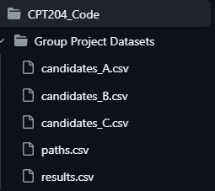
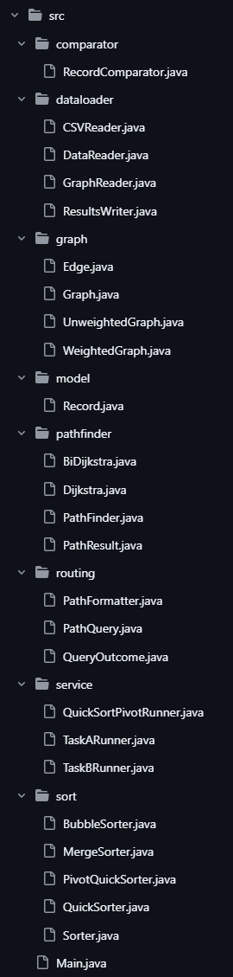
Task C - Design of the Overall Application
Overall Program Design

Slide 23
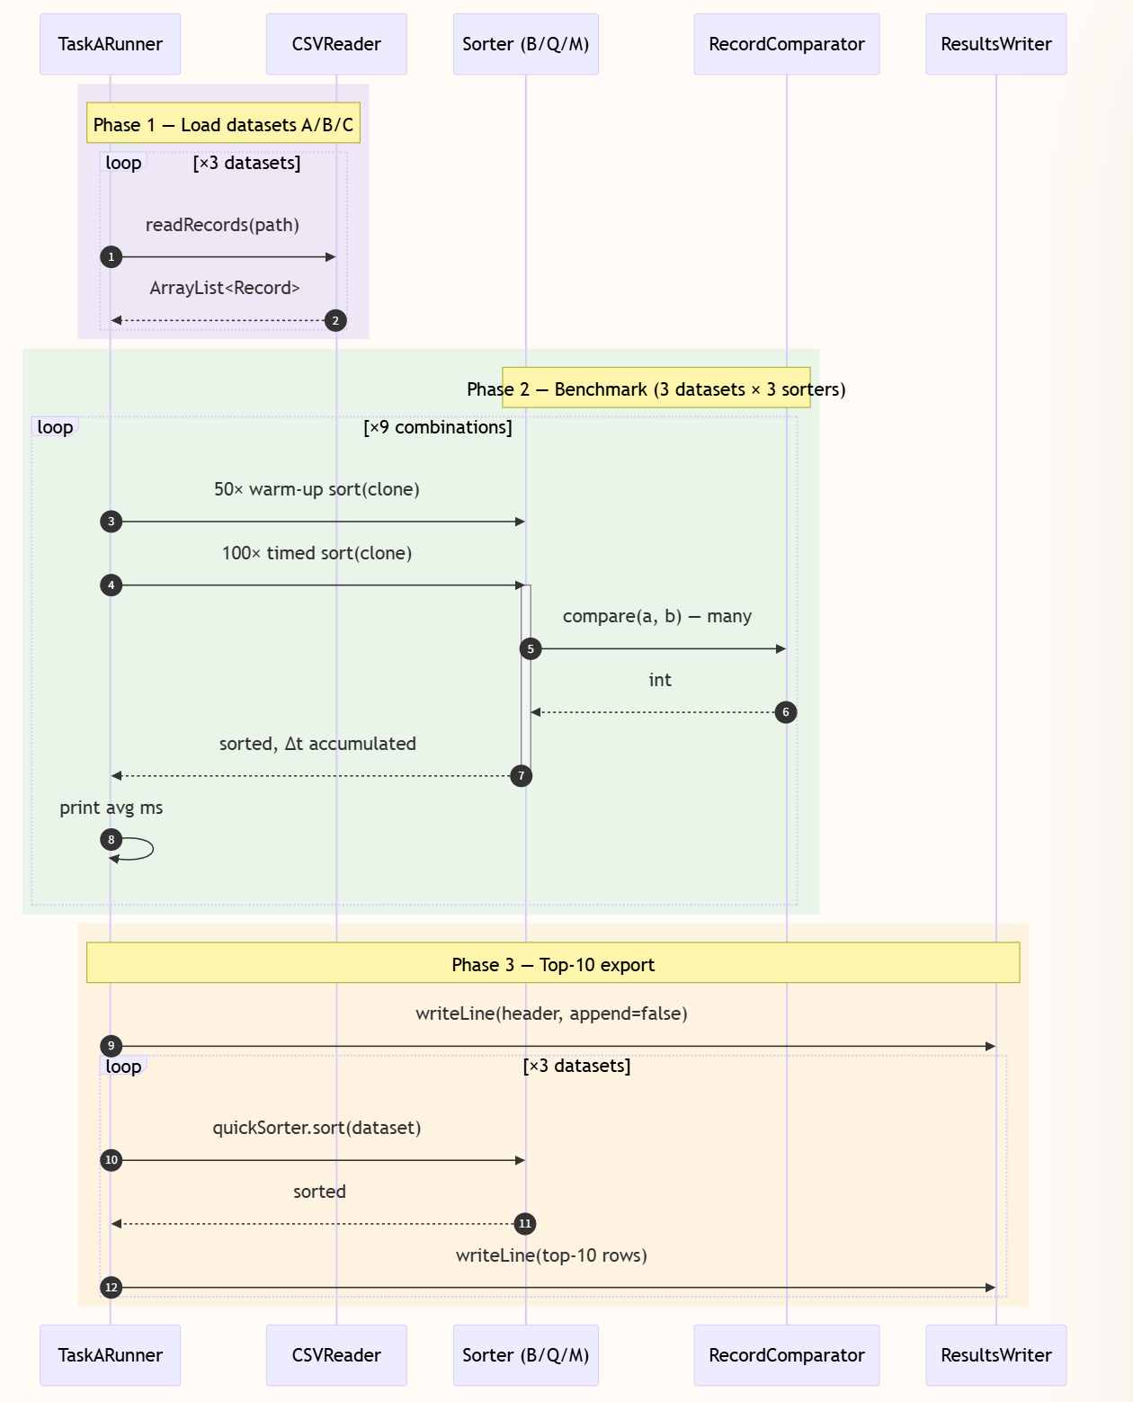
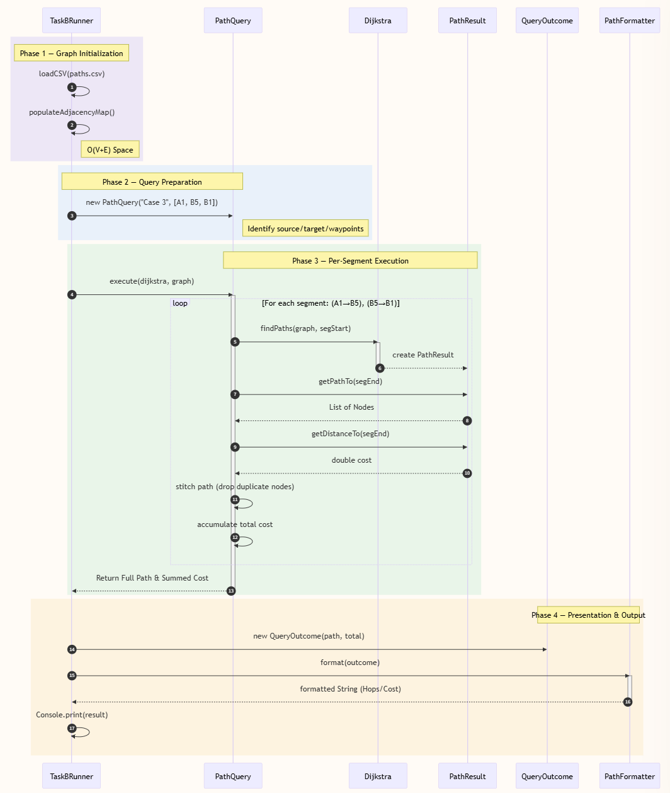
Task C - WorkFlow

Slide 24
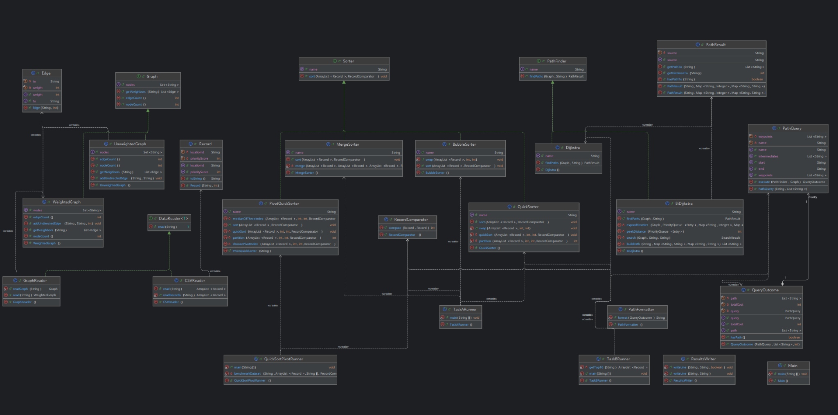
Task C - Overview of Classes We Use
Task C - Overview of Classes We Use

Slide 25
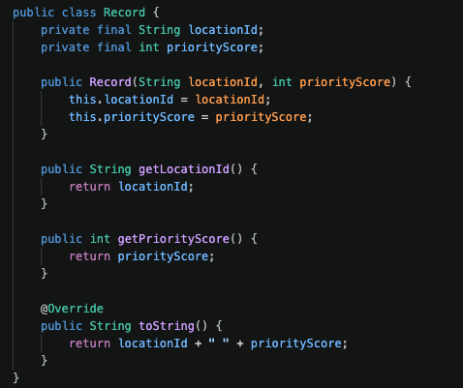
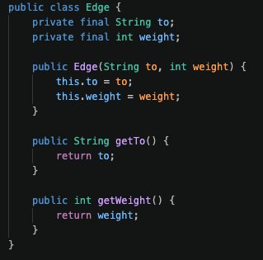
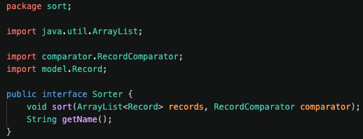
Task C - OOP Design Principles
(1). Encapsulation
Pivotal for information hiding and state protection. Applied to protect internal states and hide complex data structures.
Classes like Record and Edge use private fields and public getters.
(2). Inheritance
Allow a class to reuse or follow the structure and behaviour defined by another class or interface.
Sorting classes implement the Sorter interface, providing specific sorting logic while sharing a common structure.
Encapsulation Examples
(3). Polymorphism
Treat different classes through the same interface, executing specific methods at runtime.
Algorithms like Bubble Sort and Quick Sort are called via the same sort() method.
(4). Abstraction
Hide unnecessary implementation details, exposing only essential functions.
Interfaces like Graph define operations without exposing internal representations like WeightedGraph.
Inheritance Examples

Slide 26
Task D – Project Reflection

Slide 27

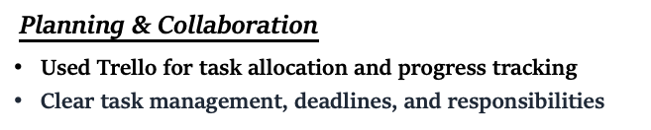
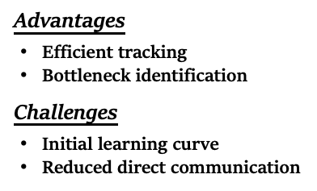
Task D - AI-assisted planning and collaboration
AI-assisted planning and collaboration

Slide 28

Task D - Equality, Diversity, and Inclusion
Equality, Diversity and Inclusion (EDI)
Future improvements
Equality: Fair opportunity for all members to contribute, regardless of gender.
Diversity: Varied backgrounds and expertise (e.g., writing vs. programming).
Inclusion: Empowered and safe environment to share insights and suggestions.
Future improvements: voice navigation, text-to-speech, multilingual support
Challenges: increased complexity, resource demands, skill gaps
Solutions: user research, accessibility training, sufficient resource planning

Slide 29
Task D - Life-long learning and future improvement
Future Plans
Optimize user experience
Accessibility features
Better resource planning
Personal Learning
Enhance OOP skills: class design, encapsulation, abstraction
Practical experience with graph and sorting algorithms
Improve teamwork, communication, and problem-solving abilities

Slide 30
THANK YOU

