Slide 1


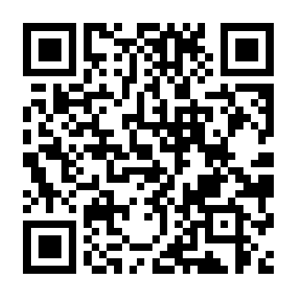
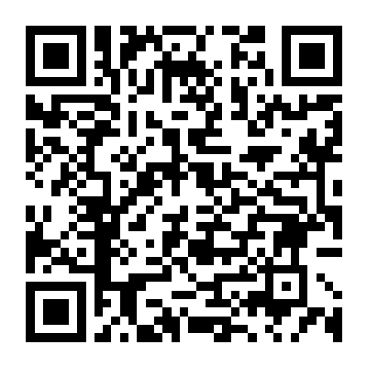
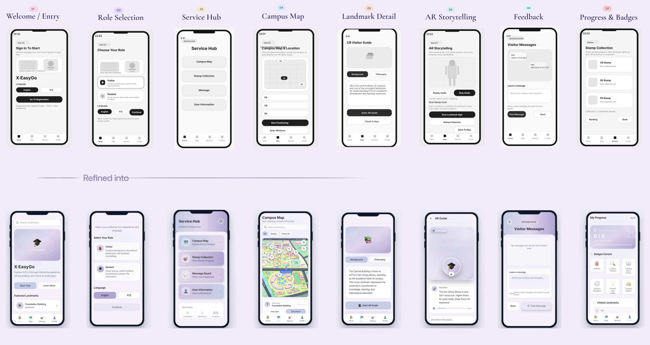
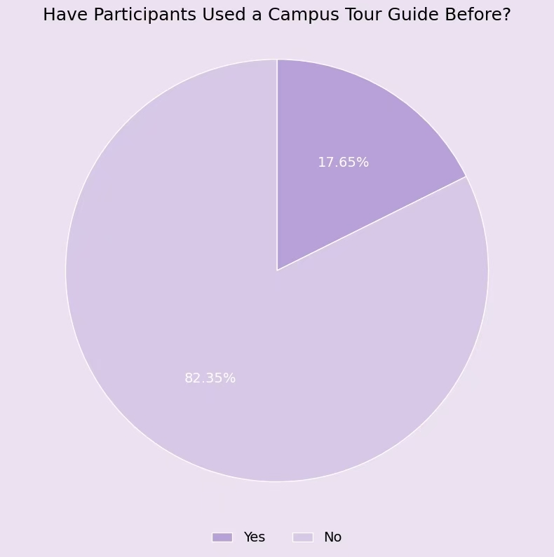
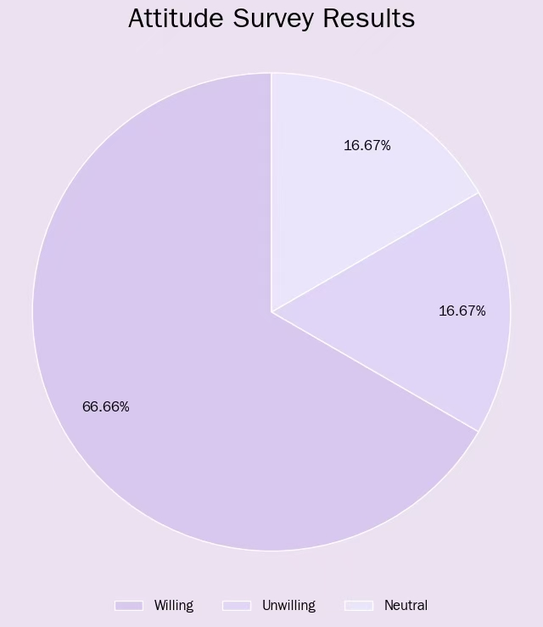
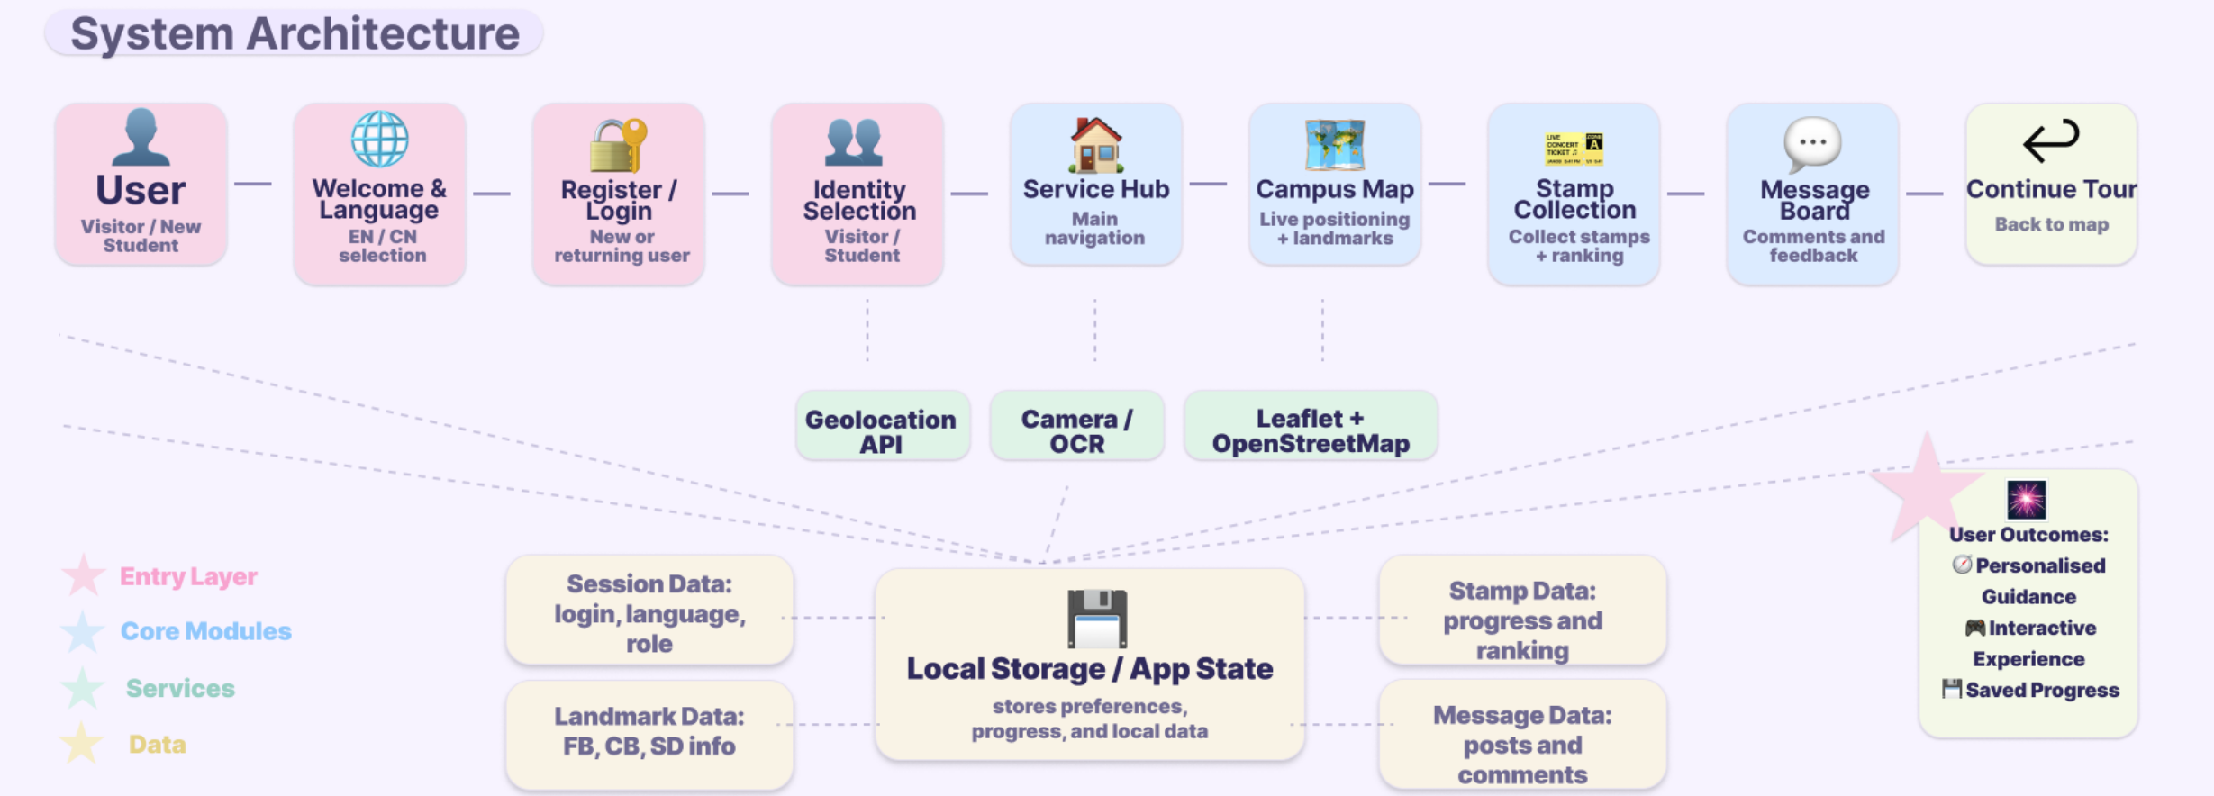
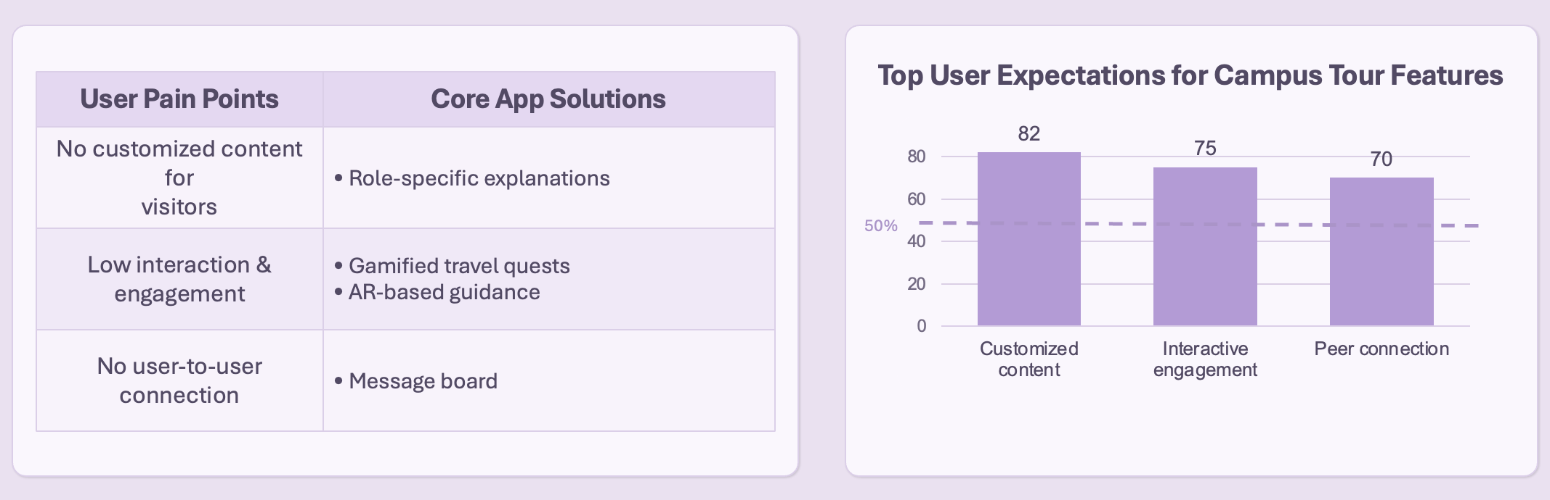
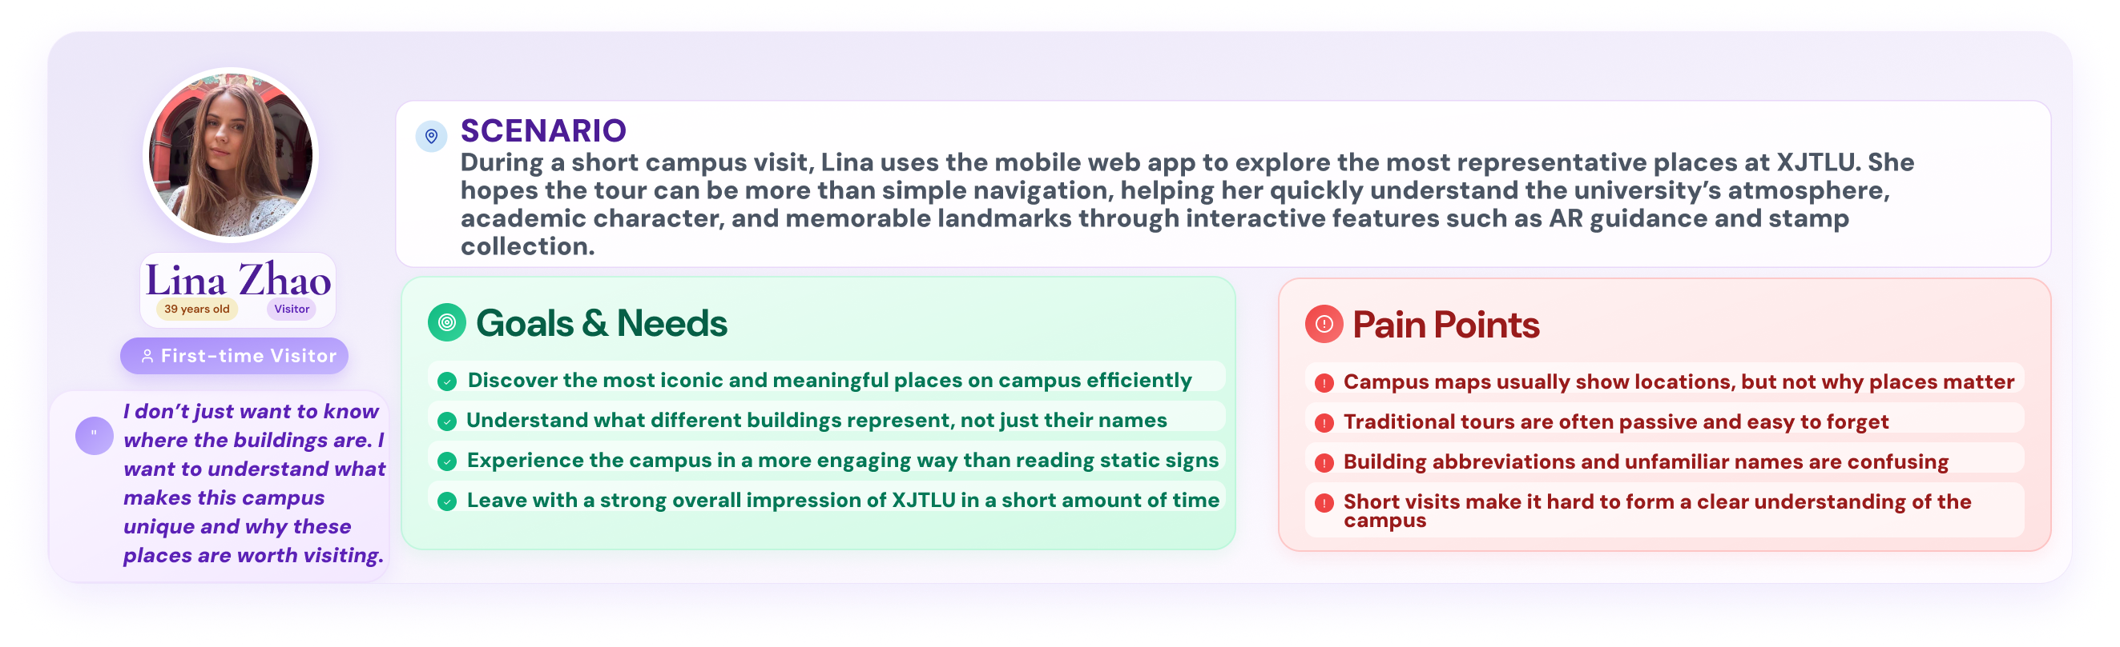
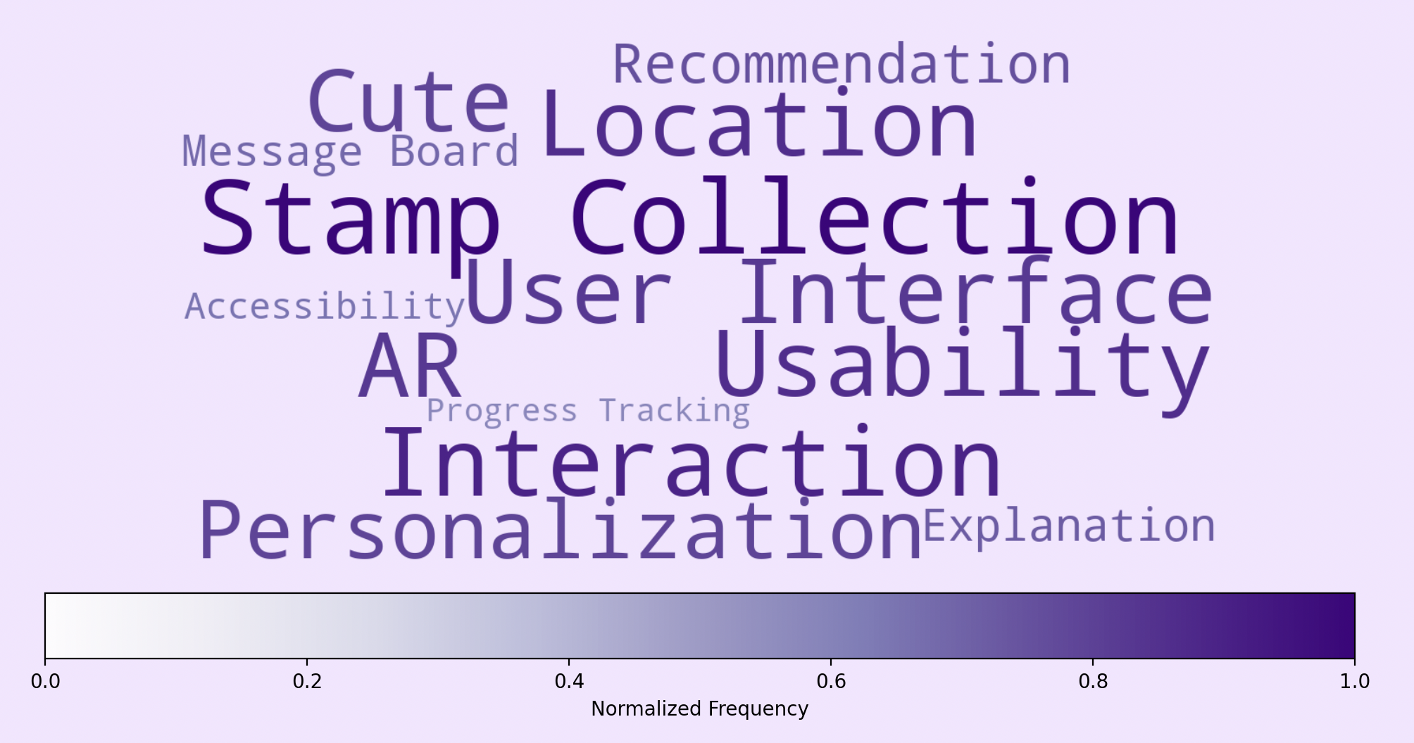
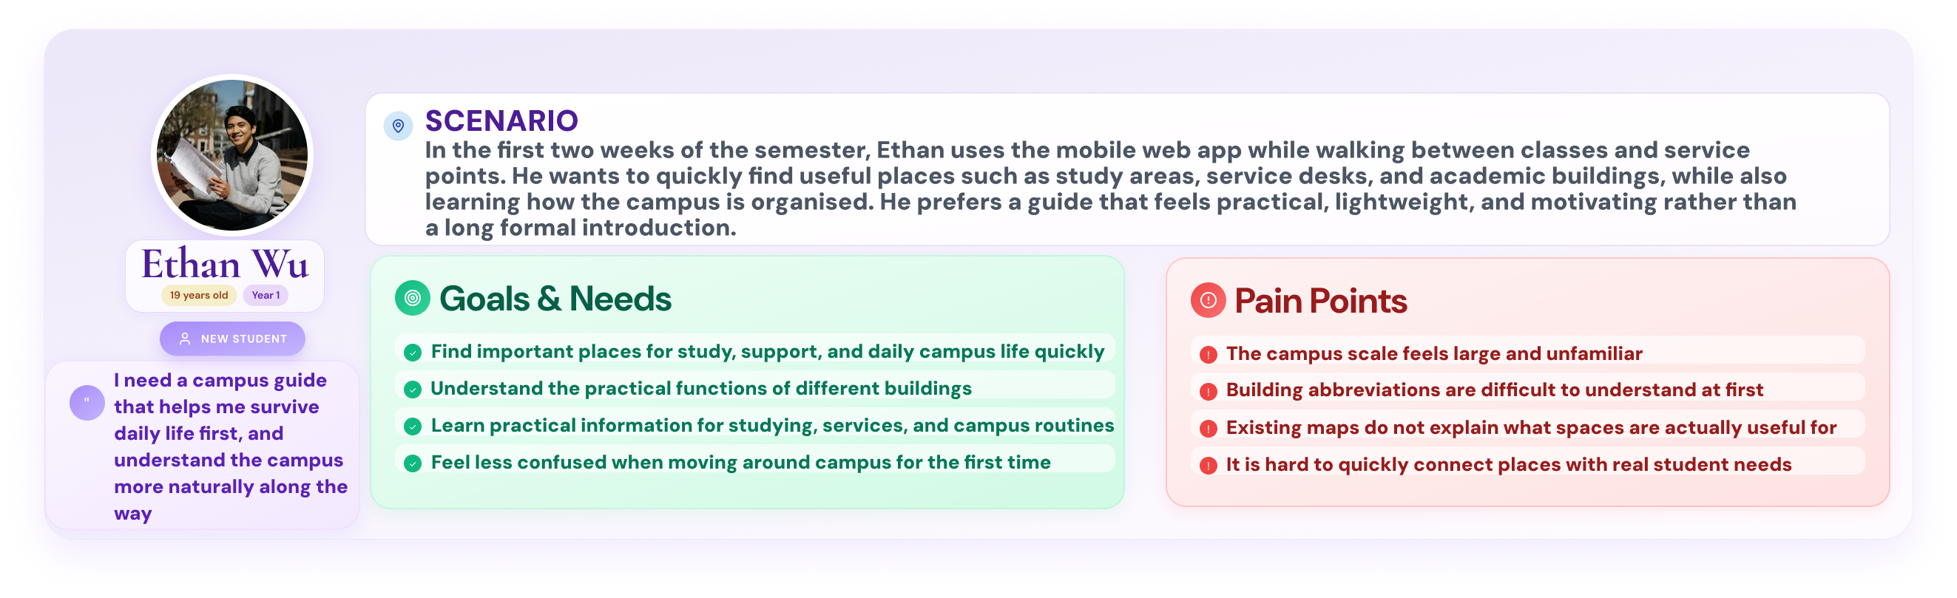
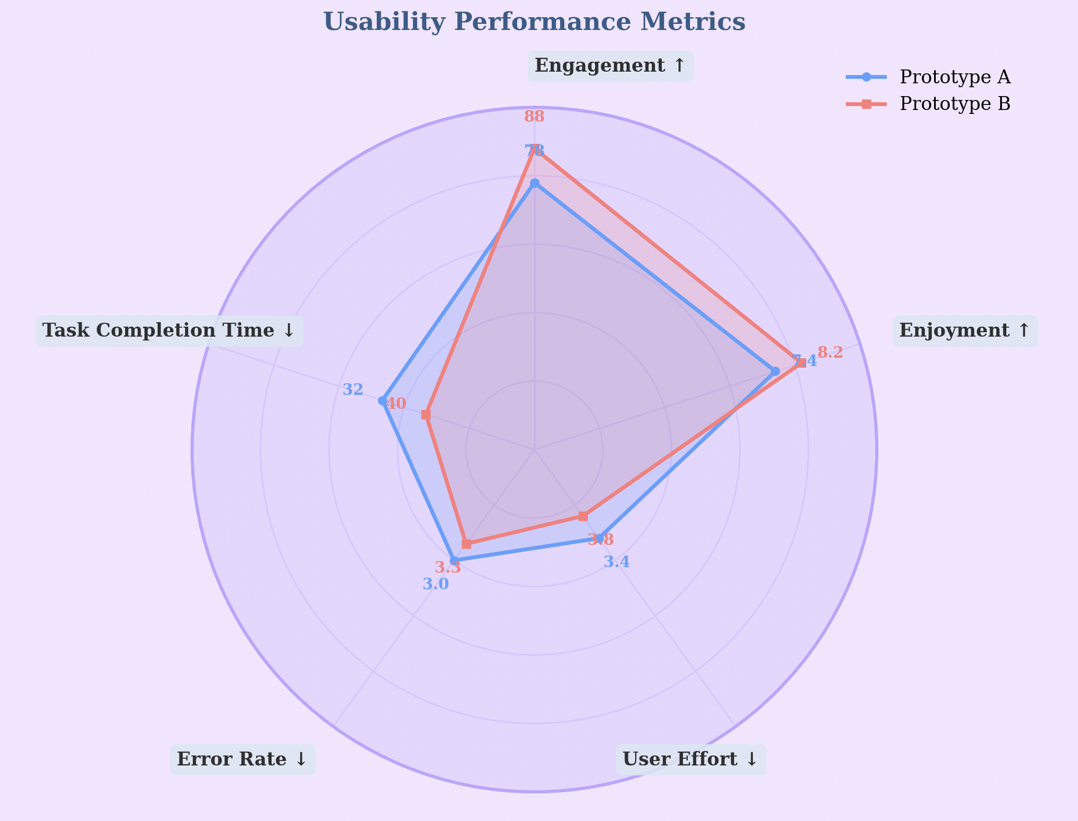
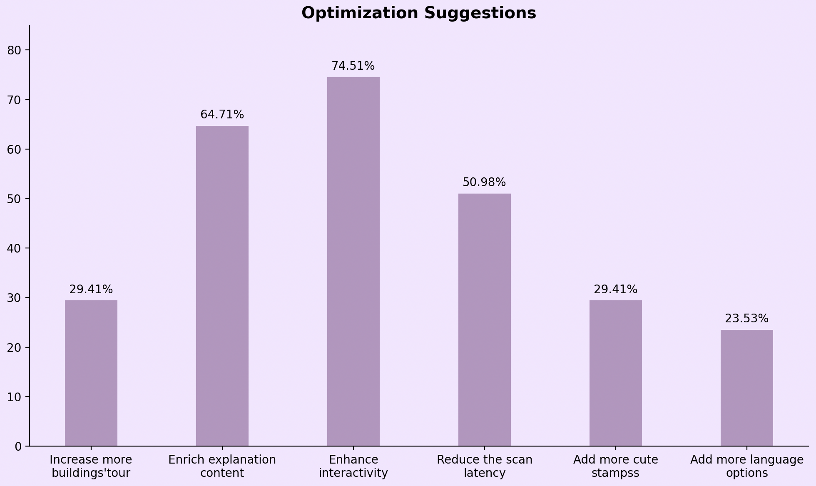
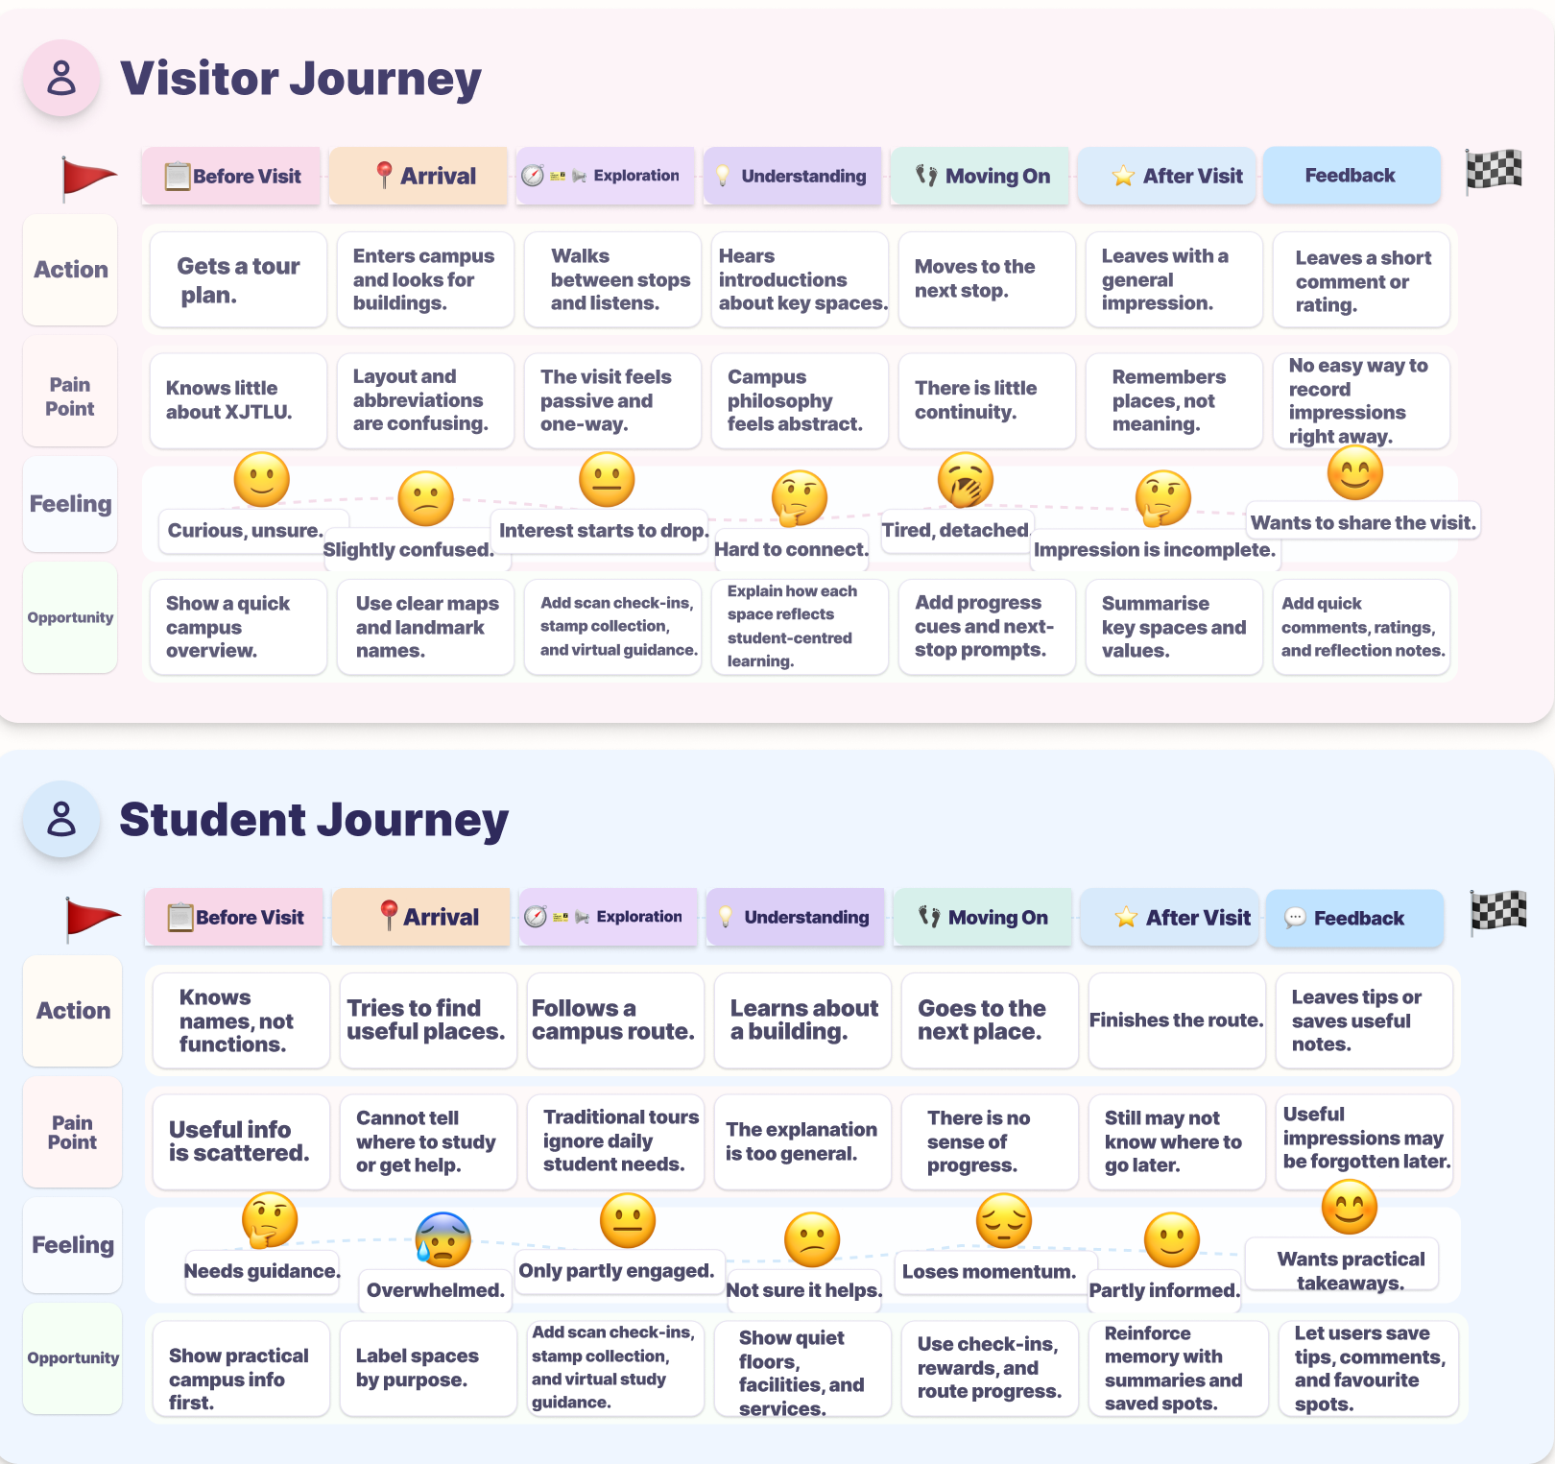
Your
LOGO
here
X·EasyGo:An interactive journey bridging reality and digital storytelling through location-based AR technology
Group B3-2 Lei.Zhang(2361007) Hanyan.Niu(2362278) Yiduo.Guo(2360180) Qi.Cao(2360908)
Prototypes & lteration
Portfolio
Demo
Abstract
Prototype Design & Iterations
✨
🎨
Traditional campus tours often rely on one-way explanations, making visitors passive listeners rather than active explorers. At Xi’an Jiaotong-Liverpool University (XJTLU), this is especially limiting because the university’s student-centered philosophy is better understood through movement, interaction, and experience. Although existing academic and commercial solutions have explored location-based AR[1][2], campus navigation[3], and playful interaction[4], they often fail to combine practical guidance, meaningful place-based learning, and user engagement in one coherent experience. In response, this project proposes X·EasyGo, an AR-supported campus tour system designed for both students and visitors. It aims to provide clear route-first navigation, role-specific landmark content, and lightweight interactive features to make campus exploration more intuitive, engaging, and reflective of XJTLU’s educational identity.
🔍
Requirement Gathering
Fig 1. Prior Usage of Campus Tours
Fig 2. Attitude to the new tour product
Fig 8. Iterations of app prototype UI design
Fig 3. User Preferences for Campus Tour Guide Formats
Fig 9. System Architecture
Figure 8 illustrates the iterative design process of the app prototype UI. We first developed a basic version of the system and then progressively added more features and a more visually appealing interface. Figure 9 shows the system workflow, illustrating how user interactions move through core modules, supporting services, and data storage.
Fig 4. Must-to-have functions and details
Fig 5. Functionality Recognition
To balance low-friction navigation with playful interaction, we explored two alternative stamp collection mechanisms: (1) an automatic location-based trigger, focusing on efficiency. (2) a manual AR scanning interaction, emphasizing user engagement.
This design dilemma informed the development of two prototype variants, which were later evaluated through user testing.
Our investigation (n = 51) reveals that 82.35% of participants have never used existing campus tour services (Fig. 1), while approximately 66.66% expressed a willingness to use such a product to assist them in exploring the campus (Fig. 2). Furthermore, the survey indicates that most participants prefer VR panoramic tours as their preferred campus tour format (Fig. 3). In addition, participants expressed a strong expectation for role-specific content, enhanced interactive engagement, and opportunities for peer connection (Fig. 5).
Then we make the the persona shown in Figure 6.
📝
📊
Evaluation Results
In the evaluation, we invited 10 participants to use and experience our product.
A/B Testing
Participants (n = 10) were divided into two groups to conduct an A/B test comparing two approaches to stamp collection:
Prototype A: Users automatically receive a stamp when the location system detects that they are near a building.
Prototype B: Users must scan the signboard outside the building to obtain a stamp.
Fig 11. Key Factors Users Value in the Product
Fig 6. Persona
The user journey map in Figure 7 illustrates how users interact with our system to address key pain points.
Fig 10. Usability Performance Metric
Fig 12. Users‘ optimization suggestions
As shown in Figure 10, Prototype A achieves higher scores in task completion time, error rate, and user effort. However, Prototype B performs better in engagement and enjoyment, which are key factors in the user requirements. Therefore, despite its drawbacks, Prototype B provides greater overall value to the user experience. As a result, Prototype B is selected as the final design.
Figure 11 presents a word cloud summarizing key themes extracted from users’ feedback after interacting with the system. Notably, “Stamp Collection” and “AR” appear most frequently, highlighting their importance to users. Figure 12 illustrates optimization suggestions provided by participants, where enhancing interactivity (74.51%) and enriching explanation content (64.71%) emerge as the most prominent.
🎯
Conclusion
Results suggest that X·EasyGo improves campus exploration by combining clear guidance, role-specific content, and interactive AR features in a more engaging and user-centred way.
Limitations ◆ The AR system is still at a preliminary stage, with limited positioning accuracy and delays in the scan-and-collect-stamp function. ◆ The current prototype covers only three campus buildings, which limits the scope and completeness of the experience. ◆ The current evaluation is based on a limited number of participants, so broader user testing is still needed.
Future Work ◆ Expand the system to cover more campus buildings and functional areas. ◆ Improve the underlying technology to enhance positioning accuracy and reduce response delays. ◆ Conduct broader testing with different user groups to further refine interaction design and content delivery.
References & Acknowledgments
📚
[1] A. Kleftodimos and A. Evagelou, “Location-based augmented reality in education,” Encyclopedia, 2025, 5, 54, doi: 10.3390/encyclopedia5020054.
[2] X. Fonseca, P. Spangenberger, M. Baer, R. Schmidt, and H. Söbke, “Location-based augmented reality in education: A systematic literature review,” Computers and Education Open, 9 (2025) 100277, doi: 10.1016/j.caeo.2025.100277.
[3] S. Taşyonar and A. M. Uzun, “Using a location-based augmented reality mobile application to support the new students’ orientation process,” Open Praxis, 17(4), pp. 768–784, 2025, doi: 10.55982/openpraxis.17.4.886.
[4] C.-Y. Hsieh, C.-M. Chen, and Y.-C. Yang, “A game-based augmented reality navigation system to support makerspace user education in a university library,” in 2023 14th IIAI International Congress on Advanced Applied Informatics (IIAI-AAI), 2023, pp. 218–223, doi: 10.1109/IIAI-AAI59060.2023.00052.
Fig 7. User Journey Map

