Slide 1
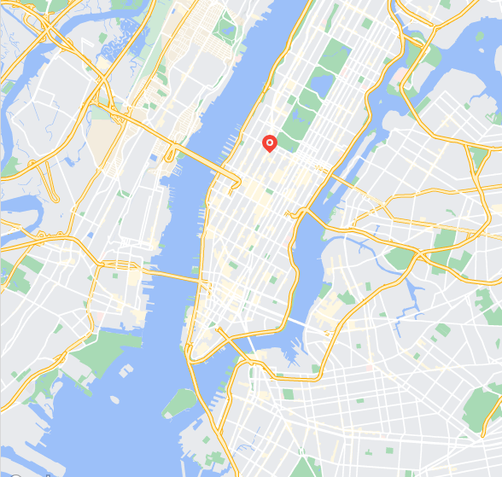
























Embedding Layer
$$u$$
Concatenate
$$u$$
$$h^{u}$$
$$h_{i}$$
$${\left[M\right]}_{L}$$
$$l$$
$$h_{i}$$
$$l$$
Masking
$$c$$
$${\left[M\right]}_{C}$$
$$c$$
$$d$$
$${\left[M\right]}_{D}$$
$$d$$
$$t$$
$${\left[M\right]}_{T}$$
$$t$$
Masked long-term preference
Location task
Masked contextual embedding
$$l_{t_{k+1}}$$
POI
$$u$$
G@4
$$h_{t_{i}}$$
$$l$$
G@5
G@6
$$c$$
G@7
$$d$$
G@8
$$t$$
Short-term preference
Region prediction auxiliary task

