Slide 1

Flight Delay
Ahmad
Nathanael

Slide 2
SECTIONS
VISUALIZATION
FEATURE ENGINEERING
MODEL BUILDING
RESULTS

Slide 3
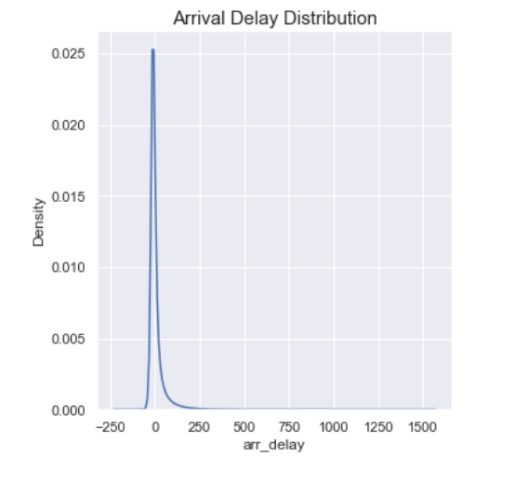
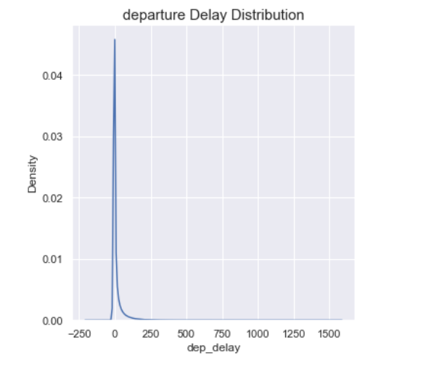
VISUALIZATION
ARRIVAL AND DEPARTURE DELAY DIST BEFORE DEALING WITH OUTLIERS

Slide 4
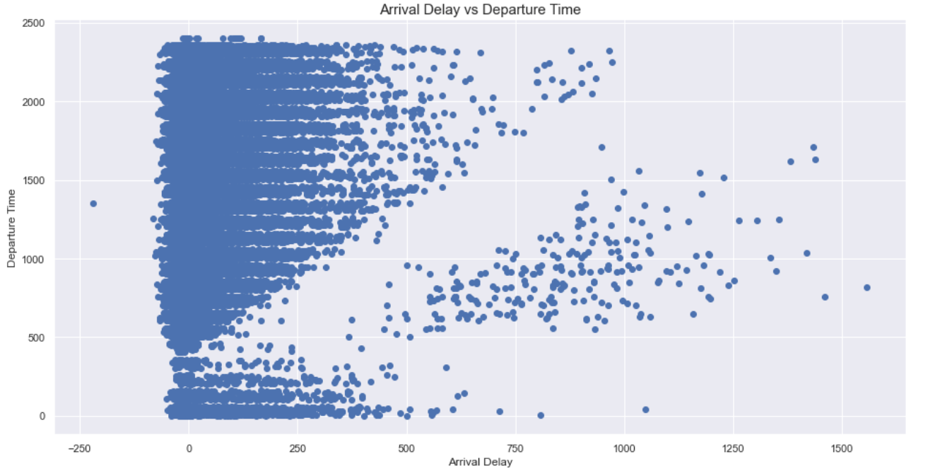
ARRIVAL DELAY OUTLIERS

Slide 5
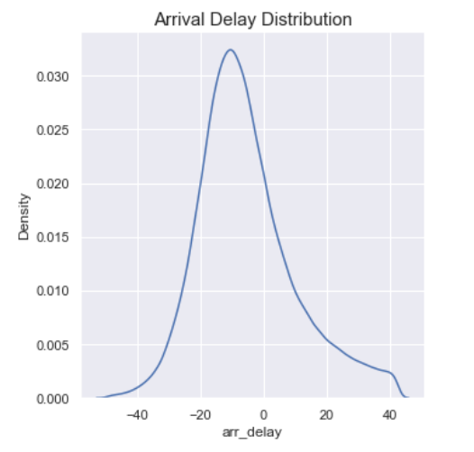
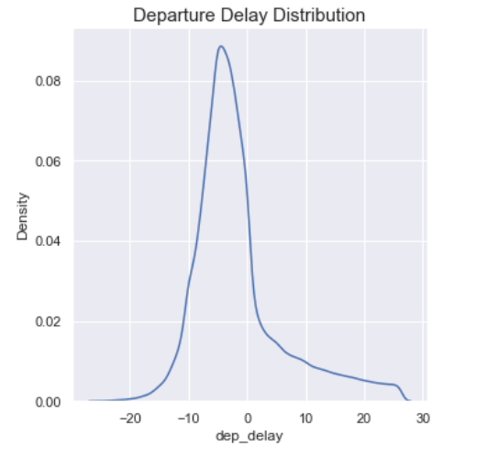
DISTRIBUTION AFTER REMOVING OUTLIERS

Slide 6
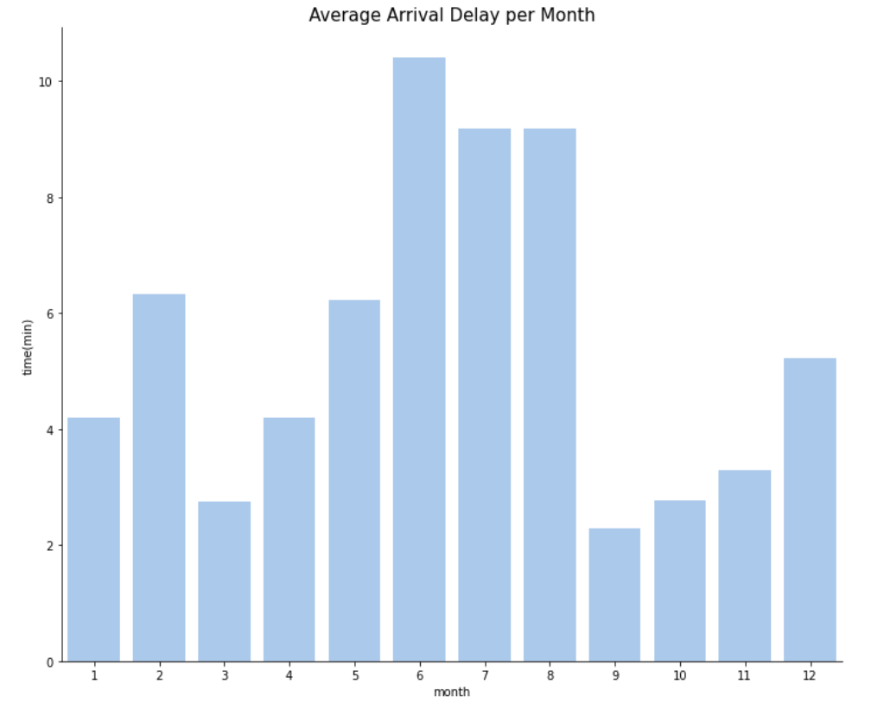
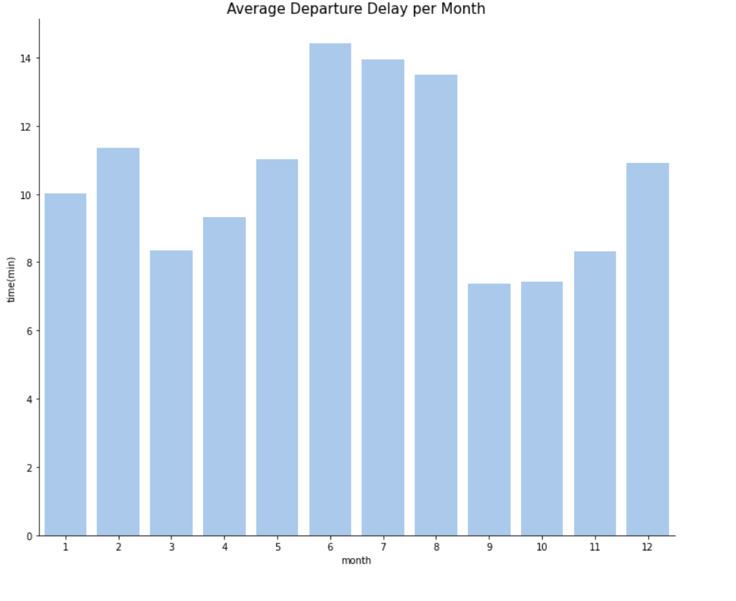
AVERAGE ARRIVAL AND DEPARTURE PER MONTH

Slide 7
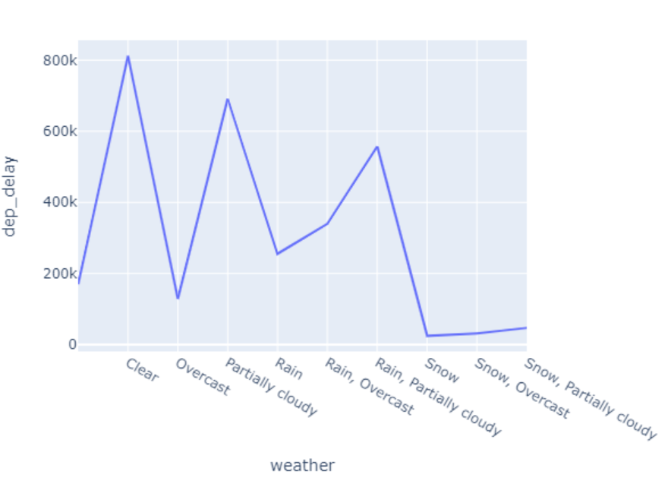
WEATHER AND DEPARTURE DELAY

Slide 8
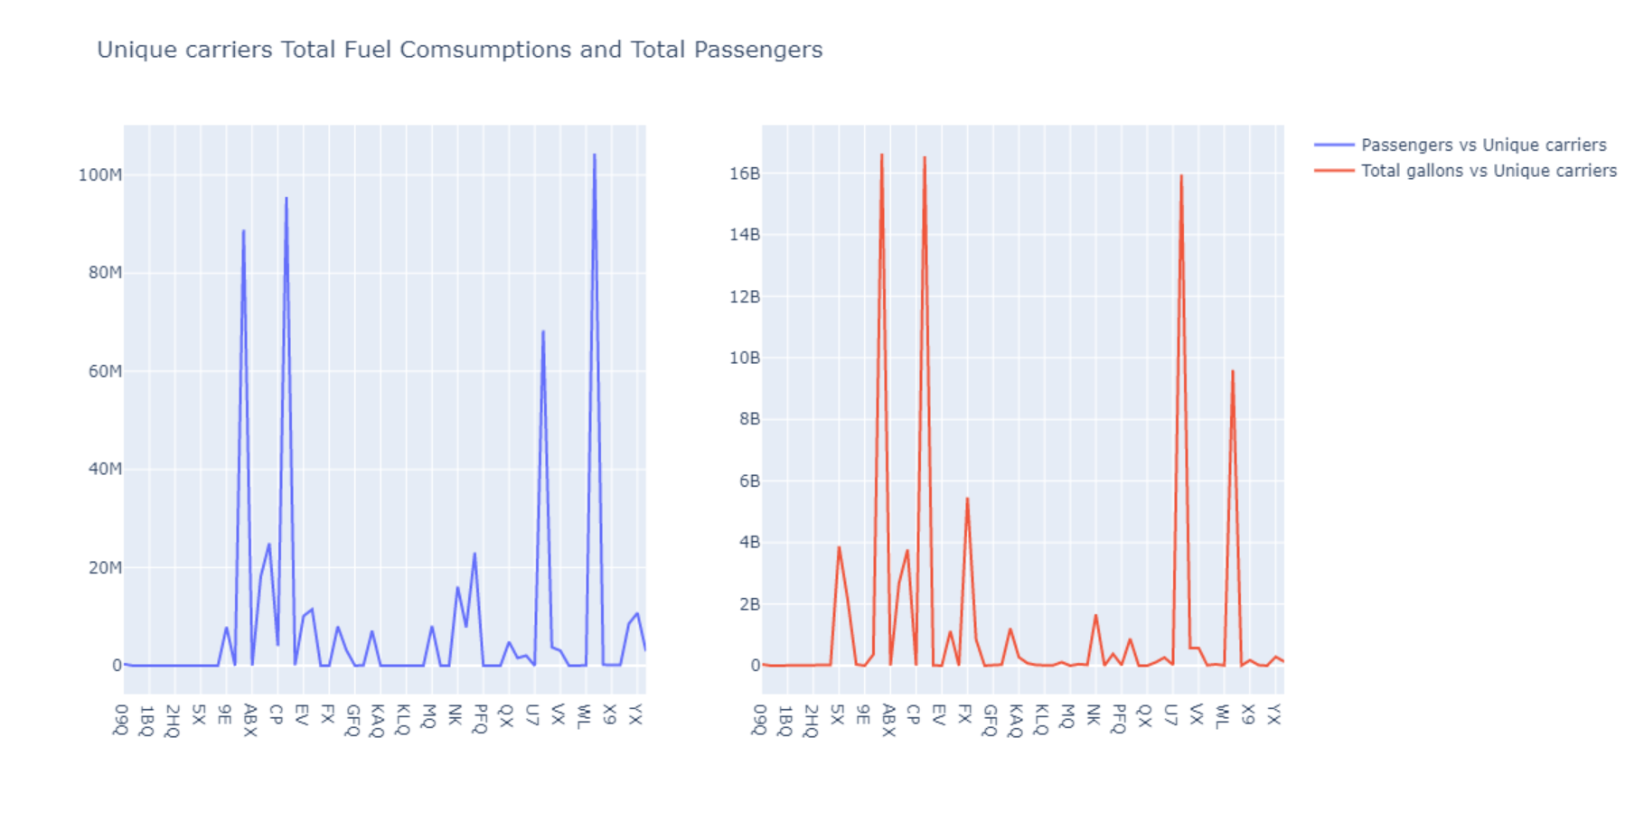
PASSENGERS AND FUEL CONSUMPTION

Slide 9
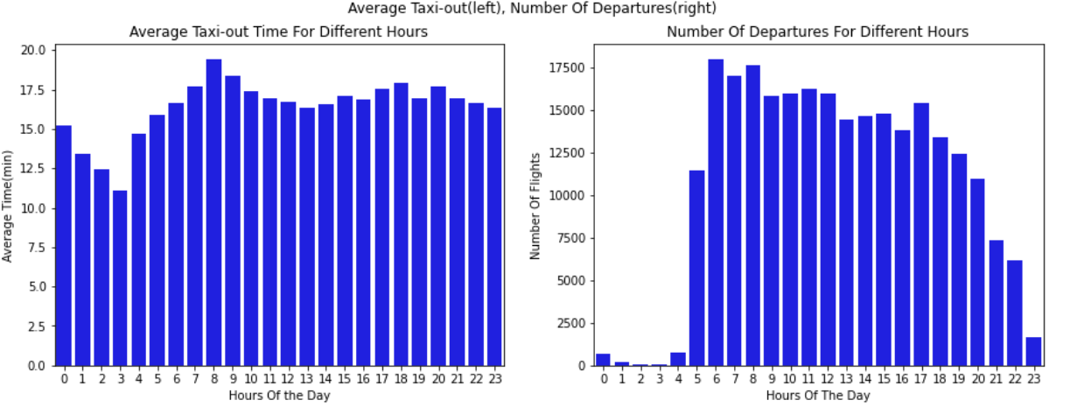
AIR TRAFFIC IN DIFFERENT HOURS OF THE DAY

Slide 10
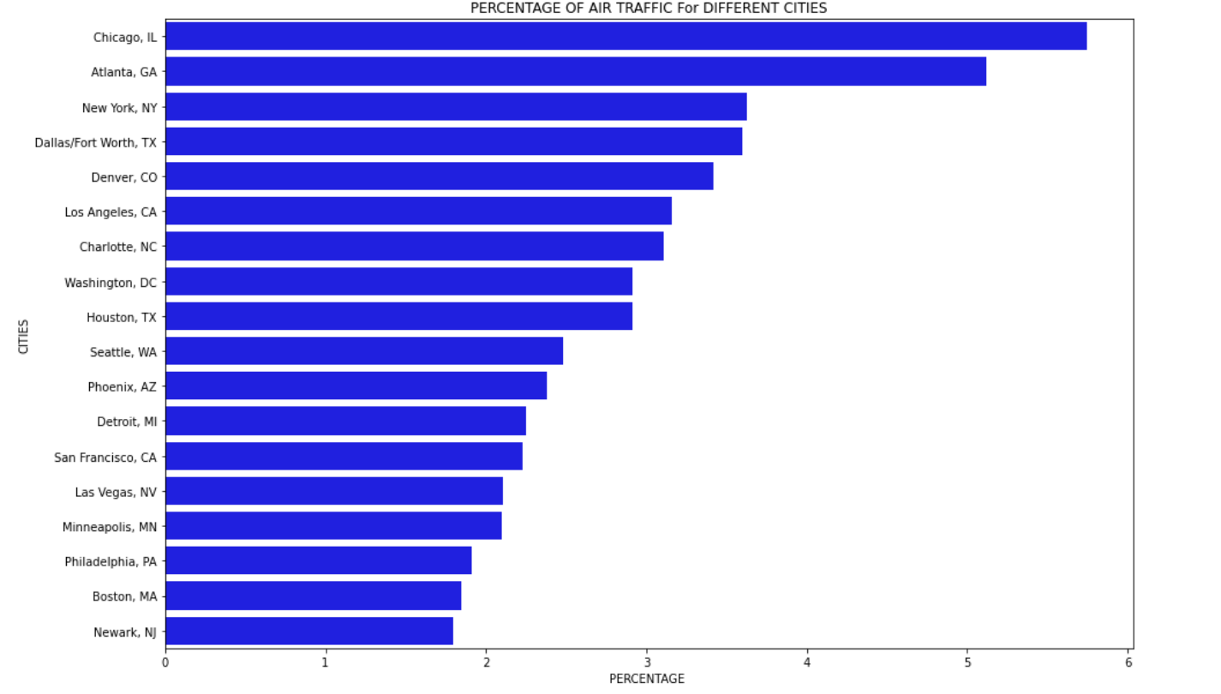
PERCENTAGE OF AIR TRAFFIC FOR TOP CITIES

Slide 11
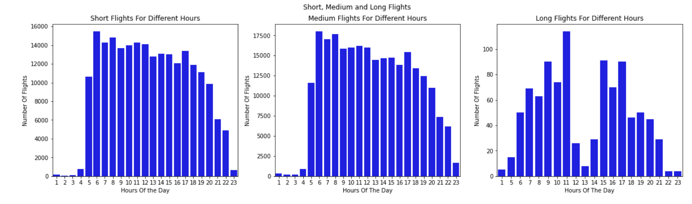
DIFFERENT FLIGHT TYPES

Slide 12
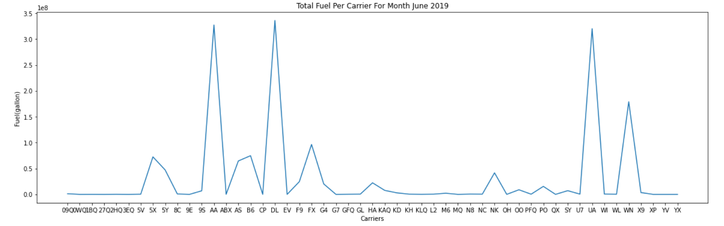
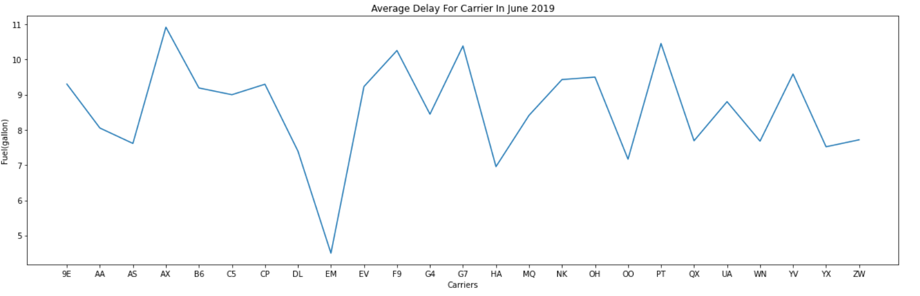
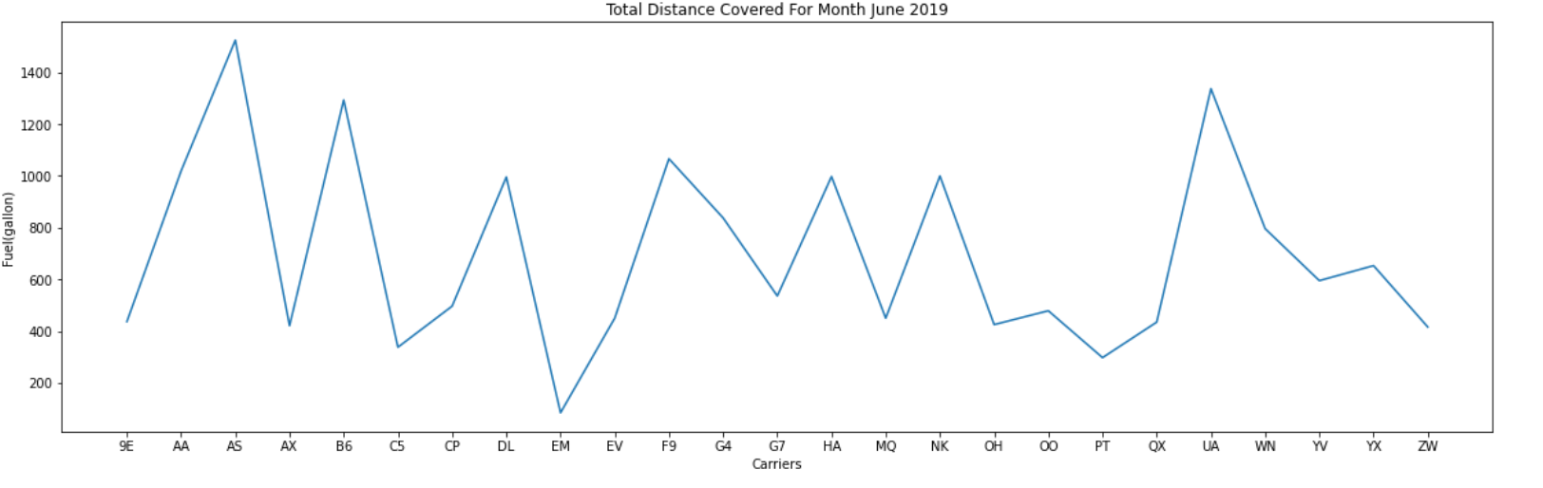
FUEL AND DELAYS

Slide 13

FEATURE ENGINEERING AND MODEL BUILDING
HIGH DIMENSION
LOW R SQUARED SCORE
VERY LOW MEAN SQAURED ERROR
HIGHLY IMBALANCE

Slide 14


Slide 15

FEATURE ENGINEERING
USING DIFFERENT FEATURES
DESTINATION
ARRIVAL TIME
MKT_CARRIER_UNIQUE
TAXI_IN
HOUR OF THE DAY
MONTH OF THE YEAR
SORTING THE VALUES BY YEAR
ELAPSED TIME

Slide 16

MODELING

Slide 17
MODELLING
RIDGE REGRESSION WITH CROSS VALIDATION
XGBOOST REGRESSION
RANDOM FOREST
XGBOOST CLASSIFIER

Slide 18
SAMPLING
SMOTE
UNDERSAMPLING
BOOTSTRAP

Slide 19

EVALUATION METRICS
R SQUARED SCORE
ROOT MEAN SQUARED ERROR
ACCURACY
RECIEVER OPERATING CHARACTERISTIC
F SCORE

Slide 20
RESULTS

Slide 21
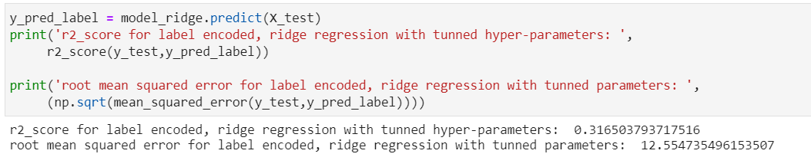
RIDGE REGRESSION (LABEL ENCODED)

Slide 22
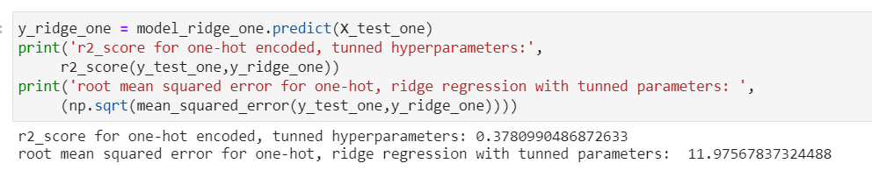
RIDGE REGRESSION(ONE-HOT)

Slide 23
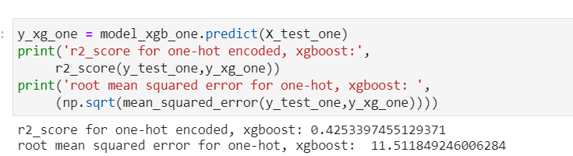
XGBOOST REGRESSION(ONE HOT)

Slide 24
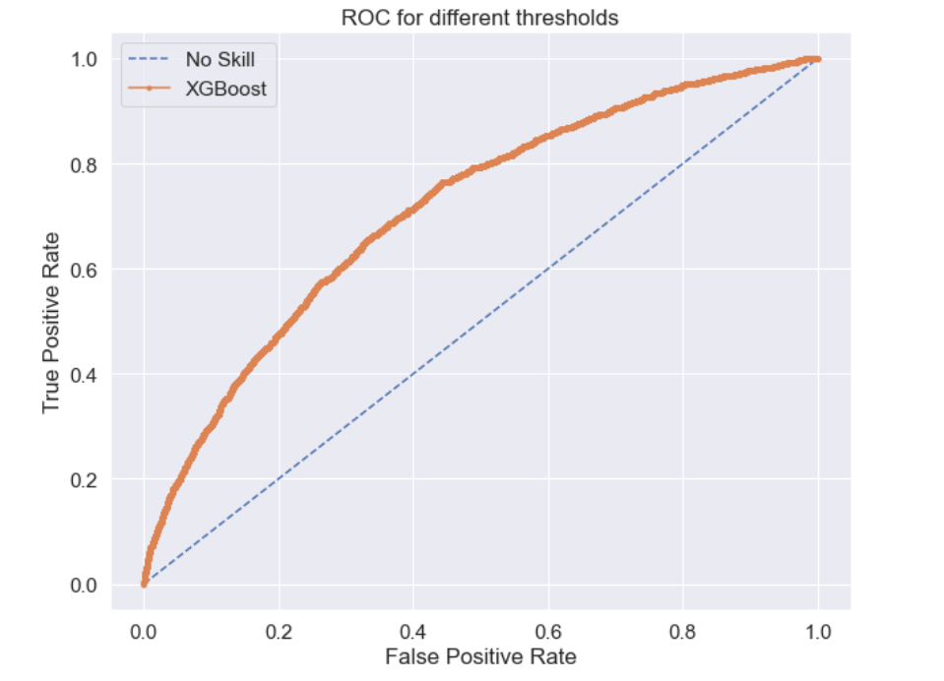
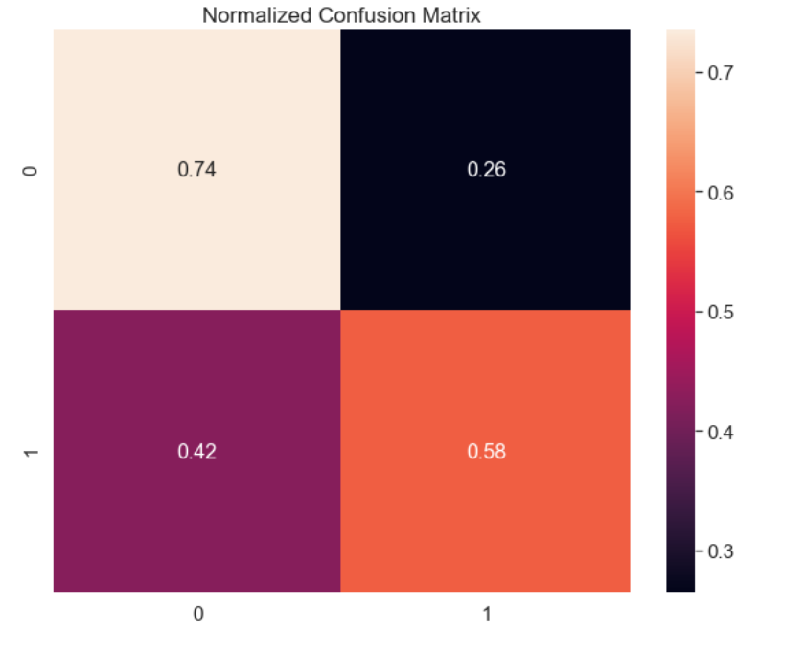

XGBOOST CLASSIFIER(WITHOUT SMOTE)

Slide 25
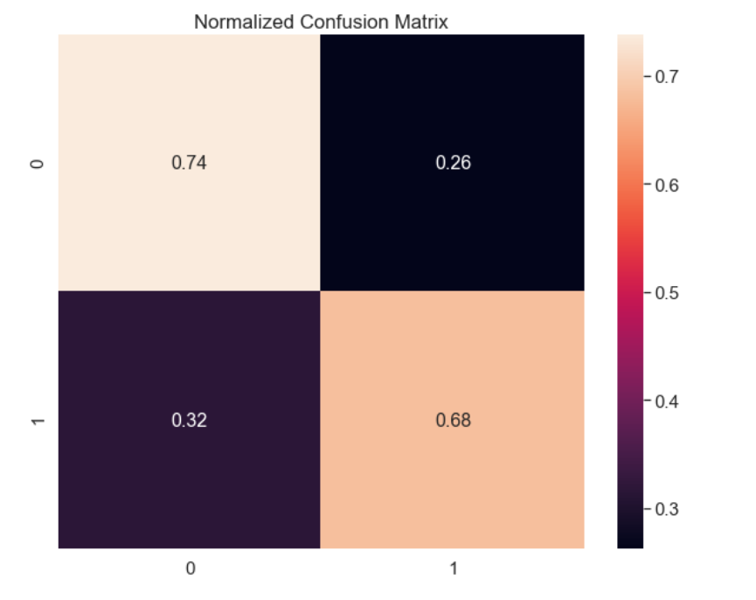
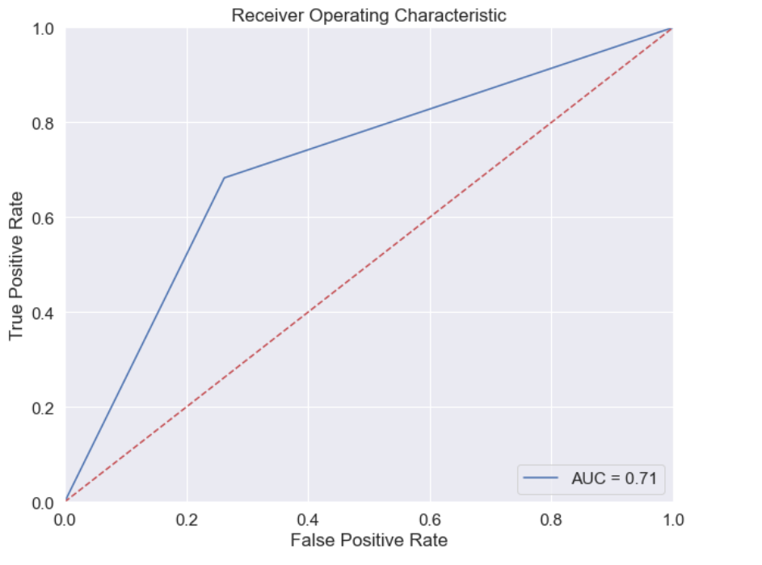

XGBOOST (WITH SMOTE)

