Slide 1
RAG-based chatbot

Slide 2
Motivation
Develop a chatbot with high accuracy for prospective store owners
Requires many PDFs with long context
Data must contain updated information

Slide 3
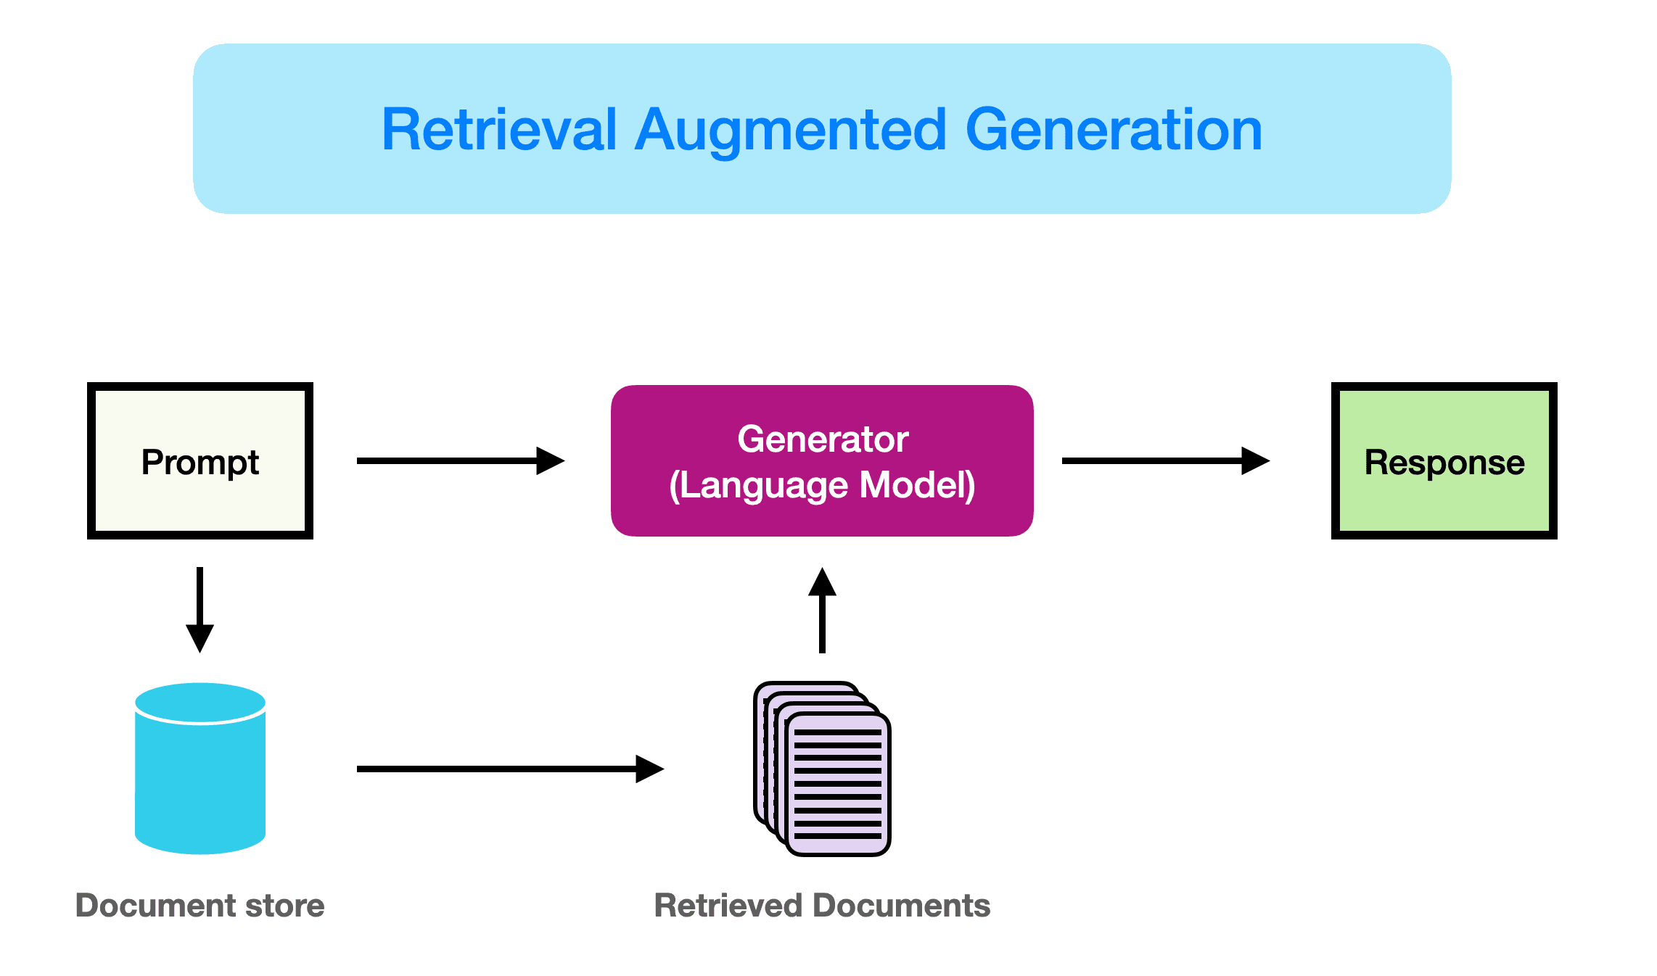
RAG

Slide 4
RAG
Reduces hallucinations
Easy to update data
Possible to feed private documents
Cheaper than re-training a model

Slide 5
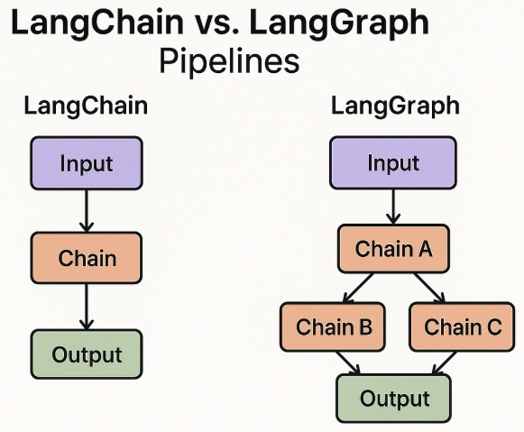
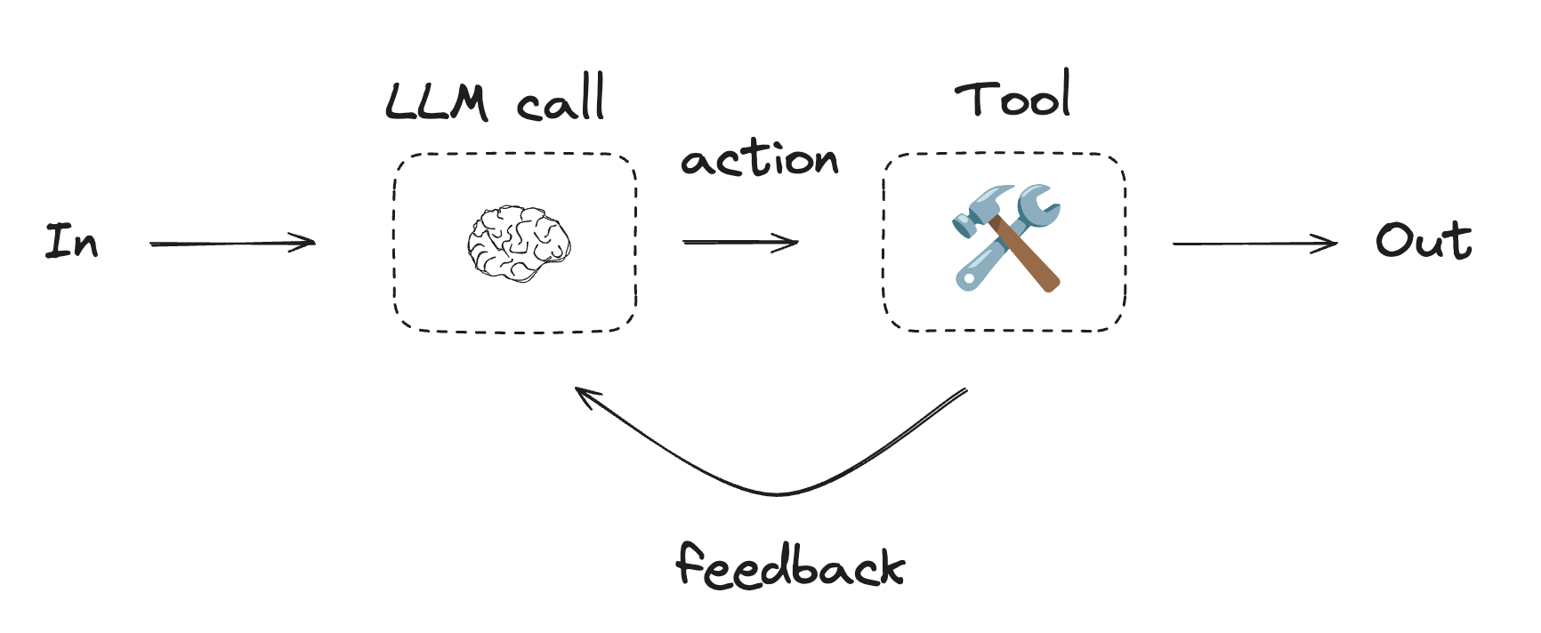
LangChain, LangGraph
Framework for simplifying different LLM components

Slide 6
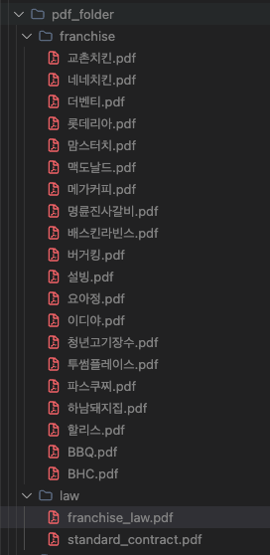
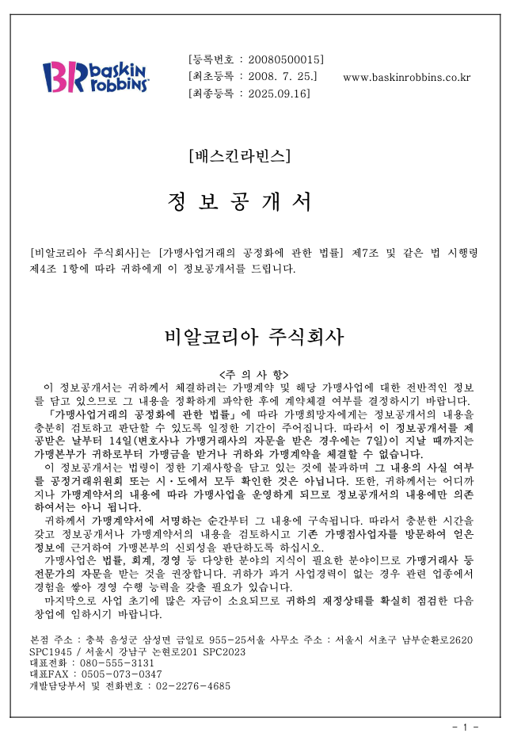
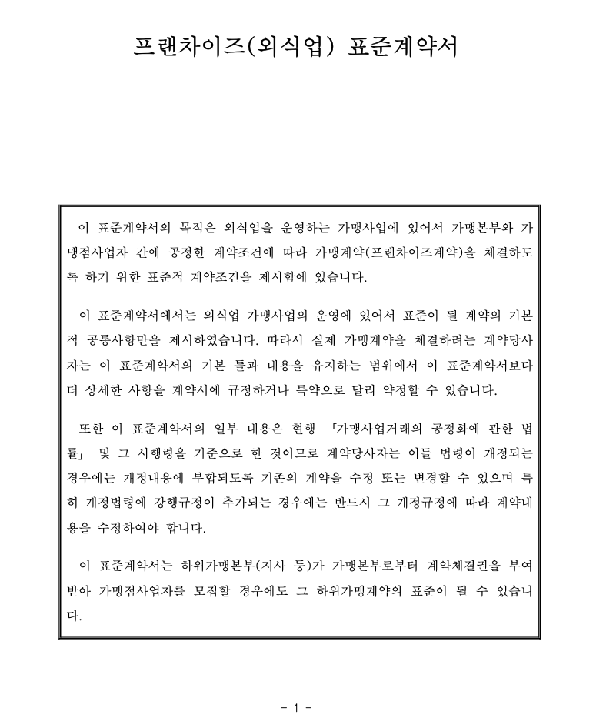
Workflow
1. Collect pdf documents (Franchise Disclosure Documents, Legal docs)

Slide 7
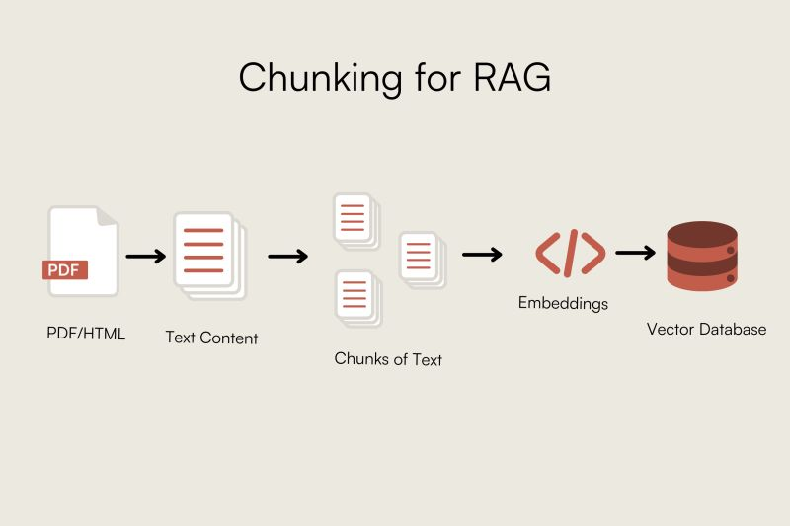
Workflow
2. Build vector store
  Load documents
  Split the texts into chunks, with small overlaps
  Embed each chunks and store it in a vector database

Slide 8
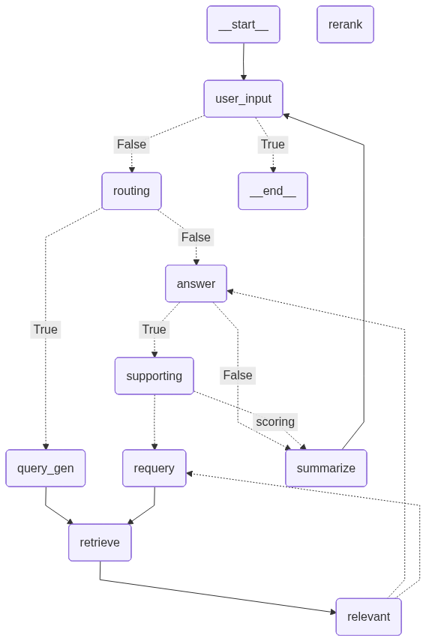
Workflow
3. Implement graph structure

Slide 9
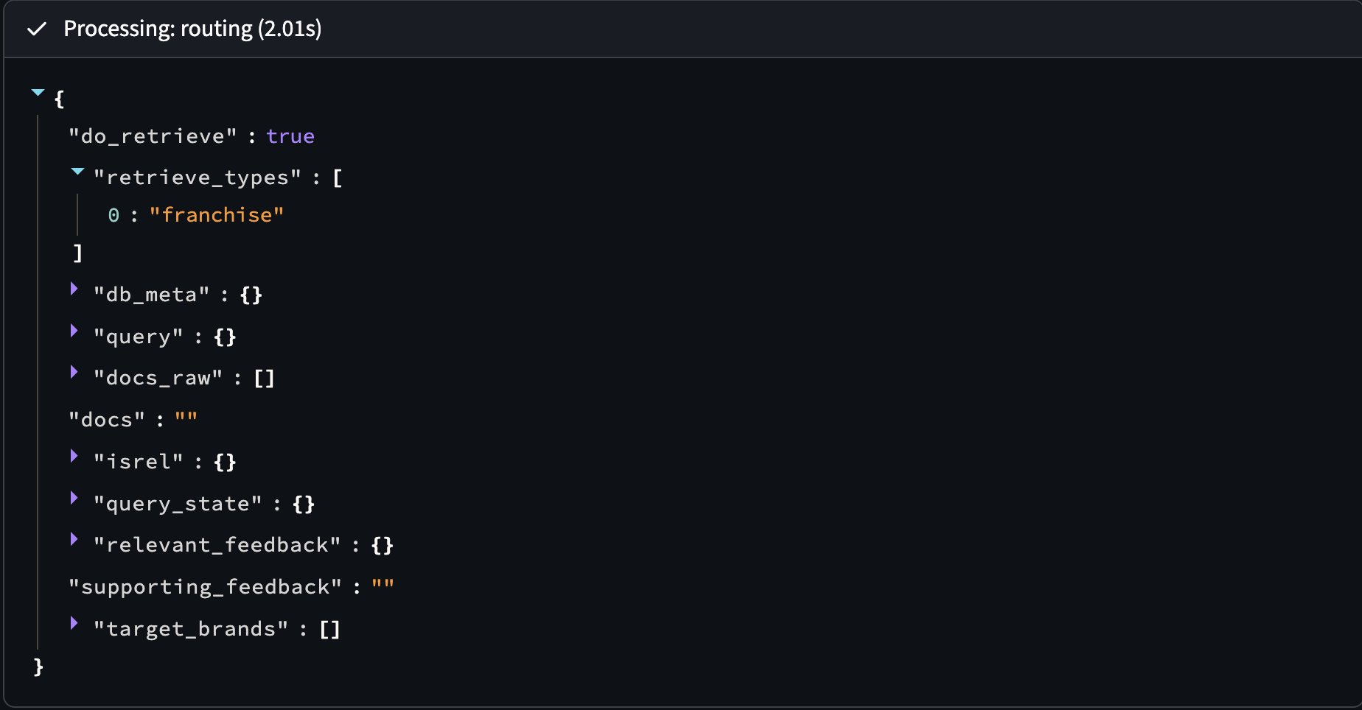
Workflow
User input
더벤티의 최근 3년간 전체 가맹점 수와 영업 중인 가맹점 수를 알고 싶습니다.
Routing
Decides next step based on user input
Need to search DB -> query_gen (franchise/law)
No need to search -> answer

Slide 10
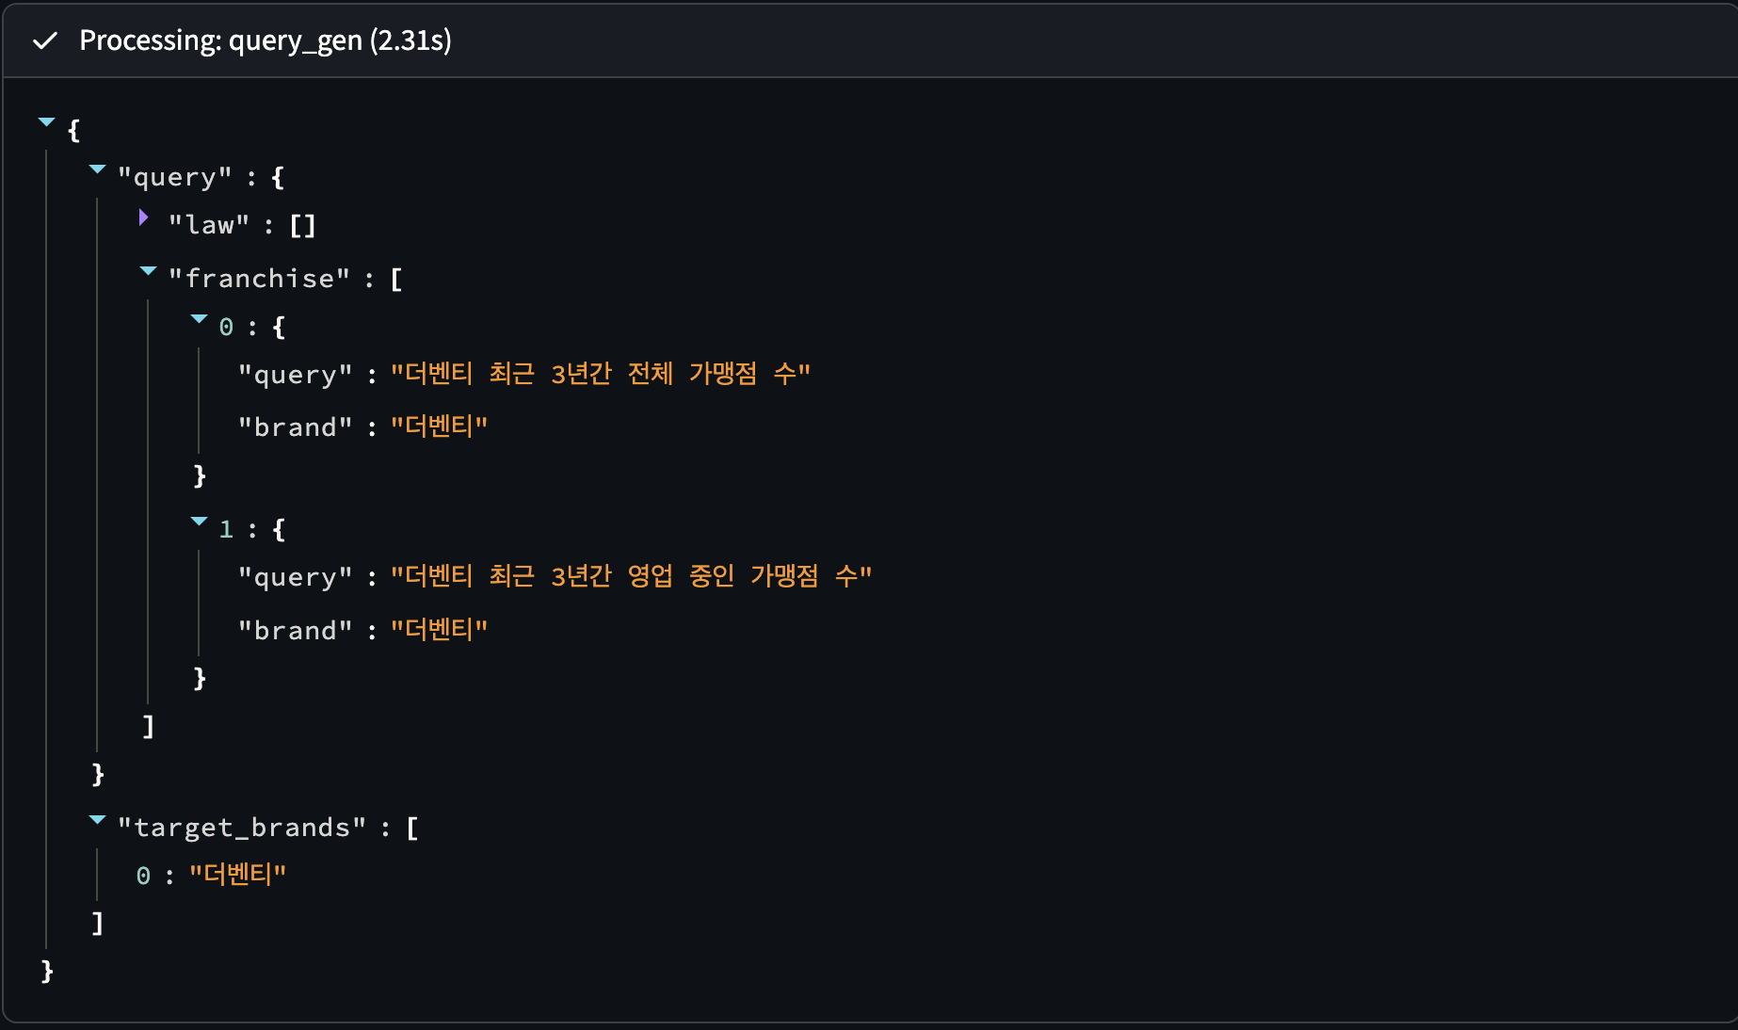
Workflow
Query_gen
Generate queries to find information in vector database

Slide 11
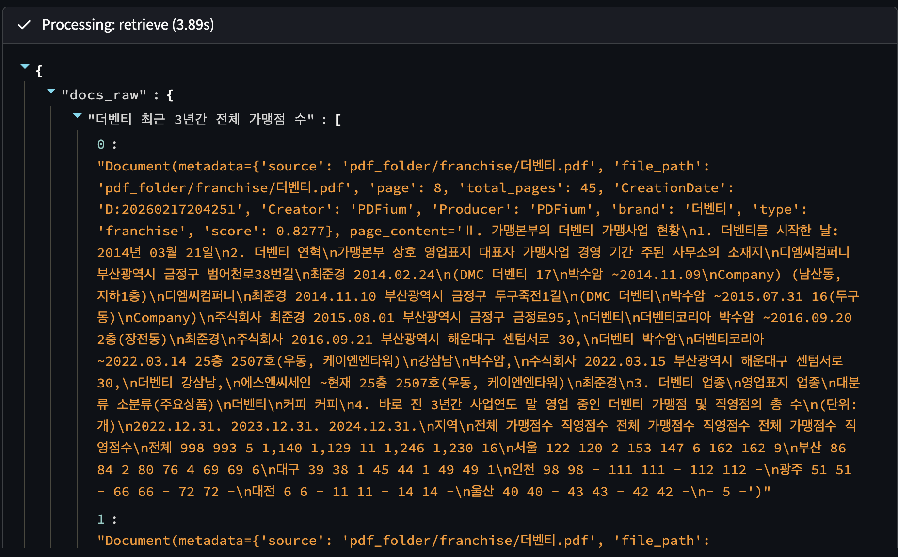
Workflow
Retrieve
Based on generated queries, retrieve relevant pdf chunks from database
Relevance is based on similarity scores

Slide 12
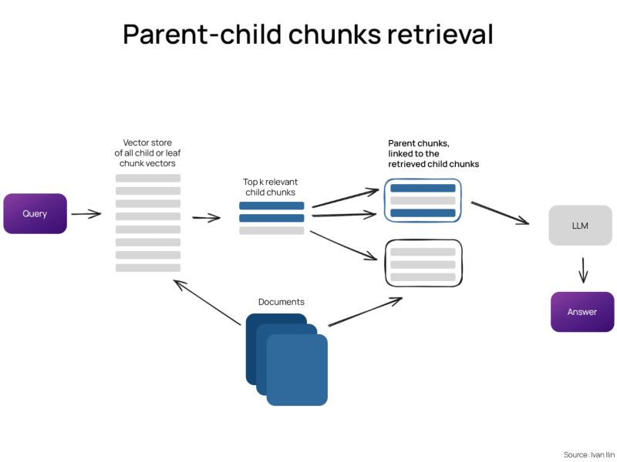
Workflow
Retrieve
Parent-based retriever

Slide 13
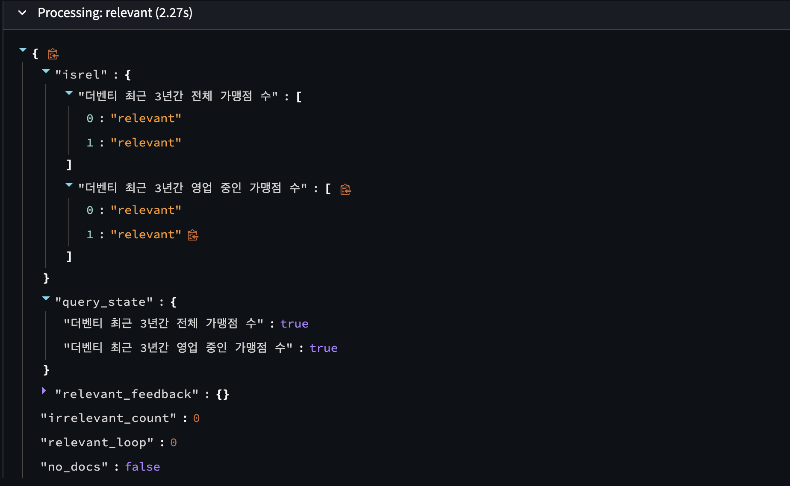
Workflow
Relevant
Read the retrieved documents and check if it is actually relevant with the query
Relevant -> answer
Not relevant -> requery

Slide 14
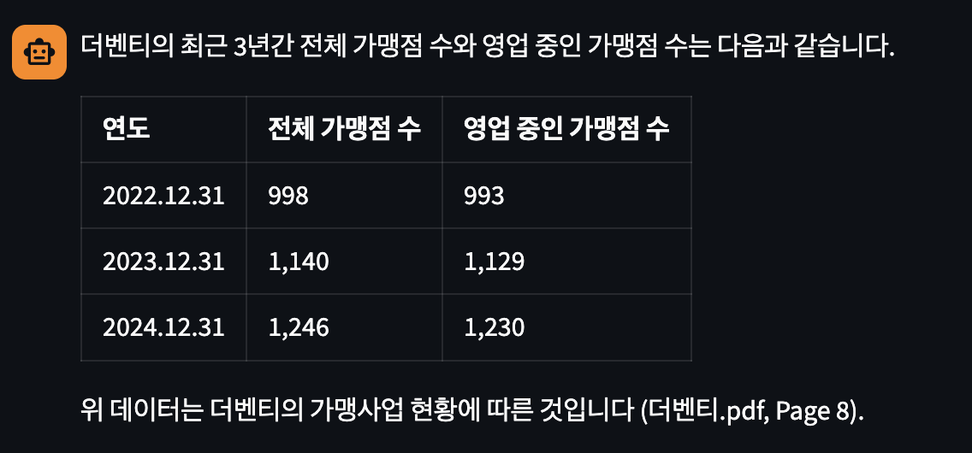
Workflow
Answer
Based on prompt, user input, retrieved documents, output answer for users

Slide 15
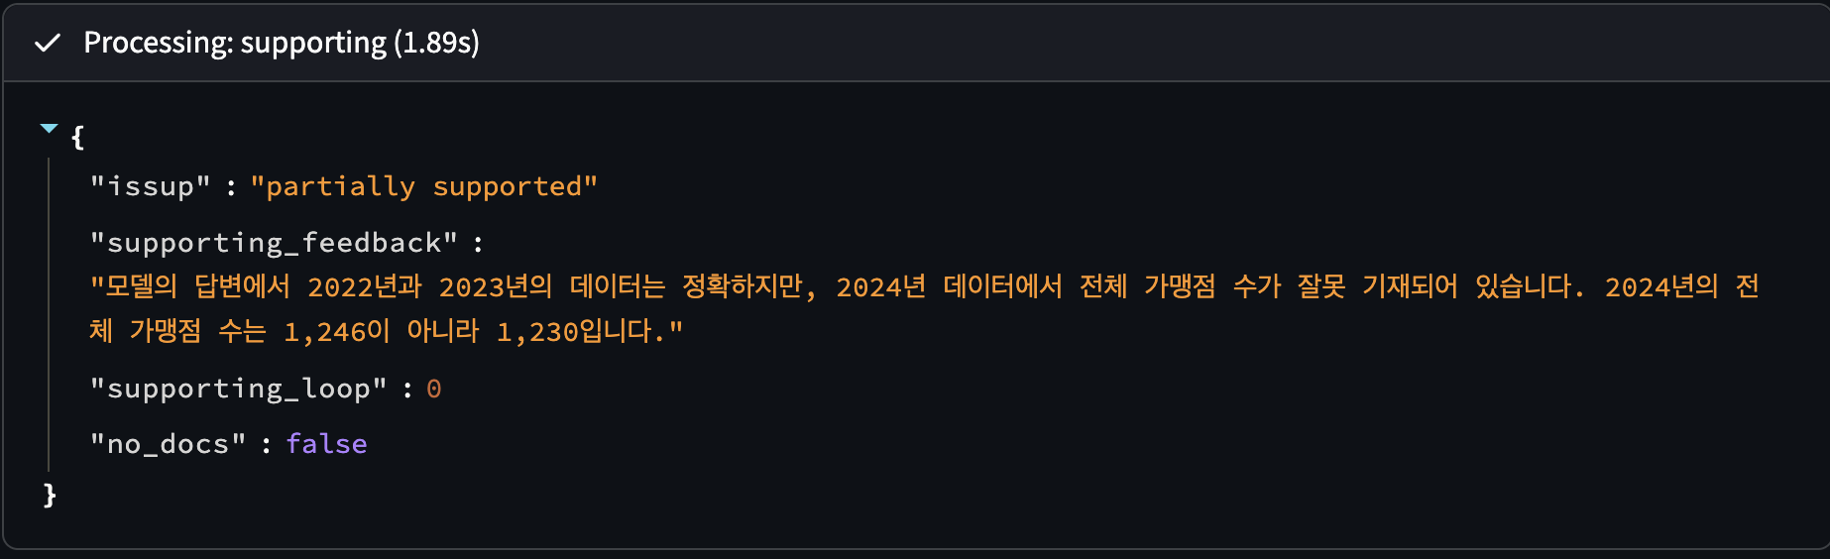
Workflow
Supporting
Check whether the answer has hallucination, and outputs a feedback

Slide 16
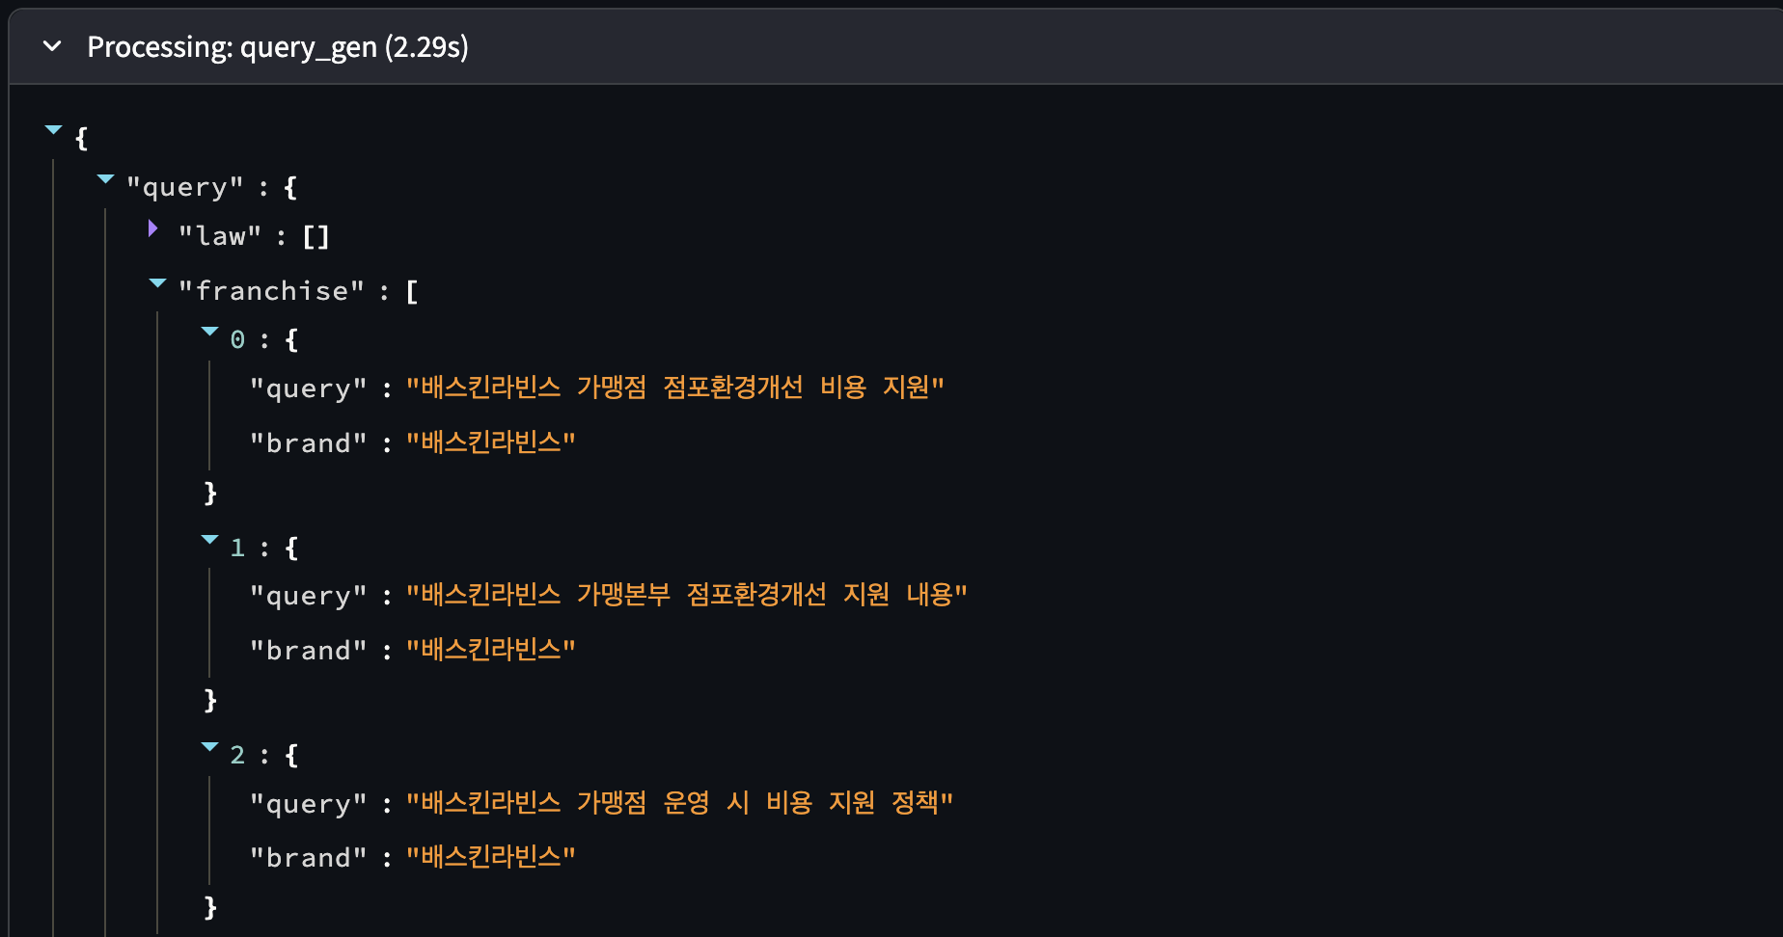
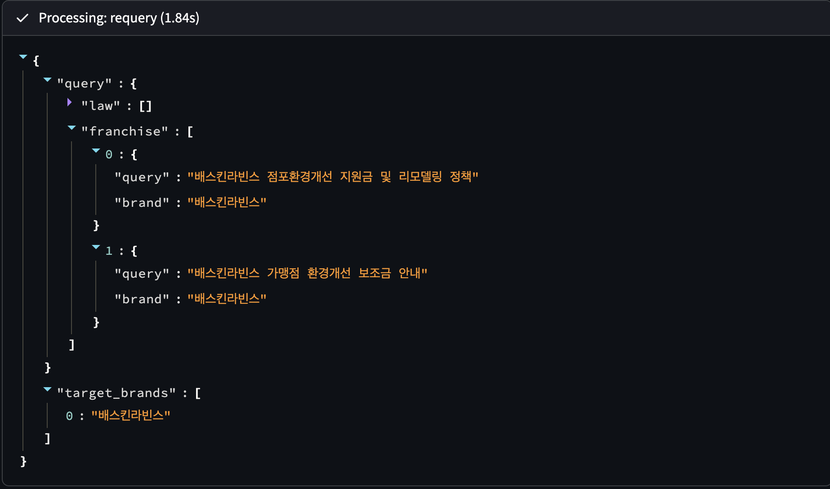
Workflow
Requery
Based on feedback (relevant, supporting), rewrite an improved query

Slide 17
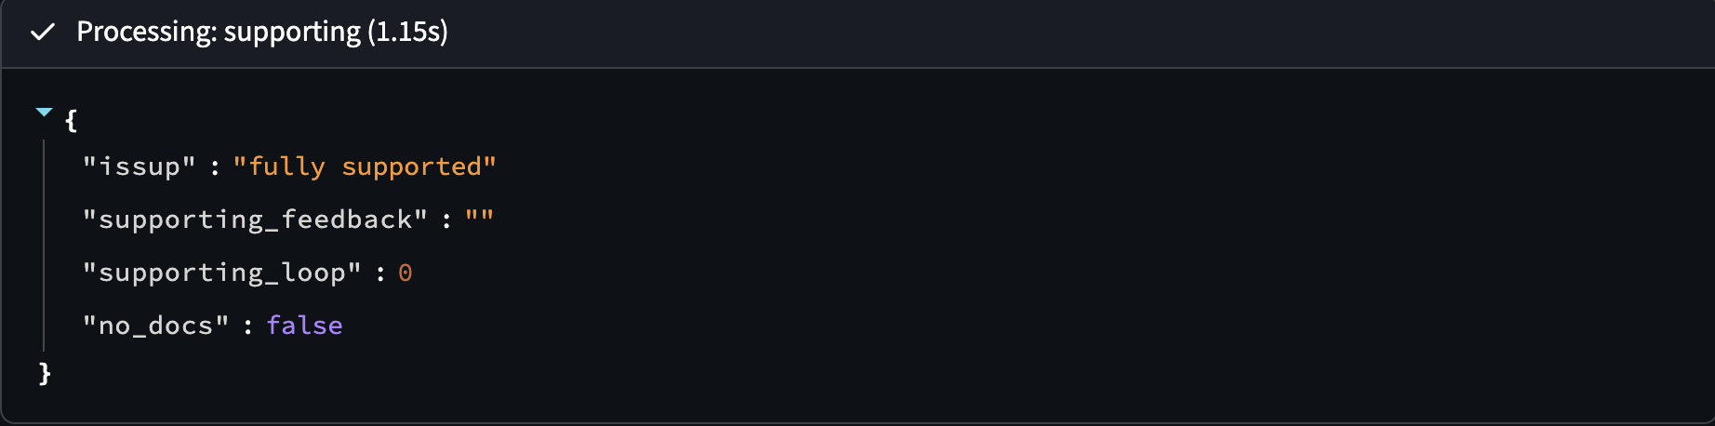
Workflow
summarize
If the answer is fully supported, store the question+answer as a context
Proceed to the next input

Slide 18
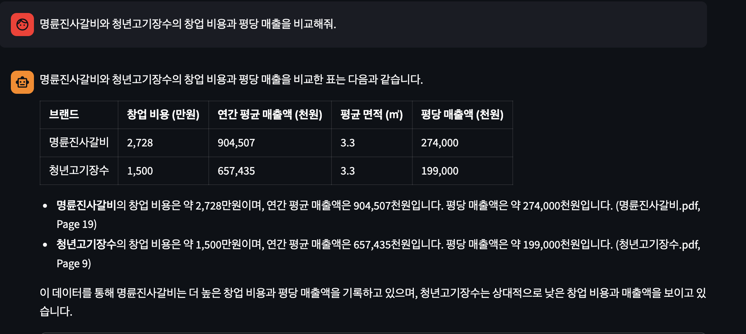
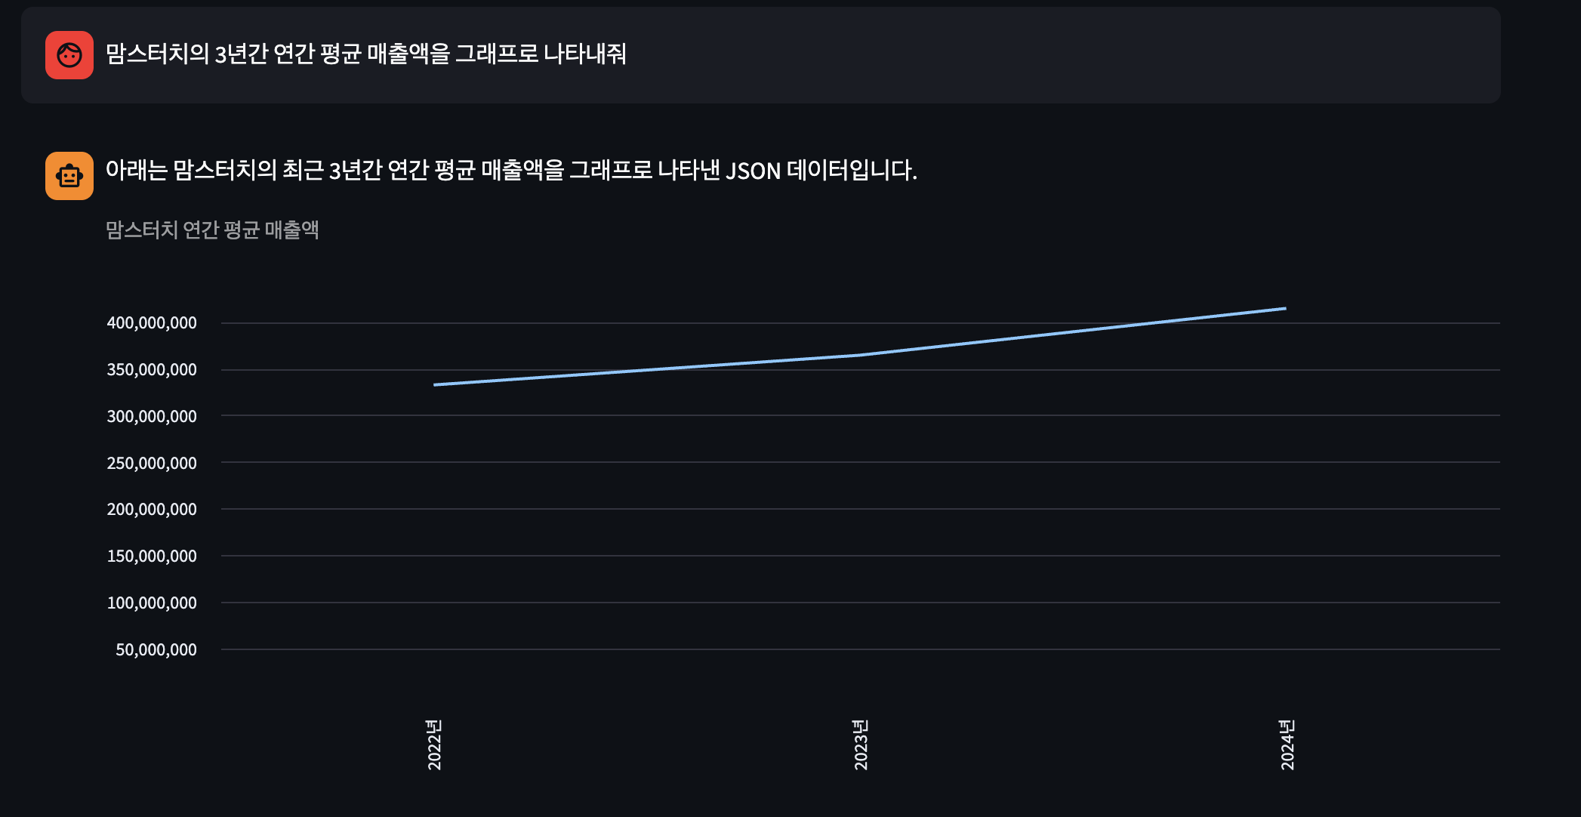
Workflow

Slide 19
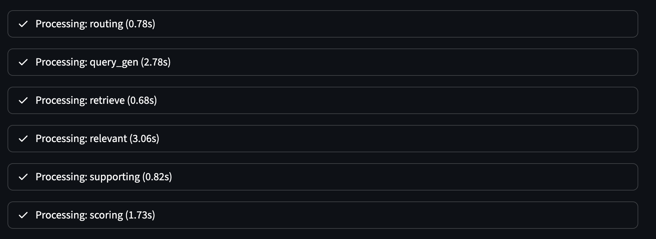
Workflow
Query, Relevant nodes takes a long time: Use good models!

Slide 20
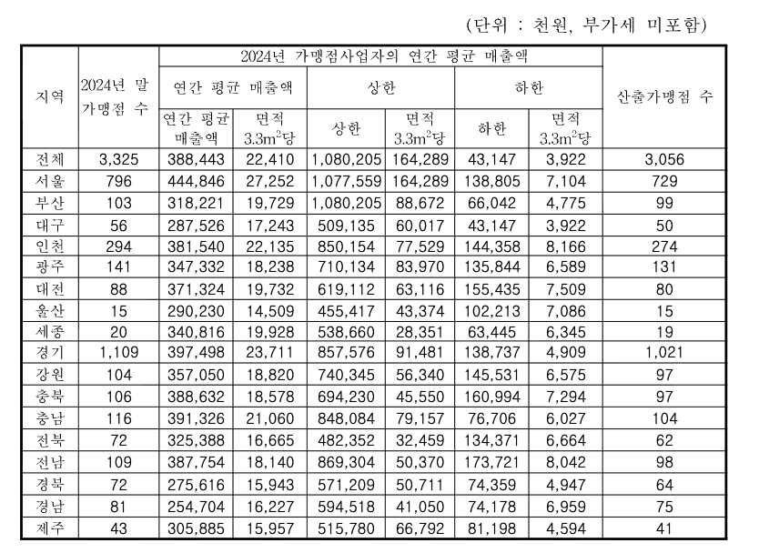
Limitations
Retrieve
  Sometimes the retriever can’t find relevant documents
  Wrong numbers in complex tables
  Try various pdf loaders, change chunking methods

Slide 21
Limitations
Evaluation
  Make benchmark Q&As
  How to evaluate them? Human or LLM?
Complicated questions
  Prompting will be important
  Use enhanced, diverse models in each node

Slide 22
Limitations
Data problems
  Can only access public data
  In real applications, more data will be needed
  For a huge database, will it work well?
  Link with web-search agent

