Slide 1
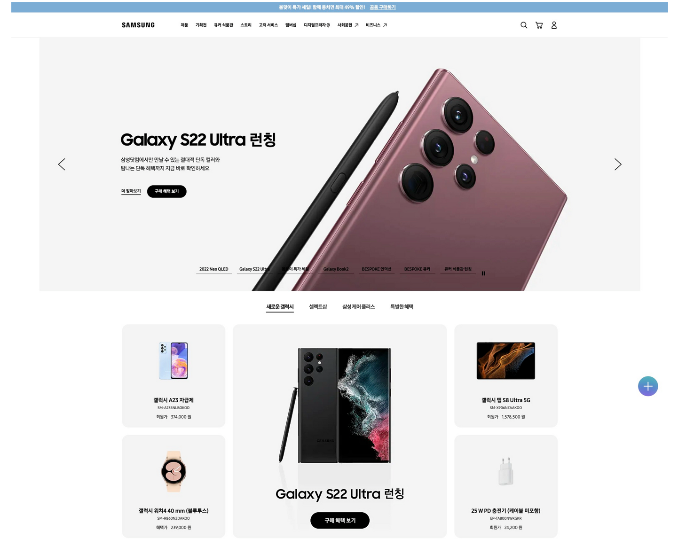
HEADER
ul,li
NAV
ul,li
빨간색 = button
ul,li
ul,li
MAIN
DIV

Slide 2
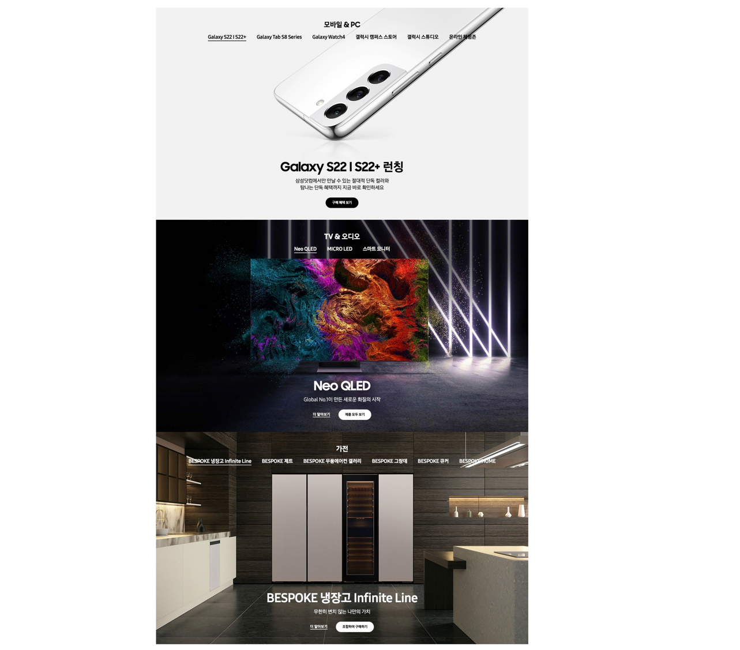
section
ul,li
ul, li

Slide 3
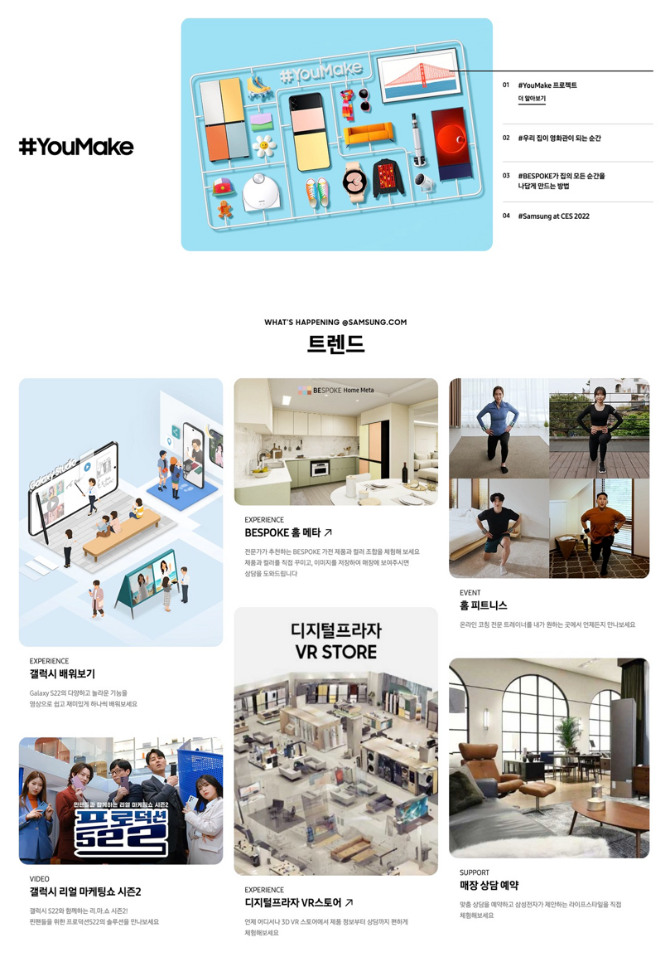
section
section

Slide 4
