Slide 1
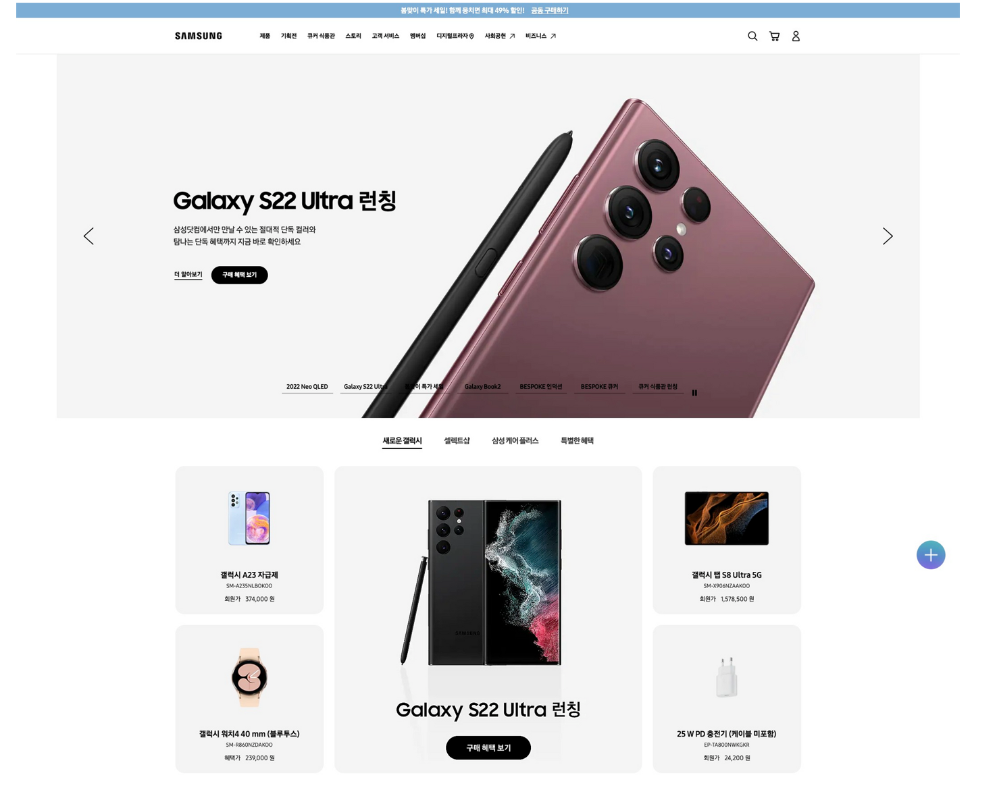
HEADER
ul,li
NAV
ul,li
ul,li
ul,li
H2
MAIN(FOOTER 전까지)
DIV

Slide 2

section
ul,li
H2
ul, li
H2
H2

Slide 3

section
H2
section
H3
H3
H3
H3
H3
H3

Slide 4
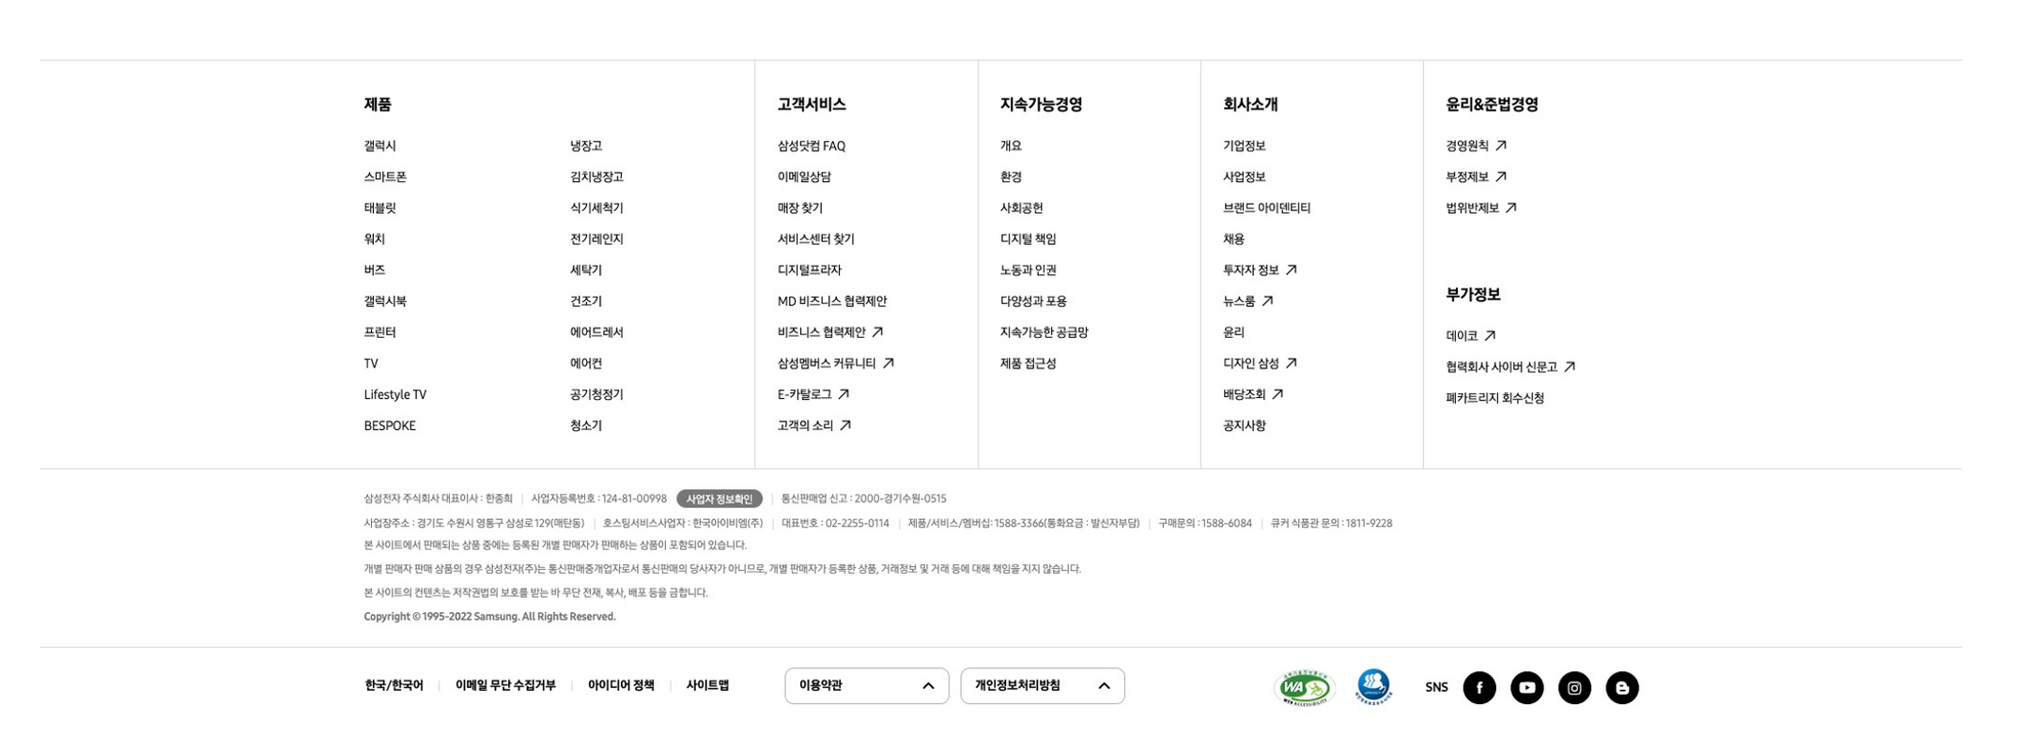
FOOTER

