Slide 1
ANALYZING BOX OFFICE MOVIES
Wonuola Abimbola and Edgar Gonzalez

Slide 2
Summary
An analysis of the film industry data was carried out to get a clearer picture of what it takes for movie to be successful.
Based on these findings, we came up with recommendations that would increase the chances of success
We also note that this analysis brought up more questions which a deeper dive into the film industry may be able to answer.

Slide 3
Business Problem
Microsoft has expressed an interest in creating a movie studio of their own, however they know little about the movie industry.
We have been tasked with exploring some data on box office movies to gain insights into what it takes to make a successful movie.

Slide 4
Hypotheses
We would like to explore the following:
Are certain genres more profitable?
Do we have a relationship between the directors associated and the profits?
Is it more profitable to release movies at certain times of the year?

Slide 5
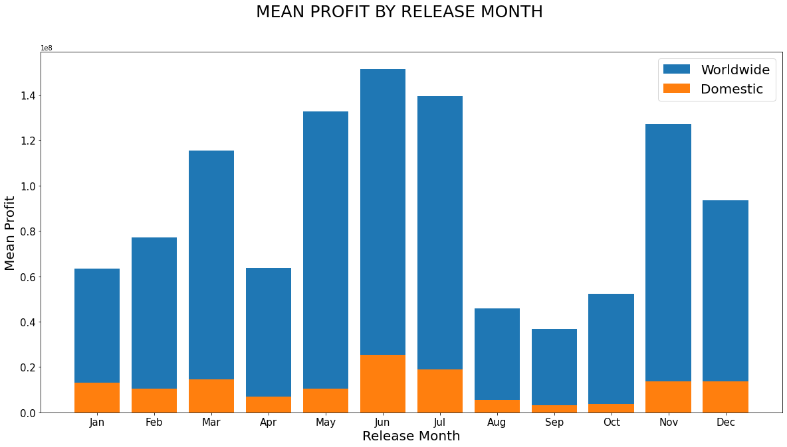
- Defined profit as difference between Gross and Production Budget
- Measured average profit grouped by month it was released
- Domestic profit peaks on June and July
- Worldwide profit peaks between May and July with smaller peaks in March and November
- Overall lowest profits between August and October
Caption

Slide 6
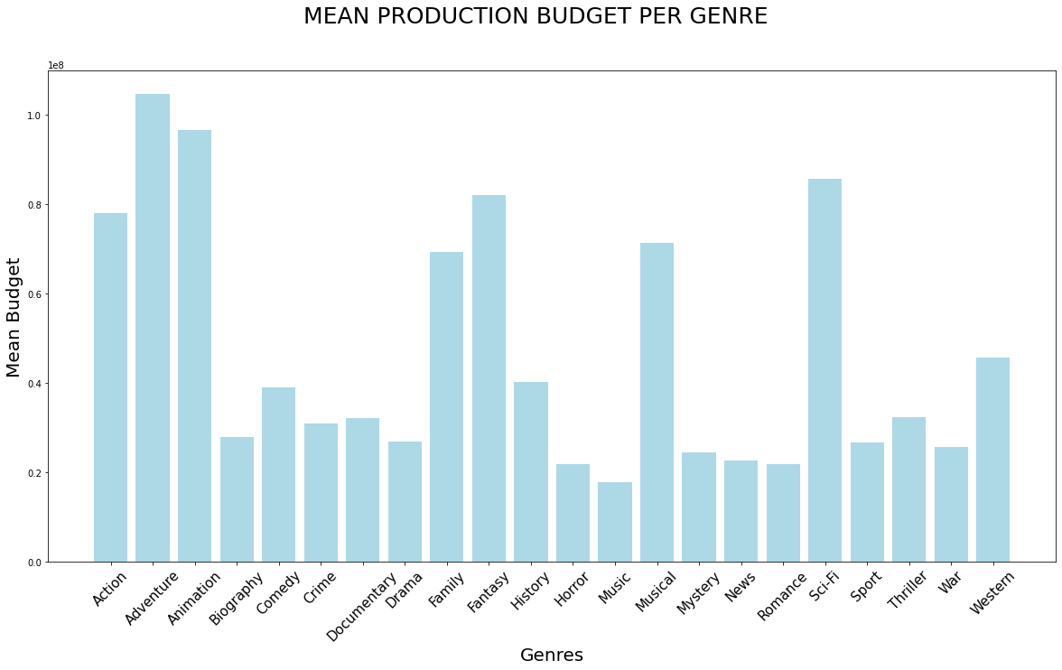
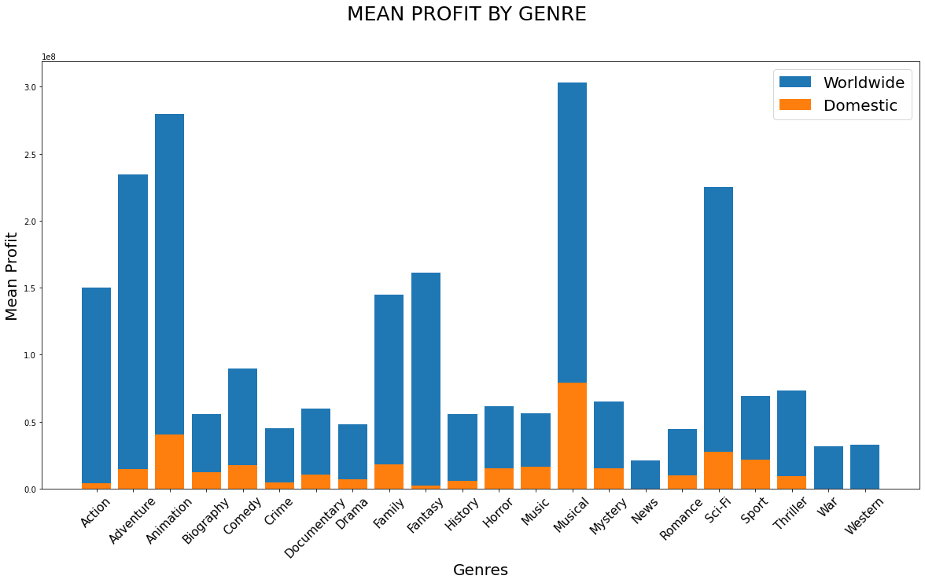
Caption
Caption
- High production costs in Adventure, Animation, Musical and Sci-fi
- Those same genres also have overall highest profits
- Least profitable genres are News, War, and Westerns

Slide 7
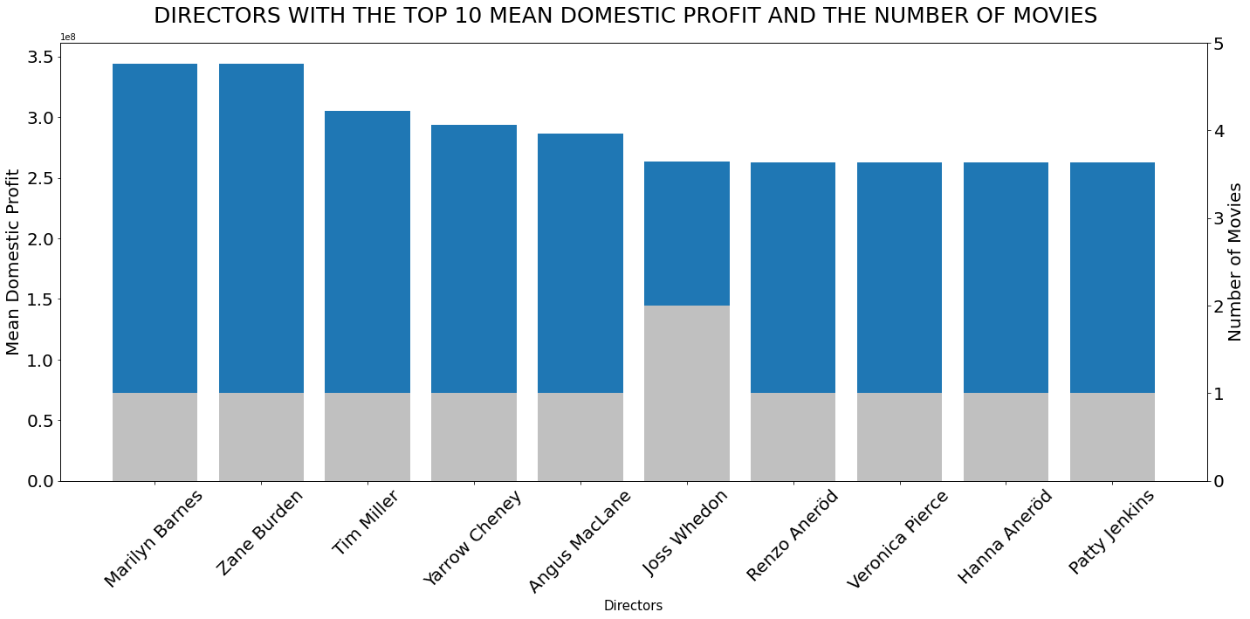
-Domestically, most directors performed similarly with the exception of Zane Burden and Marilyn Barnes

Slide 8
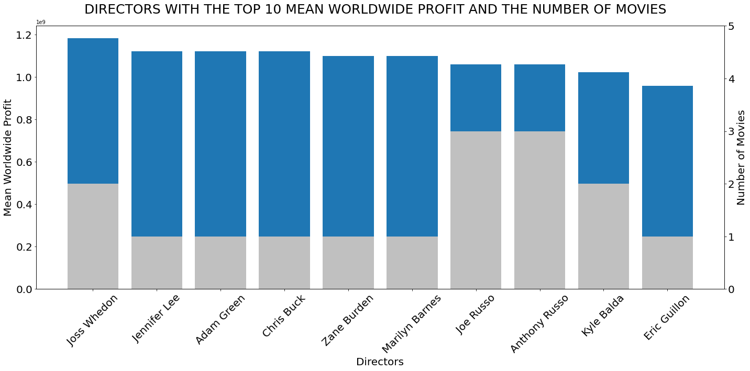
Worldwide most directors performed similarly as well with only Joss Whedon and Zane Burden also being successful domestically

Slide 9
Recommendations
It's safer to release movies during the months of May, June and July
Invest in Musical, Animation and Sci-Fi genres if possible
Employ experienced directors that have had successful box office movies like Joss Whedon, the Russo brothers etc.
As we are currently in a pandemic and going to the theatre is a rarity, you may want to consider investing in a streaming service as well.

Slide 10

THAT'S A WRAP!
THANK YOU FOR LISTENING!

