Slide 1

SignUP Login
Click

Slide 2
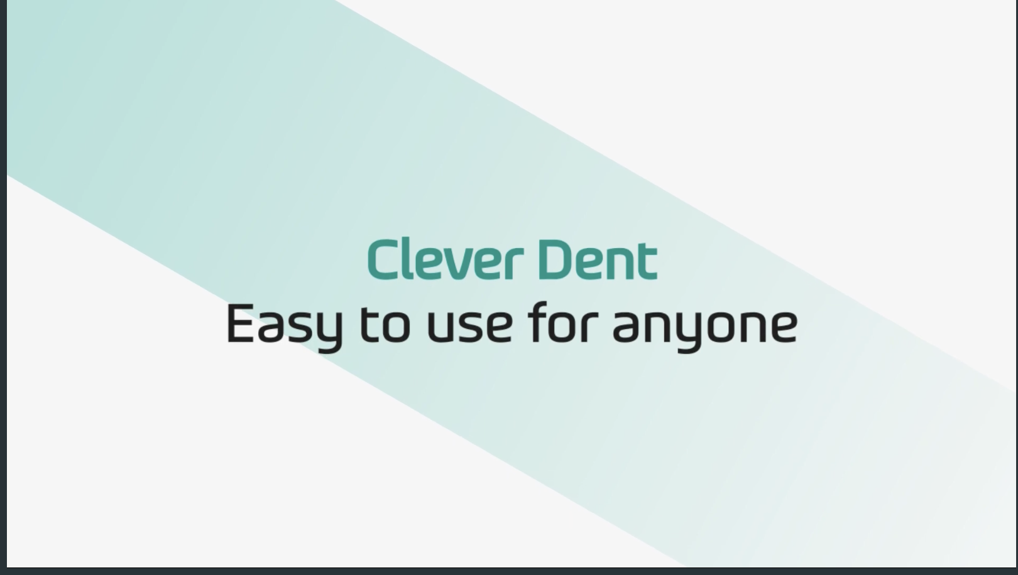
SignUP Login

Slide 3
SignUP Login
Easy & Convenient patient management
Patient menu provides all patient-related information such as Patient information, Schedule List, Medical alerts, Introduction & Family, Chart, Payment, Document and Files.​

Slide 4
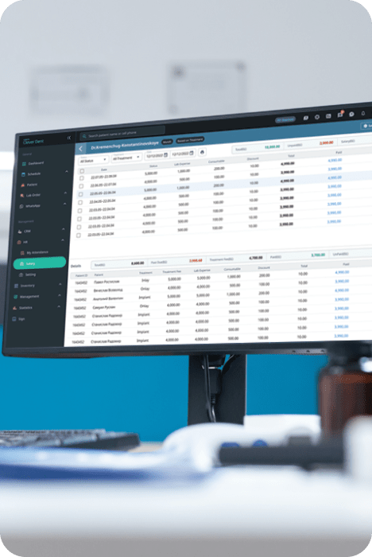
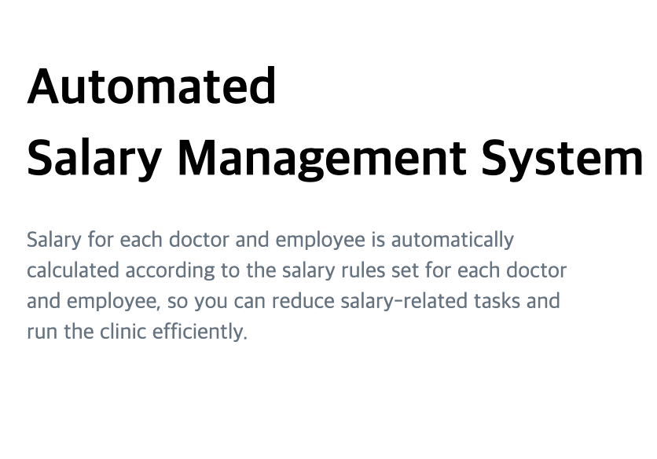

Slide 5

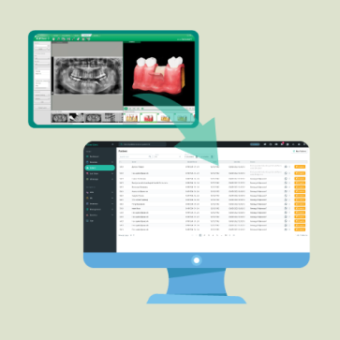
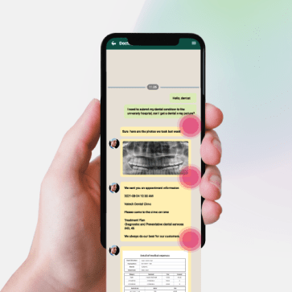
SignUP Login
Easy & powerful CRM
Clever Dent provides Powerful CRM target search for detailed patient management. By linking WhatsApp to Clever Dent, you can manage and communicate with patients easily and conveniently.​
Clever Dent Is The Solution For
Your Successful Dental Practice Management

Slide 6


Product Management
Smart Inventory Management System
Inventory Management menu supports managing the clinic's inventory items and status.​You can efficiently manage dental consumables and materials using this menu.​
Product Management
Incoming/ Outgoing
Product Management

Slide 7
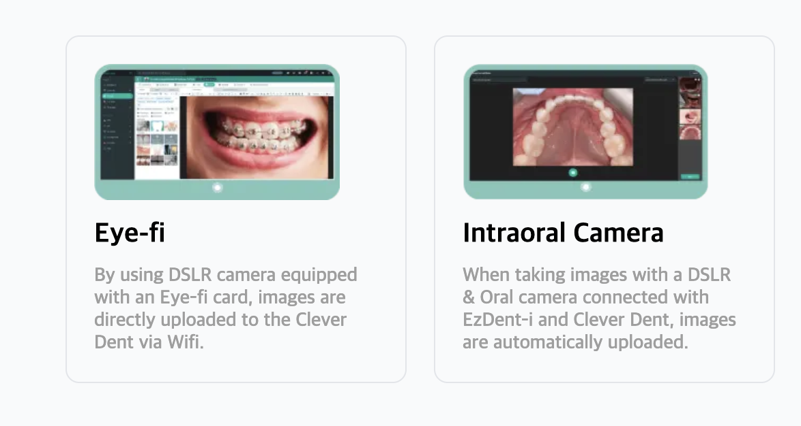
Support​Importing Images
from Other Sources​

Slide 8
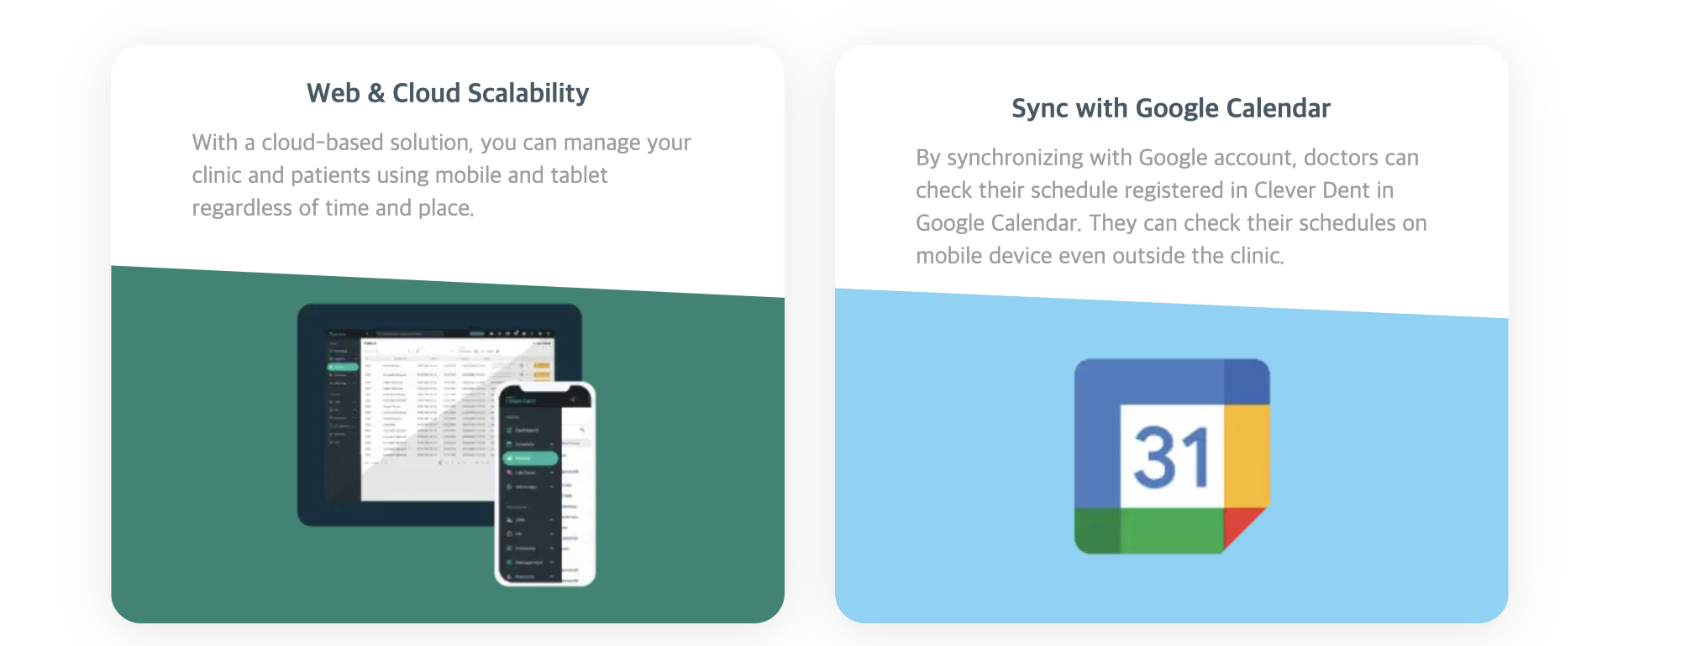
SignUP Login
THIS IS THE STRENGTH OF CLEVER THIS IS THE STRENGTH OF CLEVER

