Slide 1
Data Warehouse
MODEL CI/CD
Code change, trigger CI
New inference code, trigger release
Data Cooking Pipeline
DevOps Pipeline
TRAIN MODEL
Training code
Inference code
Git Repo
New training job is started whenever source code is pushed.
ML Pipeline handles dataPrep, training, evaluation – certifies the model is of high quality
Register Model
Data Lake
Unit Test Code
Model Store
Run Azure ML Pipeline
New data, trigger CI
Azure Data Factory Pipeline
Azure Databricks
Azure ML Compute (docker run)
Data Preparation Services (Labeling, Feedback, Drift)
New model registered, trigger release
Data movement / copy
Data cooking
Model training
Inference code has changed, trigger release pipeline
DEPLOY MODEL
DevOps Pipeline
Azure DevOps
Deploy to Azure Kubernetes Service (PROD)
Get Human Approval
Validate Model
Deploy to Azure Kubernetes Service (INT)
Package Model
Azure Machine Learning
Azure Data Factory
Inference Data

Slide 2
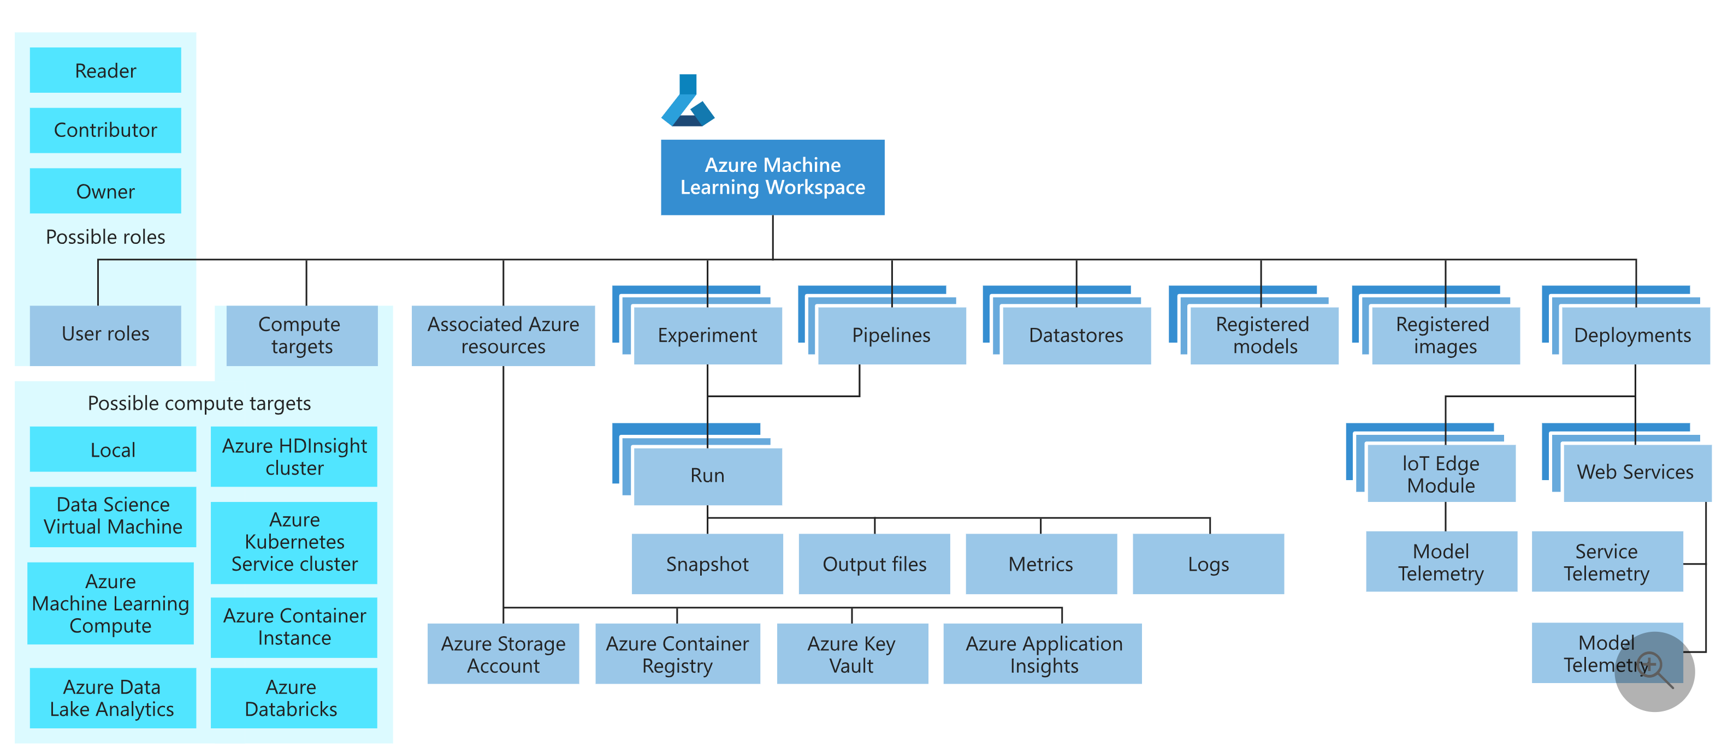
Data Preparation Services
Data Lake
Data Preparation Services

Slide 3
Choose the right pipeline for the right task
Scenario | Primary Persona | Azure Offering | OSS Offering | Canonical pipe | Differentiator
Model orchestration | Data scientist | Machine Learning Pipelines | Kubeflow pipelines | Data -> model Training/ retraining | Distribution, caching, code-first, reuse
Data orchestration | Data engineer | Data Factory Pipelines | Apache airflow | Data -> data Data movement/ transform | Strongly typed movement / data-centric activities, activity first
Code & app orchestration | App developer / ops | DevOps Pipelines | Jenkins | Code -> app/svc Validation/ deployment | Most open / flexible activity support, approval queues, phases with gating

Slide 4
Data Science DevOps Pain Points
Activities
Pain Points
Experimentation
Modeling
Versioning
Lineage
Conversion
Export
Quantization
Inferencing
Retraining
A/B Testing
Etc.
Need to solve ML problem quickly.
ML stack might be different from rest of the application stack.
Lots of Glue code.
Testing accuracy of ML model.
ML code is not always version controlled.
Hard to reproduce models
Integrating model into application can take weeks
Need to re-write featurizing and scoring code multiple times (in different languages)
Want to start using customer data to build models
Hard to track breaking changes

Slide 5
Model Registry
Goals:
Track important metadata on a model
tags, versions used for discovery – what do I have?
runtime info - model framework, operators leveraged, memory footprint, …
key metrics – how has my model evolved over time?
model lineage – what was used to create my model (code / compute / data / other models)?
upstream consumption - where has it been deployed? (services, ML pipelines, IoT devices)… is it healthy?
Make models easy to discover, consume, customize
Determine supported image types and deployment targets for a given model
Promote the best model from my experiment
Explore / fork the experiment used to create a model (customize or retrain)
Syntax (CLI)
az ml model register {{modelType}} -n modelName -f modelFile(s) [modelFlavor specific metadata]
Example model types: pytorch, pyspark, sklearn
Examples:
az ml model register tensorflow -n mymodel -f model.pb --model-type inceptionv3
az ml model promote -n promotedModelName –experiment-id experimentId -m mybestmodel
az ml model update –n mymodel:latest --all

