Slide 1
Progress Presentation
20240171 장홍준
20240576 송승윤
20240894 조현준

Slide 2
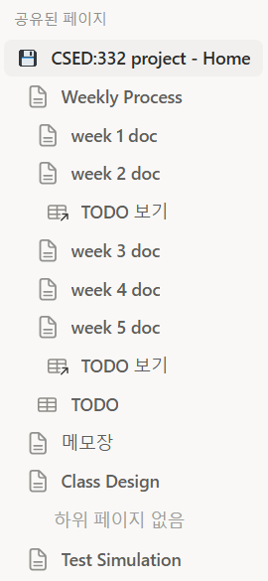
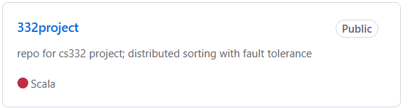
Week #1 : Build Setting & Convention Rule
Generate Scala project
-Scala 2.13.12
-sbt 1.11.7
-upload github
Generate notion page
Set convention

Slide 3
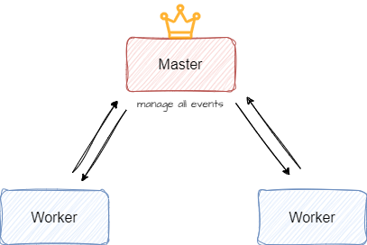
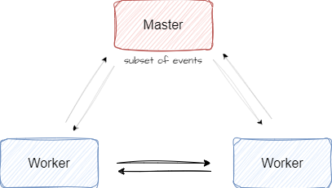
Week #2 : Basic Design
gRPC API
How to shuffle?
    worker-master-worker model vs worker-to-worker model

Slide 4
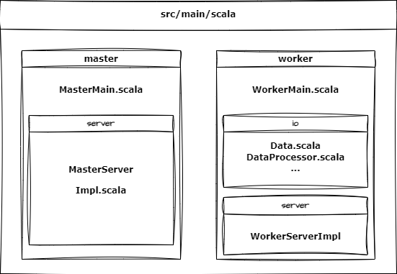
Week #3 : Detailed Design & Class Design

Slide 5
Week #4 : Implement codes & Share Issues
Worker
Master Server
Common
gensort outputs bytes, so difficult to convert to String
Need to decide byte comparison method for sorting.
Implemented register
Consider Lock.synchronizd section
Update TrieMap → mutable.Map
Discussed test strategies during development
Manage develop branch with PR
Commit main branch without PR
Notion subscription issue

Slide 6
Week #5 : Preparing Presentation
Prepare Presentation
Share some concurrent Issues about Master Server
Fix Bugs

Slide 7
Future tasks
Finish code implementation
Design test situations
~Week #6 : code implement done & component test finish
~Week #7 : test on VM w/ concurrent Issues, memory safe...
**We are creating and sharing simulation situations that illustrate the above issues on Notion pages.

Slide 8
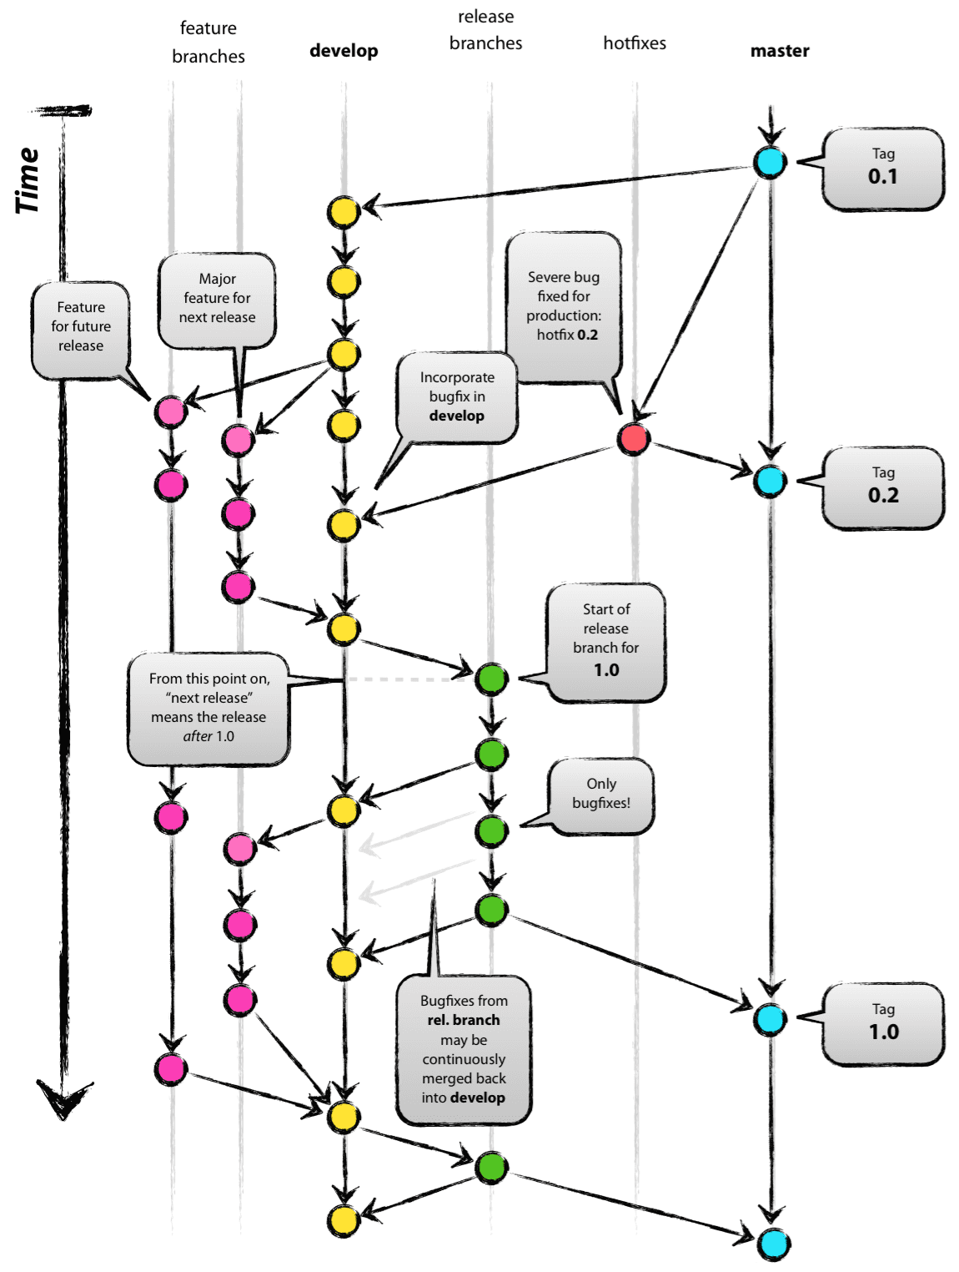
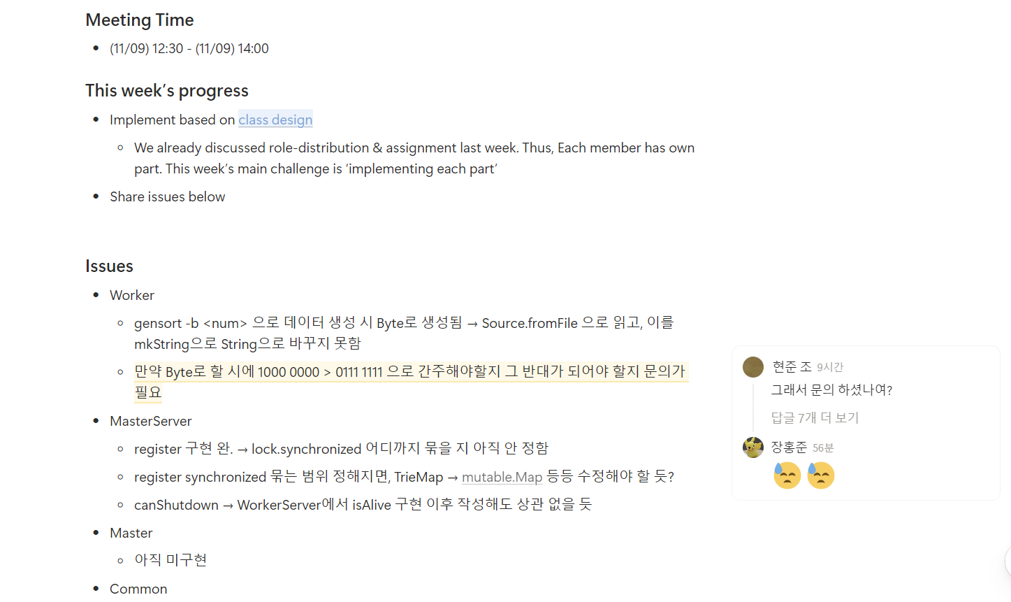
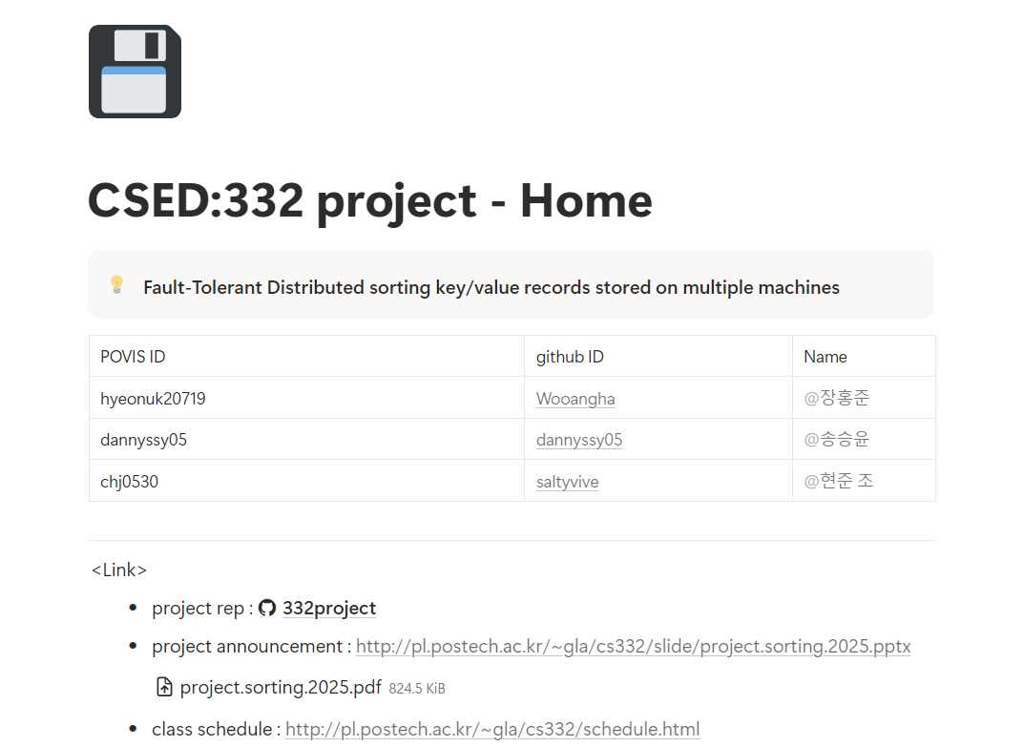
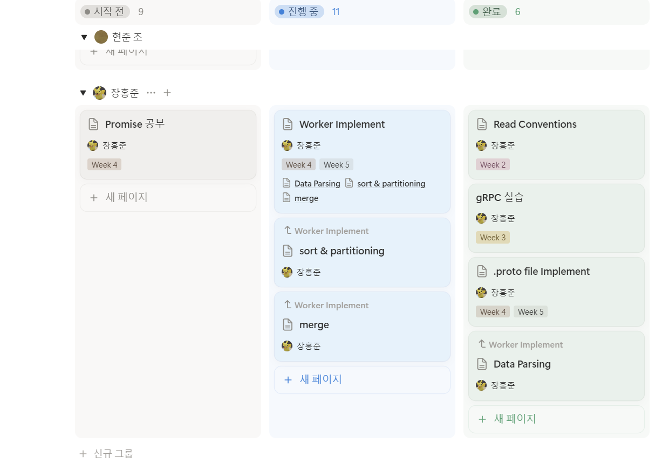
Logistics
Had meetings 1–2 times a week to discuss design decisions
Shared issues and tracked each other’s progress
Manage documentation: Notion
Manage git repo: git flow

Slide 9
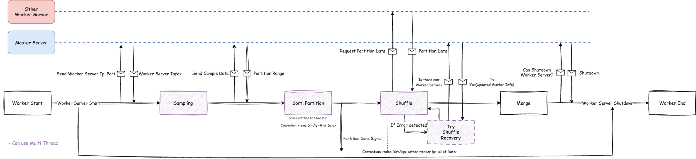
Flow Chart - Worker

Slide 10
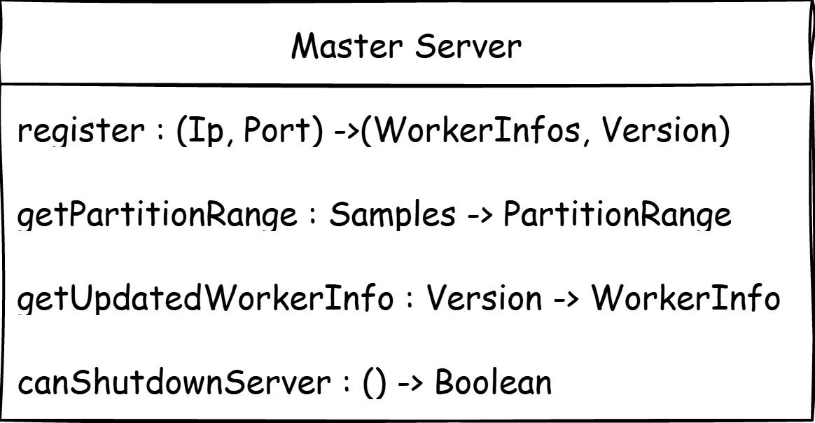
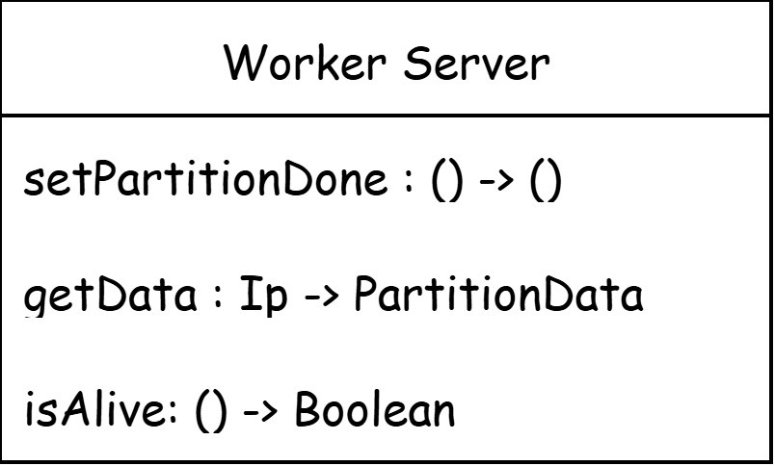
Server Methods

Slide 11
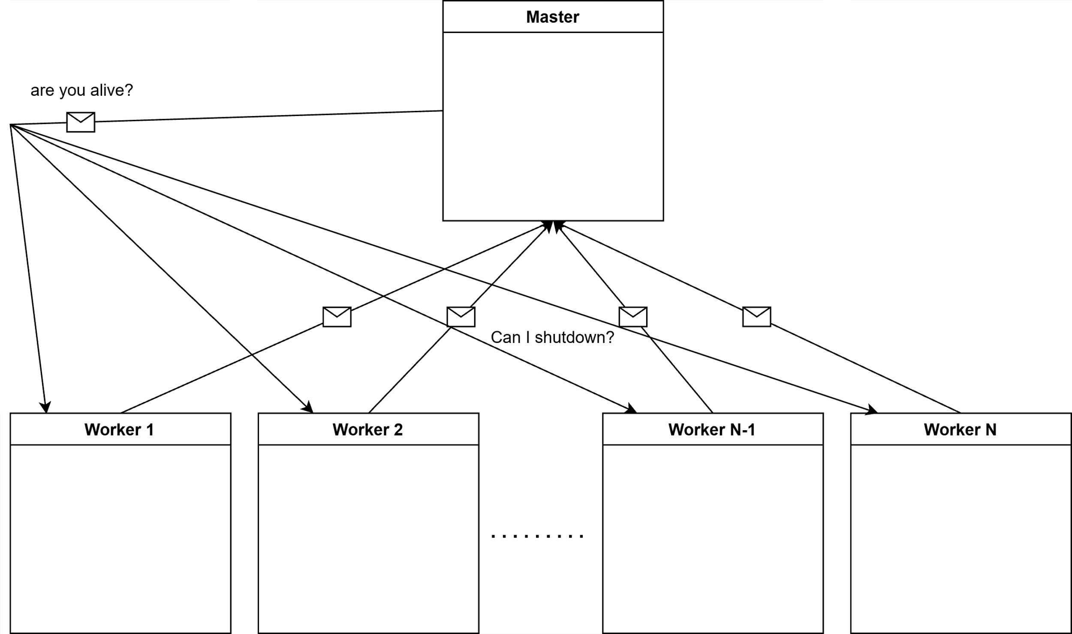
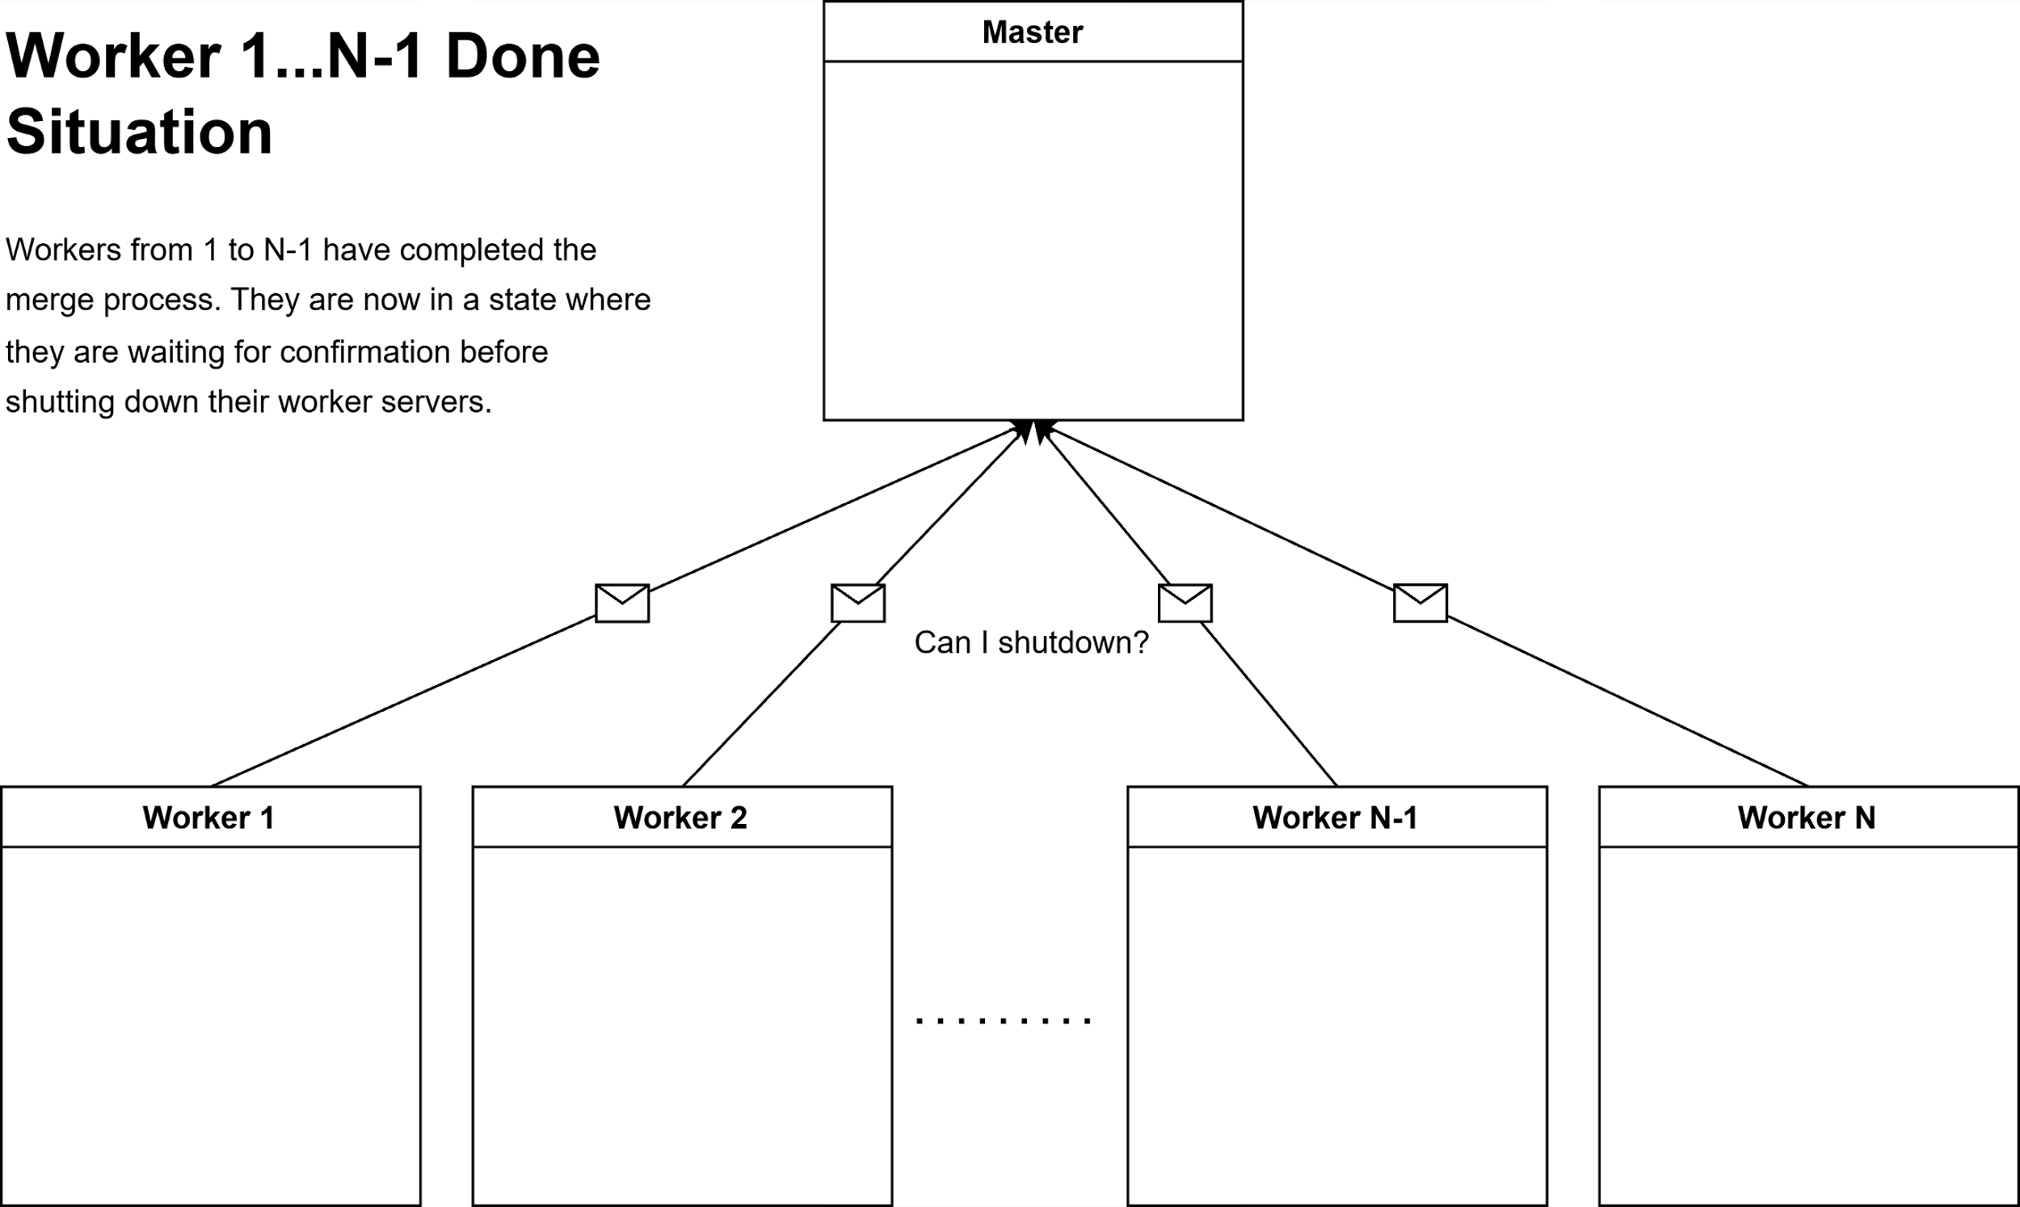
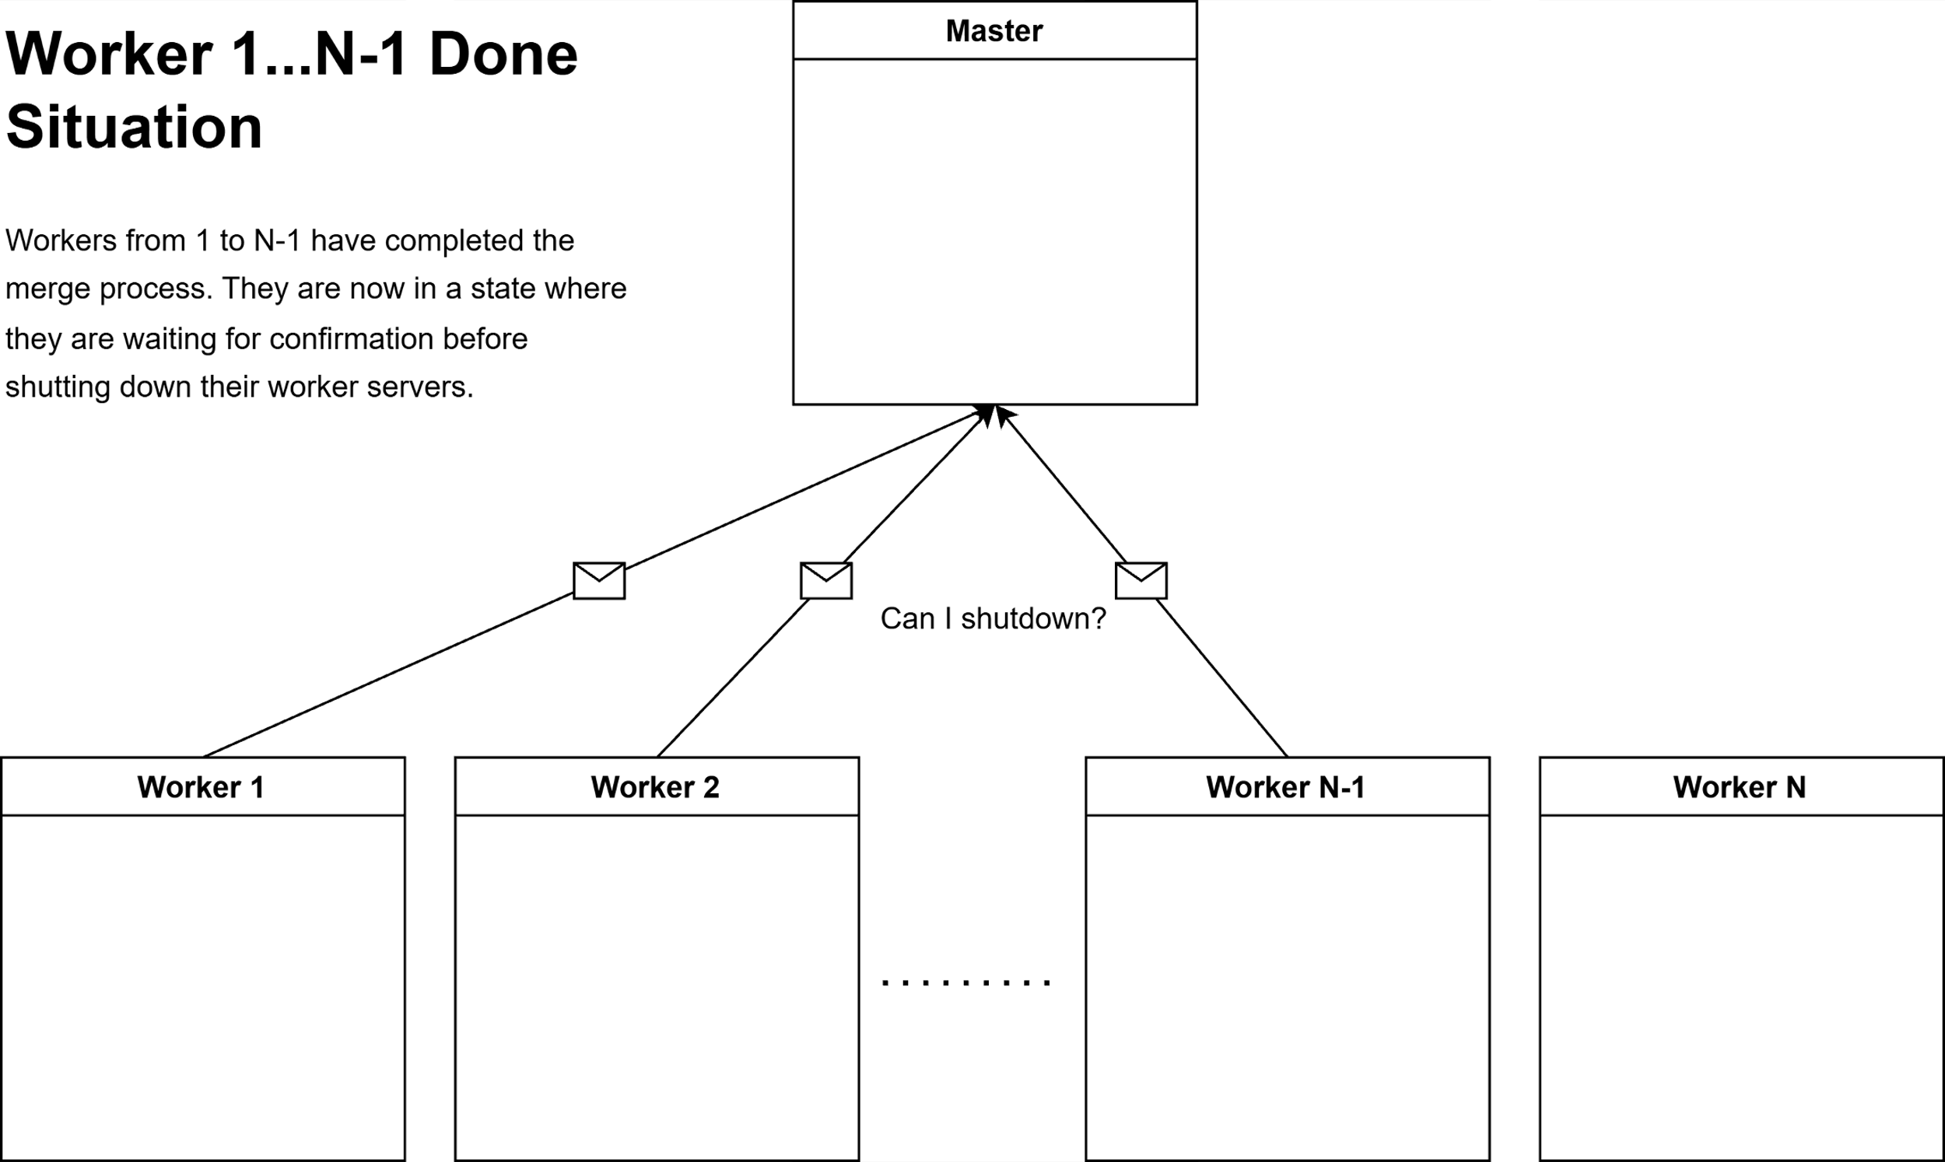

Why use isAlive

Slide 12
Q&A​
Feel free to ask any questions

