Slide 1
Rectification of Stereo Images
Милош Миловановић
Урош Поповић

Slide 2
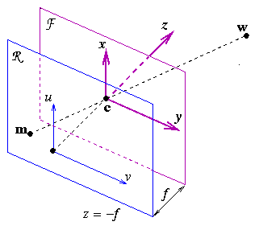
Camera Model
c – optical center
R – retinal plane
F – focal plane
f – focal length

Slide 3
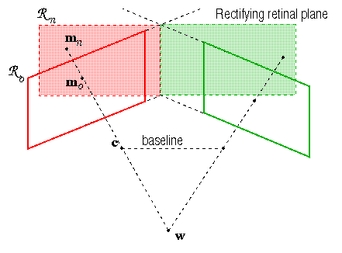
Stereo Images

Slide 4
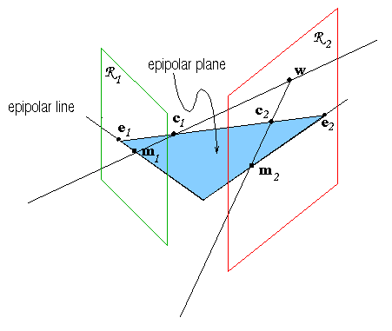
Epipolar Geometry
m₁, m₂ – conjugated points
m₁c₁c₂ – epipolar plane
m₂e₂ – eipiolar line conjugated to m₁
e₁=c₁c₂R₁ – first epipole
e₂=c₁c₂R₂ – second epipole
Rectification: e₁ , e₂

Slide 5
Fundamental Matrix
m₁=(x₁,y₁,1)
m₂=(x₂ y₂,1)
m₂ ∈ line(Am₁,e₂)
m₂ ∙(Am₁ X e₂)=0
m₂^{t} F m₁=0
m₁^{t} F^{t} m₂=0
Rank F=2
m₂^{t} Fe₁=0 for all m₂
Fe₁=0, F^{t}e₂=0
Am₁

Slide 6
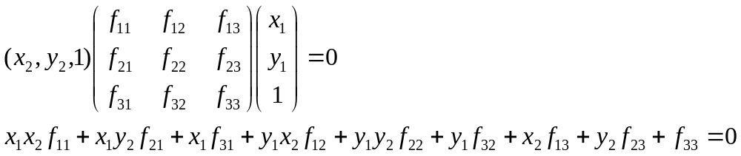
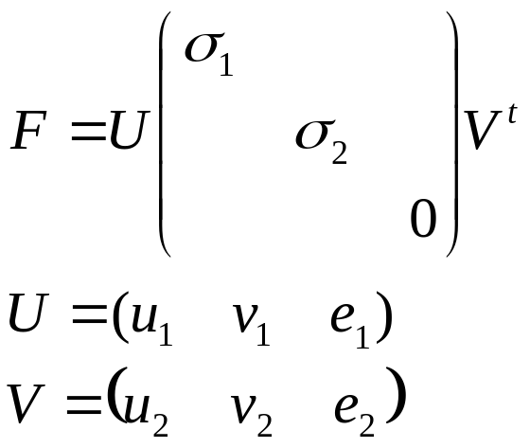
Estimating of Fundamental Matrix
8 points to estimate F up to a constant factor
Singular value decomposition

Slide 7
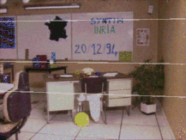
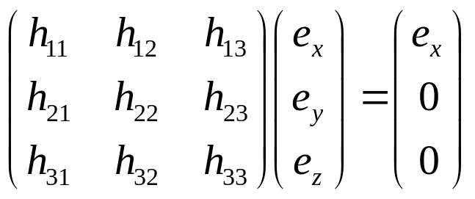
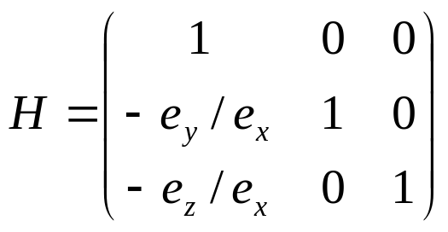
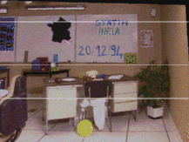
Rectification
x=0 – invariant points

Slide 8
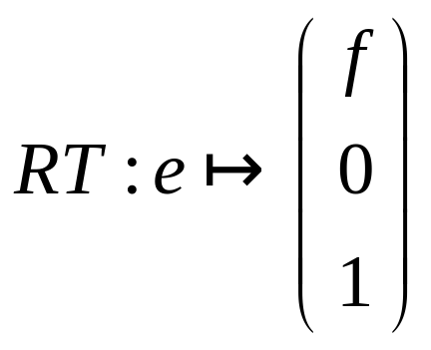
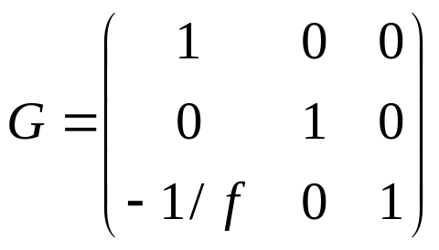
Better solution
H=GRT
T – translation central point to the origin
R – rotation epipole to be on X-axis
G – projective transform

Slide 9
R. I. Hartley, Theory and practice of projective rectification, International Journal of Computer Vision 35 (2) (1999) 115–127.
C. Loop, Z. Zhang, Computing rectifying homographies for stereo vision,in: Proceedings of the IEEE Conference on Computer Vision and Pattern Recognition, Vol. 1, 1999, pp. 125–131.
J. Mallon, P. F. Whelan: Projective rectification from the fundamental matrix. Image Vision Comput. 23(7): 643-650 (2005)

