Slide 1
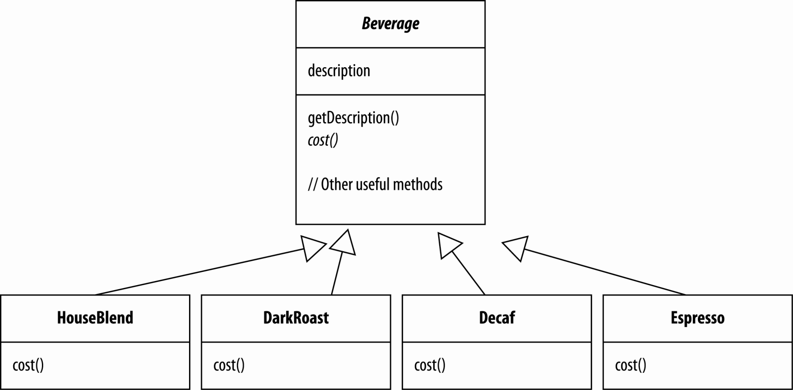
A first design
Starbuzz Coffee: Their first computer system implemented “beverages” as shown.
Beverage is an abstract class…
… because of the cost() method
Each subclass implements cost() to return cost of beverage

Slide 2
Business is changing and expanding…
Starbuzz wishes to charge a bit for condiments:
Steamed milk
Soy
Mocha
Whip
Other junk stuff
We want these costs to be built into their order system.
Perhaps inheritance based on the domain will help (i.e., “is-a” concept)
What follows is a first attempt at a solution…

Slide 3
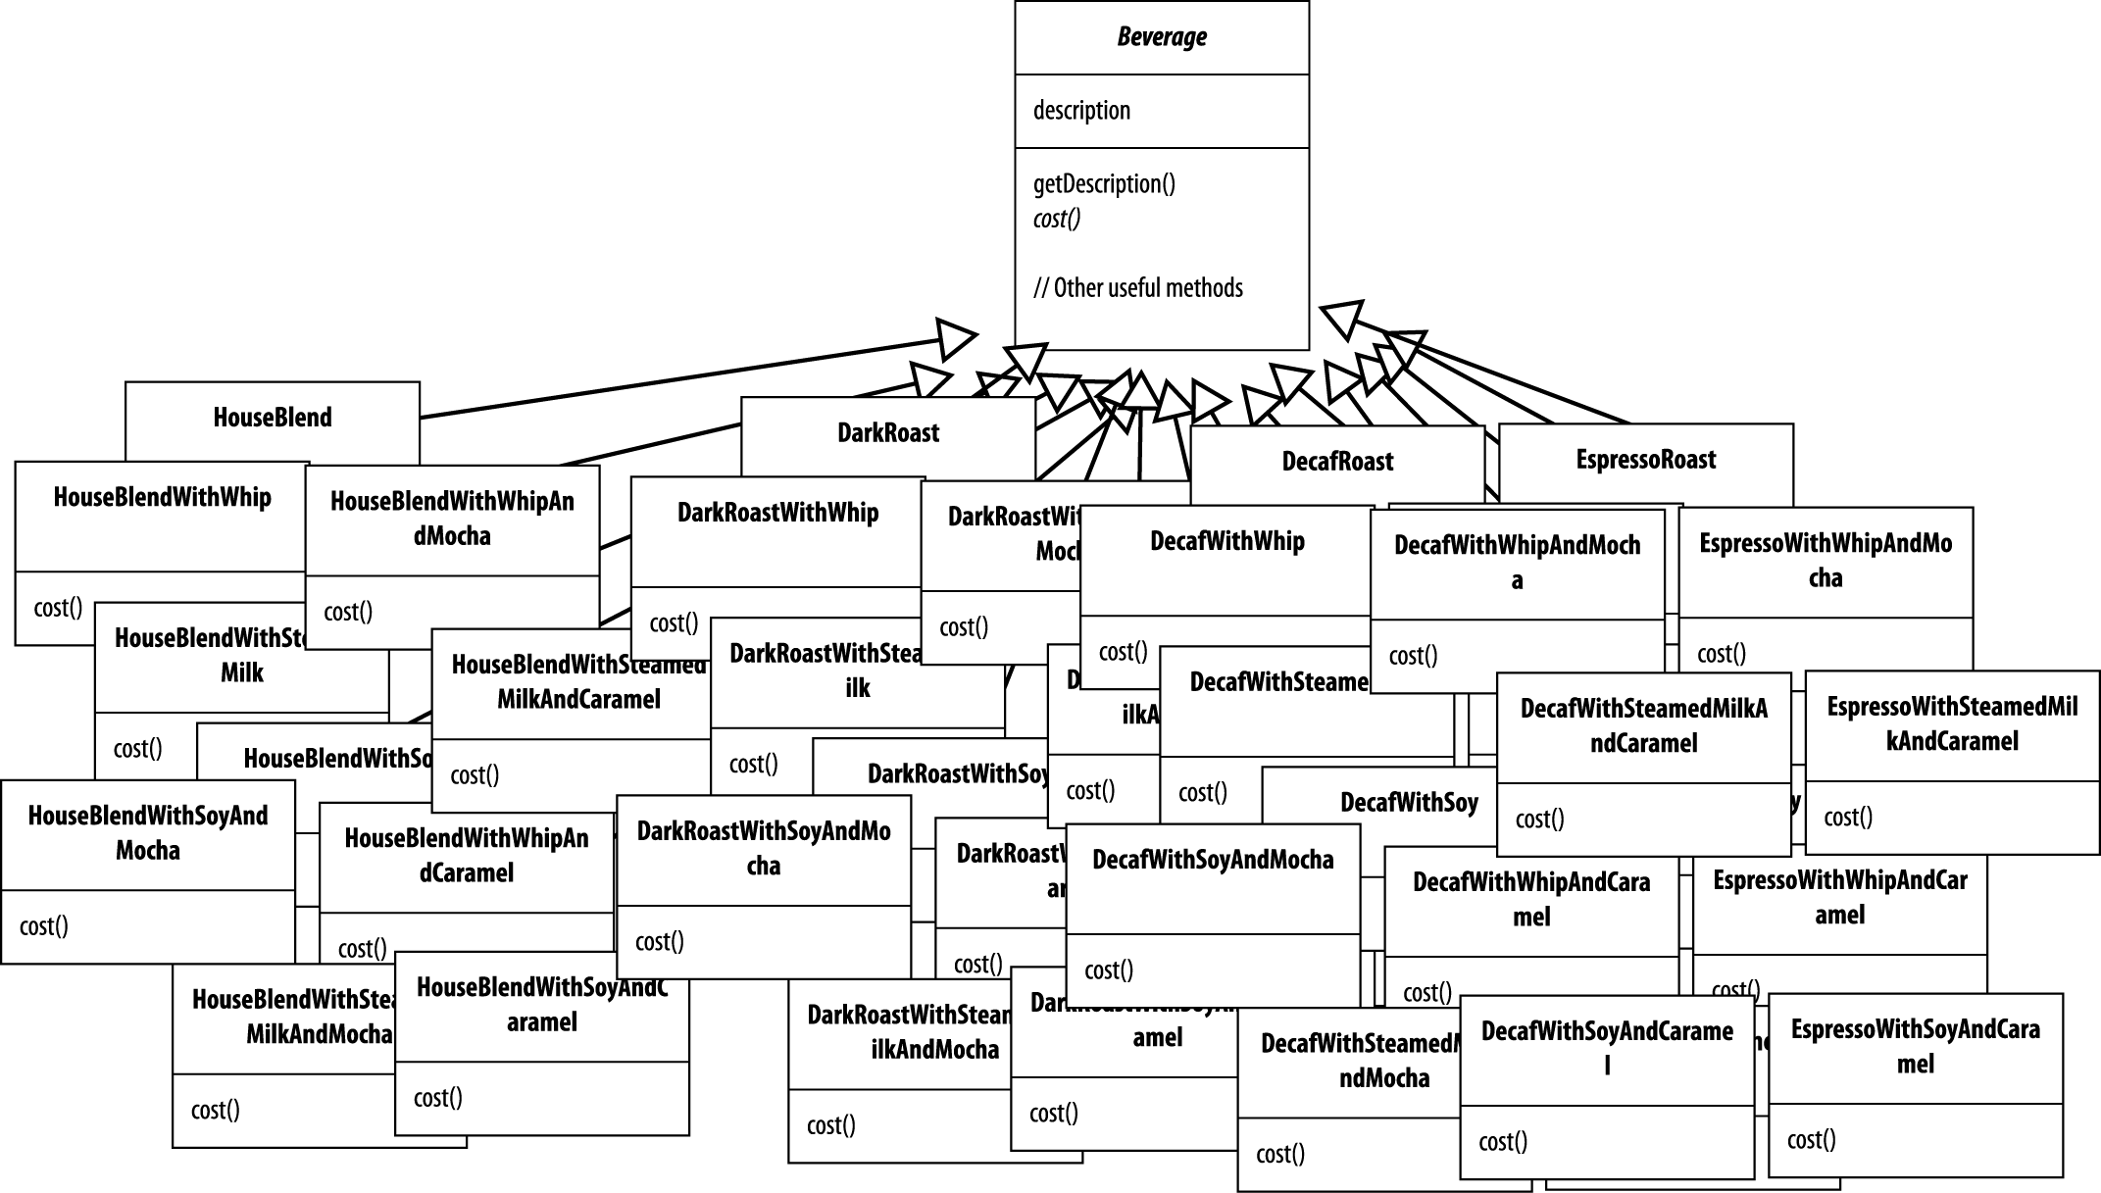
Starbuzz v. 2
“Houston: We have a problem.”
Each cost method computes the cost of coffee along with the other condiments in order.

Slide 4
Some OO Principles
There exist many such principles. Here are some important ones:
Encapsulate what varies.
Program to interfaces, not implementations.
Strive for loosely coupled designs between objects that interact (e.g., “event” vs. “responder”, “model” vs. “controller”)
Which of these are violated in Starbuzz v.2?
Hint: they’re violating two of them in a big way!
I might ask you this in the oral exam if you choose this pattern.

Slide 5
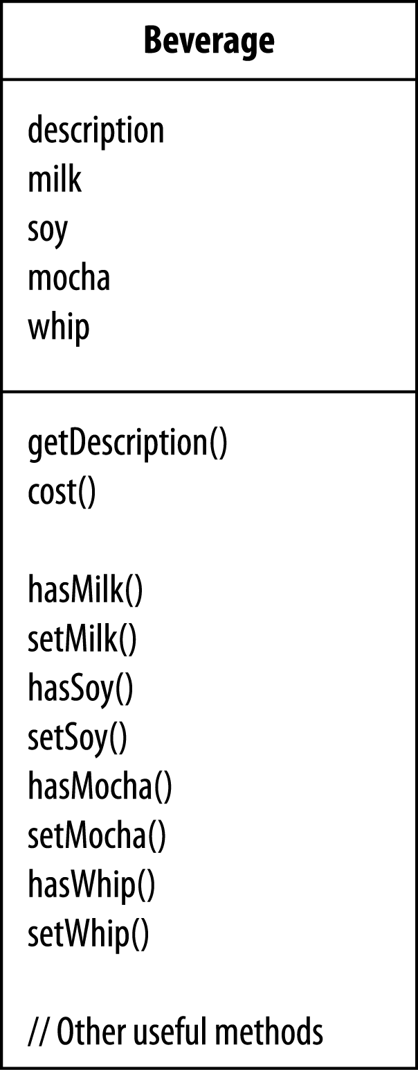
Possible solution…
Perhaps we can use inheritance and instance variables
We will add more methods to the superclass
cost() now implemented in superclass.
Subclasses override cost(), but use superclass version to compute total cost

Slide 6
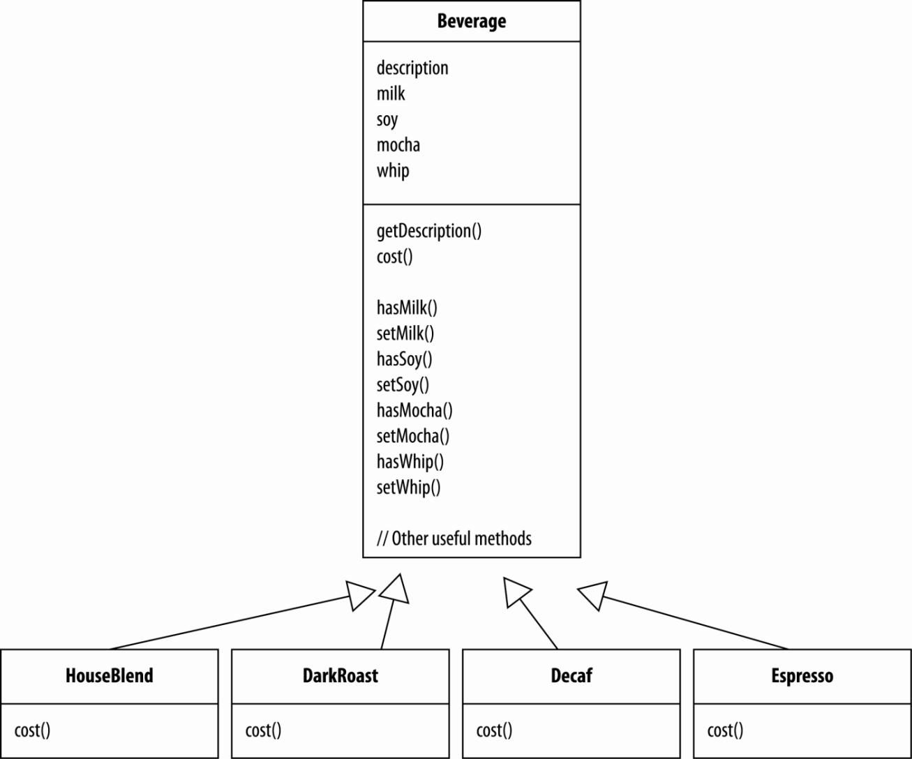
And add in subclasses…
Superclass cost() calculates costs for all condiments.
Overridden cost() handles case of individual “base beverage”
Each cost() method computes cost of beverage and then adds in condiment costs by invoking superclass cost().

Slide 7

… and stir.
class Beverage {
double cost() {
double condiment_cost = 0.0; if (hasMilk()) { condiment_cost += 0.50; } if (hasSoy()) { condiment_cost += 0.55; } if (hasMocha()) { condiment_cost += 0.30; } if (hasWhip()) { condiment_cost += 0.40; } return condiment_cost;
} }
class Decaf extends Beverage {
Decaf () { description = “Character-less Decaf”; } double cost() { return 1.10 + super.cost(); } }
// using the beverages … … Beverage decaf_with_soy = new Decaf(); decaf_with_soy.setSoy(); … cout << decaf_with_soy.cost() << endl;

Slide 8
But alas and alack …
… there are problems.
What happens when condiment costs change?
What happens when new condiments are added?
What happens when we have new beverages for which condiments are not appropriate (i.e., SweepedTea)?
What if a customer wants triple whip? double mocha?

Slide 9
Inheritance: not a silver bullet
Note that inheritance is powerful!
However, it does not always lead to most flexible or extensible designs.
Basic problem: behaviour inherited by subclassing is static
i.e., happens at compile time
Two design principles will help us here:
Favour composition over inheritance.
Classes should be open for extension, but not for modification.

Slide 10
Composition vs. Inheritance?
Difference between "is-a" and "has-a"
In the first example, Apple is related to Fruit by inheritance ("is-a")
In the second example, Apple is related to Fruit by composition (ie., Apple has an instance variable referencing Fruit, or "has-a")
If superclasses changes frequently, then "is-a" results in brittle code.
class Fruit { // … }
class Apple: public Fruit { // … }
class Fruit { //… }
class Apple { private:
Fruit fruit; // … }

Slide 11
Our goal:
Allow classes to be easily extended to incorporate new behaviour without modifying existing code.
This produces designs that are resilient to change and flexible enough to take on new functionality to meet changing requirements (i.e., more & more use cases).
We will make judicious use of "has-a" to accomplish this.

Slide 12






One solution: Decorator pattern

Slide 13
… A real Decorator pattern
Let’s use composition:
Start with a beverage…
… and then dynamically decorate it with condiment (i.e., at runtime).
Example: Decaf double Mocha with Whip.

Slide 14
Step 1: Start with Decaf object
Decaf will inherit from Beverage so it will have a cost() method.
cost()
Decaf

Slide 15
Steps 2 & 3: Customer wants double-mocha
We create a Mocha object and wrap it around Decaf
cost()
cost()
cost()
Decaf
Mocha
Mocha
And then another around the first Mocha.

Slide 16
Step 4: Add the whip
We create a Whip object and wrap it around Decaf
cost()
cost()
cost()
cost()
Decaf
Mocha
Mocha
Whip

Slide 17
Calculating the costs
Call the outermost cost()
cost()
cost()
cost()
cost()
Decaf
Mocha returns 1.70
Decaf returns 1.10
Mocha
Mocha
Mocha returns 1.40
Whip
Whip returns 2.10

Slide 18
What will be apparent about Decorators:
Decorators have the same supertype as the objects they decorate.
You can use one or more decorators to wrap an object.
We can pass around a decorated object in place of the original (i.e., wrapped) object.
Decorator adds its own behavior before or after (or both!) delegating to the object it decorates to do the rest of the job.
Objects can be decorated at any time.

Slide 19
Decorator pattern defined
The Decorator Pattern attaches additional responsibilities to an object dynamically.
Decorators provide a flexible alternative to subclassing for extending functionality.

Slide 20
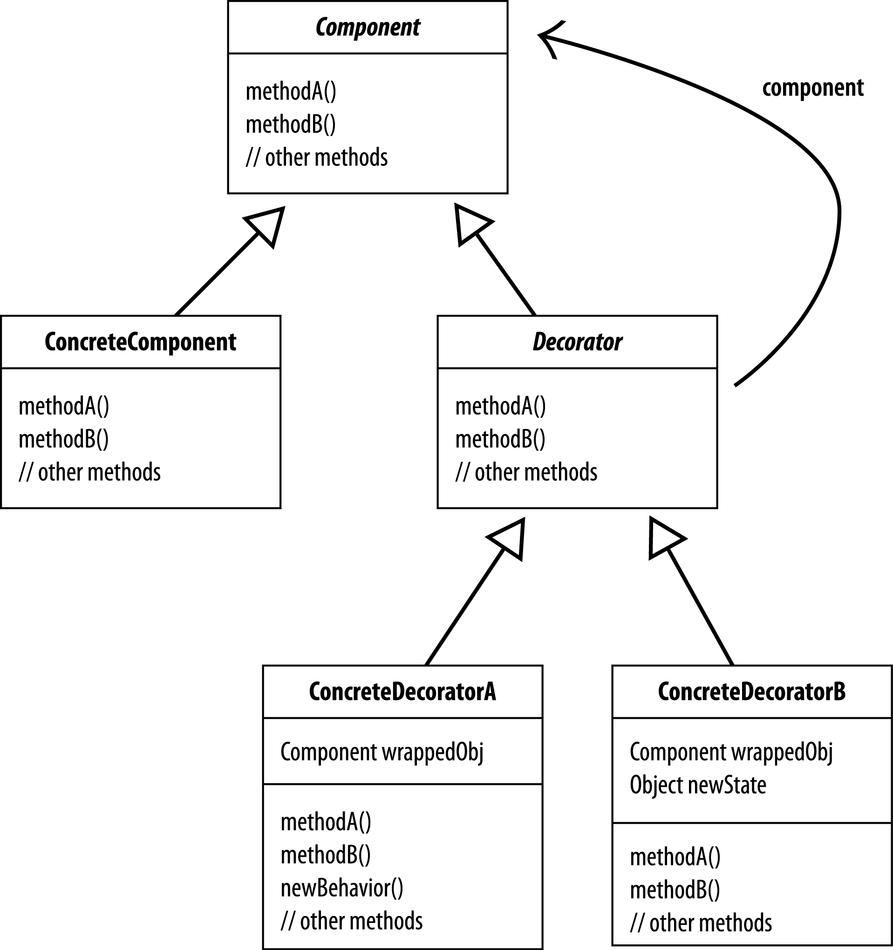
Decorator Pattern definition
Each decorator HAS-A (wraps) a component, which means the decorator has an instance variable that holds a reference to the component.
Each Component can be used on its own or wrapped by a decorator.
We intend to add new behavior to this.
Decorators implement the same interface or abstract class as the component they will decorate.
The ConcreteDecorator has an instance variable for the thing it decorates (the Component the Decorator wraps).
Decorators can extend the state of the component.
Decorators can add new methods; however, new behavior is typically added by doing computation before or after an existing method in the component.

Slide 21
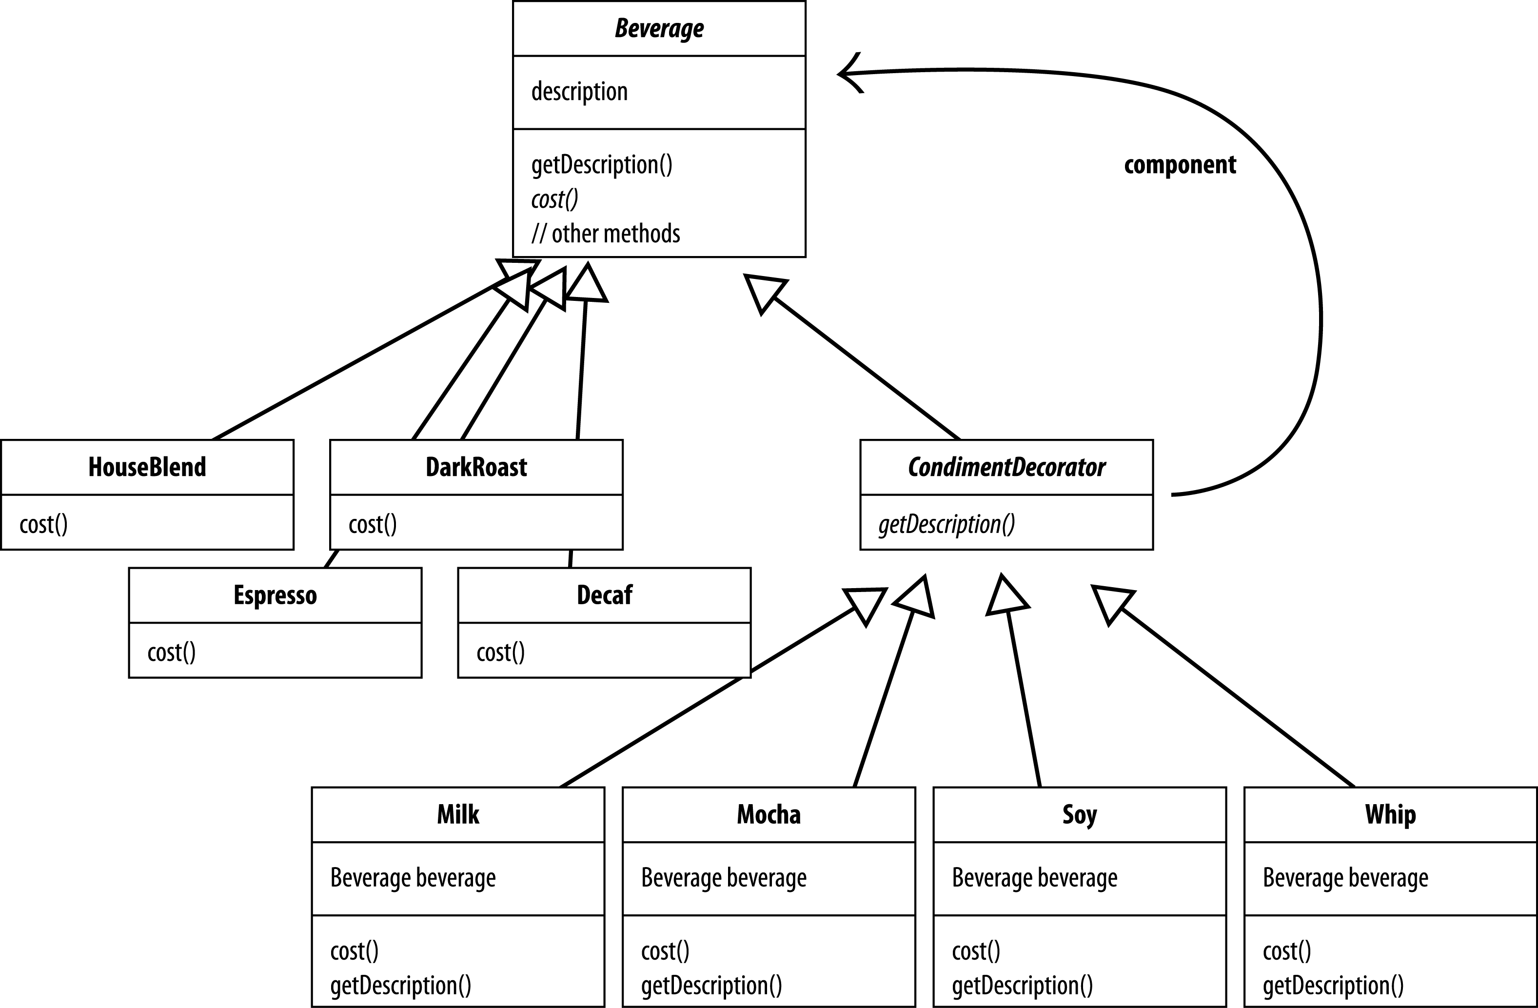
And now Starbuzz v. 3
Beverage acts as our abstract component class.
The four concrete components, one per coffee type.
Condiment decorators; note which methods they need to implement – both cost() and getDescription().

Slide 22
You try…
Make a picture for what happens when the order is for a "double mocha soy latte with whip"
Label costs edges…
Coffees:
House Blend: 0.89
Dark Roast: 0.99
Decaf: 1.05
Espresso: 1.99
Condiments:
Steamed Milk: 0.10
Mocha: 0.20
Soy: 0.15
Whip: 0.10

Slide 23
Answer…
0.89
0.15
cost()
0.20
cost()
House Blend
0.20
cost()
Soy
0.10
cost()
Mocha
cost()
$1.54
Mocha
Whip
Should I put a question like this on the final/midterm?

Slide 24
Deep thought moment
How would you implement the cost() method of the coffees and condiments?

Slide 25
Let’s start looking at real code…
class Beverage { string description = “Unknown Beverage”; string getDescription() { return description; } virtual double cost() = 0; }
Abstract base class
class CondimentDecorator : Beverage { virtual string getDescription() = 0; }
Abstract base class

Slide 26
And now let’s code some base beverages
class Decaf : Beverage { Decaf() { description = “Decaf abomination”; } double cost() { return 1.10; } }
class HouseBlend : Beverage { HouseBlend() { description = “HouseBlend Acid-Reflux Generator”; } double cost() { return 1.00; } }
How about Espresso and DarkRoast? (Hint: This is a great exam question.)

Slide 27
Coding condiments
Subclass
Recall: CondimentDecorator extends Beverage
class Whip : CondimentDecorator { Beverage beverage; Whip (Beverage beverage) { this.beverage = beverage; } string getDescription() { return beverage.getDescription() + “, Whip”; } double cost() { return 0.40 + beverage.cost(); } }
Has a
constructor
Add whip to superclass description
Add cost to the superclass cost
How about Mocha? Soy? Milk? (Hint: ditto)

Slide 28
Let’s serve some coffee
We need the following drinks:
Ordinary Espresso.
Decaf with double Mocha, wrapped in whip (ugh).
HouseBlend with Soy, Mocha and Whip.

Slide 29
Coding → Coffee
class UIKaffeeHaus {
int main () {
Beverage beverage = new Espresso(); cout << beverage.getDescription() << “ $” << beverage.cost() <<endl;
Beverage beverage2 = new Decaf(); beverage2 = new Mocha (beverage2); beverage2 = new Mocha (beverage2); beverage2 = new Whip (beverage2); cout << beverage2.getDescription() << “ $” << beverage2.cost() <<endl;
Beverage beverage3 = new HouseBlend(); beverage3 = new Soy (beverage3); beverage3 = new Mocha (beverage3); beverage3 = new Whip (beverage3); cout << beverage3.getDescription() << “ $” << beverage3.cost() <<endl;
}
}
Espresso $1.99
Decaf double Mocha with whip $1.55
HouseBlend with Soy, Mocha and Whip $1.39

Slide 30
Summary
Inheritance: one form of extension, but not necessarily the best.
Principle: Favour composition over inheritance.
Principle: Classes should be open for extension by closed for modification.
Decorator Pattern provides an alternative to subclassing for extending behaviour.
You can wrap a component with any number of decorators.
Decorators can result in many small objects in our design; overuse can result in complexity.

