Slide 1





Marketing Strategy:
Based on First Principles and Data Analytics
All Customers Differ
All Customers Change
All Competitors React
All Resources are Limited
First Principles: The foundational concepts or assumptions on which a theory, system, or method is based (Oxford Dictionaries )

Slide 2
Agenda
Overview
Course Overview
Marketing Strategy Overview
First Principles of Marketing Strategy
MP#1: All Customers Differ → Managing Customer Heterogeneity
MP#2: All Customers Change → Managing Customer Dynamics
MP#3: All Competitors React→ Managing Sustainable Competitive Advantage
MP#4: All Resources Are Limited → Managing Resource Trade-Offs
Integrating the Four First Principles of Marketing Strategy
Markstrat
Takeaways

Slide 3

Course Focus: Strategically Analyzing and Solving Marketing Problems
Two Key Learning Objectives:
Understand and effectively use the fundamental frameworks, processes, and analysis tools of marketing strategy
Use the “first principles” of marketing strategy to solve business problems and improve business performance
First Principles: The foundational concepts or assumptions on which a theory, system, or method is based (Oxford Dictionaries )
Notes:
This book takes a very different approach to marketing strategy. Rather than adding to its complexity, we attempt to simplify it by arguing that managers’ marketing decisions should focus on solving four underlying “problems” or “complexities” that all organizations face when designing and implementing their marketing strategies. These four problems represent the most critical hurdles to marketing success; they also define the organization for this book. We refer to them as the First Principles of marketing strategy, because they reflect the foundational assumptions on which marketing strategy is based.2 In short, marketing strategists’ most critical decisions must address the following First Principles of marketing strategy:
1 All customers differ.
2 All customers change.
3 All competitors react.
4 All resources are limited.
This First Principle approach to marketing strategy is unique, because its goal is to align the analysis tools, processes, and research techniques offered in many consulting books, together with existing frameworks and insights on the marketing mix (4Ps), competitors, and marketing tasks from traditional textbooks. Their alignment in turn suggests tactics for “solving,” or at least addressing, the underlying First Principles. Organizing the varied discussions around four fundamental principles means that every decision appears within its meaningful context, which includes its impact on other decisions. This view and context establishes a guiding purpose for strategic marketing efforts.
For example, segmentation and customer centricity both attempt to deal with a First Principle: all customers differ. By taking the First Principle approach, we offer marketing strategists a toolbox for dealing with a broad range of marketing challenges, rather than learning unique techniques for each specific marketing event. That is, the guiding framework can solve a wide range of marketing problems. Conceptually, the application is similar to using Newton’s laws of motion (i.e., First Principles of physics) to solve a multitude of physics problems, rather than learning different process steps for each type of problem.
This chapter therefore begins with a short, historical overview and definition of marketing strategy, to place it in an appropriate temporal context and set the boundaries of the domain relative to corporate strategy. We offer arguments for why marketing is so critically important to a firm’s success and provide evidence for why managers should invest the time and effort to develop effective marketing strategies. In turn, we present the logic behind the First Principle approach to marketing strategy. With an overview of each of the four First Principles, we prepare readers to dive deeper into the concepts, analyses, and decisions addressed in the rest of this book. Finally, this chapter integrates the four First Principles of marketing strategy to derive insights into how they fit together in a natural sequence that allows organizations to develop effective marketing strategies.

Slide 4


Course Materials
Course Pack (Canvas)
Syllabus
Assignment due dates and descriptions
Help session dates
Readings (assigned/optional) and assignments
Class slides
Everything is organized by module
Markstrat and Marketing Engineering Software
Book: Robert W. Palmatier and Shrihari Sridhar, Marketing Strategy: Based on First Principles and Data Analytics, (Palgrave McMillian, 2017)

Slide 5
Course Content and Deliverables
Lectures and discussion (individual: participation 20%)
Problem-specific frameworks and processes
Research methods and analysis techniques
In class exercises
Examples from your experience (helpful to class)
3 Marketing Engineering assignments (individual: 30%)
MarkStrat competitive simulation (20%)
Marketing project
5-page written plan (10%)
Presentation (10%)
Team-based final exam (10% and prizes)

Slide 6
Agenda
Overview
Course Overview
Marketing Strategy Overview
First Principles of Marketing Strategy
MP#1: All Customers Differ → Managing Customer Heterogeneity
MP#2: All Customers Change → Managing Customer Dynamics
MP #3: All Competitors React→ Managing Sustainable Competitive Advantage
MP#4: All Resources Are Limited → Managing Resource Trade-Offs
Integrating the Four First Principles of Marketing Strategy
Markstrat
Takeaways

Slide 7

Brief History and of Marketing Strategy
Strategy arose from a military context: “The forces available must be employed with such skill that even in the absence of absolute superiority, relative superiority is attained at the decisive point” -Karl von Clausewitz, On War (1832)
Management scholars added two elements to apply the strategy concept to business: the need to make the differential advantage sustainable and the idea that the objective of any business strategy is to enhance firm performance (60 and 70s)
Marketers argue that it must be from the perspective of the customer (90s)
Thus, five key elements are critical to marketing strategy:
Leads to a differential advantages over competitors
Sustainability
Ability to enhance firm performance
Customer perspective
Guides decisions and actions
Notes:
Brief History and Definition of Marketing Strategy
To appreciate the First Principle approach to marketing strategy, we first have to define marketing strategy: What are its key elements and its scope? We note five key elements that have been identified as its conceptualizations have evolved over time:
Decisions and actions
Differential advantages over competitors
Sustainability
Ability to enhance firm performance
Customer perspective
Initially, the strategy concept arose from a military context, where a strategy represents the pursuit of situational superiority over an enemy. Karl von Clausewitz, in On War (1832), thus describes strategy as follows: “Consequently, the forces available must be employed with such skill that even in the absence of absolute superiority, relative superiority is attained at the decisive point (p. 196).” From these military roots, the notion of using resources skillfully, to create decisive positions of superiority over competitors, began to be applied in business in the 1950s and 1960s. A variety of forces (e.g., rapid, unpredictable changes in customer, competitor, technical, and economic environments) were beginning to challenge the “lumbering corporations” of the time, whose size presented an obstacle to operational dexterity. A new way of thinking—generally described as formal strategic planning—was needed. Thus a typical definition of business strategy from the 1960s described “the determination of the basic long-term goals and objectives of an enterprise, and the adoption of courses of action and the allocation of resources necessary for carrying out these goals (p. 13).” Management scholars and practitioners from this era retained two elements of military strategy, focused on how decisions and actions could lead to differential advantages over opponents (or competitors).
Over the next few decades though, thought leaders added two elements that they regarded as necessary to apply the strategy concept to a business: the need to make the differential advantage sustainable and the idea that the objective of any business strategy is to enhance firm performance. Even more recently, marketing strategists have suggested a refined view in which both the sustainable differential advantage and its objective should be evaluated from the perspective of the customer, such that the central approach is “strategy from the outside-in.”

Slide 8
Customer-Centricity is Key to an Effective Marketing Strategy
Customer ultimately determines strategy’s success or failure
The shift in focus from firm to customer by incorporating the customer’s perspective represents a natural, long-term progression in strategy
Economists tend to take an industry-level perspective, and management scholars adopt a firm-centric perspective, but customer is an even smaller unit of analysis
Helps explain variation in firms’ performance by addressing smaller and smaller units of analysis
Marketing strategy consists of decisions and actions focused on building a sustainable differential advantage, relative to competitors, in the minds of customers, to create value for stakeholders.
Notes:
As adopted in this book, this viewpoint argues that crafting the most effective long-term strategy begins by creating value for the customer, because the customer ultimately determines the strategy’s success or failure. Working backward from a desired position of advantage among customers, strategy can be crafted purposefully, to make such a position a reality and deliver it with a business model that provides attractive returns to the firm. This customer-centric view contrasts with that of economists who tend to take an industry-level perspective, or of management scholars who often adopt a firm-centric perspective. But the objective of a marketing strategy cannot be to focus only on the firm’s goals; it must include the goals of key stakeholders (i.e., customers). Any strategy that fails to generate customer value in the long term ultimately is unsustainable. Therefore, this customer-centric perspective represents a key difference between a corporate strategy and a marketing strategy.
The shift in focus that involves explicitly incorporating the customer’s perspective also represents a natural, long-term progression. Academics and managers continue to search for ways to explain variation in firms’ performance by addressing smaller and smaller units of analysis: from a focus on industries, to firms, to individual customers. Each new level of analysis provides another set of variables that help explain more variation in firm performance. Ultimately though, customers represent the fundamental unit of analysis for marketing strategy, because each individual customer is an independent, decision-making entity. Industries and firms instead represent aggregations of customers, and aggregation is always accompanied by a necessary loss in precision and insights.
The customer-centric perspective therefore is an important foundation for this book, as reflected in later chapters that describe marketing strategy frameworks and analysis techniques designed to capture, evaluate, and act on individual, customer-level data (versus treating all customers the same way or grouping customers into a few segments based on some demographic characteristic). For example, customer lifetime value (CLV) analyses attempt to assign discounted cash flow values to each customer based on future sales and costs, such that they offer the potential for marketing decisions that are optimized for each individual customer.
On the basis of this brief history of the evolution of marketing strategy, we can capture the five key elements in a summary definition of marketing strategy:
Marketing strategy consists of decisions and actions focused on building a sustainable differential advantage, relative to competitors, in the minds of customers, to create value for stakeholders.
With this perspective, a marketing strategy can be equally meaningful for any entity with “competitors” focused on some group of “customers.” It is just as applicable to countries competing for the right to host a future Olympics games, to competing industry trade groups or sales regions, and to firms or individual product lines. However, as time progresses, organizations must innovate their marketing strategy in order to remain competitive and adapt to customers’ changing needs.

Slide 9

Example: Philips (Netherlands)
Netherlands-based technology company
Over past 125 years, Philips innovated its marketing strategy many times to remain competitive
Company builds a strong presence in each market to understand the local market and customer desires
Innovates continually; created “technology incubator” to develop new technologies
Customer-centric view → success
Notes:
Philips, the Netherlands-based technology company, has become a global leader in consumer technology over the past 125 years. Over this time, Philips has innovated its marketing strategy many times to stay competitive. Philips is working to become more customer-centric. Philips builds a strong physical presence in each market it is active in, and uses these teams to understand the local market and its consumers’ desires. But as customers’ needs are not static, it needs to innovate to continually sustain its competitive advantage. To this end, Philips has nine research centers around the world that have competencies in various domains and can remain connected to local markets. But innovation on existing offerings is not enough. To stay ahead of the competition, it has also created a “technology incubator” that provides an environment where Philips can create technologies new to both the firm and customers. Through market and technical innovation and a consumer-centric focus, Philips has managed to gain and hold global and regional leaderships in many product categories.

Slide 10
Exercise: What is Your Firm’s Marketing Strategy
Take 5 minutes and answer these three questions:
What is your firm doing to build a relative advantage vs. competitors in the minds of your targeted customers? ________________________________________
How is your firm building barriers to competitors copying this advantage to make it sustainable? ________________________________________
How is your firm “selling” this relative advantage? ________________________________________

Slide 11
Differences Between Corporate Strategy and Marketing Strategy
Corporate Strategy
The overall scope and direction of a firm and the way in which its various business operations work together to achieve particular goals.
Legal
Tax & Finance
Operations
HR
R&D
Marketing Strategy
Both corporate and marketing strategy influence human resources, operations, and R&D.
Decisions and actions focused on building a sustainable differential advantage, relative to competitors, in the minds of customers, to create value for stakeholders.
Sales & Marketing
Notes:
How Marketing Strategy Differs from Corporate Strategy
The larger the organization, the more likely its corporate-level strategic plan is distinct from any marketing strategy. Although the two levels of strategy should have consistent goals (i.e., marketing strategy aligns with corporate strategy), the marketing strategy focuses specifically on the interplay of the firm with its customers. Consider the primary questions to answer to define an entity’s marketing strategy:
-Who are your customers?
-What value do you provide your customers (e.g., product, service, experience, status)?
-How are you building a differential advantage relative to competitors for these customers?
-What value do you earn from your customers due to this differential advantage (sales, profits, referrals)?
-How will you sustain this differential advantage into the future?
A marketing strategy must answer these questions, then use the answers to inform the development and implementation of action steps required to achieve firm and stakeholder objectives. However, the implementation of a marketing strategy requires resources and a stable organizational platform from which to operate. Thus, additional questions arise, regarding other aspects of the business, such as cash flow plans, tax considerations, and legal and personnel policies. These queries are the domain of the corporate strategy, defined as “the direction and scope of an organization over the long term: which achieves advantage for the organization through the configuration of resources within a changing environment, to meet the needs of markets and fulfill stakeholder expectations” (p. 10).10 Figure 1.1 summarizes key questions for corporate and marketing strategies, such that it illustrates the differences in emphasis and relevant decisions. Although certain domains are primarily associated with corporate (taxes, legal) or marketing (promotions, pricing) strategic decisions, other domains may be influenced by both corporate and marketing strategies (human resources, operations, R&D).
As reflected in Figure 1.1, all questions must be answered appropriately. If the questions addressed by the marketing strategy are answered incorrectly or insufficiently, the business’s enduring success will be in doubt.

Slide 12
Why is Marketing Strategy Key to Long-Term Financial Performance?
Large amount of research documents its impact on financial performance, but many people don’t realize the scope of influences on sales and profits
Grow market size (new products and services, lower prices)
Grow share (better products and services than competition, higher loyalty to retain, and/or steal customers with acquisition strategies)
Better prices and margins (improve loyalty, brand image, relationships, products, targeting of high margin customers)
Reduce costs (WOM, brand, relationships, retain with loyalty)
Firm’s
Sales Revenue
$500,000
Market
Demand
1,000,000
Firm’s
Market Share
10%
Firm’s Average Selling Price
$5
=
x
x
Firm’s
Profit
$30,000
Firm’s
Sales Revenue
$500,000
Firm’s
Gross Margin
20%
Firm’s Sales & Marketing Expenses
$50,000
Firm’s G&A Expenses
$20,000
=
x
-
-
Notes:
Importance of Marketing Strategy
Multiple perspectives highlight the importance of an effective marketing strategy for a firm’s success. Academic studies provide evidence of the strong links between marketing actions (brand and selling expenditures) and intermediate marketing metrics (customer satisfaction, loyalty, market share) with a firm’s financial performance.11 For example, improving customer satisfaction is not just a “feel-good” tactic but is associated with positive financial outcomes, including enhanced cash flows with reduced variability, sales growth, improved gross margins, and total shareholder returns. Strong evidence also describes when, how, and where brand advertising pays off; how price promotions affect short- and long-term outcomes (e.g., causing current customers to stock up versus attracting new customers); and how other elements of the marketing mix interact to drive performance.
However, research also notes some important nuances: not every strategy pays off every time. For example, the relationship between market share and profitability is not a direct function. Some strategies that might succeed in increasing market share actually can damage profitability. A variety of brand, customer relationship, and other factors conspire to determine the ultimate outcome of a market share strategy.
In addition, business trends help determine marketing strategies. Some trends, especially in developed markets, highlight the importance of market-based barriers (i.e., barriers erected through marketing strategic actions) to help a company withstand competitive assaults. For example, globalization and reduced trade barriers have increased the prevalence of low-cost competitors in many industries that offer similar, “me-too” products at low prices. In response, firms might increase their investments in brand building or relationship marketing strategies, or they might launch a range of loyalty programs to differentiate their “total offering” through intangible factors that are harder for low-cost, copycat firms to duplicate. Today, firms spend as much on customer relationship management and brand building as they do on new product and service introductions. The business trend of building strong brands appears to have caught on in developing countries too. Simply manufacturing world-class products at a low cost is not the only path to success, so new paths for brand building (e.g., tapping into the country’s indigenous qualities and culture) are being cut.
In another trend, firms are outsourcing product manufacturing, because the actual production of a product often offers little differential advantage over competitors. As the examples of the personal computing, shoes, and clothing industries reveal, just a few firms have distinctive manufacturing capabilities that create meaningful incremental value for customers, beyond what they can access with products produced by high-capability, subcontracted manufacturers. In response, senior managers shift their emphases, from operations to marketing, with the recognition that strong brand, channel, or customer relationships are more difficult to duplicate than virtually any tangible product. John Stuart, the long-serving CEO of Quaker Oats, explains: “If this business were to be split up, I would be glad to take the brands, trademarks and goodwill and you could have all the bricks and mortar – and I would fare better than you” (p. 8). Empirical evidence similarly shows that marketing capabilities have a greater impact on improving firm performance than either R&D or operations capabilities.
Finally, another way to view the impact of marketing strategy is by considering how sales revenues and profits can be broken down into component parts. Marketing strategy simultaneously affects many different factors, each of which has a role in determining an organization’s sales revenue and profit. For example, the sales revenue ($) chain ratio equation in Figure 1.2(a) comprised of market demand (units) market share (%) average selling price ($). Firms that launch innovative new products or advertise extensively grow their own market share and receive a price premium versus competitors; they also influence growth in the overall market by creating spillover awareness for the product category. That is, a marketing strategy affects all three components of the sales revenue chain ratio equation.
Building a powerful brand image or strong relational bonds with customers also can have a strong effect on average selling prices of a firm’s products. Price premiums are normal for strong consumer brands, such as Tiffany & Co., Nordstrom, or BMW. Such forces also affect business-to-business (B2B) firms. For example, B2B customers will pay, on average, a 4–5% premium to deal with their favorite salesperson rather than buy the same product from a different salesperson. The price a firm can charge depends hugely on which customers the firm chooses to target and how it implements its targeting strategy. A firm that builds a customer portfolio using price discounting promotions often ends up with a customer base that is highly price sensitive and deal prone, such that it constantly must defend against other firms’ price discounts.20 Thus, all components of the sales revenue chain ratio (demand, market share, and price) stem from a firm’s marketing strategy, which in turn has a strong
multiplier effect on net sales.
A similar analysis is possible for a firm’s profit, as represented in the chain ratio equation in Figure 1.2(b). A new factor in this equation deserves special attention: sales and marketing expenses. These expenses, incurred to execute marketing strategies, can be accounted for as direct reductions to profit, but they also should be recognized as investments that affect all three components of the sales revenue chain ratio. Moreover, effective marketing strategies that build a strong, loyal customer base can affect profitability directly, by significantly reducing sales and marketing expenses. First, having loyal customers is less expensive than launching new programs to retain current customers or convincing defectors to come back. Even recognizing the significant cross-industry variation, the cost of acquiring a new customer is generally 5–10 times more than simply retaining an existing customer. Second, strong loyalty among current customers can reduce new customer acquisition costs, because current customers engage in positive word of mouth, which effectively persuades other customers to try or switch. Jonah Berger, in his book Contagious, attributes the effectiveness of word of mouth to its credibility (i.e., fellow customers are objective and candid) and its targeted nature (i.e., customers share news that they believe is relevant to the listener). For example, Ben Fischman, founder of Rue La La (ruelala.com), which sells overstock and clearance high-end fashion products, notes that member word of mouth was far more effective than the firm’s early ad campaigns at attracting new members, because: “When a friend tells you you’ve gotta try Rue La La, you believe them. And you try it” (p. 53). Accordingly, loyal customers can be worth up to three times their individual value, because of their referrals of new customers.

Slide 13


Example of Chain Ratios: Apple (US)
Year | iPhone Sales Revenue (millions) |  | Cell Phone Market Size in Units (millions) |  | iPhone Market Share (%) |  | iPhone Unit Price ($)
2007 | $1,841.40 | = | 109.21 | x | 3% | x | $558.00
2008 | $6,749.22 | = | 126.51 | x | 9% | x | $591.00
2009 | $14,934.00 | = | 163.14 | x | 15% | x | $600.00
2010 | $28,426.00 | = | 285.23 | x | 16% | x | $610.00
2011 | $55,341.20 | = | 486.34 | x | 18% | x | $620.00
Launch of Apple’s iPhone catalyzed explosive growth of smartphone market
Market grew from 109 million units than 486 million in 5 years
iPhone’s market share increased from 3.3% to 18.4%.
Apple maintains premium price
Notes:
Example: Apple (US)
Consider the launch of Apple’s innovative iPhone. It catalyzed the explosive growth of the overall smartphone market. For example, the overall smartphone market grew from 109 million units to more than 486 million five years later, an increase of 345%. During that time, iPhone’s share of the market increased from 3.3% to 18.4%. Apple has a remarkable ability to maintain a premium price over its competitors’ average selling prices. In aggregate, using the chain ratio for insight, Apple’s sales revenues from unit sales of iPhone (not counting accessories) grew from $1.8 billion in its first year (3% market share Å~ 109 million unit market Å~ $558 unit selling price) to $55.3 billion after five years (18% share Å~ 486 million unit market Å~ $620 unit selling price) – an increase in sales revenue of more than 2,900%.18

Slide 14
Agenda
Overview
Course Overview
Marketing Strategy Overview
First Principles of Marketing Strategy
MP#1: All Customers Differ → Managing Customer Heterogeneity
MP#2: All Customers Change → Managing Customer Dynamics
MP #3: All Competitors React→ Managing Sustainable Competitive Advantage
MP#4: All Resources Are Limited → Managing Resource Trade-Offs
Integrating the Four First Principles of Marketing Strategy
Markstrat
Takeaways

Slide 15
Why a First Principles Approach to Marketing Strategy?
Managers are being overwhelmed with more and more analysis tools, processes, and research techniques, but hard to know when to apply each one
Why not just use “case” examples?
Hard to find a case example for every marketing problem
Often what works for “case firm” will not work for your firm because:
Different customers
Different stage of product or industry lifecycle
Different competitive situation
Different resources
Thus, a key requirement for making good marketing decisions is to identify underlying factors on which the decisions depend
First Principles approach argues that marketing strategy is the pursuit of solutions to four fundamental marketing problems and organizes all frameworks, processes, and analyses to solve these problems.
Notes:
As the marketing discipline evolves, managers are being overwhelmed with more and more analysis tools, processes, and research techniques for evaluating business phenomena and implementing new marketing strategies (e.g., customer centricity, big data, net promoter scores). After the success of each new startup, a flood of articles follows, offering unique marketing insights into how to duplicate its results (e.g., Freemium pricing! Crowdsourcing! Big data!). Although many of these new approaches offer some value, any individual marketing strategist is left with unanswered questions:
When should I use each specific approach?
How does each new marketing approach improve my firm’s performance?
Which approaches are worth my firm’s time and investment to implement?
Marketing strategy texts integrate new techniques into their existing structures, typically organized around discrete chapters for each of the 4Ps of the marketing mix (product, price, place, promotion), suggesting ways for dealing with competitors or executing specific marketing tasks (segmenting, branding). This functional or task perspective on marketing strategy leaves managers with a wealth of frameworks and processes, distributed across different marketing domains. But it offers little overall guidance on when to use the various frameworks, how they work, which ones are most valuable, or how they all fit together.

Slide 16
Marketing Principles: Aligning Key Marketing Decisions with the First Principles of Marketing Strategy
First Principles of Marketing Strategy
Key Marketing Decisions
Marketing Principle (#1)
All customers differ
Managing
customer heterogeneity
Marketing Principle (#2)
All customers change
Managing
customer dynamics
Marketing Principle (#3)
All competitors react
Managing
sustainable competitive advantage
Marketing Principle (#4)
All resources are limited
Managing
resource tradeoffs
First Principles: The foundational concepts or assumptions on which a theory, system, or method is based (Oxford Dictionaries )
Notes:
The Logic for a First Principle Approach to Marketing Strategy
If marketing strategy consists of key decisions that result in certain actions that ultimately lead to enhanced performance, then the path to success seems obvious. Shouldn’t a manager simply look at past marketing strategies, identify those that generated the highest performance, and implement those same strategies, again and again? Some firms can follow this approach to generate success in the short run. But, as customers, competitors, and conditions continue to evolve, strategies that created success in the past may become inappropriate, especially if circumstances change. In some cases, past successes using a particular strategy can even hinder a firm’s ability to develop the necessary capabilities and strategies to address new conditions. Copying the successful strategies of a competitor also might fail to yield the same results, because each firm has different capabilities.
We want to state this inconvenient truth plainly – no single marketing strategy is ever going to be consistently effective in all conditions or for all firms. As vast research and practical examples demonstrate, the effectiveness of a marketing strategy depends on a multitude of underlying customer, competitor, and contextual factors that are both interdependent and time varying.
A key requirement for making good marketing decisions – which is part of the essence of a marketing strategy – is to identify underlying factors on which the decisions depend. Without such information, a firm might copy the successful marketing actions of a competitor, only to find that those actions work only for certain segments of customers, only at particular points in the customer’s lifecycle, only in response to specific competitive actions, or only in certain conditions. Identifying the underlying factors or complexities that determine the efficacy of marketing decisions also requires digging deeper than reading about the most recent consulting fad in a business article. By definition, these fads tend to apply only for a short period of time or in certain situations.
For example, many Silicon Valley firms have been sorely tempted to launch new software products by using, instead of their traditional direct sales forces, a “freemium” or “viral” strategy (e.g., giving away a basic model in the hopes that users will like the product and upgrade to a paid premium version). With a few prominent exceptions, this temptation is likely to lead to ruin. As Bloomberg Businessweek noted: “For every Yammer, a social networking company that attracted corporate users initially by giving the product (bought by Microsoft for $1.2 billion), there are hundreds of companies that fail” – in part because consumers and potential adopters are inundated by the thousands of new business apps, all trying to catch their eye with a free version.
Thus, marketing strategy effectiveness requires decisions congruent with four underlying assumptions or complexities that are inherent, at least to some degree, to all businesses interactions:
1 All customers differ.
2 All customers change.
3 All competitors react.
4 All resources are limited.
Of course, you will recognize these four assumptions as the First Principles of marketing strategy, or the foundational assumptions on which any marketing strategy is based. As Figure 1.3 indicates, this approach to marketing strategy involves grouping or aligning key marketing decisions with these four assumptions, in such a way that managers can understand and account for their interdependencies and temporal ordering when making decisions.
Each First Principle or underlying assumption, when matched with its associated marketing decisions, is a Marketing Principle (MP). For example, all customers differ, so firms must make strategic decisions to manage customer heterogeneity, and these combined statements constitute MP#1.
Each First Principle or underlying assumption, when matched with its associated marketing decisions, is a Marketing Principle (MP). With this approach, firms can effectively manage these four inherent business complexities when developing and implementing their marketing strategies. It does not imply removing or preventing underlying complexities; it recognizes that in most cases, the First Principles are given, so firms need to understand and effectively manage each of them.
In support of this approach, we develop guiding frameworks for each of the four MPs, identifying specific tools and analysis techniques that are relevant to the specific principle and can support effective decision making. Then we can integrate the four frameworks to detail the interdependencies and natural causal ordering among the four MPs, such that any firm can generate its overall marketing strategy.
The chapters of this book focus on each Marketing Principle in detail. In the remainder of this chapter, we offer short overviews to help readers understand just what we mean by the four MPs, available tactics for making decisions relevant to that MP, and a graphical input–output framework, all according to a First Principle approach.

Slide 17
Agenda
Overview
Course Overview
Marketing Strategy Overview
First Principles of Marketing Strategy
MP#1: All Customers Differ → Managing Customer Heterogeneity
MP#2: All Customers Change → Managing Customer Dynamics
MP#3: All Competitors React→ Managing Sustainable Competitive Advantage
MP#4: All Resources Are Limited → Managing Resource Trade-Offs
Integrating the Four First Principles of Marketing Strategy
Markstrat
Takeaways

Slide 18

First Principle #1: All Customers Differ
For most products and services customers vary widely on desires/needs
Over 9000 mutual fund options, Grocery stores carry 60,000+ SKUs
Even for “commodities” (e.g., coffee, water)
Thus, firms are targeting smaller & smaller segments
Mass marketing → niche marketing → 1-to-1 marketing
Competitive race as firms target smaller segments
Retail (Sears vs. Eurosport), cars (Model T vs. today)
Why?
Matches inherent customer desires (real, perceived)
Faster response to customer trends and changes
Technology enabled (more economical to target/customize)
Only limited by tradeoff in efficiency (cost) versus benefit of better match to need (solution)
Notes:
First Principle: All Customers Differ
The first, foundational, and most basic issue facing managers making marketing mix decisions (pricing, product, promotion, place) is that all customers differ. Customers vary widely in their needs and preferences, whether real or perceived. Their desires even vary for basic commodity products, such as salt and bottled water. Customers’ desire for variety is evident in the tens of thousands of products offered by most large grocery stores, in their effort to match each individual customer’s preference.
Various factors lead customers to differ in their preferences, including: basic, personal differences; varying life experiences; unique functional needs for the product; distinct aspirational self-identities; and previous persuasion-based activities focused on changing their preferences. These different sources all work together to drive substantial variation in customers’ preferences.
If firms ignore this first principle of customer differences and offer a single product, they may gain sales in the short term, particularly if competition is weak or the product is scarce. The well-known example in this case is the Ford Model T. As long as Ford was virtually the only company able to provide vehicles, it could get away with making all its cars black. But as competition grew and automobiles became more widely available, Henry Ford’s maxim – customers can have any color they want, as long as it is black – flipped on its head. Today, customers can have any color they want in their car’s finish, and any company that tried to limit its offerings would find itself in trouble quickly. As demand for any new offering grows, competitors recognize opportunity and begin supplying differentiated products that match the preferences expressed by targeted subsegments of the overall market. If an incumbent firm fails to respond with refined offerings, customers move. The firm thus loses sales revenue. In addition, because competitors likely have targeted the fastest growing or most profitable subsegments, the incumbent firm is left with customers in less desirable, slow growing, and less profitable segments. Failing to manage customer heterogeneity – defined as variation among customers in terms of their needs, desires, and subsequent behaviors – has been the death knell for many firms. Marketing Decision: Managing Customer Heterogeneity
The different sources of individual variation work together in multifaceted ways. Although customer heterogeneity is a fundamental challenge that all firms must address when developing an effective marketing strategy (MP#1), the ways to do so are not particularly clear. That is, how should each firm manage customer heterogeneity?
First, it could ignore customer heterogeneity and provide an offering that matches the average customers’ needs. Many customers will be dissatisfied, but in a large enough market, average customers could be numerous enough to keep the firm profitable – at least temporarily. If the market keeps growing, though, a competitor likely will seek to appeal to some subgroup of customers who are interested in a better fitting solution. The original firm then is left with an oversized infrastructure and associated costs. Combined with lost sales and profits, this situation greatly erodes its financial performance.
Second, a firm could offer a range of products and services to satisfy the needs of many different customer segments. This strategy can be highly effective; it also can be very costly and difficult. A single firm rarely can meet the needs of all these different customers simultaneously. Imagine, for example, trying to appeal to high-end markets, as Four Seasons hotels and Neimen Marcus retailers do, while also marketing to low-end markets, as Motel 6 and Walmart do. From brand and infrastructure perspectives, such efforts seem virtually impossible.
Third, firms might embrace the notion that customers will sacrifice desired product attributes if the price is low enough. With a classic low-cost strategy, firms attempt to identify core, must-have attributes that will satisfy consumers’ functional needs, then focus all their efforts on reaching the lowest cost for an offering that meets those needs. Here again, the strategy can be viable, depending on the size of the low-cost segment and the firm’s ability to gain differential cost advantages over its competitors.
Fourth, to deal with customer heterogeneity, a firm might select a specific segment of customers and target them by positioning its offering as the best solution, compared with those available from any competitors, for that particular segment (i.e., segmentation, targeting, and positioning, or an STP approach). The result is often a strong brand that customers in the segment know and respect. Despite its effectiveness for dealing with customer heterogeneity, an STP approach can limit a firm’s future growth. Therefore, it often is combined with a customer-centric approach or strategy, in which the firm recognizes the long-term value of its core customer segment and puts it at the center of all major internal business processes and decisions.

Slide 19


Example: Godiva (Belgium)
Addressed MP #1 by developing different products for different consumers
3 reasons people buy chocolate
1. To gift to others
2. To share with a group
3. To eat by themselves
Expanded product line to meet all these needs (individually wrapped candies for candy dishes, fondue baskets for sharing with a group, packaged candy bars for people to eat themselves)
Sales have increased by more than 10% per year for many years
Notes:
Example: Godiva (Belgium)
Godiva wants to sell you more chocolate, but the Belgian-based chocolate confectionary needed an effective global marketing strategy. Godiva addressed MP#1 by developing different products for different consumers, or consumers who are looking to purchase their chocolate for different reasons. It realized that there are three basic reasons why people buy premium chocolate: to give to others as a gift, to share with a group, and to eat by oneself. Having identified the three basic reasons, it targeted each category of consumer with a different offering. For example, rather than just offering boxed chocolate for gift-givers to exchange on holidays, Godiva expanded its product line to include new products like boxed brownies or chocolate-fondue baskets. For consumers who want to share their chocolates with a group, Godiva determined that its delicate truffles were not appropriate for candy dishes and so prepared individually wrapped candies. In the case of those who were looking for self-indulgence, Godiva came up with products that worked for “chocolate emergencies.” As such, Godiva created lines of large candy bars and individually wrapped Godiva Gems for sale through supermarkets across the world. This strategy has paid off, Godiva has increased its sales by more than 10% per year for many years.

Slide 20
Input-Output Framework for Managing Customer Heterogeneity
Three key inputs to the framework are required to conduct segmentation, targeting, and positioning of potential customers
The second and third inputs are similar, but one focuses on the focal company and the other involves the company’s competitors
The inputs to managing customer heterogeneity entail the 3C’s of situation analysis: Customers, Company, and Competitors
In turn, the framework generates outputs, which then provide the inputs for subsequent First Principles
Notes:
Input–Output Framework for Managing Customer Heterogeneity
Figure 1.4 contains the input–output framework for managing customer heterogeneity. It captures the approaches, processes, and analyses that aid managers’ decision making. The three key inputs to the framework are required to conduct segmentation, targeting, and positioning of potential customers. The first input focuses on all potential customers in the industry or product category; it involves their needs, desires, and preferences (i.e., segmentation); perceptions of specific firms and brands in the marketplace across key attributes (i.e., targeting); and information to determine segment attractiveness, such as their growth rate or price sensitivity. Market segment attractiveness information often comes from multiple sources, such as customer surveys, marketing industry reports, and other secondary sources.
The second and third inputs are similar, but whereas one focuses on the focal company, the other involves the company’s competitors. Inventories of the company’s and its competitors’ strengths and weaknesses are needed to evaluate the focal firm’s relative competitive strength in each segment, in support of targeting and positioning processes. Company and competitor strengths and weaknesses should span all relevant domains (i.e., manufacturing, technical, financial, marketing, sales, research) that can be leveraged into a relative competitive advantage. Company and competitor strengths and weaknesses should be collected in conjunction with opportunities and threats in a classic SWOT (strengths, weaknesses, opportunities, and threats) analysis, because all four factors might facilitate the firm’s targeting and positioning efforts.
The inputs to managing customer heterogeneity thus entail 3Cs of situation analysis: Customers, Company, and Competitors. Together, they provide the contextual background for the firm’s strategy. A firm’s marketing strategy is embedded in this background and must both “fit” and “leverage” customers’ preferences and perceptions, market trends, and the firm’s relative strengths.
In turn, the framework generates three outputs, which then provide the inputs for subsequent First Principles. To start, this framework maps key customer segments for an industry or product category, according to customer preferences. This critical output describes the potential customer landscape by addressing two key questions: (1) Can the marketplace be subdivided into homogenous groups, and (2) what does each group of potential customers want?
A second output then moves from the overall market landscape to the specific segment(s) of interest to the firm, providing detailed descriptions of each segment. These descriptions include the value or attractiveness of each segment and the firm’s relative strength. Thus, the second output addresses two additional questions: (1) What segment will the firm pursue, and (2) how can the firm identify each group of target customers?
Finally, the third output is a positioning statement, which encapsulates three key questions in a single, concise statement that firms can use to direct their internal and external marketing mix activities. The three questions ask:
Whom should the firm target?
What needs and benefits are being fulfilled?
What are the relative advantages of this offering versus competitive offerings?
A position statement should be developed for the firm overall, as well as for each key target segment that the firm addresses. A positioning statement captures the essence of the positioning strategy for a target segment.
Summary of Marketing Principle #1
The process of converting customer, company, and competitor (3Cs) input into a representation of the firm’s environment through industry segmentation, target segments, and positioning statement (STP) outputs is a critical first step in developing a marketing strategy. It allows the firm to make sense of the customer landscape by identifying a manageable number of homogenous customer groups, such that the firm can meaningfully evaluate its relative strengths and make strategically critical decisions about how to win and keep customers. Almost all other decisions build on this critical first step, according to how it accounts for customer heterogeneity, customer attractiveness, and the company’s relative advantage.

Slide 21
Marketing Principle #1: All Customers Differ ➔ Managing Customer Heterogeneity
Inputs (3Cs)
Managing Customer Heterogeneity
Outputs (STP)
All Potential Customers
Needs
Demographics
Size, growth, perceptions
Approaches & Processes
Segmenting, targeting, and positioning (STP)
Perceptual/positional maps
Customer-centric view
Analyses
Factor analysis
Cluster analysis
GE matrix
Discriminant analysis
Classification
Industry Segmentation
Customer segments
Needs, demographics, and opportunity of each segment
Your Company
Strengths and weaknesses
Opportunities and threats
Target Segment
Detailed needs, demographics, and value of target segment(s)
Discriminant function
Relative perceptions
Your Competitors
Strengths and weaknesses
Opportunities and threats
Positioning Statement
Who (target segments)
What needs/benefits
Why (relative advantage & support)

Slide 22
First Principle # 2: All Customers Change
Customer’s desires/needs for most products and services change overtime or due to specific events
Consumer needs change: cars (Buick), clothes, food, financial services, and healthcare as consumers age
Trigger events: marriage, kids, job change, finances, move, graduation, acquisition, new managers, legal changes
Industries/markets change: experience curve, diffusion, competitive responses, overproduction
Customer's needs vary not only due to inherent differences in people (heterogeneity) but also as people and markets change (dynamics)
Thus, segmentation and targeting needs to account for lifecycle changes/customer dynamics
Notes:
First Principle: All Customers Change
In addition to accounting for inherent differences in customers (MP#1), managers developing their marketing strategies also must account for variation as a customer’s needs change over time (MP#2). These changes might occur at the individual customer level, reflecting specific customer, product market, and contextual factors. At any point in time, customers might be grouped and targeted on the basis of how well their needs and desires match or resonate with a particular product or service. Soon thereafter though, customers’ needs start to evolve. Even within a well-defined segment, members’ individual needs often evolve at different rates or directions. At some point in the future, customers who once were part of a relatively homogenous segment thus will exhibit widely divergent needs and desires and no longer fit neatly into a market segment.
Consider, for example, the relatively homogenous segment of new college graduates. Companies like Ford and GM frequently design automobile incentives targeted to these well-educated consumers, on the cusp of launching their professional lives. Fast forward just two or three years, and the distinct paths that members of the “new college graduate” segment follow are nearly innumerable. Some have invested totally in their career success. Others have gotten married and are raising or contemplating having children. Another group has returned to an academic setting by entering graduate school. Some are buying their first homes, others rent, and still others have moved back into their parents’ houses. The underlying needs and buying preferences that were fairly consistent a short time ago thus have splintered in various, distinct directions. The processes by which customers’ desires and needs change over time are customer dynamics.
The changes also can be market-level evolutions in customer preferences that accompany technological innovations. In these cases, nearly all customers eventually change, albeit at different rates, so the firms that lag suffer a risk of extinction, along with the old technology. Blockbuster was a strong market leader when watching a movie at home required the rental of physical VCR tapes, and it shifted effectively to the rental of physical DVDs when that technology emerged. But it struggled to adapt to the flexibility and convenience offered by rental kiosks (e.g., Redbox) and rentals-by-mail (e.g., Netflix). When video streaming entered the fray, it simply could not compete any more and suffered a fatal blow.
Let’s look more systematically at these changes in individual customer needs and preferences over time. Why do they occur? The different sources and drivers of customer dynamics combine to make change inevitable. Most of these drivers can be grouped into five categories:
Seminal events. The needs and preferences of individual customers may change due to discrete life events, whether anticipated or not, such as a car accident, graduation, a major promotion, or a new job.
Life stages. People tend to progress relatively steadily through typical lifecycle stages as they mature (e.g., single → married → children → parent of teens → empty nesters → retirement), which influence many of their product and service priorities.
Knowledge/expertise. The attributes most critical to customers often vary systematically, according to their experience with and knowledge about a product or service category, which has been termed a learning effect. For example, the choice criteria for by a first-time guitar buyer (e.g., price, color, “looks like the one that Slash plays”) get replaced over time as the musician’s knowledge of the attributes that affect playability and sound quality (e.g., neck width, fret board material, tone woods used) grows and expands.
Product category maturity. The changes brought on by this learning effect operate at both the individual customer level and the product market level. For example, when it comes to digital photography, even novice consumers buying their first camera likely consider attributes, like pixels and zoom rates, that were once the domain of only the most expert professional photographers.
Regular exposure to relevant information. Each customer makes decisions in an environment filled with the constant bombardment of information that arrives through varied communication media and sources, from many marketers and organizations (e.g., government, industry trade groups, nonprofit organizations), or from friends or acquaintances—all intending to impact the person’s needs and preferences. Think about the number of messages you received in the past week regarding healthy living for example: admonitions to eat more vegetables and fewer desserts, stop smoking, and get exercise, as well as advertisements for exercise equipment or healthy recipes sent by friends. You likely ignored some of those messages, but others might spur some change, in one direction or the other. A public service announcement to get 30 minutes of exercise might encourage you to take a walk after dinner; a recipe from your mom for a vegetable casserole instead might leave you feeling nagged, such that you rebel by ordering the large order of fries at the drive-through.
Because all customers change over time, unless a firm’s time horizon is extremely short, a failure to understand and address customer dynamics ultimately will undermine virtually any marketing strategy.

Slide 23
Input-Output Framework for Managing Customer Dynamics
Whereas MP#1 focuses on the market as a whole, MP#2 narrows the scope to the firm’s existing customers, challenging the firm to understand how its customers change over time
There are three categories of inputs for managing customer dynamics:
Your customers
Past marketing programs
Lost customers
These inputs in turn produce three categories of outputs:
Segmentation of Customers
AER Positioning Statements
AER Strategies
Notes:
Input–Output Framework for Managing Customer Dynamics
The organizing framework for managing customer dynamics is in Figure 1.5. Whereas MP#1 focuses on the market as a whole, MP#2 narrows the scope to the firm’s existing customers, challenging the firm to understand how its customers change over time.
There are three categories of inputs for managing customer dynamics. The first category, data about the existing customer portfolio, is arguably the most important. A firm’s customer relationship management (CRM) system should provide detailed, customer-level data, such as financial accounting (sales, margins), product purchase (timing, frequency, product migrations), and demographic (zip code, family size, age) information, over time. More advanced and rarer data capture what customers are thinking and feeling at different points in their lifecycle. Such information rarely is available in a CRM database and instead requires additional primary data collection (e.g., surveys, focus groups, observations).
The second category of inputs consists of data that link past customer responses to specific marketing programs (e.g., advertising, new customer promotion, price discounts, reward program gifts), as well as the costs of those programs. If a firm lacks data to connect programs to individual customers, it can instead run small “A/B” experiments. Splitting customers randomly into equally sized groups, it would offer a marketing program to one group but not the other, then track its performance with both groups over time. Such experiments also can compare a program’s effectiveness across different customer segments. Properly designed experiments provide robust evidence of the effects of a program and how its impact may vary across customer groups at various points in their lifecycle (see Chapter 4, which describes the experimental methods in more detail).
A third category of inputs for this framework comes from lost customer analysis. The careful analysis of customers who have stopped doing business with the firm, or are at a high risk of doing so (e.g., customer complaints), can provide insights into the causes of customer defection, where lost customers go (e.g., stopped using the category, switched to low cost competitors, upgraded to competitor with more features), and potential recovery strategies. It also can uncover ineffective strategies, such as those that lead the firm to acquire customers who are not in its target market, promote poorly fit products or services to target customers, or fail to help customers form relational bonds with its brands or employees to minimize churn.
These inputs in turn produce three categories of outputs. First, a thorough segmentation of the firm’s own customer portfolio can reveal how those customers evolve over time. By describing customer personas, their needs and preferences, and how and when customers migrate among those personas, the strategist gains answers to crucial questions: (1) what critical triggers lead to migration among stages; (2) what products and services customers buy in different stages in their lifecycle migration, and why; (3) when they stop buying, and why; and (4) the CLV associated with customers in each persona.
The second and third outputs are closely interrelated, namely, AER positioning statements and AER strategies. They represent key strategic decisions to make in the effort to manage customer dynamics. This process of identifying aspirational positions for specific personas/segments, then designing strategies to achieve these positions, parallels the decisions that firms make to determine their positioning in the overall market. However, the MP#2 framework is unique, in that it focuses on a firm’s existing customers, captures differences across their personas and stages, and incorporates insights from lost customers. The AER positioning statements thus need to be congruent with the firm’s overall positioning in the marketplace to be effective. However, when firms first start to be proactive in managing customer dynamics, they may find that the relevant data they need to conduct specific analyses and define specific strategies are missing or too general. Over time, firms should track and acquire richer data, which will enable managers to address any gaps and missed opportunities, using more robust strategies that also provide critical input to specific marketing decisions (e.g., acquisition strategies, branding activities, sales approaches).
Summary of Marketing Principle #2
Because customers’ needs and preferences are always changing, for a wide range of underlying causes, a firm’s marketing strategy must account for customer dynamics to avoid becoming obsolete. Firms that fail to respond to emerging needs will be replaced by competitors that produce solutions that better meet customers’ evolving needs. This First Principle acknowledges that customers change and offer a framework for managing customer dynamics, by identifying and understanding how a firm’s customers migrate (i.e., change), triggers of these migrations, differing needs across stages, and, ultimately, desirable positions to appeal to these customers over time. Whereas MP#1 recognizes diverse customer needs across the market and seeks to select appropriate target segments, MP#2 looks at the customers within each target segment to understand how to win and keep them, even as they change over time, by accounting for their evolving diversity.

Slide 24
Marketing Principle #2: All Customers Change➔ Managing Customer Dynamics
Inputs (CRM data)
Managing Customer Dynamics
Outputs (AER)
Your Customers
Individual customers’ sales, margins, costs
Behaviors/needs over time/events
Approaches & Processes
Lifecycle approach
Dynamic segmentation approach
Acquisition, expansion, retention (AER) model
Lost customer approach
Analyses
Customer lifetime value (CLV)
Hidden Markov model (HMM)
Choice models
Factor, cluster, discriminant analyses
Segmentation of Customers
Customer personas
Needs and CLV of personas
Why and how they migrate
Past Marketing Programs
Source of customers
Past programs targeted at specific customers
AER Positioning Statements
How best to position the firm in each persona/AER stage
Lost Customers
Cause of defection
Characteristics of lost customers
AER Strategies
What marketing strategies work best for each persona/AER stage
Notes:
Marketing Decision: Managing Customer Dynamics
Marketing strategies often take a significant amount of time to implement and begin producing results. Therefore, waiting for the evidence that customers have begun their inevitable change, such as in the form of financial reports that indicate lagging customer sales, before responding is not an effective plan. So how should a firm manage customer dynamics?
There are three main approaches firms can use to respond quickly to change and manage it effectively for a segment of consumers. First, a firm can gain insight into customer dynamics by applying lifecycle perspectives to customers, products, or industries. A customer lifecycle refers to the average change or migration among customers as they age, independent of any product or industry differences.
These methods thus capture the first two or three sources of customer dynamics we listed previously. A product or industry lifecycle approach instead captures typical user experiences and industry developmental effects that can be observed as the product category matures. It ignores individual sources of customer dynamics. In this sense, it mainly captures the fourth and fifth sources of change. These lifecycle approaches are simple and easy to use, which probably explains why they remain predominant in many marketing courses and textbooks.
However, suggesting that all customers or products follow some predetermined lifecycle curve, such that organizations can identify an optimal marketing strategy at each stage, is problematic. Because these approaches use averages across all customers or all products, they assume all customers and products evolve in the same way. Furthermore, the different lifecycles capture effects at different levels but often ignore or provide little insight into other sources of customer dynamics that might be operating simultaneously at different levels. Yet every source of customer dynamics, specific to the firm’s customers and products, is critical for understanding and developing the marketing strategy.
Second, some of the insights from MP#1 can apply to the customer dynamics problem, such that firms might segment their existing customers according to where they expect to find similar migration patterns. To get a handle on customer dynamics, firms might use the acquisition, expansion, retention (AER) approach, which we explain in detail in Chapter 3. Briefly, grouping existing customers into three stages – those recently acquired, longer-term customers, and those lost or at risk of being lost – can offer some insights into customer dynamics, as well as their needs and preferences, so that the firm can compile a descriptive “persona” for each group. Even without the specific AER framework, naming and describing important personas (i.e., prototypical customer groups within a firm’s target market), describing their needs and migration paths, and developing visual representations that capture these insights can help managers understand and manage customer dynamics, as well as communicate customer dynamics throughout the organization.
Third, enhancing the dynamic segmentation across AER stages, a customer lifetime value (CLV) approach attempts to capture the financial contribution of each customer by determining the discounted value of the sales and costs associated with them, according to their expected migration path over the entire relationship with the firm. Thus, CLV accounts for customer heterogeneity (MP#1), in that it is calculated at the individual customer or segment level, rather than assuming that all customers in the firm’s portfolio are the same. It also accounts for customer dynamics (MP#2) by discounting the cash flows (sales and costs) across the acquisition and expansion stages and then integrating the expansion and retention expectations for any specific customers’ or segments’ expected migration trajectory. As its greatest advantage, CLV provides guidance for making optimal trade-offs and resource allocation decisions across stages and market mix investments.

Slide 25
First Principle #3: All Competitors React
Competitors are always copying successful strategies and innovating new ones
Only one firm remains from the original Dow 30 firms (GE)
Given enough money and time most strategies can be copied
Thus, companies need to build a “barrier” to being copied, giving them time to adapt to innovation by others
These barriers are termed sustainable competitive advantage (SCA) and are critical to long-term superior financial performance
SCAs must meet 3 conditions:
Customers care
Company does “it” better than competitors
Hard to duplicate
Notes:
First Principle: All Competitors React
The first two marketing principles are focused on potential and existing customers, because understanding and managing customer heterogeneity and dynamics allows a firm to develop a positioning strategy that matches its targeted customers’ needs and manage these needs as the firm engages with those customers over time. The selection of target markets and positioning strategies is based on the firm’s relative strengths compared with existing competitors’; the firm’s long-term success and financial performance also depend on how competitors react now and in the future. No matter how well a firm addresses MP#1 and MP#2, competitors will constantly try to copy its success or innovate business processes and offerings to match customers’ needs and desires better. The persistent effort by other firms to copy and innovate, such that all competitors react, is the third principle marketing managers must address, by building and maintaining barriers to competitive attacks, which together constitute MP#3.
Competitors have many avenues for undermining a focal firm’s market position. First, technical innovations provide platforms for launching new offerings, such that the firm’s existing products or services become obsolete (e.g., transistor radios). Second, customers’ desires may change when cultural, environmental, or seemingly random factors cause the firm’s brand to appear no longer relevant or even harm the firm’s performance directly (e.g., US-based, market share leader Wonder Bread suffered reversed fortunes when consumers started seeking healthier, whole grain, or fresh breads). Third, the entrepreneurship and creativeness of diverse actors are constantly being leveraged to find different, better, alternative solutions to problems and offer new products and services (e.g., Uber replacing taxis). In some cases, these creative efforts replace the market leader; in others, they completely redefine the marketplace. Fourth, competitors can generally copy the firm’s offering but also be better at executing its strategy. Marc, Alexander, and Oliver Samwer, three German brothers, have generated billions of dollars by copying the success formula of firms like Pinterest, Groupon, and Airbnb.
Thus, technology, customers, and business environments keep changing, and among these changes, a firm’s competitors are constantly trying to create new ways to satisfy customers’ needs and desires. Those efforts have great potential to disrupt the firm’s market position. The more successful a firm is, as reflected in its sales, profits, and stock prices, the more effort its competitors expend to attack its financially successful position.
The more successful a firm is, as reflected in its sales, profits, and stock prices, the more effort its competitors expend to attack its financially successful position.

Slide 26

“Business has only two basic functions: marketing and innovation” -Drucker
Sources of SCA:
Building brands and relationships
Awareness, image, status, meaning, reciprocity debts
Unconscious psychological barriers
Innovative offerings
Products, services, and experience (value)
Patents, trade secrets, habits, switching costs
Costs, scale, location, first mover
What are these companies’ SCAs?
Coca-Cola, Nordstrom, Quicken, JC Penney
Which sources of SCA are growing in importance?
Notes:
Marketing Decision: Managing Sustainable Competitive Advantage
Because competitors are always attacking the firm’s marketing position, managers developing marketing strategies cannot solely focus on customers’ unique needs now (MP#1) and manage the changes in these needs over time (MP#2) but also must anticipate future competitors’ reactions, then build barriers to withstand the never-ending competitive onslaught (MP#3). These barriers arise when a firm builds sustainable competitive advantage (SCA). A firm should develop SCAs that are relevant for a specific target segment, if those customer needs change then the firm has to adapt its SCA to protect that segment or evaluate moving to a different customer segment. Accordingly, firms often spend much of their discretionary expenditures on marketing activities to shore up their SCA, relying on the three key marketing-based sources of SCA, which are brands, offerings, and relationships:
-Brands as sources of SCA often are most effective in large consumer markets (e.g., soft drinks, beer, fashion, automobiles). Firms invest heavily in advertising, public relations, and celebrity sponsorships to build brand awareness and brand images in customers’ minds and match the firms’ own positioning strategy. Brands create SCA through multiple mechanisms, but in the simplest form, strong awareness can cause customers to buy on the basis of recognition and habit, which reduces their cognitive effort. When brands have a strong, unique meaning, customers might purchase them, out of a desire for status, to enhance their self-identity, or because of their strong positive attachment to the brand. Customers feel attracted to a brand if its perceived image matches their needs and desires. If the firm’s brand aligns better with customers’ desires than other, competitive brands, it provides a sustainable relative advantage.
-Offerings, such as innovative products or services, can be effective sources of SCA in many markets, because new and innovative products and services have the potential to disrupt most market segments. Firms allocate large budgets to research and development (R&D) in an effort to achieve the newest or most innovative product, as well as reduce their costs, add supplementary services, or fundamentally change customers’ experiences. Offerings create SCA if they meet customers’ needs better or provide more value than existing offerings. This route also requires that customers care about the new feature, innovation, or value proposition established by the new offering.
-Relationships are especially effective sources of SCA in business-to-business (B2B), service, or complex business settings. Building strong relationships between customers and the firm’s salespeople or other boundary-spanning employees can bar customer defection, prompt enduring customer loyalty, and ensure superior financial performance.31 Most B2B transactions are fairly complex, require significant two-way communication, and span long periods, so strong interpersonal relationships between buyers and sellers can help establish the necessary trust, cooperation, and flexibility for these business exchanges. Relationships thus lead to SCA through multiple mechanisms, including greater trust, commitment, and interpersonal reciprocal bonds, which help the exchanges adapt to changing circumstances and give buyers confidence that future outcomes will be fair.
These three sources of sustainable competitive advantage are additive, so they can be evaluated from a customer equity perspective, which indicates that customers should be treated like other important assets – measured, managed, and maximized just as the firm would its land, buildings, or equipment. Customer equity for a firm is “the total of the discounted lifetime values of all of its customers” When a firm focuses its advertising on building strong brands, makes R&D investments to develop new innovative products, and devotes resources to hiring, training, and incentivizing salespeople to build enduring customer relationships, the results should be brand, offering, and relational equities that combine to increase its customer equity.
The additive nature of these three equities can be captured by the brand, offering, relationship (BOR) equity stack. If summed across all the firm’s customers, this stack represents the firm’s overall customer equity. At an individual customer level, customer equity is analogous to the customer lifetime value (CLV). In turn, a customer equity perspective is well suited to the application of a CLV analysis approach, such that each equity in the BOR equity stack can be analyzed as an addition to the customer’s discounted cash flow over time. Similar to tangible assets, BOR equities generate a return on assets, can be built with investments, and depreciate over time if not maintained.
We outline this framework in detail in Chapter 4, in which we implement the customer equity perspective according to the BOR equity stack. However, effectively building sustainable competitive advantage using specific BOR strategies is a critical element of marketing strategy, so we also address the strategic management of brands (Chapter 5), offerings (Chapter 6), and relationships (Chapter 7) in more detail in separate chapters, to understand how to manage BOR strategies in a way that leads to sustainable competitive advantage. Thus, Chapters 4–7 are all focused on MP#3, which reflects the importance and key role that marketing strategy plays in a firm’s SCA and ultimate financial performance.

Slide 27

Example: General Electric (US)
History shows few firms can maintain a leadership position forever
Of the original Dow 30 companies, only one remains: General Electric (GE)
GE has repositioned itself during multiple drastic, company-wide initiatives to stay competitive
From 1929-2013, the Dow Jones top firms were replaced 56 times due to their failure to respond to market changes and competitive threats
Notes:
The ubiquity of competitors’ reactions may seem self-evident, yet history shows that few firms can maintain a leadership position forever. Of the original Dow 30 companies in 1928, only one remains on the list: General Electric (GE), which has repositioned itself during multiple drastic, company-wide initiatives. From 1929 to 2013, the Dow Jones top firms were replaced 56 times due to bankruptcy, poor performance, or other reasons, reflecting their failures to respond successfully to market changes and competitive threats.

Slide 28

Input-Output Framework for Managing Sustainable Competitive Advantage
MP#3 builds and maintains strong barriers to withstand competitive attacks
Three main inputs for SCA framework:
Positioning Statements
AER Strategies
Future Trends
This leads to two outputs for SCA:
SCAs
BOR Strategies
BOR (Brand-Offering-Relationship) equities combine into customer equity
Notes:
Input–Output Framework for Managing Sustainable Competitive Advantages
We provide an organizing framework for managing sustainable competitive advantage in Figure 1.6. Of the three key inputs for this framework, two of them are outputs from MP#1 and MP#2, and the third captures long-term environmental trends that might disrupt a firm’s existing and future SCA. Probably the most important input for this framework is the positioning statements derived from the first two marketing principles. Specifically, the positioning statement from the STP process identifies the product or service features that the firm will use to appeal to this target segment (e.g., status, price, performance) better than its competitors. It provides guidance about where the firm needs to invest to build and maintain its SCA. The AER positioning statements, an output of MP#2, answer similar questions but focus only on the firm’s existing customers and describe who, what, why, and when details for each customer persona in the firm’s portfolio, as they develop over time. The two positioning statements in combination provide insights into what aspects of a BOR equity stack are key for winning customers in the marketplace and keeping these customers as they change over time.
A second input for this framework is the AER strategies from MP#2. The AER strategies are developed and organized by stage and persona, to provide guidance into how a firm should invest to acquire and keep various customers. Thus, AER strategies provide a granular summary of how to win/acquire and keep/retain customers. However, the strategies must be aggregated and reorganized by brand, offering, and relationship categories to match marketers’ methods for building SCA, which reflect the firm’s BOR equity stack, captured in a BOR equity grid (see Chapter 4 for details).
The third input comes from long-term environmental (e.g., technology, regulatory) trends, which may disrupt an organization’s SCA. This input helps counteract the known weaknesses of focusing only on existing customers and competitors. That is, managers who do so often fail to recognize long-term trends or discontinuous changes in the environment.
Two outputs result from the managing SCA framework. The first is a description of the firm’s SCA, now and in the future. This description offers a high-level statement of how the organization will win in the competitive marketplace. The aggregation, across all individual target segments and personas, helps ensure compatibility and requires the firm to recognize the core foundation of its long-term success.
The second output is the BOR strategies, reflecting an aggregation and reorganization of each targeted customer and persona need (accounting for customer heterogeneity) and the most effective strategies over time (accounting for customer dynamics), according to the brand, offering, and relationship categories. Marketing programs often spill over to multiple personas and stages, so a high-level strategy is needed to provide consistent brand strategies that remain effective for multiple customer groups.
Both of these outputs (i.e., SCA and BOR strategies) thus aggregate insights gained from more fine-grained analyses, combining and reorganizing them to support more effective macro-level decision making. The micro–macro duality is critical to a successful marketing strategy, because true customer understanding occurs at micro levels (which avoid aggregation bias), but many strategic and resource-oriented decisions occur at macro levels (advertising, R&D, sales force strategies and expenditures).
—Figure 1.6 about here—
Summary of Marketing Principle #3
Thus, MP#1 focuses on understanding what customers in the overall marketplace want and how the firm should position itself in this space, and MP#2 addresses the firm’s own customers to understand what AER strategies are most effective when customers change over time. Then MP#3 reflects a natural next step, that is, building and maintaining strong barriers to withstand competitive attacks. These barriers, or sustainable competitive advantages, result because marketing efforts build them, in the form of brand, offering, and relationship (BOR) equities.
The three BOR equities combine into customer equity. That is, customers can be viewed as similar to other firm assets, measured and managed to improve firm performance. The natural ordering for making BOR strategic decisions leads to the firm’s customer equity stack. First, the firm should make brand decisions, which are highly influenced by its overall positioning objectives (MP#1 and MP#2). Second, the firm should make choices about its offering, because product and service innovation and R&D efforts must align with both brand strategies and the firm’s positioning. Third, relationship strategies normally get determined last, because they involve delivery and the experiential aspects of the offerings.

Slide 29
Marketing Principle #3: All Competitors React ➔ Managing Sustainable Competitive Advantage
Managing Sustainable Competitive Advantage
Inputs (MP #1 & MP #2)
Outputs (SCA, BOR)
Positioning Statements
Target (external customers)
AER (internal personas)
Approaches & Processes
SCA
Brand, offering, relationship equity stack
AER strategy and BOR equity grids
Brand and relationship mgt.
Innovation processes
Analyses
Field experiments
Conjoint analysis
Multivariate regression
Choice models
SCAs
Existing SCAs, why you win now
Future SCAs, how you will win in future
AER Strategies
What strategies work best for each persona/AER stage
Future Trends
Technology trends
Regulatory trends
Socioeconomic trends
BOR Strategies
Brand strategies
Offering/innovation strategies
Relationship marketing strategies

Slide 30

First Principle #4: All Resources Are Limited
Most marketing decisions require tradeoffs across multiple objectives where resources are constrained and often interdependent
Advertising vs. salespeople vs. discounts vs. channel co-ops vs. R&D vs. online
Many “messages” are mutually exclusive (high status and low price) or (high performance and economical)
Short-term vs. long-term tradeoffs
Thus, need to balance marketing resources across:
Customers (STP)
Acquisition, Expansion, and Retention stages (AER)
Brand, Offering, Relationships (BOR)
Marketing mix elements (4 to 7 Ps)
Notes:
First Principle: All Resources Are Limited
The final issue is perennial for managers: all resources are limited. Most marketing decisions require trade-offs across multiple objectives, because the resources available to address these needs often are interdependent. Allocating thousands of square feet of retail shelf space to products that serve a wrongly targeted consumer segment could lead to substantial losses, such as the obsolescence that would result if a retailer stocked pallets full of skinny jeans, just as wide-legged styles were coming back into fashion. When marketing strategies allocate spending to brand advertising, or innovating new products, or expanding the sales organization to build stronger relationships, they often rely on the same fixed resource pool. A firm only has so many resources so important trade-offs are unavoidable.
Managing resources optimally also is critical, because marketing resources create the levers to implement what the firm has learned from MPs#1–3.
Multiple factors impact these complex resource trade-offs, though five are perhaps the most critical:
-Resource slack refers to the usable resources a firm has that enables it to initiate changes in its marketing strategy. Firms differ substantially in how much they choose to emphasize marketing, but for most firms, their amount of resource slack generally depends heavily on the economy and the firm’s financial performance.
-Changes in customers’ needs result in the size and attractiveness of segments changing over time, as well as the number of targeted segments the firm addresses, which can cause the firm to reallocate resources to match the firm’s ongoing commitment to the various segments.
-As the lifecycle stages of a firm’s product portfolio evolve, a firm might try to balance its product portfolio to include various products that span multiple lifecycle stages and serve varied target segments.
-Changes in the product market landscape result from the entry and exit of competitors. When the firm moves into an advantageous market position, competitors quickly make countermoves, which could negate the impact of the incumbent’s advantage, often leading to jostling for secondary demand. That is, firms steal market share from one another. These competitive actions and reactions often require resource allocations to be revised.
-The effectiveness of marketing activities also varies, because customer segments, values, and tastes change as products age, as do the competitive landscape and economic conditions. The same amount of well-targeted resources thus could be rendered more or less effective due to changes in the effectiveness of the marketing activity. Trading off resources in such environments can be very challenging, and firms must constantly vary their allocations over different planning horizons; in some cases, they even must reverse their seemingly stable allocation rules. These different sources work together to create the powerful need for complex trade-offs when firms execute their marketing strategy, representing another First Principle.
Firms that ignore the complexity of making resource allocation adjustments may gain sales in the short term, particularly if they operate in a monopoly (e.g., daily newspapers from the 1960s to the 1990s). But it rarely works in the longer run. Trading off among multiple marketing options is inevitable in a dynamic business environment where multiple factors simultaneously influence firm performance. If firms do not develop effective methods to manage these complex trade-offs, they risk losing whole customer segments or significant market share to competitors that have become more effective at allocating their resources.

Slide 31
Input-Output Framework for Managing Resource Trade-Offs
There are three main inputs to the framework for managing resource trade-offs:
Positioning statements
AER strategies
BOR strategies
There are two main outputs from the framework for managing resource trade-offs:
Marketing metrics
Plans and budgets
As market segments change, due to changes in customers or the competitive landscape, the metrics and resource allocation decisions need to be adapted continually too
Notes:
Input–Output Framework for Managing Resource Trade-Offs
In the organizing framework for managing resource trade-offs in Figure 1.7, the three key inputs reflect the outputs of the three preceding First Principles. That is, MP#1 (what customers want and how the firm should position itself) yields a positioning statement that captures information to enable several trade-offs, including (1) the key customer segments to target, (2) the key products to invest in or discontinue, (3) the key regions to target, and (4) the key relative differences to build and maintain. This output thus serves as a starting point for the resource trade-off framework, because it provides the working bounds for executing the firm’s positioning statement.
Next, MP#2 yields AER positioning statements and strategies that describe who, what, why, and when information for each key customer persona in the firm’s customer portfolio as well the most effective AER strategies across customer personas and stage. The combined outputs from MP#1 and MP#2 thus narrow the key trade-offs (across segments, products, regions, and relative differences) in the resource allocation decision. That is, these inputs restrict the decision to those trade-offs that are key to winning customers in the marketplace and keeping these customers as they change over time.
Finally, MP#3 focuses on how to build and maintain strong barriers around customers to withstand competitive attacks, so its output captures the firm’s BOR strategy, describing the key objectives of branding, offering, and relationship investments—and their many trade-offs—to build and maintain the firm’s SCA.
Then this managing resource trade-off framework produces two outputs: metrics and resource allocation decisions. The appropriate metrics that a firm needs to manage its resource allocation activities can determine whether it is successful in achieving its goals. For example, financial metrics based on financial ratios can be converted easily into monetary outcomes such as net profit or returns on investments. Marketing metrics reflect customers’ attitudes, behaviors, and mindsets about a firm’s products, measured with variables such as awareness, satisfaction, loyalty, and brand equity. Mindset metrics also can answer questions about exactly why marketing has paid off. Chapter 8 provides an exhaustive list of marketing and financial metrics pertaining to various marketing functions.
The second set of outputs is the specific resource allocation decision that the manager makes (captured in the firm’s annual marketing plans and budgets). It consists of three sub-decisions:
Total marketing budget for an activity, or the size of the commitment the firm makes for that marketing activity.
Budget allocation, which represents the percentage split of the marketing activity allocated to each sub-activity.
The time horizon for the budget, or the timespan during which the firm will remain committed to this marketing budget.
As market segments change, due to changes in customers or the competitive landscape, the metrics and resource allocation decisions need to be adapted continually too. Chapter 8 therefore outlines a three-step process for using the framework to transform inputs into outputs.
Summary of Marketing Principle #4
With MP#4, the focus is on tackling the perennial issue of resource limitations. Managing resources optimally is critical; marketing resources provide the levers to implement what the firm learns from the first three marketing principles. First, to manage customer heterogeneity (MP#1) effectively, managers must develop a segmenting and targeting approach, but then they need good systems and processes to allocate resources appropriately to these identified segments. Second, to manage customer dynamics (MP#2) effectively, managers design acquisition, expansion, and retention strategies to be able to serve customers through their lifecycles. In this case, they need adequate marketing dollars to refine their resource allocation policies and cater to any changes in the customer landscape. Third, to build sustainable competitive advantages (MP#3), managers devote various resources to building brands, introducing new products, and maintaining organizations that ensure strong customer relationships, which demand astute resource allocation policies across BOR strategies.
Chapter 8 describes two approaches for managing resource trade-offs in more detail. With a heuristics-based approach, managers use an “anchor” as a base decision rule, then adjust the anchor every period. An attribution-based approach is more scientific, relying on a mathematical assessment of the effectiveness of marketing activities according to past data to optimize resource trade-off decisions.

Slide 32
Marketing Principle #4: All Resources Are Limited ➔ Managing Resource Trade-Offs
Inputs (MPs 1, 2, & 3)
Managing Resource Trade-Offs
Outputs (Metrics & Plans)
Positioning Statements
Who, what, and why, overall and for each persona, across AER stages
Approaches & Processes
Heuristic approach
Attribution approach
Analyses
Anchoring-adjustments
Response models
Experimental models
Marketing Metrics
Marketing metrics
Financial metrics
AER Strategies
What strategies work best for each persona across AER stages
BOR Strategies
Brand
Offering/innovation
Relationship marketing
Plans and Budgets
Budget size
Budget allocation
Time horizon
Notes:
Marketing Decision: Managing Resource Trade-offs
The assumption that all resources are limited and that an effective marketing strategy must manage resource trade-offs is the fourth and final marketing principle. A firm’s resource trade-off strategies, defining how much it allocates to each target market segment, AER strategy, and SCA strategy, should be developed to be relevant to the firm’s current target segments (MP#1), to maintain the firm’s current AER strategy (MP#2), and to support its stated SCA (MP#3). If any of these factors (e.g., changes in the composition of a firm’s customer segments or product portfolio, changes in the effectiveness of marketing activities) induce additional resource trade-offs, the firm also must adapt its strategy to acclimate to these changes. A firm’s resource allocation decision framework can be informed by two broad approaches.
First, firms use heuristic-based processes to make resource trade-offs when they lack hard data about the attractiveness of each resource option. Managers solve the resource trade-off problem by using simple rules of thumb, driven by intuition and judgment. Such easy-to-use heuristics might suggest allocating a percentage of sales to marketing, an approach that also can be
adapted quickly, such that it is appealing in a complex situation. However, most heuristics are incorrect. They lack any scientific basis for the decisions, relying instead on managers’ gut feelings about what the right resource allocations are. For example, keeping the average percentages allocated in the past to set advertising budgets for all segments would violate MP#1; it assumes advertising pays off equally across all customer groups, ignoring the principle that all customers differ. If the firm instead sets advertising expenditures as a percentage of sales, it violates MP#2 and ignores the principle that all customers change, because it assumes that advertising pays off equally well today and in the future.
To improve on these methods, firms can continually adjust their heuristics, in a process known as “anchoring and adjusting.” For example, managers might make resource allocations based on an initial heuristic (i.e., anchors), then adjust their decisions every period, after observing the outcomes of their prior choice. For a heuristic that suggests spending 1% of sales on advertising, in each period, the firm can conduct “business as usual” and set advertising at 1% of sales, or it might “adjust” the heuristic upward or downward. In relatively stable markets, these methods might be acceptable; however, in highly unstable markets with substantial heterogeneity and sales volatility, simple decision rules often lead to poor trade-off decisions.
Second, the use of attribution-based processes is more popular for making resource trade-off decisions, especially as modern managers capitalize on their improved computing power and advances in statistics and data management. Firms are in a better position to review their historical data and measure the impacts of various marketing resource allocations on outcomes such as sales and profits.
Historical data contain insightful information about whether and how much marketing resources truly increase economic outcomes. With a well-executed attribution approach, marketing managers can answer critical resource allocation questions, such as: How much would our financial outcomes change if we increased marketing efforts by 1% (i.e., marketing elasticity)? If marketing managers use more than one marketing resource (as is almost always the case), they can discern the relative impact of each resource, which is crucial to their optimal allocation.
In summary, all resources are limited, and a firm’s marketing strategy must effectively allocate resources to maximize its business performance over time. Chapter 8 is dedicated to expanding on this discussion of heuristic- and attribution-based approaches to effective resource trade-offs. All resources are limited, and a firm’s marketing strategy must effectively allocate resources to maximize its business performance over time.

Slide 33
Agenda
Overview
Course Overview
Marketing Strategy Overview
First Principles of Marketing Strategy
MP#1: All Customers Differ → Managing Customer Heterogeneity
MP#2: All Customers Change → Managing Customer Dynamics
MP#3: All Competitors React→ Managing Sustainable Competitive Advantage
MP#4: All Resources Are Limited → Managing Resource Trade-Offs
Integrating the Four First Principles of Marketing Strategy
Markstrat
Takeaways

Slide 34
Natural Temporal Ordering of the First Principles of Marketing Strategy
The solution to the four principles is hierarchical: Solving some principles requires knowledge of the solution to other principles
A firm should embrace the notion that these solutions must address both static and dynamic heterogeneity
Sustainable offerings that stand the test of time require a recognition that the firm cannot solve all the First Principles simultaneously, because of their complex and interrelated nature. Instead, firms need an iterative approach to integrate the principles
Notes:
Temporal Ordering of the Four First Principles of Marketing Strategy
Integrating the Four Marketing Principles
First, the solution to the four principles is hierarchical: Solving some principles requires knowledge of the solution to other principles. Figure 1.8 illustrates how the four First Principles are connected in operation. The grey boxes represent the overarching marketing principle; the blue ovals represent its solution (or output). Imagine a firm faced with developing an SCA by devising a set of brand and offering strategies for its customer base. The brand and offering strategy needs to address three conditions: (1) customers must care about what the SCA offers, (2) the firm must do “it” (whatever “it” is) better than competitors, leading to a relative advantage, and (3) the SCA must be hard to duplicate or substitute. However, it would be impossible to build an effective set of brand and offering strategies unless the firm knows what customer segments it wants to pursue and how it can uniquely fulfill their needs and benefits (relative to other offerings). That is, it would need the output of MP#1 to even begin building an SCA (“Positioning statement” in Figure 1.8). Moreover, to build SCA that thwart competitive attacks, it needs to account for how customers might change over time and understand when customers might start or stop buying from it or competitors. The output of MP#2, which captures critical triggers of migration across stages, thus represents critical input to the problem of building SCA (“AE positioning and strategies” in Figure 1.8). The same intuition applies to the solution of MP#4, because making resource trade-offs requires a clear understanding the first three marketing principles.
Second, a firm should embrace the notion that these solutions must address both static and dynamic heterogeneity. Traditionally, marketing has focused on developing tactics aimed to segment, target, and position customers, which reflect the static First Principle that all customers are different. Traditional customer segmentation then provides the input for resource-trade off decisions, such that firms would move straight from MP#1 to MP#4 (the recommended approach from marketing texts a decade ago). Direct marketers, for example, might sort customers into segments on the basis of their past purchase behavior and demographics, then dedicate more marketing efforts to the segments of customers they have identified as likely to purchase more, which represents a resource trade-off. However, the measures these firms traditionally have used rarely are forward looking, so they do not consider where or how a customer might buy in the future, despite the changing natures of customer preferences and competitive dynamics. To identify the optimal customers to target, firms instead need to account for questions like whether the customer is likely to buy in the future, or if competitors are trying to attract these customers with their own direct marketing efforts. That is, firms need to acknowledge both the static notion that customers are different and the dynamic notion that some customers are more likely to defect to competitors than others. Adding MP#2 and MP#3 to Figure 1.8 means that firms address both static and dynamic heterogeneity when making their resource trade-offs.
Third, sustainable offerings that stand the test of time require a recognition that the firm cannot solve all the First Principles simultaneously, because of their complex and interrelated nature. Instead, firms need an iterative approach to integrate the principles. An ideal solution would optimize all the key First Principles simultaneously, but firms likely lack the required time, resources, and skills to implement an ideal solution. Instead, they can gradually improve their overall marketing functions by improving one principle at a time, maintaining an existing (even if suboptimal) approach to the other three marketing principles. In Figure 1.8, for any given time period (e.g., 6–12 months), a firm can focus its efforts on improving the processes associated with one marketing principle (grey box), to improve the related macro output (blue box), while maintaining its “business as usual” practices in other areas. Then in the next time period, it can improve a second marketing principle, having already improved the first one, and follow the same process for the third and fourth marketing principles. With this approach, the firm can cycle through all four marketing principles in four planning periods (e.g., 2–4 years). With this iterative approach, the firm gradually improves, focusing on one principle at a time, so that it can to collect and analyze data effectively to make significant improvements.
Consider an example. A firm could conduct a deep segmentation analysis of its customers and define them better on the basis of their actual current needs and product usages. While conducting this study, the firm would maintain its current level of expertise to operate according to the other three marketing principles. Then in the next quarter, the firm could focus on determining where the newly defined customer segments migrate when they undergo changes. Because the firm can dedicate its resource base to one marketing principle at a time, it gains the best chance to maximize the outputs in a complex environment.

Slide 35
Integrating the First Principles of Marketing
All Customers Differ
All Competitors React
Managing Customer Heterogeneity
STP
Perceptual maps
Customer centricity
Cluster analysis
Managing Sustainable Competitive Advantage
SCAs
BOR equity stack
Brand/relationship mgt.
Innovation processes
Conjoint /choice models
Positioning statement
SCAs
now and in the future
Historical Marketing Framework
MP#1
MP#3
BOR marketing strategies
Managing Customer Dynamics
Lifecycles
AER bathtubs
Lost customer
CLV analysis
Managing Resource Trade-Offs
Heuristic approach
Attribution approach
Response models
Experimental models
AER positioning and strategies
Plans, budgets, and metrics
MP#2
MP#4
All Customers Change
All Resources Are Limited

Slide 36
Is it Worth it? Does Marketing Matter?
The Bottom Line: Marketing and Firm Performance
Improves stock price and reduces cash flow needs
Customer satisfaction drives stock price (high vs. low, 3x higher stock price in 10 years), but customer complaints matter more
Marketing capabilities larger impact than R&D or operational capabilities since “less vulnerable to competitive threat”
Brands, innovation, and relationships all drive financial performance
Marketing is especially key for IPO success
The New Intelligent Enterprise (executives from 3000 leading firms, not marketers)
Top 5 issues: innovating, growing revenue, reducing costs, profitably acquiring and retaining customers, faster and more adaptable
High performers 3x more likely to use “big data” and analytics
Shortage in managers that use data and analysis to solve business problems
High performers store data centrally but distributes use and analysis

Slide 37
Agenda
Overview
Course Overview
Marketing Strategy Overview
First Principles of Marketing Strategy
MP#1: All Customers Differ → Managing Customer Heterogeneity
MP#2: All Customers Change → Managing Customer Dynamics
MP#3: All Competitors React→ Managing Sustainable Competitive Advantage
MP#4: All Resources Are Limited → Managing Resource Trade-Offs
Integrating the Four First Principles of Marketing Strategy
Markstrat
Takeaways

Slide 38
Markstrat Simulation
Markstrat simulation software is an interactive learning tool that requires real-time decisions
It can be used to understand the four First Principles of marketing strategy and how they fit together
The decisions that each team makes map onto the four First Principles of marketing strategy, related to many of the tools and analyses described herein
In addition to participating in a simulated environment that encompasses many aspects of the four First Principles of marketing strategy, the software offers a range of reports and analysis tools
Conjoint
Surveys
Experiments
Notes:
Markstrat Simulation
In order to understand the four Marketing Principles and how they t together, we recommend “gaining practice” using market simulation software such as Markstrat. Markstrat simulation soft- ware is an interactive learning tool that requires real-time decisions. Teams of students or business- people, assigned to different virtual companies, compete by making a series of marketing decisions. After each decision round, each team submits its marketing decisions. The simulation platform then determines the sales, pro ts, and market share of each rm, using an empirical model derived from the historical performance of many real businesses. Teams observe the impact of their decisions before making another set of decisions to compete in the simulated business environment. With this decision environment, participants can review marketing reports, analyze data, make actual deci- sions, and then see the results of their decisions. Customers and markets shift over the years in each decision round, such that participants can observe ve to ten years of market evolution in just a few weeks.
The decisions that each team makes map onto the four Marketing Principles and parallel many of the tools and analyses described in this book. Each team makes STP decisions: targeting customer segments, evaluating perceptual maps to determine their positioning strategies (MP#1, all customers differ, so teams must manage customer heterogeneity). Customer segments evolve over time due to alterations in their desired attributes (performance, price), channel preferences, and size or impor- tance(MP#2, all customers change, so teams need to change their strategy to manage customer dynamics). In addition, the business environment includes mature and emerging product markets, with varying lifecycles. Because each team can observe the actions (targeting, advertising, new product launches) and results (sales, share, stock price) of all other teams, a real-time competitive environment results. The teams need to build sustainable competitive advantage (SCA) through their brands, offer- ings, and sales channels to withstand competitive onslaughts by the other teams (MP#3, all competi- tors react, so teams need to manage their SCA). Finally, in each decision round, teams have a budget. Therefore, they must make resource allocation decisions across advertising, new products, and sales organizations in each decision round (MP#4, all resources are limited, so teams need to manage resource trade-offs).
In addition to participating in a simulated environment that encompasses many aspects of the four Marketing Principles, the software offers a range of reports and analysis tools. Participants can see how marketing research reports (positioning maps, surveys) and analysis techniques (experiments, conjoint analysis) inform key decisions–reinforcing many of the key aspects of the approach promoted in this book.
The Markstrat simulation software is described in more detail in Data Analytics Technique 1.1. Although this simulation software is an excellent companion to this book, it is not required and there are many other simulation packages available, including Interpretive Simulation’s PharmaSim and StratSimMarketing programs, Cesim’s SimBrand, and Marketplace Simulation’s Strategic Marketing and Advanced Strategic Marketing.35 We focus on Markstrat, because it mirrors our approach for this book, but the other simulation packages are also very effective for integrating the concepts, approaches, and techniques offered herein.

Slide 39
Markstrat: A Tool for Practicing the First Principle Approach to Marketing Strategy
MP#1: Target products to meet the needs of different customer segments and manage customer heterogeneity.
MP#2: Adjust strategies over time to adapt to changing customer needs.
High performance
High performance
High Earners
Shoppers
Low price
Savers
High price
Low price
High price
Savers
Low performance
Low performance
MP#3: Introduce new products to create a sustainable competitive advantage (SCA) as a barrier to other teams attacking your position.
MP#4: Manage limited resources by making resource trade-offs among marketing mix categories and brands.
Possible Design Characteristics
Product Designs
Low price
Product A
R&D
Sales
Small display
Advertising
Advertising
Fast processor
Product B
Sales
Modern design
R&D

Slide 40
MarkStrat Success Depends on Applying First Principles of Marketing
Managing customer heterogeneity (STP)
Segmentation is done in Sonites, while Vodites is just developing
You must pick target segment(s)
You must position products (advertising, channels, and R&D)
Managing customers dynamics
Customer segment “needs” change every week (year)
Managing sustainable competitive advantage (BOR)
You see competitors’ actions and they will react to your actions
Build SCA with brands, product innovation, and salespeople/channels (targeting and positioning)
Managing resources
You must make tradeoffs across segments and products
You must make spending tradeoffs across marketing mix

Slide 41
Each Firm Can Compete in Two Product Categories
You can market up to 5 brands in each category at a given time
Independent
Not substitutes
Not complements
Sonites
Vodites

Slide 42
Sonites Are Already Being Marketed, Each is Characterized by 6 Attributes
Number of Features 10 – 20 | Design Index 3 – 10 | Battery Life 24 – 96 Hours (H)
Display Size 4 – 40 Inches (“) | Processing Power 5 – 100 Gigaflops (Gflops) | Base Cost Minimum $10
$

Slide 43

Vodites Are in a New Market and Have No Sales
Resolution 20 – 100 lines/mm | Energy Efficiency 10 – 100 bio computations/Wh | Carbon Footprint 5 – 50 Kg
Connectivity Index 3 – 10 | Number of Apps 5 – 100 | Base Cost Minimum $10
$

Slide 44
Brand Name Convention
T
O
NIC
M
E
LODY
Company marketing the brand:
L, M, N, R, S, T
Product Category:
O = Sonite
E = Vodite
Freely chosen letters or numbers

Slide 45
Sonites Have 5 Segments
EXPLORERS (Ex)
PROFESSIONALS (Pr)
SHOPPERS (Sh)
HIGH EARNERS
(Hi)
SAVERS (Sa)
Highly interested in Sonite product
Demand high performance products
Quite price sensitive
Personal and professional usage
Look for high quality, high-performance and easy-to-use products
Can afford expensive products
Good product knowledge through extensive product comparison
Demand high quality–price ratio
Quite price-sensitive
High income level
Demand performance and convenience
Purchase expensive products
Cautious in the way they spend their money
Demand cheap, low-performance, average convenience products
Future growth rate could exceed forecasts

Slide 46

Vodites Market Segments Follow a “Traditional” Development Pattern
Sales
Typical segment size evolution over time
Followers
Early Adopters
Innovators
Time
Notes:
Market segments (Vodites)
While potential consumers for Vodites are the same individuals who buy Sonites, a different segmentation scheme is likely to be valid for Vodites. Analysts believe that it will be most effective to consider three segments for this new technology:
Innovators (In) - People in this segment tend to be adventurous, more cosmopolitan in their social relationships, and wealthier than those who adopt later. They are willing to try new ideas at some risk.
Early adopters (Ad) - They usually adopt new ideas early but carefully. They are among the most influential people in their communities. They represent a critical group in the adoption process. They tend to be opinion leaders and helpful in 'advertising' the new product to other potential buyers.
Followers (Fo) - These people represent the bulk of customers. They adopt an innovation only after a large number of people have tried it, and are thus often highly influenced by early adopters.

Slide 47
Your Objective
Maximize your Stock Price Index (SPI)
You will have to optimize as all drive stock price:
Market share
Sales growth
Net contribution
Cumulative net contribution
R & D investments
Use what we learn in class by doing it
Learn, grades, and prizes!

Slide 48
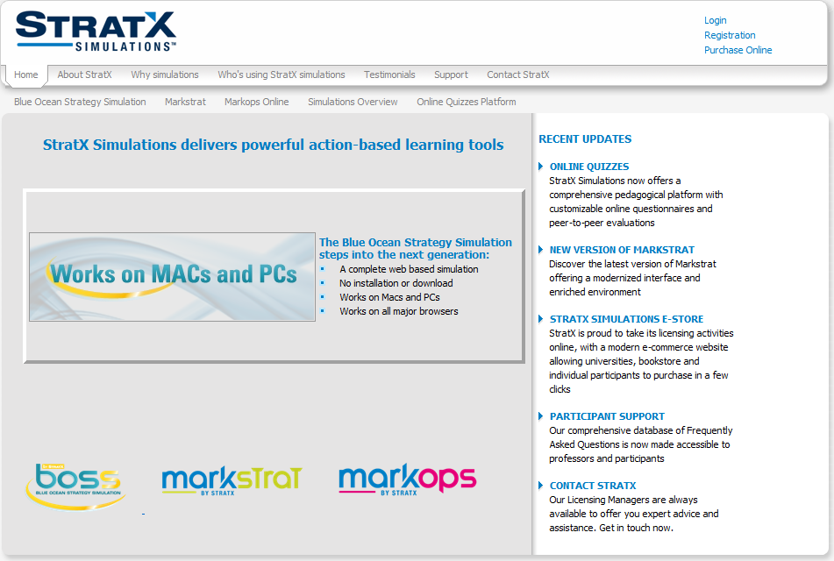
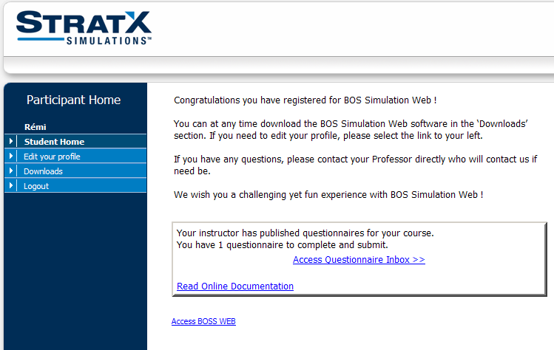
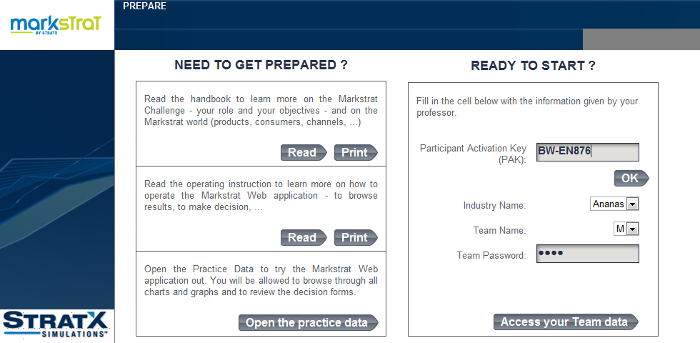
To Start Log Onto www.stratxsimulations.com
1) Log in www.stratxsimulations.com
Access
3) Enter your Participant Activation Key (PAK) and team password
2) Click the Markstrat Logo

Slide 49
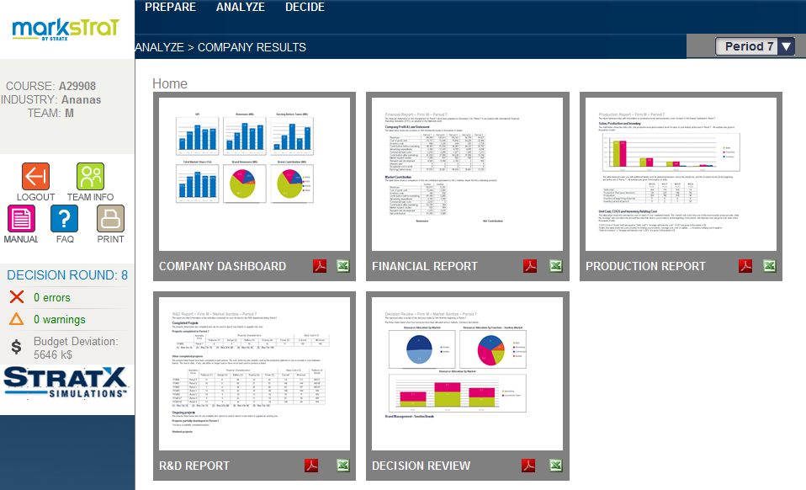
Use the ANALYZE Menu to Find Reports
Start from here
Click one of these images to open the corresponding report or study
Notes:
The 'decisions' component in Markstrat is composed of five main sections:
Brand portfolio
Production, Price & Advertising
Sales force & Distribution
Market research studies
Research & Development
As decisions for Period 1 are limited in scope, the 'brand portfolio' and 'research and development' buttons have not been released at this stage and remain gray to indicate that you cannot access them.

Slide 50
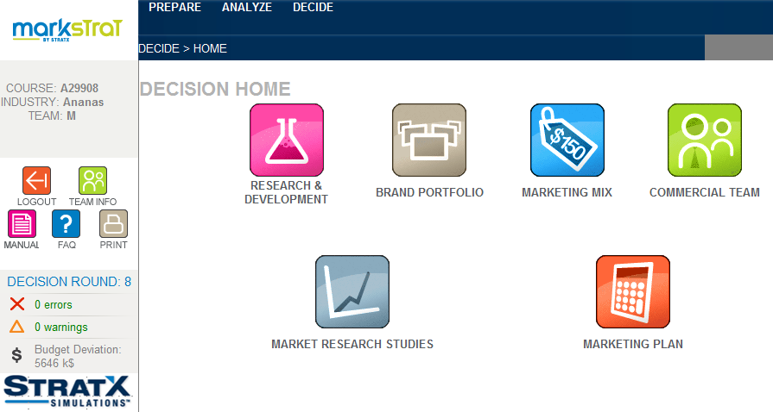
You Can Access All Decisions on the DECIDE Home
Start from here
Notes:
The 'decisions' component in Markstrat is composed of five main sections:
Brand portfolio
Production, Price & Advertising
Sales force & Distribution
Market research studies
Research & Development
As decisions for Period 1 are limited in scope, the 'brand portfolio' and 'research and development' buttons have not been released at this stage and remain gray to indicate that you cannot access them.

Slide 51
Develop Your Strategy and Make Decisions
You will need to do a certain amount of analysis before setting a strategic direction for your firm
Make three types of decisions in the first session
Marketing Mix
Commercial Team (Sales force)
Market Research
Production planning
Advertising & segmentation strategy
Pricing
Size of commercial team
Allocation across distribution channels
Allocation across marketed brands
Ordering industry-wide market studies
Ordering market-specific market studies
Notes:
Before making dramatic decisions, try to get a good feeling for the behavior of the market.
Do not jump to the first explanation, or conclusion, that you may have reached when faced with a problem: it may be incomplete.
Analysis of key information from market research studies, of your own situation and of past competitive behavior should help you reach more robust decisions.

Slide 52
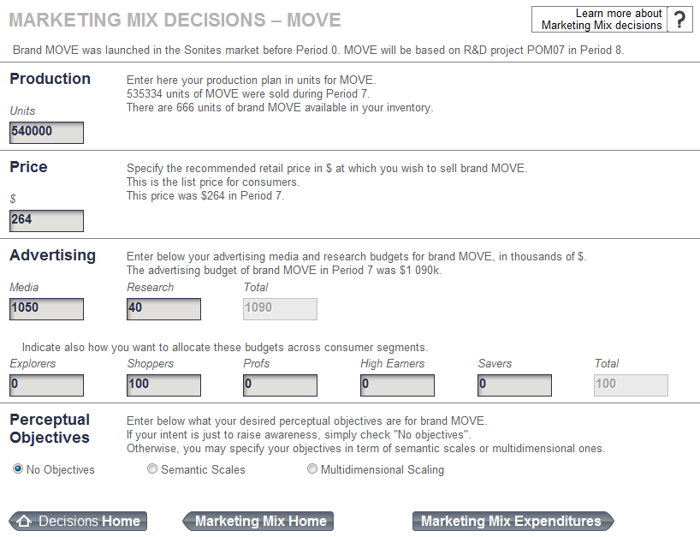
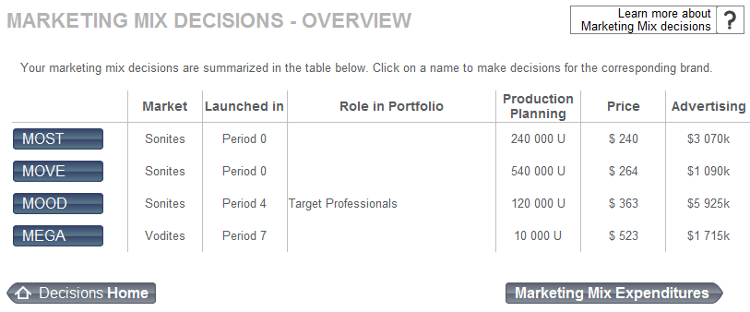
Enter Market Mix Decisions for Each Brand
Your marketed brands

Slide 53
Sample Production Planning Decisions (Adjusts +/- 20%)
Ideal Case
20,000
Pessimistic Case
154,000
Optimistic Case
154,000
150,000
Reduced to 134,000
154,000
0
0
20,000
100,000
Increased to 120,000
140,000
14,000
0
20,000
200,000
Reduced to 160,000
154,000
0
26,000
Potential sales
Beginning inventory
Production plan
Actual production
Actual sales
Lost sales
Ending inventory
154,000
Market Demand
Initial Situation
Your Decision
Production Action
Final Situation

Slide 54
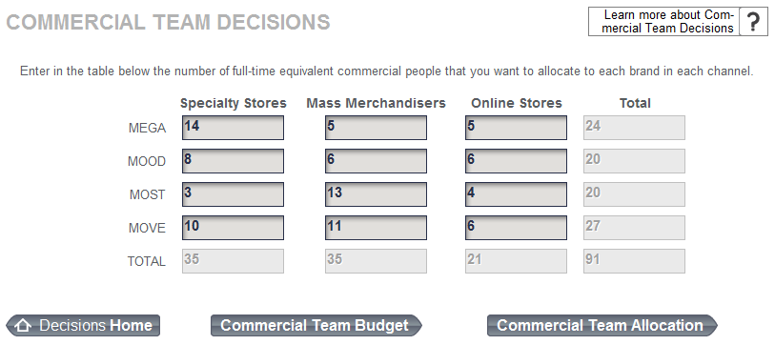
Allocate Salesforce Across Distribution Channels and Brands
Notes:
Sales force and Distribution
Your company's sales force is organized by channel of distribution.
Number of sales persons - Your primary decision will be to assign a number of sales people to each of the three distribution channels. Changes in the number of salespersons are expected to have an influence on the distribution coverage of your brands. Your sales force is knowledgeable about all your products, you can therefore modify the allocation of salespeople to specific distribution channels without any expenditure.
The 'assistant' button generates automatic allocation options through a dialog box which provides help on the time allocation decision. Four assistant options are proposed. The first option 'equal allocation on all brands' allocates an equal amount of effort to each brand within a channel. The three following options are based on the previous period's results. In these cases, no effort will be allocated to new brands introduced during the current period. You will need to enter some figures so that some effort is devoted to new brands.

Slide 55
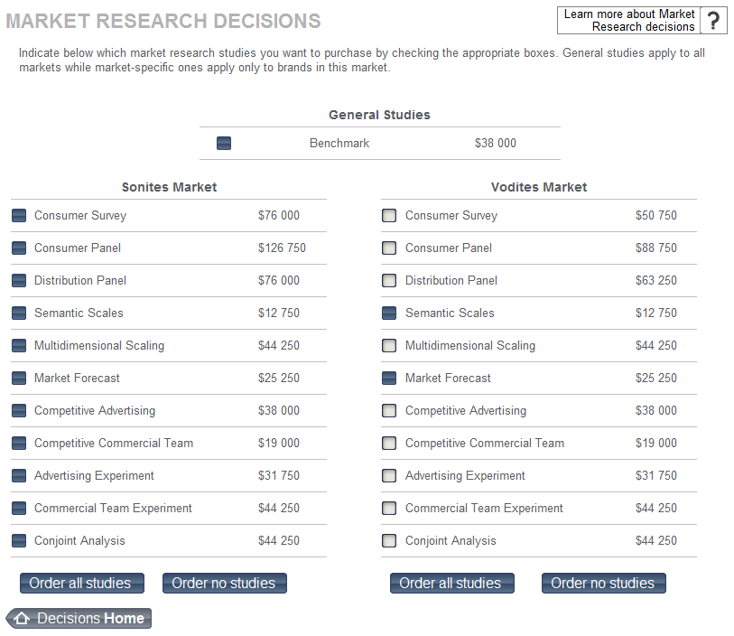
Buy Research Reports as Needed
The cost of each study is given here
Notes:
Market Research Studies
Market research studies may be requested simply by checking the boxes corresponding to each of the studies desired. The cost of these studies appears as the boxes are checked.
When you order a study, the study is performed during the simulated period and the results are made available at the end of the period, providing information for the next period's decisions.
Some of the studies may apply only if there are brands marketed during the period (e.g., the consumer panel for the Vodite market). It may be difficult to anticipate whether the competition will launch new brands ahead of time. You can nevertheless order these studies in anticipation that the study will contain relevant information. If this is not the case, you will not be charged for this study.

Slide 56
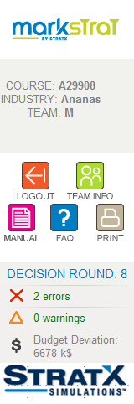
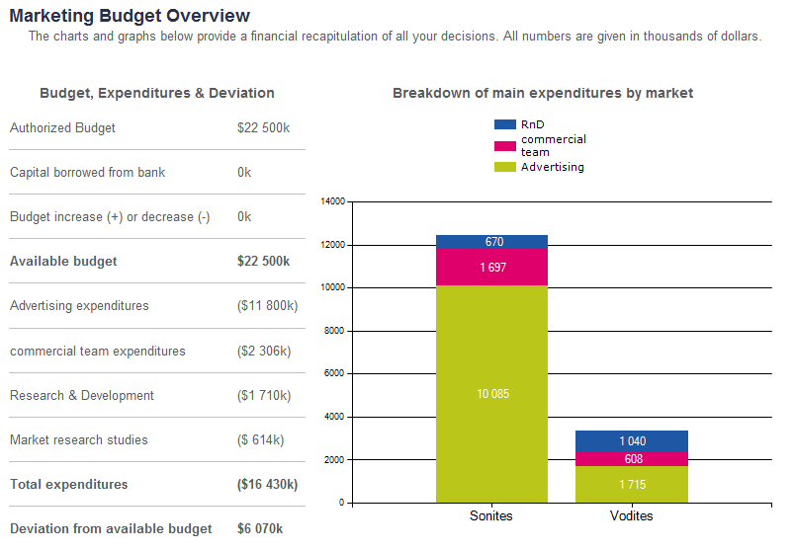
Must Stay Within Your Budget
Click here to check your budget
Notes:
Decision Tools
Check your Budget - The overall budget section displays expenditures by market. The allocation of advertising and sales force expenditure by brand can be found in the brand details section. The R&D details section lists the R&D projects requested for the next period with the corresponding budgets assigned to each of them. These three parts can be found in the tabs at the top of the screen. At any time you can check your expenditures against your allocated budget. A warning message will appear when the budget is exceeded.
Review your decisions- This link gives access to five tables which provide a detailed description of all decisions. Each of these tables can be reviewed by clicking on the corresponding tab at the bottom of the screen.
Check your Decisions- Errors indicate corrections that should be made because of inconsistent decisions, while warnings draw attention to possible problems detected by the software that need to be checked carefully to make sure that the entry is correct.

Slide 57
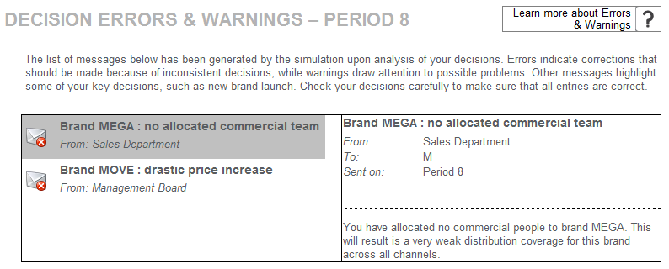
Don’t Submit Decisions With Any Errors or Warnings
Click here to check your messages

Slide 58
Ready to Start First Decision Round
Read handbook; need to invest some upfront time
Look at practice data
Decide how to divide tasks and make decisions
Whoever talks the loudest (my favorite)
Sonite and Vodite product managers
Recommend using an R&D manager(s)
Competitive tracking
Decision are constrained in first round
No perceptual objective in advertising
No R&D projects
At end of class you will need to debrief your strategy so keep track of your decisions and why

Slide 59
Agenda
Overview
Course Overview
Marketing Strategy Overview
First Principles of Marketing Strategy
MP#1: All Customers Differ → Managing Customer Heterogeneity
MP#2: All Customers Change → Managing Customer Dynamics
MP#3: All Competitors React→ Managing Sustainable Competitive Advantage
MP#4: All Resources Are Limited → Managing Resource Trade-Offs
Integrating the Four First Principles of Marketing Strategy
Markstrat
Takeaways

Slide 60
Takeaways
Marketing strategy is the set of decisions and actions focused on building a sustainable differential advantage, relative to competitors, in the minds of customers, to create value for stakeholders.
This book takes a simplifying approach to marketing strategy, arguing that marketing decisions should focus on solving the four underlying problems or complexities that all entities face when designing and implementing a marketing strategy.
The first and most basic issue facing managers in their marketing mix decisions (pricing, product, promotion, place) for the firm is that all customers differ. Customer heterogeneity is a fundamental problem that all firms must address when developing an effective marketing strategy (MP#1).
Notes:
Marketing strategy is the set of decisions and actions focused on building a sustainable differential advantage, relative to competitors, in the minds of customers, to create value for stakeholders.
This book takes a simplifying approach to marketing strategy, arguing that marketing decisions should focus on solving the four underlying problems or complexities that all entities face when designing and implementing a marketing strategy.
The first and most basic issue facing managers in their marketing mix decisions (pricing, product, promotion, place) for the firm is that all customers differ. Customer heterogeneity is a fundamental problem that all firms must address when developing an effective marketing strategy (MP#1).

Slide 61
Takeaways
The input–output framework for managing customer heterogeneity captures the approaches, processes, and analyses that can aid managerial decision making. The inputs include customers, the company, and competitors, which together constitute the contextual background in which a firm’s strategy must operate. The output identifies key industry segments, the firm’s target segment(s), and positioning statements, which reveal the relative advantage of the firm’s offering for the target segment.
A second underlying complexity for both short- and long-term marketing decisions is that all customers change. Therefore, with a focus on the firm’s own customers, MP#2 challenges firms to understand how their existing customers change over time.
The input–output framework for managing this customer dynamism emphasizes the firm’s existing customer portfolio and data that link past customer responses to specific marketing programs as inputs. The outputs are AER positioning statements and strategies, which help the firm effectively manage dynamics.
Notes:
The input–output framework for managing customer heterogeneity captures the approaches, processes, and analyses that can aid managerial decision making. The inputs include customers, the company, and competitors, which together constitute the contextual background in which a firm’s strategy must operate. The output identifies key industry segments, the firm’s target segment(s), and positioning statements, which reveal the relative advantage of the firm’s offering for the target segment.
A second underlying complexity for both short- and long-term marketing decisions is that all customers change. Therefore, with a focus on the firm’s own customers, MP#2 challenges firms to understand how their existing customers change over time.
The input–output framework for managing this customer dynamism emphasizes the firm’s existing customer portfolio and data that link past customer responses to specific marketing programs as inputs. The outputs are AER positioning statements and strategies, which help the firm effectively manage dynamics.

Slide 62
Takeaways
The idea that all competitors react is the third principle that marketing managers must address, by building and maintaining barriers to these competitive attacks and thereby ensuring a sustainable competitive advantage (MP#3).
The input–output framework for managing competitive reactions cites three inputs: the outputs from MP#1, the outputs from MP#2, and long-term environmental (e.g., technology, regulatory) trends. Its outputs are a firm’s BOR strategies, which aggregate and reorganize the needs of each targeted customer and persona, as well as the most effective strategies over time, in terms of brands, offerings, and relationships.
The fourth marketing principle holds that all resources are limited, so firms must develop resource trade-off strategies that are relevant for their current target segments (MP#1) and maintain their current AER strategy (MP#2) and stated SCA (MP#3), which together constitute MP#4.
Notes:
The idea that all competitors react is the third principle that marketing managers must address, by building and maintaining barriers to these competitive attacks and thereby ensuring a sustainable competitive advantage (MP#3).
The input–output framework for managing competitive reactions cites three inputs: the outputs from MP#1, the outputs from MP#2, and long-term environmental (e.g., technology, regulatory) trends. Its outputs are a firm’s BOR strategies, which aggregate and reorganize the needs of each targeted customer and persona, as well as the most effective strategies over time, in terms of brands, offerings, and relationships.
The fourth marketing principle holds that all resources are limited, so firms must develop resource trade-off strategies that are relevant for their current target segments (MP#1) and maintain their current AER strategy (MP#2) and stated SCA (MP#3), which together constitute MP#4.

Slide 63
Takeaways
In the input–output framework for managing resource trade-offs, the inputs include the outputs from the first, second, and third marketing principles; the outputs are the metrics that firms need to manage their resource allocation activities, as well as the specific resource allocation decision that managers make for that period.
To integrate these four principles into their day-to-day practices, managers should acknowledge that the framework is hierarchical, requires a static and dynamic perspective, and demands an iterative solution approach.
Notes:
In the input–output framework for managing resource trade-offs, the inputs include the outputs from the first, second, and third marketing principles; the outputs are the metrics that firms need to manage their resource allocation activities, as well as the specific resource allocation decision that managers make for that period.
To integrate these four principles into their day-to-day practices, managers should acknowledge that the framework is hierarchical, requires a static and dynamic perspective, and demands an iterative solution approach.

Slide 64
Readings
MarkStrat background: MarkStrat Online Student Handbook
Rethinking Marketing (very good summary of many of the First Principles, customer centricity, and changing role of marketing)
Insight into the effect of marketing on firm performance
The Bottom Line: Marketing and Firm Performance (summary of research on empirical linkages)
10 Insights: The New Intelligent Enterprise Winning with Data (survey of business managers, especially shows importance of using data and analytics)
Marketing Strategy: Chapter 1

