Slide 1

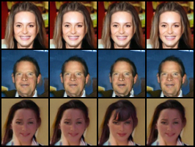
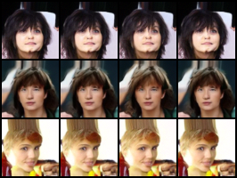
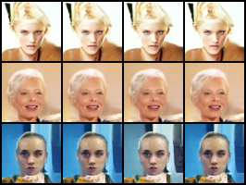
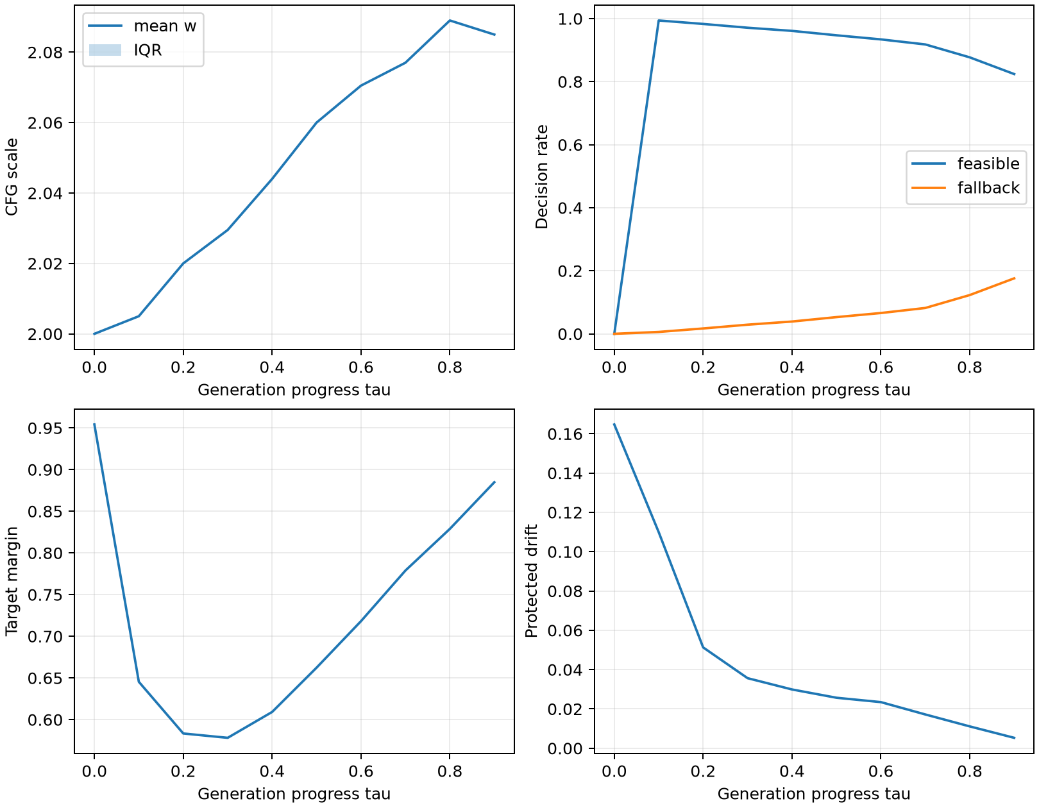
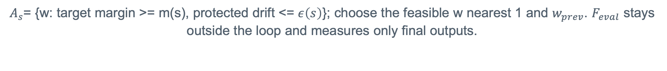
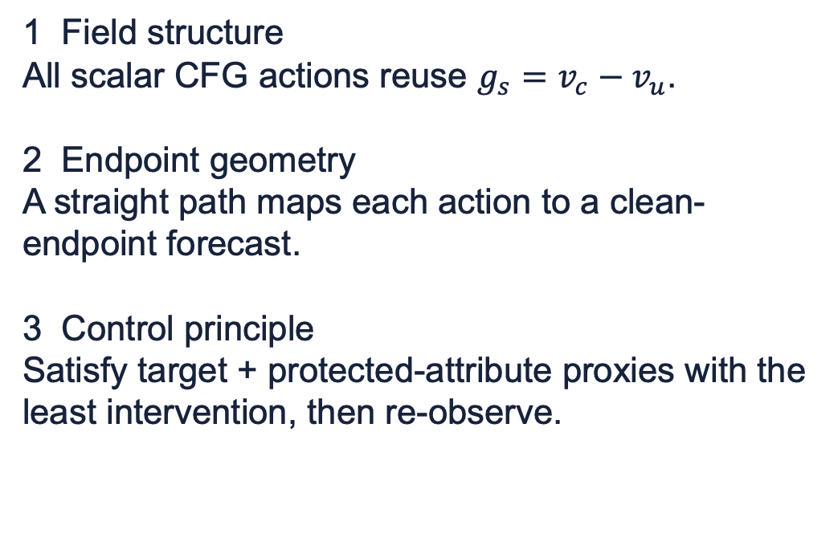
Constraint-Aware Receding-Horizon CFG
for Attribute-Conditioned Flow Matching
Mu Chen | CMU 10-799 Diffusion & Flow Matching | Controllability Track
One affine guidance axis + one analytic endpoint map turns fixed CFG into constrained feedback.
1-D
x0
+0
CFG control authority
analytic endpoint forecast
extra U-Net calls for selection
First principles: derive the controller
CRH-CFG: field reuse -> endpoint reasoning -> constrained action
1 Field structure
All scalar CFG actions reuse $g_{s}=v_{c}−v_{u}$.
2 Endpoint geometry
A straight path maps each action to a clean-endpoint forecast.
3 Control principle
Satisfy target + protected-attribute proxies with the least intervention, then re-observe.
$$v_{w}=v_{u}+w\left(v_{c}−v_{u}\right) {\hat{x}}_{0}\left(w\right)=x_{s}+\left(1−s\right)v_{w}$$
1. Reuse field
>
2. Forecast
>
3. Score
>
4. Constrain
>
5. Execute
Frozen conditional + unconditional pair
Affine scale bank -> analytic endpoints
Frozen F_ctrl: margin + protected drift
Feasible set + minimum intervention
Gate / fallback -> held Heun pair -> replan
$A_{s}$= {w: target margin >= m(s), protected drift <= $ε\left(s\right)$}; choose the feasible w nearest 1 and $w_{prev}$. $F_{eval}$ stays outside the loop and measures only final outputs.
Fixed w is open-loop. CRH-CFG asks the finite constrained question again at each observed state.
Execution: early gate | decide every 5/50 steps | hold w* across each Heun pair | matched U-Net work
Evidence: adherence at matched generator work
Evidence boundary: success, boundary, and failure cases
Smiling
Bangs
Blond Hair
Observed successes (out of 1,000):
Smiling 985 -> 987 | Bangs 980 -> 984 | Blond 987 -> 993
Columns: static w=2, interval CFG, target-only, full CRH-CFG. Rows are selected by frozen rules: maximum-margin success, nearest evaluator boundary, minimum-margin failure.
Claim -> evidence -> boundary
Mean success: .9840 -> .9880 (+0.4 pp). Cost: +1.80%, same U-Net work.
Common-w=1 preservation does not improve; KID_marg rises for all targets but cannot identify conditional quality. No per-seed transitions: descriptive only.
Reachability
One scalar direction cannot make every constraint feasible.
Proxy activity
The selected preservation budget never changes the finite-set argmin.
Measurement
Endpoint scores from F_ctrl do not guarantee final outcomes under F_eval.
Adaptation concentrates on difficult trajectories
What the ablations and failures teach us
At the last saved decision (s=0.9):
Smiling mean w 2.017 | fallback 5.7%
Bangs mean w 2.085 | fallback 17.6%
Blond mean w 2.186 | fallback 1.6%
Median and IQR remain w=2 at every saved decision. CRH-CFG mainly corrects a minority of hard samples.
Reliability gate is essential
Removing it drops reduced-protocol success from 98.83% to 91.54%.
Preservation budget is non-binding
Adding the preservation term changes no reported reduced-controller value.
Extra scale saturates
$w_{max}$ 2 -> 3 adds +0.26 pp; 3 -> 4 adds 0.00 pp.
Scalar authority is limited
Selected failures reach high fallback or w=4 without crossing the evaluator boundary.
Supported: low-overhead adaptive correction. Not supported: joint adherence-preservation-quality improvement.
Reproducibility & compute
Selected references
Resources & disclosure
3 targets x 1,000 paired seeds | frozen checkpoint/split | 19 tests
HW4: 3.824 measured L40S GPU-h | HW3 training: 2.688 estimated | qualified total: 6.512 GPU-h
Lipman et al., Flow Matching, 2023 | Ho & Salimans, CFG, 2022 | Guided Flows, 2023
Limited Guidance Interval / CADS, 2024 | Online feedback, 2025 | CFG++ / Rectified-CFG++, 2024-25
Built independently from the course starter repository and cited papers. OpenAI Codex assisted implementation, analysis, writing, and poster production; all displayed numbers were checked against retained artifacts.
CMU 10-799 Spring 2026 | Final Poster Presentation

