Slide 1

Repurchase Agreements
150 North Meramec Avenue
Sixth Floor
St. Louis, MO 63105
(314) 721-1900 phone
(314) 721-3041 fax
www.nisanet.com
Copyright© 2009 by NISA Investment Advisors, L.L.C. All rights reserved.

Slide 2
General Terms & Concepts
Repo – dealer lending collateral
Reverse repo – dealer borrowing collateral
General collateral (GC) – broad term for fungible Treasury securities
General collateral rate (repo rate) – generic rate charged for borrowing when lending general collateral
Trading Special – when the rate charged on cash is lower than the GC rate. This happens when a bond is in high demand and it can be used to borrow cash at a low rate.
On-the-run (OTR) – the most recently issued security of a particular maturity
Haircut – the percentage (or margin) of funds not received when lending securities. This is similar to initial margin.
Basis Trade – Buy (Sell) Bond and Sell (Buy) Futures
  Buy bond/ Sell Futures when the implied repo > GC
  Sell bond/ Buy Futures when the implied repo < GC

Slide 3
Life Cycle of a REPO Transaction
REPOs are secured lending/ borrowing transactions
Step #1 – Client Buys Bond A to get rate exposure without cash
Client
Dealer Sends Bond
Dealer
Client Needs Money to Settle Trade
Client uses Cash to settle trade
Step #2 – REPO initiation to get Cash
Client
Dealer Sends Cash
Dealer
Client Sends Bonds
Step #3 – Client Sells Bond to Return Cash
Client
Dealer Sends Cash
Dealer
Client Sells Bond A from Step #1
Step #4 – REPO ends with return of Bond and Cash
Client
Dealer returns Bond
Dealer
Client returns Money from Step #3 + Interest

Slide 4
Who uses REPOs
Federal Reserve
    Liquidity management
    Credit extension
Broker Dealers
  Basis Trading (futures vs bonds)
  Financing trades
    Derivatives Trades
    Cash Trades
  Leverage (synthetic exposure)
  Auction participation
Asset Managers
  Cash Management/ Yield Enhancement
  Leverage
  Exposure Modification
  Basis Trading

Slide 5
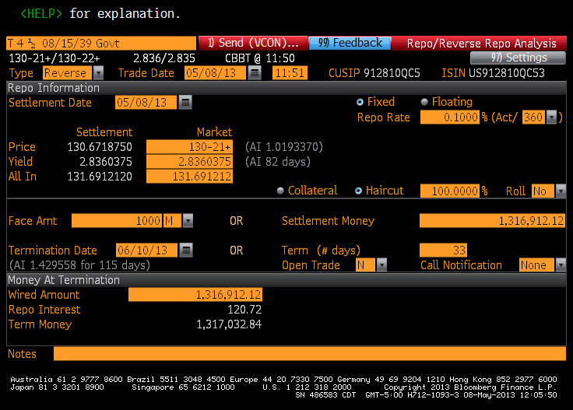
Bloomberg Screen – RRRA – No Haircut
Reverse REPO
0% Haircut on the collateral lent
Calculations
$1mm * 10 * 131.691212 = $1,316,912.12 → Settlement Money
$1,316,912.12 * 33/360 * 10bps = $120.72 → REPO Interest (ACT/ 360)
$1,316,912.12 + $120.72 = $1,317,032.84 → Money at Termination

Slide 6
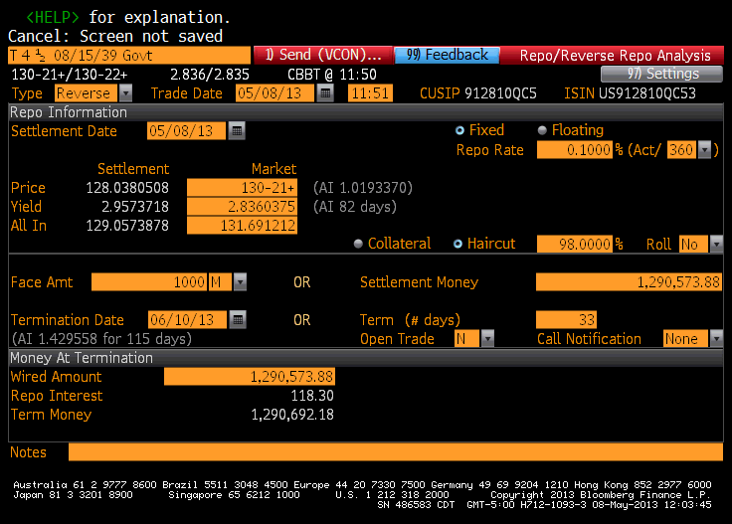
Bloomberg Screen – RRRA - Haircut
Reverse REPO
2% Haircut on the collateral lent
Calculations
$1mm * 10 * 131.691212 * 98% = $1,290,573.88 → Settlement Money
$1,290,573.88 * 33/360 * 10bps = $118.30 → REPO Interest → only on Settlement Money
$1,290,573.88 + $118.30 = $1,290,692.18 → Money at Termination

Slide 7
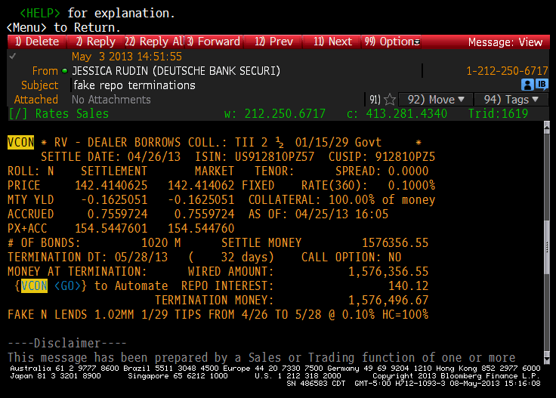
Bloomberg Screen – VCON – No Haircut

Slide 8
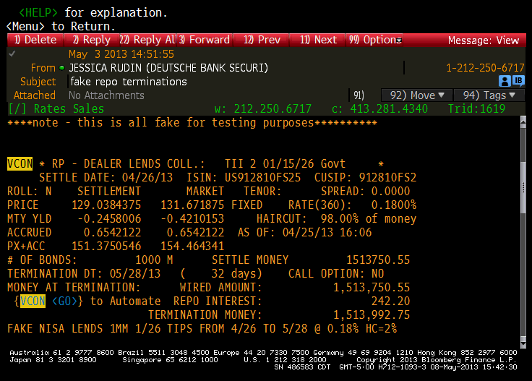
Bloomberg Screen – VCON - Haircut
Incorrectly says REPO/ dealer lending collateral

