Slide 1
Volume (emptyDir, hostPath)

Slide 2
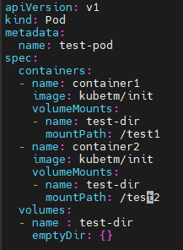
emptyDir
Pod
Container1
/test1
Volume
test-dir
Container1
/test2
<emptyDir.yaml>

Slide 3
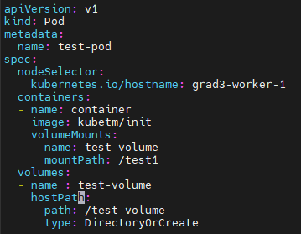
hostPath
grad2-worker-1
Volume
testDir
Container
/test1
<hostPath.yaml>

Slide 4
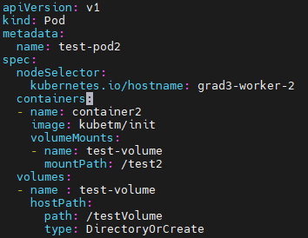
hostPath
grad3-worker-1
Volume
test-volume
grad3-worker-2
test-pod2
Container2
/test2
<hostPath2.yaml>

Slide 5
PV/PVC/StorageClass

Slide 6
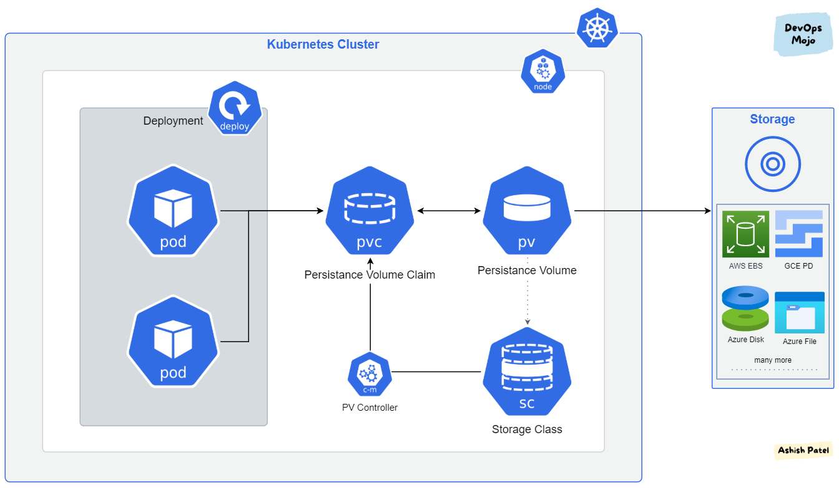
scenario

Slide 7
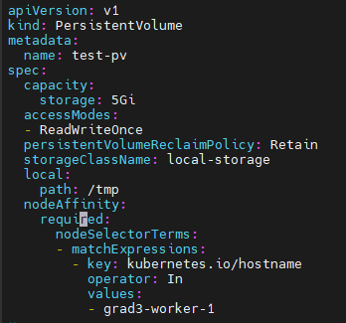
PersistentVolume
<pv.yaml>

Slide 8

StorageClass
<storageclass.yaml>

Slide 9
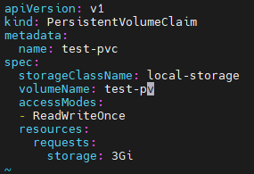
PersistentVolumeClaim
<pvc.yaml>

Slide 10
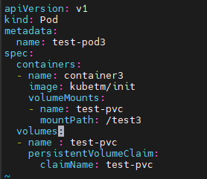

Pod
<test.yaml>

