Slide 1
Graph Theory Application in Computer Vision “Image Segmentation using Graph Cut”

Slide 2
Agenda
Image as a Graph
Graph-based representation
Graph Cuts
Min-cut/Max-flow Algorithm → Nonlinear optimization problem
Ford-Fulkerson Algorithm
User Interactive example

Slide 3

Image as a Graph
Graph-based representation
Two main components: Node & Edge
Formation: $G=<V,E>(V:node, E:Edge)$
Image
Graph
Segmentation
Segmented Image
Interactive Graph Cuts for Optimal Boundary

Slide 4
Image as a Graph
Graph-based representation
Two main components: Node & Edge
Formation: $G=<V,E>(V:node, E:Edge)$
“Cut!”
Image
Graph
Segmentation
→ Segmentation can be regarded as a “cut” in a graph
Interactive Graph Cuts for Optimal Boundary

Slide 5
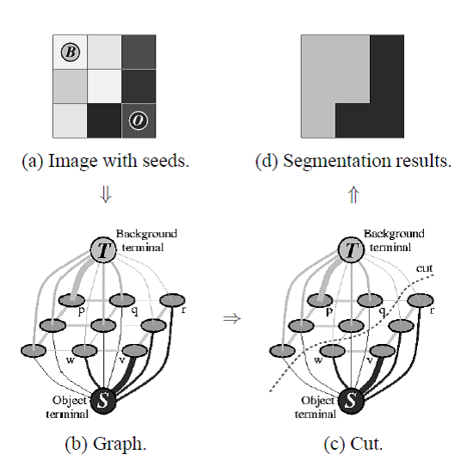
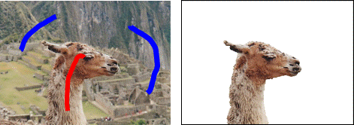
Graph Cuts Algorithm
Min-cut/Max-flow Algorithm
Seed is given by user by drawing
Drawn image provides terminal nodes
Source and Sink
→ Cut the Graphs with a minimum cost
Interactive Graph Cuts for Optimal Boundary

Slide 6
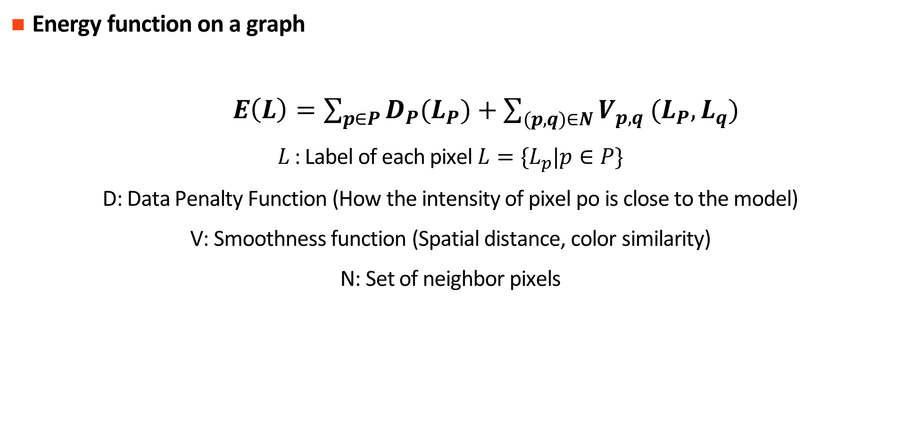
Graph Cuts Algorithm
Energy function on a graph
$E\left(L\right)=\sum_{p∈P}{D_{P}(L_{P})}+\sum_{(p,q)∈N}{V_{p,q} (L_{P},L_{q})}$
$L$: Label of each pixel $L=\{L_{p}|p∈P\}$
D: Data Penalty Function (How the intensity of pixel po is close to the model)
V: Smoothness function (Spatial distance, color similarity)
N: Set of neighbor pixels
There is no closed form solution → Optimization techniques are required: Min-cut/ Max-flow
→ Energy will be maximized at the ground truth
Interactive Graph Cuts for Optimal Boundary

Slide 7
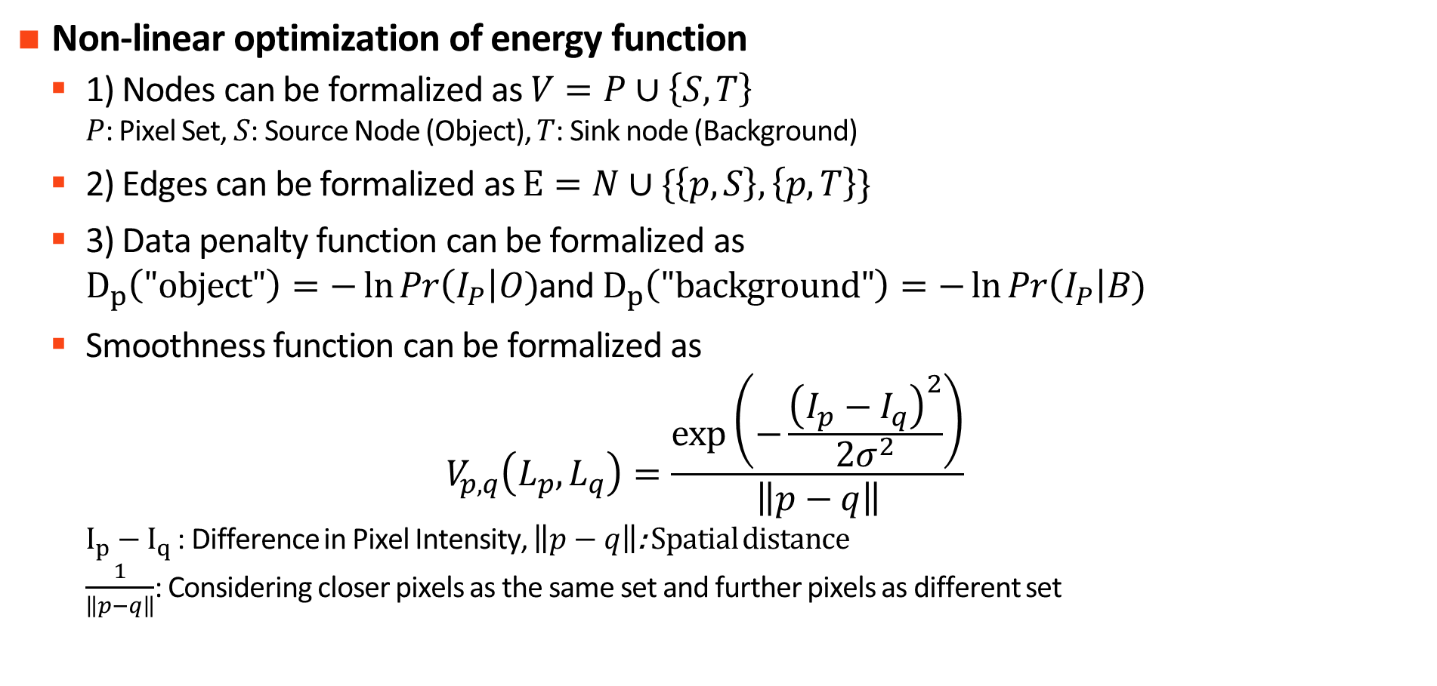
Graph Cuts Algorithm
Non-linear optimization of energy function
1) Nodes can be formalized as $V=P∪\left\{S,T\right\}$ $P$: Pixel Set, $S$: Source Node (Object), $T$: Sink node (Background)
2) Edges can be formalized as $E=N∪\{\left\{p,S\right\},\left\{p,T\right\}\}$
3) Data penalty function can be formalized as $D_{p}\left(\text{"}\text{object}\text{"}\right)=−\ln{Pr\left(I_{P}\right|O)}$and $D_{p}\left(\text{"}\text{background}\text{"}\right)=−\ln{Pr\left(I_{P}\right|B)}$
Smoothness function can be formalized as $V_{p,q}\left(L_{p},L_{q}\right)=\frac{\exp\left(−\frac{{\left(I_{p}−I_{q}\right)}^{2}}{2σ^{2}}\right)}{\left\|p−q\right\|}$ $I_{p}−I_{q}$ : Difference in Pixel Intensity, $\left\|p−q\right\|$: Spatial distance $\frac{1}{\left\|p−q\right\|}$: Considering closer pixels as the same set and further pixels as different set
Ford-Fulkerson Algorithm

Slide 8



Graph Cuts Algorithm
Construct a graph and compute the corresponding weights
20
20
70
1
1
2
3
1
2
3
0.946
10
15
70
4
5
6
4
5
6
15
70
90
7
8
9
7
8
9
Image
Graph
Weighted Graph
$$\frac{\exp\left(−\frac{{\left(20−20\right)}^{2}}{2{∗30}^{2}}\right)}{1}=1$$
Let’s set $σ$=30, $\left\|p−q\right\|$=1
$$\frac{\exp\left(−\frac{{\left(20−10\right)}^{2}}{2{∗30}^{2}}\right)}{1}=0.946$$

Slide 9
Graph Cuts Algorithm
Construct a graph and compute the corresponding weights
Source
0
2
1
0.249
1
0.249
1
2
3
1
2
3
1
2
3
0.946
0.986
1
0.946
0.986
1
4
5
6
0. 186
0. 186
0.986
4
5
6
0.986
4
5
6
7
8
9
0.986
0. 186
0.801
0.986
0. 186
0.801
7
8
9
7
8
9
2
Graph
0. 186
0.801
0. 186
0.801
Weighted
Graph
10
Min cut
Sink

Slide 10
Ford-Fulkerson Algorithm
How can we find the min-cut path automatically?
→ Ford-Fulkerson Algorithm
Apply the concept of “augmenting path” based on the residual graph
Code Application
Ford-Fulkerson Algorithm

