Slide 1
과학계산을 위한 컴퓨터활용

Slide 2
Review of previous work
do
enddo
Do While () enddo

Slide 3
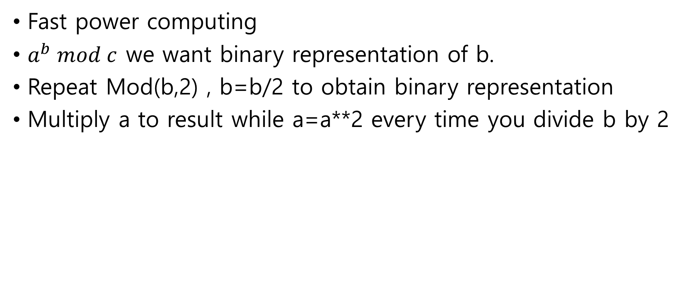
Review of previous work
Fast power computing
$a^{b} mod c$ we want binary representation of b.
Repeat Mod(b,2) , b=b/2 to obtain binary representation
Multiply a to result while a=a**2 every time you divide b by 2

Slide 4
File opening
OPEN(unit= , file=‘ ‘, action=‘ ‘,iostat=)
Unit : Giving a name to file. Must be an integer
File: filename e.g. file=‘test1.txt’
Action: ‘read’ or ‘write’ depending on your purpose
Iostat: Whether you have succeeded opening file.

Slide 5
Read File
1. Make a simple file by emacs
2. Open(unit=10, file=‘data.txt ‘, action=‘read ‘)
3. read(10,*) a,b,c

Slide 6
Write File
1. Open(unit=11, file=‘write.txt ‘, action=‘write‘)
2. write(10,*) a,b,c

Slide 7
Won to Dollar
For given data file “Won.DATA”
Read “Won.data” file
Convert Won to Dollar
Save converted result to “dolloar.data” file
For convenience we assume 1$=1200\

Slide 8
ARRAY
REAL(8), dimension(3) ::v
Integer ::v(3)
REAL(16) v(3)

Slide 9
Mutli-dimensional Array
Real(8), dimension(3,3)::v
Real(8)::v(3,3)

Slide 10
Exercise
Read vector and Matrix to perform Matrix-vector multiplication(or dot-product)
Read vector, Matrix(or vector)
Perform multiplication(or dot-product)
Print result

Slide 11
Dynamic array
Real(8),allocatable:: v(:)
Allocate(v(n))

Slide 12
Excercise
1. 벡터의 크기와 벡터를 입력받고
2. 벡터를 저장.
3. 저장된 벡터를 다시 읽고 원래 것이랑 비교

