Slide 1
Python 강의자료02
공학정보처리 ENG1108
김 은 진

Slide 2
Values and Types
Strings
Variables
Keywords
Expressions
Operators
Evaluation order

Slide 3

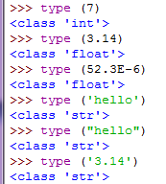
Values and types
Values (Literal Constants)
One of the basic things a program works with, like
Ex) 1 2.5 ‘Hello World’
Values belongs to different types
Data Types
Integer
Float
String
Boolean
NoneType

Slide 4
Limitations of number types
Mathematics provides the infinite set of natural numbers N = {1, 2, 3, … }. Because the computer has finite size, it is impossible to represent all of these numbers in the computer. Instead, only a small subset of numbers is represented.
-2147483648 and +2147483647 as shown above for 4 bytes
+9223372036854775807 as the maximum integer for 8 bytes (that's 9.2*10¹⁸)
Following (roughly) the IEEE-754 standard, one uses 8 bytes for one float x: 10⁻³⁰⁸ ~ 10³⁰⁸ , 15 significant digits

Slide 5
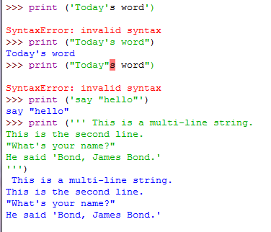
Strings
‘ or “
multi-line string
( ’’’ or ””” )

Slide 6
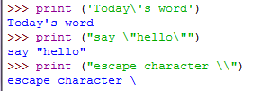
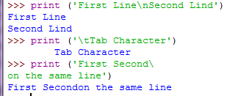
Strings
escape character \
character ‘ “ \
\n \t \(enter)
raw string

Slide 7
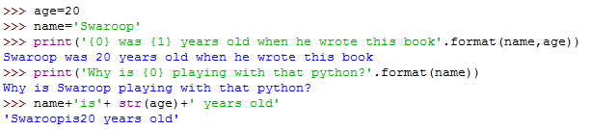
Strings
Making string with format() method
{0} {1} … : corresponding arguments to the format method
Without explicit conversion to strings
Same string using string concatenation +

Slide 8
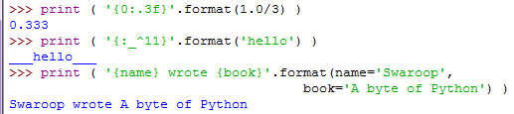
Strings
More on format()

Slide 9

Variables
storing and manipulating any information
hold values of different data types
can change values
Parts of computer’s memory
Names(Identifiers) for accessing variables
First character: alphabet letter or underscore( _ )
Rest of the name : letters, underscore, digits( 0 ~ 9)
Case sensitive
Example
Valid : i, name_2_3
Invalid: 2things, this is spaced out, my-name, >alb2_c3
Notes:
Assignment operator creates new variables
Data type of a variable can be changed (flexibility)
num = 10
num = ‘kim’

Slide 10
Variables
Memory
Central Processing Units
Program
(commands)
num
10
pi
3.14
name
‘python’

Slide 11
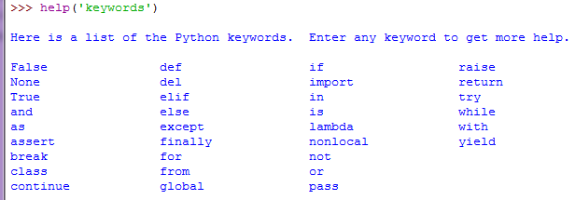
Keywords

Slide 12
Objects
Everything in a Python program is an object including numbers, strings and functions

Slide 13
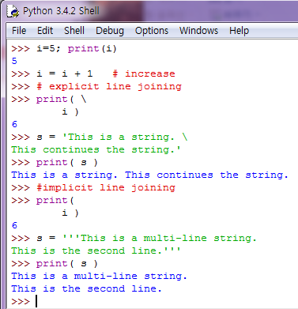
Variables and literal constants
Assignment operator:
assign the literal constant value( 5 )
to the variable( i )
;
one physical line statement
two logical line statements
Comments: start with #
notes for the readers of program
Notes:
주석
가정한 사항들
중요 결정사항 설명
중요 세부사항 설명
해결하려는 문제 설명
앞으로 극복하려는 문제 설명

Slide 14
Expressions
operator
2 + 3
operands
Notes:
Expressions
a combination of values, variables, and operators
Operator
연산자 – 계산할 때 쓰이는 기능(functionality that do something)
Operands
피연산자 – 계산에 사용될 데이터(some data to operate on)

Slide 15
Operators
string * int
floor division
float % ➔몫을 int로
Op | Expression1 | Result1 | Expression2 | Result2
+ | 3 + 5 | 8 | ‘a’ + ’b’ | ‘ab’
- | 50 – 24 | 26 | ‘2’ – ‘1’ | Error !
* | 2 * 3 | 6 | ‘la’ * 3 | ‘lalala’
** | 3 ** 4 | 81 | 4 ** 0.5 | 2.0
/ | 13 / 3 | 4.333333 | 13.0 / 3 | 4.33333333333
// | 13 // 2 | 6 | 13.5 // 2 | 6.0
% | 13 % 3 | 1 | -25.5 % 2.25 | 1.5
Notes:
Floor division:
effectively throws away digits to the right of the decimal point

Slide 16
Operators
Op | Expression1 | Result1 | Expression2 | Result2
<< | 2 << 2 | 8 | 2.0 << 2 | Error !
>> | 11 >> 1 | 5 | 11.0 >> 1 | Error !
& | 5 & 3 | 1 | 5.0 & 3 | Error !
| | 5 | 3 | 7 | 5 | 3.0 | Error !
^ | 5 ^ 3 | 6 | 5.0 ^ 3.0 | Error !
~ | ~5 | -6 | ~’a’ | Error !
0010 ➔ 1000
1011 ➔ 0101
0101 & 0011 ➔ 0001
0101 | 0011 ➔ 0111
0101 ^ 0011 ➔ 0110
~ 00000101 ➔ 11111010

Slide 17
Operators
Multi operands 가능
Case-sensitive
Op | Expression1 | Result1 | Expression2 | Result2
< | 5 < 3 | False | 3 < 5 < 7 | True
> | 5 > 3.5 | True | 5 > ‘a’ | Error!
<= | 3 <= 6 | True | ‘b’ <= ‘b’ | True
>= | x=4; x >= 3 | True | ‘kim’ >= ‘park’ | False
== | 2 == 2 | True | ‘Str’ == ‘str’ | False
!= | 2 != 2 | False | 3 != ‘3’ | True
not | x=False; not x | True | not ‘a’ | False
and | 3 < 4 and ‘a’!=‘b’ | True | 3 > 4 and ‘a’==‘a’ | False
or | 3 > 4 or ‘a’==‘a’ | True | 3 < 4 or ‘a’!=‘a’ | True
Short circuit evaluation
Short circuit evaluation

Slide 18
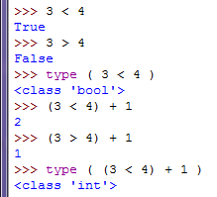
bool data type
bool (Boolean) data type
True and False are called Boolean data types
True and False are considered as 1 and 0

Slide 19
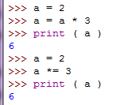
Shortcut for math operation and assignment
var = var operation expression
➔ var operation = expression

Slide 20
Evaluation order
high
(expressions …), [expressions …], {key: value …}, {expressions …}
x[index], x[index: index], x(arguments …), x.attribute
**
+x, -x, ~x
*, /, //, %
+, -
<<, >>
&
^
|
in, not in, is, is not, <, <=, >, >=, !=, ==
not x
and
or
if – else
lambda
low

Slide 21
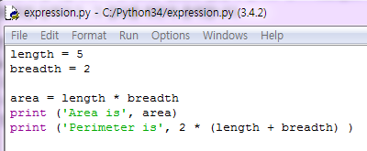

Evaluation order
Changing the order of evaluation with ( )
( 2 + 3 ) * 4
Associativity
a + b + c ➔ ( a + b ) + c
a = b = c ➔ a = ( b = c )
Python script file
Python shell

