Slide 1
Python 강의자료03
공학정보처리 ENG1108
김 은 진

Slide 2
Control flow
Control Statements
if
while
for
break
continue
Exceptions

Slide 3
Control Flow
In the program, statements are executed in top-down order
Control statements change the order of execution of statements
Control statements
if
while
for
break
continue

Slide 4
if statement
if the condition is true, run if-block, else run else-block
else part is optional
if expression : statement11
statement12
……
else : statement21 statement22
statemsnt23
……
Block (set of statements) must have the same indentation ( leading whitespaces of the logical line)

Slide 5
if statement
elif and else part is optional
if expression1 : statement11
……
elif expression2 : statement21
……
elif expression3 : statement31
……
……
else : statement41 ……
elif clause
combines two if else – if else
makes the program easier and
reduce the amount of indentation

Slide 6
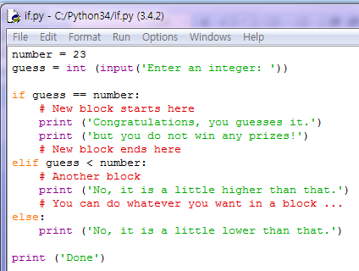



if statement
input( str ) function
prints str to the screen
waits for input from user
If user enter something and enter key
returns what user entered, as a string
int( ) function
convert string to an integer
Finally the integer is stored in the variable guess
number guess
23
50
22
23
Notes:
Function: 재사용 가능한 프로그램 조각 (다음 chapter에서 설명)

Slide 7
while statement
repeatedly execute a block as long as a condition is true.
can have an optional else.
while expression : statement11
statement12
……
else : statement21 statement22
statemsnt23
……
else block is executed when the condition becomes False.
else block is not executed when you break out of the loop with a break statement

Slide 8
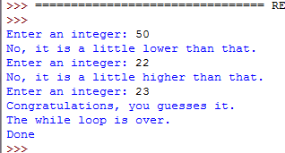
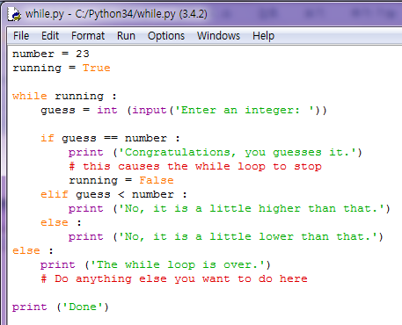
while statement
repeatedly execute a block as long as a condition is true.
can have an optional else.

Slide 9
while statement

Slide 10
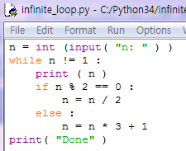

while statement

Slide 11
for..in statement
iterates over a sequence of objects.
sequence: an ordered collection of items
can have an optional else.
Any kind of sequence of any kind of objects.
for target_list in expression_list : statement11
statement12
……
else :
statement21
statement22
statemsnt23
……
else block is executed once after the loop is over.
else block is not executed when you break out of the loop with a break statement
Notes:
Sequence
의미: 여러 항목들이 나열된 어떤 목록
간단히 설명하고 나중에….

Slide 12
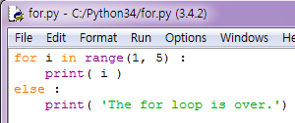
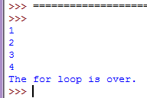
for..in statement
range(a, b) function returns
a seq. of numbers starting from a up to b
range(a, b, c)
c is the step count , default value is 1

Slide 13
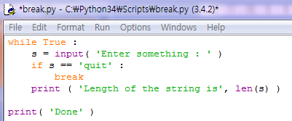
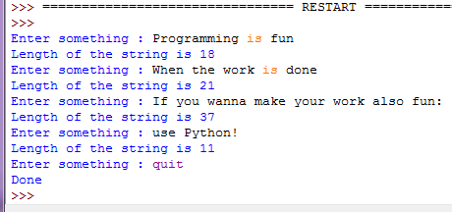
break statement
stop the execution of a loop statement(for, while).
else block is not executed.
len( ) function
returns the length of the input string
Notes:
Sequence
의미: 여러 항목들이 나열된 어떤 목록
간단히 설명하고 나중에….

Slide 14
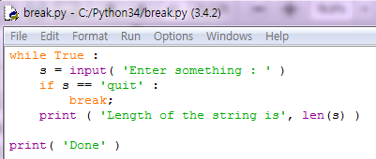
break statement
Notes:
Sequence
의미: 여러 항목들이 나열된 어떤 목록
간단히 설명하고 나중에….

Slide 15
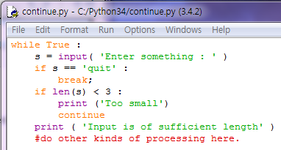
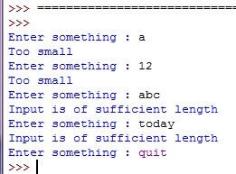
continue statement
skip the res of the statements in the current loop block and continue to the next iteration of the loop(for, while).
Notes:
Sequence
의미: 여러 항목들이 나열된 어떤 목록
간단히 설명하고 나중에….

Slide 16
continue statement
Notes:
Sequence
의미: 여러 항목들이 나열된 어떤 목록
간단히 설명하고 나중에….

Slide 17
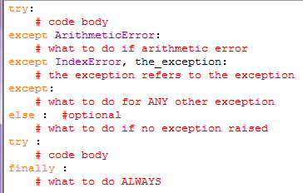
exceptions
Errors detected during execution
Exceptions can be caught and dealt with.

Slide 18
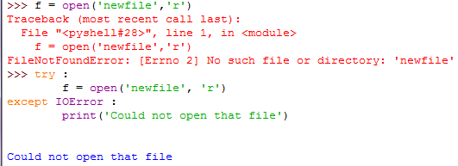
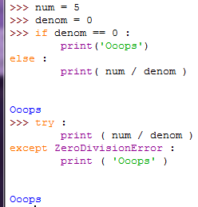
exceptions

